Slide 1

What if two lost years could cost your sponsor a billion dollars?
TechIQ 2026
IQVIA Predictive Clinical Development
A 75-minute sales enablement course for IQVIA representatives and new hires

Slide 2

The R&D clock is running backward
Composite median R&D program duration: 8 years in 2016, 10 years in 2025
Source: Citeline Pharmapremia and IQVIA Institute, February 2026
Every added year is a year of lost protected revenue
This is published benchmark data you can cite in any sponsor meeting
© 2026. All rights reserved. IQVIA® is a registered trademark of IQVIA Inc. in the United States, the European Union, and various other countries.

Slide 3
Development time becomes commercial time
A launch pulled forward two years does not just save cost — it creates revenue
Two extra years before the LOE/patent cliff means two extra years at full commercial pricing
Annual sales x 2 added protected years = the incremental opportunity Watch: [ADD VIDEO LINK]
At $500M/yr
$1B incremental opportunity
At $750M/yr
$1.5B incremental opportunity
At $1B/yr
$2B incremental opportunity
© 2026. All rights reserved. IQVIA® is a registered trademark of IQVIA Inc. in the United States, the European Union, and various other countries.

Slide 4
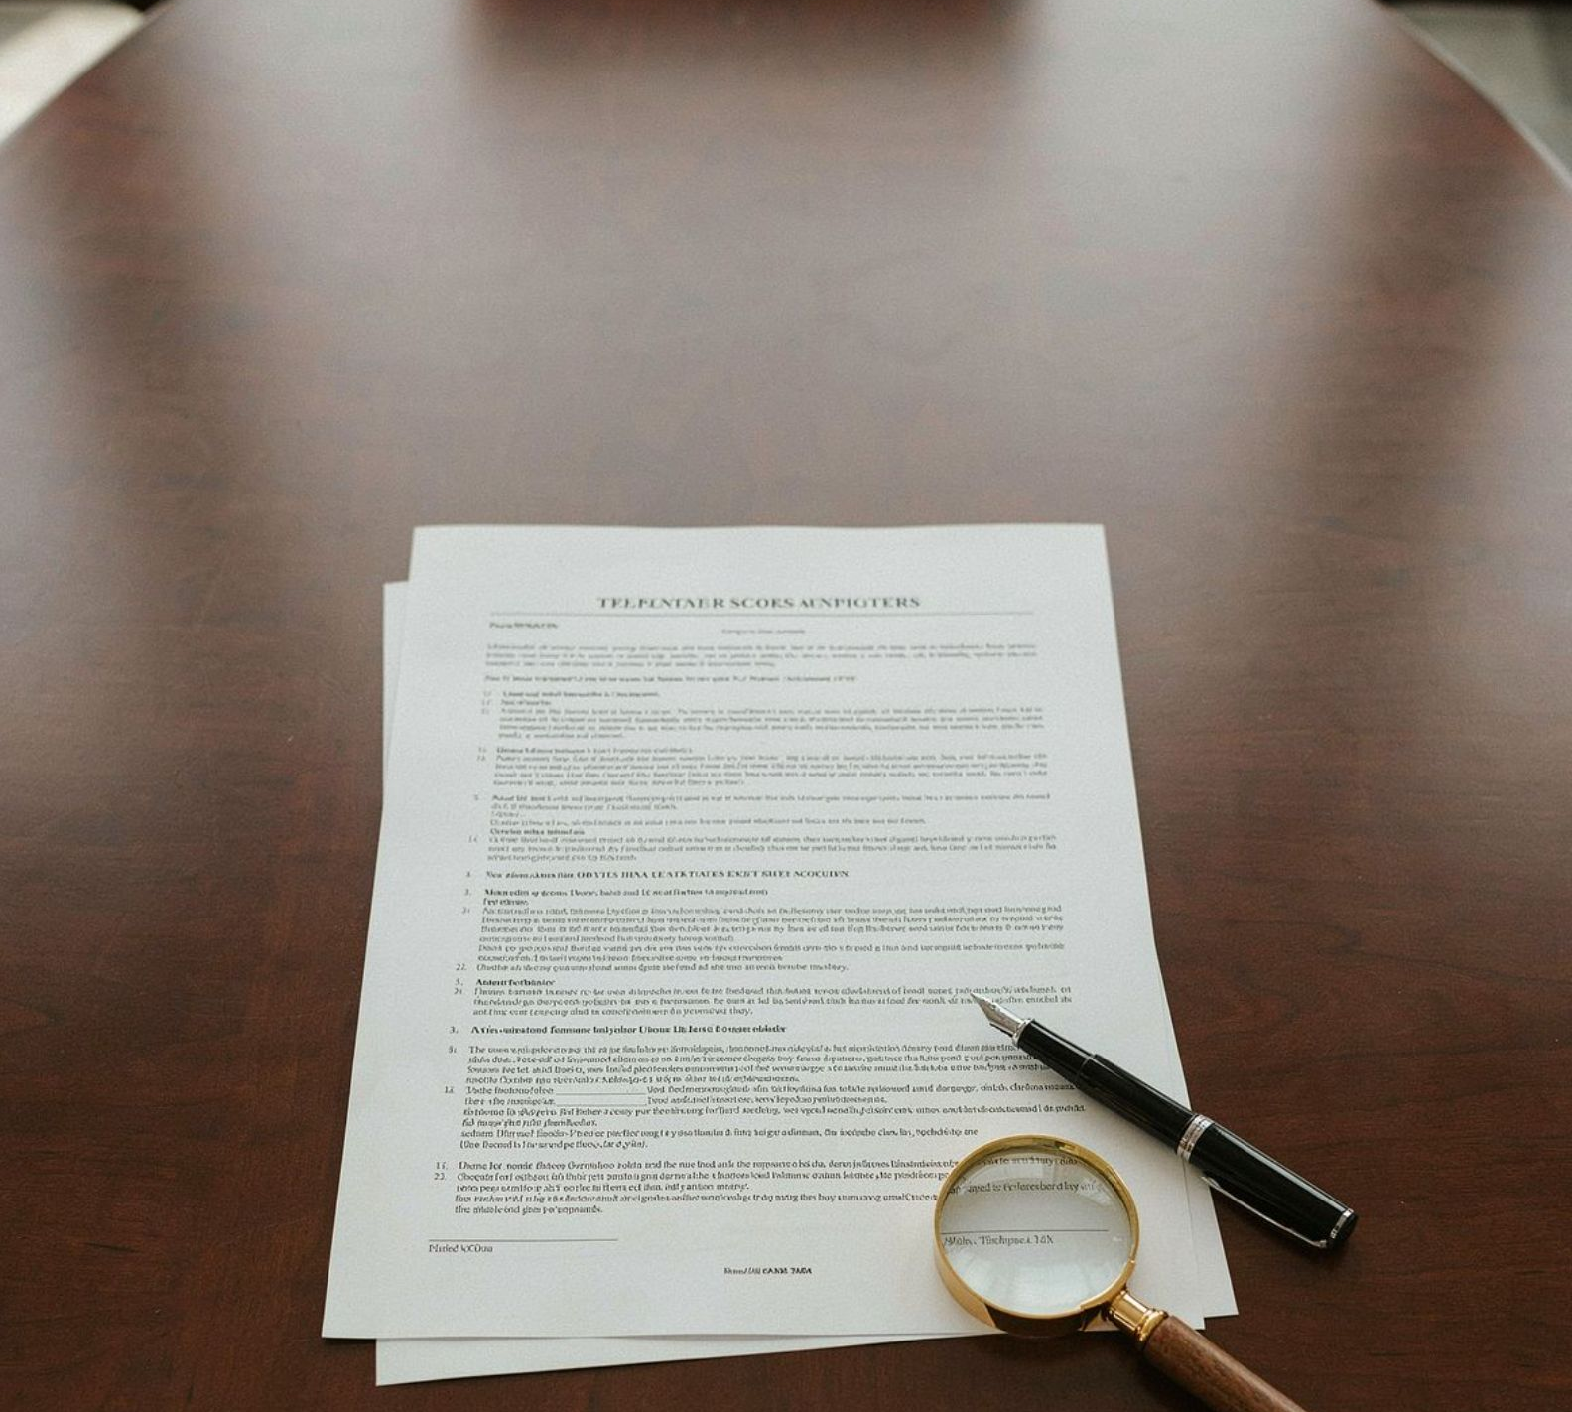
The headline claim — and how to say it correctly
IQVIA Predictive Clinical Development can deliver up to two years off a 10-year program Always qualify: actual timelines vary based on program-specific factors and are not guaranteed Based on IQVIA analyses of client programs utilizing Predictive Clinical Development and adoption of IQVIA-recommended study delivery approaches
Overstating this claim creates legal and commercial risk — internalize the language exactly
© 2026. All rights reserved. IQVIA® is a registered trademark of IQVIA Inc. in the United States, the European Union, and various other countries.

Slide 5
Activity — make the math personal to your sponsor
Your voice instructor is ready to run a number-translation exercise with you
Tell your instructor the hypothetical annual sales figure for a sponsor asset you are working on
Your instructor will walk you through calculating that sponsor's specific incremental revenue opportunity
Ask your instructor to run the number-translation exercise with you now
© 2026. All rights reserved. IQVIA® is a registered trademark of IQVIA Inc. in the United States, the European Union, and various other countries.

Slide 6
Two delivery modes frame the entire solution
Inter-Trial Delivery
Enhanced program and study design — better decisions before execution begins
Four phases carry the acceleration:
Early Engagement
Study Design and Strategy
Start-Up
Conduct and Close Out
Intra-Trial Delivery
Faster operational execution — speed and predictability through every phase
Four AI and data enablers underpin every speed claim:
Healthcare-Grade AI
Process Optimization
Libraries and Standards
Protocol Digitization
© 2026. All rights reserved. IQVIA® is a registered trademark of IQVIA Inc. in the United States, the European Union, and various other countries.

Slide 7
Early Engagement — the entry point you can propose today
An 11-to-12-week framework that produces four concrete artifacts
Feasibility view, endpoint tradeoff matrix, country scenario models, risk register Sales move: anchor the conversation to one specific open decision the sponsor is wrestling with right now
Weeks 1–2
Align on open decisions
Weeks 3–6
Bring evidence and expert perspectives
Weeks 7–10
Stress-test feasibility and country strategy
Weeks 11–12
Finalize shared decision log
© 2026. All rights reserved. IQVIA® is a registered trademark of IQVIA Inc. in the United States, the European Union, and various other countries.

Slide 8
What IQVIA brings into the room
Listen: [ADD AUDIO LINK]
Real-world data and analytics
To ground feasibility, eligibility, and patient density assumptions
KOL and patient-advocacy networks
To pressure-test scientific and patient-experience choices
Regulatory intelligence and precedent
To evaluate pathway tradeoffs
Operational feasibility and country strategy modeling
Rooted in delivery experience
© 2026. All rights reserved. IQVIA® is a registered trademark of IQVIA Inc. in the United States, the European Union, and various other countries.

Slide 9
Study Design and Strategy — one integrated strategy eliminates handoffs
One single integrated study strategy removes functional handoffs, re-interpretation, rework, and delays
Key design elements: Critical to Quality Factors, data flow from collection to consumption, RBQM-driven data review, patient insights and site strategy, integrated risk management
Push-Button Start-Up compresses start-up from 12 to 8 weeks — a 33 percent reduction
Standardization, automation, parallel execution, and reduced rework drive that compression
© 2026. All rights reserved. IQVIA® is a registered trademark of IQVIA Inc. in the United States, the European Union, and various other countries.

Slide 10
>25%
Start-Up acceleration — know these numbers cold
37%
Faster site selection
18%
Faster contract negotiation
25%
Faster country ICF adaptations
Faster lab readiness
6 versus 8 weeks
© 2026. All rights reserved. IQVIA® is a registered trademark of IQVIA Inc. in the United States, the European Union, and various other countries.

Slide 11
Conduct — enrollment, sites, and data in motion
4mo
Enrollment accelerated
30%
Higher enrollment rates
53%
Reduction in screen failure rates
43%
Increase in screening activity
52%
More patients
18%
Faster first participant screened
© 2026. All rights reserved. IQVIA® is a registered trademark of IQVIA Inc. in the United States, the European Union, and various other countries.

Slide 12
Close Out — speed from database lock to CSR
Database lock under 14 days
Driven by 81% faster data entry at sites and greater than 50% faster data cleaning
Greater than 90% fewer lab queries
With e-requisition
SDTM creation reduced from 8 to 6 weeks
Where 90% or more standards compliance is achieved
Tables, listings, and figures development reduced by 60%
Significant compression in reporting timelines
CSR narratives completed 35% faster
Clinical Study Report delivered in 8 weeks
Topline BIOS outputs
Available 15 to 20 days post database lock
© 2026. All rights reserved. IQVIA® is a registered trademark of IQVIA Inc. in the United States, the European Union, and various other countries.

Slide 13

The data ecosystem behind every speed claim
Daily automated data transfers from EDC, lab, IRT, eCOA, and connected devices into a centralized ODS
Real-time data cleaning, integrated RBQM, and automated issue generation
Cross-functional data review through a single platform: Clinical, DM, Biostatistics, Medical, Safety, Lab This is the operational infrastructure behind every metric — not a feature list
© 2026. All rights reserved. IQVIA® is a registered trademark of IQVIA Inc. in the United States, the European Union, and various other countries.

Slide 14
The AI roadmap — live now versus in development
Never represent an in-development tool as currently available — this is a firm boundary These demonstrate forward momentum and a credible technology trajectory
Live Now
Protocol Analyzer
Enrollment Optimizer
Regulatory Intelligence Assistant
In Development
Tools in development are evidence of continuous, roadmapped AI investment
© 2026. All rights reserved. IQVIA® is a registered trademark of IQVIA Inc. in the United States, the European Union, and various other countries.

Slide 15
Activity — metric recall drill
Your voice instructor will name a phase or a specific activity
Respond with the correct acceleration metric and time comparison
Your instructor will give immediate feedback and correct any errors
Ask your instructor to run the metric recall drill with you — repeat until you move through the full set without prompting
© 2026. All rights reserved. IQVIA® is a registered trademark of IQVIA Inc. in the United States, the European Union, and various other countries.

Slide 16
Two sponsor personas, two different conversations
Same solution, different frame — match the language to what each persona values most
Emerging Biopharma
Accelerate proof of concept
Reduce investor and governance risk
Advance multiple assets without building infrastructure
Bring value inflection points forward
Large and Mid Pharma
Improve portfolio performance at scale
De-risk before delays occur
Improve global consistency
Supplement in-house capabilities without replacing them
© 2026. All rights reserved. IQVIA® is a registered trademark of IQVIA Inc. in the United States, the European Union, and various other countries.

Slide 17
Qualifying sponsor readiness — six requirements
Engage IQVIA at the pre-IND or IND clinical development plan stage, including during protocol concept
Deploy a full-service outsourcing model using IQVIA's processes and technology solutions
Adopt protocol optimization, regulatory path strategy, and operational strategies including IQVIA technology solutions
Collaboratively identify at-risk activities and begin next-phase planning when prior phase interim analysis go decision is made
Establish parallel activities centrally and in-region for optimal risk parameters in database build and monitoring plan
Run parallel global and regional activities to identify risks and incorporate them into database build and monitoring plans
If a sponsor cannot meet these requirements, the accelerated timeline outcomes are not achievable
© 2026. All rights reserved. IQVIA® is a registered trademark of IQVIA Inc. in the United States, the European Union, and various other countries.

Slide 18
Handling the two most predictable objections
Practice saying this naturally, not defensively
Objection — we have already started
Assess which phase they are in and whether the six requirements can still be met; Early Engagement is the clearest entry point, but start-up and conduct tools still add value
Objection — can you guarantee the two years
The answer is always no
Correct language: up to two years, based on IQVIA analyses of client programs utilizing Predictive Clinical Development and adoption of IQVIA-recommended study delivery approaches; actual timelines vary based on program-specific factors and are not guaranteed
© 2026. All rights reserved. IQVIA® is a registered trademark of IQVIA Inc. in the United States, the European Union, and various other countries.

Slide 19
Proof points — select two or three, not all of them
95%
Of sites would work with IQVIA again
18% faster
First participant screened vs. industry
53% reduction
In average screen failure rates
>90% fewer
Lab queries with e-requisition
SDTM 8→6 weeks
CSR narratives 35% faster
© 2026. All rights reserved. IQVIA® is a registered trademark of IQVIA Inc. in the United States, the European Union, and various other countries.

Slide 20
Activity — sponsor persona role-play
Tell your voice instructor which persona to play: Emerging Biopharma VP of Development or Large Pharma Head of Portfolio Operations
Your instructor will open with a realistic concern or objection
Respond using the messaging and qualification framework from this module
Ask your instructor to run the persona role-play with you — you can repeat the same scenario or switch personas
© 2026. All rights reserved. IQVIA® is a registered trademark of IQVIA Inc. in the United States, the European Union, and various other countries.

Slide 21
The conversational sequence — start to close
Open with the burning platform — 8 to 10 years, published benchmark data
Pivot to revenue math — Development time becomes commercial time, $1B to $2B framing
Introduce the solution at headline level — Up to two years, two delivery modes, with the required qualifier
Anchor to the relevant phase — The phase most relevant to where the sponsor is right now
Qualify readiness — Against the six requirements
Propose Early Engagement — As the immediate and concrete next step
© 2026. All rights reserved. IQVIA® is a registered trademark of IQVIA Inc. in the United States, the European Union, and various other countries.

Slide 22

Early Engagement as the close of the first conversation
The 11-to-12-week framework gives a sponsor something specific to say yes to
What they walk away with: feasibility view, endpoint tradeoff matrix, country scenario models, risk register, shared decision log
Describe all five without reading from a document — that fluency signals expertise The sales message: let's start with the one decision where evidence and experience could create the most acceleration
© 2026. All rights reserved. IQVIA® is a registered trademark of IQVIA Inc. in the United States, the European Union, and various other countries.

Slide 23
What IQVIA is not claiming — stay inside these boundaries
Not a guarantee of two years saved — always use the qualifier
Not a replacement for sponsor in-house capabilities, especially for Large and Mid Pharma
AI tools in development are not sold as current deliverables
Staying within these boundaries builds sponsor trust and protects IQVIA's credibility
© 2026. All rights reserved. IQVIA® is a registered trademark of IQVIA Inc. in the United States, the European Union, and various other countries.

Slide 24
The core of every Predictive Clinical Development conversation
Burning platform — revenue math — solution and proof — entry point: that structure is the pitch
Watch: [ADD VIDEO LINK]
Burning platform
Here is what slow costs you
Revenue math
Here is what fast is worth
Solution and proof
Here is the specific path to getting there
Entry point
That structure is the pitch
© 2026. All rights reserved. IQVIA® is a registered trademark of IQVIA Inc. in the United States, the European Union, and various other countries.

Slide 25
Activity — capstone 90-second pitch
Deliver a 90-second pitch aloud to your voice instructor
Your instructor will give feedback on three dimensions: accuracy of the headline claim and disclaimer, correct persona identification and tailored message, and whether Early Engagement was described as the next step
Ask your instructor to listen to your capstone pitch — your instructor will invite you to try again if any dimension needs improvement
© 2026. All rights reserved. IQVIA® is a registered trademark of IQVIA Inc. in the United States, the European Union, and various other countries.

Slide 26
Optional — test yourself before your first conversation
• If you want to confirm you have the key numbers and disclaimer language ready, your instructor can run a quick knowledge check
Just ask — nothing is recorded, and it is entirely for your own preparation
Optional: a private knowledge check is available — nothing is recorded
TAKEAWAY
© 2026. All rights reserved. IQVIA® is a registered trademark of IQVIA Inc. in the United States, the European Union, and various other countries.

Slide 27

You are ready — here is your next move
Thank you for completing IQVIA Predictive Clinical Development Messaging
Your next step: identify one sponsor meeting on your calendar and determine which phase of the solution is most relevant to where they are right now
Prepare your proof point selection and your Early Engagement proposal before that meeting
The conversation starts with what slow costs them — you now know exactly what to say next
© 2026. All rights reserved. IQVIA® is a registered trademark of IQVIA Inc. in the United States, the European Union, and various other countries.

