Slide 1

When a Contract Slows Down, Everything Slows Down
TechIQ 2026
What if you could cut the time from draft CTA to signed agreement — and never lose a payment trigger in the process? This course will prepare you to have that conversation with confidence.

Slide 2

What Is CTFS — and Where Does Contracting Fit?
CTFS is IQVIA's unified, agentic AI-powered platform for the full clinical trial financial lifecycle. It connects five stages: budgeting, contracting, forecasting, site payments, and participant payments. Contracting is the foundational module — nothing downstream works well if the contract is wrong.
Watch: https://www.iqvia.com/events/2025/03/innovative-approaches-to-clinical-trial-financial-management
© 2026. All rights reserved. IQVIA® is a registered trademark of IQVIA Inc. in the United States, the European Union, and various other countries.

Slide 3

The Problem CTFS Contracting Solves
CTA processing today is manual, error-prone, and slow. Delays in contract execution stall site activation and disrupt payment workflows. In a Phase III trial, that can cost up to $55,000 per day.
This is the problem your client already lives with — your job is to name it before they do.
© 2026. All rights reserved. IQVIA® is a registered trademark of IQVIA Inc. in the United States, the European Union, and various other countries.

Slide 4
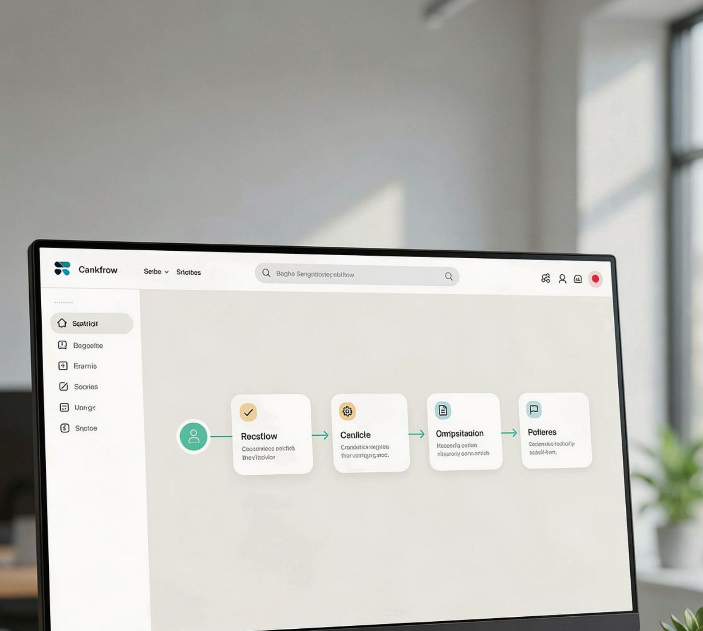
What CTFS Contracting Does
Streamlines authoring, exchanging, and amending contracts between sponsors and sites. Configurable workflows replace manual handoffs and email chains. The goal: reduce cycle time from first draft to signed agreement.
© 2026. All rights reserved. IQVIA® is a registered trademark of IQVIA Inc. in the United States, the European Union, and various other countries.

Slide 5

The AI Difference — Beyond Basic OCR
CTFS uses agentic AI to ingest CTAs intelligently — not just scan them. The system extracts, interprets, and contextualizes key terms, payment triggers, and site-specific nuances. That data feeds directly into financial and operational workflows downstream.
This is what separates CTFS from tools that just digitize a manual process.
© 2026. All rights reserved. IQVIA® is a registered trademark of IQVIA Inc. in the United States, the European Union, and various other countries.

Slide 6
The Business Case in Numbers
$3M
Projected annual savings
50%
Reduction in financial processing time
90%
Top 20 pharma companies
200+
Geographies
© 2026. All rights reserved. IQVIA® is a registered trademark of IQVIA Inc. in the United States, the European Union, and various other countries.

Slide 7

Flexible Delivery — On Their Terms
CTFS Contracting is available as SaaS, Tech-Enabled Services, or a hybrid model. Clients can insource, outsource, or blend approaches based on their operational needs. This flexibility is a selling point — meet the client where they are, not where you need them to be. Activity: Ask your instructor to quiz you on the three most important things CTFS Contracting does and what makes it different from a manual CTA process. Answer out loud and ask for feedback.
© 2026. All rights reserved. IQVIA® is a registered trademark of IQVIA Inc. in the United States, the European Union, and various other countries.

Slide 8
Meet Rachel
Rachel is a Clinical Operations Director at a research site. She runs fast-moving studies with a lean team. She is accountable for study execution, cash flow predictability, and keeping her team from drowning in admin.
She is not shopping for technology. She is looking for outcomes. Clinical Operations Director at a research site.
© 2026. All rights reserved. IQVIA® is a registered trademark of IQVIA Inc. in the United States, the European Union, and various other countries.

Slide 9
Rachel's World — What She Is Juggling
Multiple sponsors and studies running simultaneously.
Inconsistent contract terms across sponsors.
Payment delays tied to CTA errors and manual invoicing.
Disputes that require back-and-forth to resolve.
No real-time visibility into where a contract or payment stands.
© 2026. All rights reserved. IQVIA® is a registered trademark of IQVIA Inc. in the United States, the European Union, and various other countries.

Slide 10
What Rachel Actually Wants
Predictable cash flow.
Fewer payment disputes.
Less administrative burden on her team.
A consistent experience across every sponsor she works with.
She has been burned by automation promises before. She will ask whether this actually works.
© 2026. All rights reserved. IQVIA® is a registered trademark of IQVIA Inc. in the United States, the European Union, and various other countries.

Slide 11
How to Talk to Rachel — and How Not To
Activity: Ask your instructor to step into character as Rachel and run a two-minute introductory role-play. Your goal is to open the conversation, establish credibility, and show you understand her world before you mention any product. Ask for feedback on tone, relevance, and whether you led with her pain or with the product.
Use:
"predictable cash flow," "fewer disputes," "real-time visibility," "reduce the chasing."
"your team spends less time on admin and more time running the study."
Avoid:
Platform architecture language, vendor-centric framing, leading with AI before you have established her pain.
Rachel engages when she feels you understand the site side — not just what the sponsor gets.
© 2026. All rights reserved. IQVIA® is a registered trademark of IQVIA Inc. in the United States, the European Union, and various other countries.

Slide 12

Discovery — Understand Before You Explain
Discovery is not a checklist. It is a structured conversation designed to surface the client's specific pain before you present any solution.
Four areas to explore: current state, friction points, downstream impact, priorities and decision criteria.
Your goal in the first half of any client conversation: listen more than you talk.
© 2026. All rights reserved. IQVIA® is a registered trademark of IQVIA Inc. in the United States, the European Union, and various other countries.

Slide 13
Current State and Friction Points
Current state:
How does the client manage CTA authoring, exchange, and amendment today? What tools? How many sites and sponsors?
Friction points:
Where do delays happen? How long from draft to signed agreement? What happens when amendments are needed mid-trial?
Strong question to use: "Across the sponsors you work with, how consistent is the contracting experience?"
© 2026. All rights reserved. IQVIA® is a registered trademark of IQVIA Inc. in the United States, the European Union, and various other countries.

Slide 14
Downstream Impact and Decision Criteria
Downstream impact:
What happens to invoicing and payments when a CTA is incomplete or inaccurate? How much staff time goes to resolving disputes?
Decision criteria:
What would a better contracting process need to look like? Who else is involved in that decision?
Strong questions: "When a payment dispute comes up, how often can you trace it back to a CTA term that was missed?" and "What would it mean for your site if CTA processing time was cut in half?"
© 2026. All rights reserved. IQVIA® is a registered trademark of IQVIA Inc. in the United States, the European Union, and various other countries.

Slide 15

Transitioning from Discovery to Value
Once Rachel has named her pain in her own words, reflect it back before you introduce the product. "What I am hearing is that the manual nature of your current CTA process is creating downstream delays that your team has to absorb. Let me show you how CTFS Contracting addresses that specifically." Never skip this step. The reflection is what earns the right to present.
© 2026. All rights reserved. IQVIA® is a registered trademark of IQVIA Inc. in the United States, the European Union, and various other countries.

Slide 16
The CTFS Contracting Value Statement for Rachel
Three outcomes to lead with:
Faster cycle times
Through AI-driven ingestion and configurable workflows.
Fewer errors and disputes
Because payment terms flow directly from the CTA into the payment system.
A consistent experience across every sponsor
Regardless of how each sponsor operates on their end.
© 2026. All rights reserved. IQVIA® is a registered trademark of IQVIA Inc. in the United States, the European Union, and various other countries.

Slide 17
Handling Rachel's Objections
Activity: Ask your instructor to run a full discovery role-play as Rachel — moderately skeptical, open to talking, but not impressed by vendor pitches. Work through the discovery framework, transition to the value statement, and handle at least one objection. When the role-play ends, ask for specific feedback on your discovery questions, your transition moment, and how you handled the objection.
"We have tried automation before and it did not work."
Acknowledge it, then distinguish: CTFS understands context, not just characters. This is not OCR.
"Our sponsors all have different processes."
CTFS is configurable per sponsor and delivers a consistent site-side experience regardless of sponsor variation.
"My team does not have time to learn something new."
The site portal is designed to reduce workload, not add to it. Minimal training, immediate payoff in admin time saved.
© 2026. All rights reserved. IQVIA® is a registered trademark of IQVIA Inc. in the United States, the European Union, and various other countries.

Slide 18

Optional — A Quick Confidence Check
Before your next client conversation, you might want to take a quick knowledge check. It is just for you. Nothing is recorded. It takes only a few minutes. Think of it as a personal gut-check on the product, the Rachel persona, and the discovery framework.
© 2026. All rights reserved. IQVIA® is a registered trademark of IQVIA Inc. in the United States, the European Union, and various other countries.

Slide 19

You Are Ready — Here Is Your Next Step
You can now explain what CTFS Contracting does, why it matters, and how to connect it to what Rachel actually cares about.
Your next step: get on a call or site visit and open the discovery conversation. Lead with her world. Reflect her pain. Then show her the solution.
Good selling.
© 2026. All rights reserved. IQVIA® is a registered trademark of IQVIA Inc. in the United States, the European Union, and various other countries.

