Slide 1
SQL HOMEWORK
JOHN DILLIGARD

Slide 2
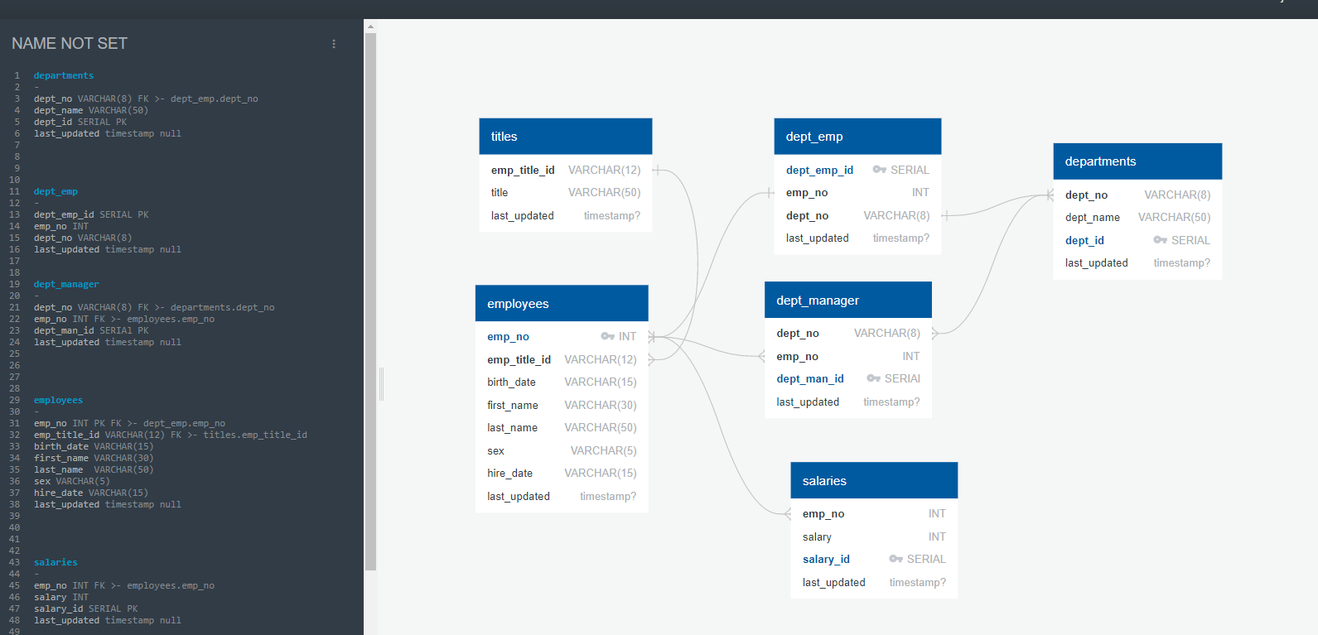
ERD

Slide 3
HOMEWORK OVERVIEW
This is the ERD, the queries, and the outputs for all of the work.

Slide 4
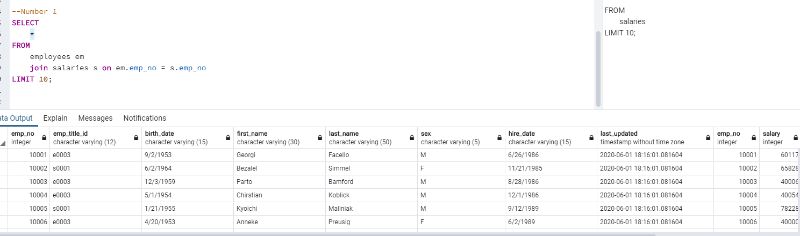
QUERY Problems - Q1
1. List the following, last name, first name, sex, details of each employee: employee number and salary.

Slide 5
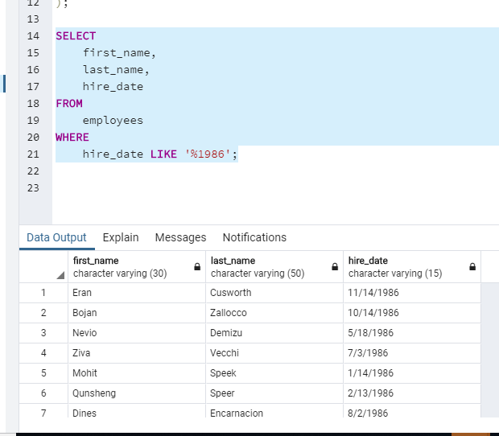
QUERY Problems - Q2
2. List first name, last name, and hire date for employees who were hired in 1986.

Slide 6
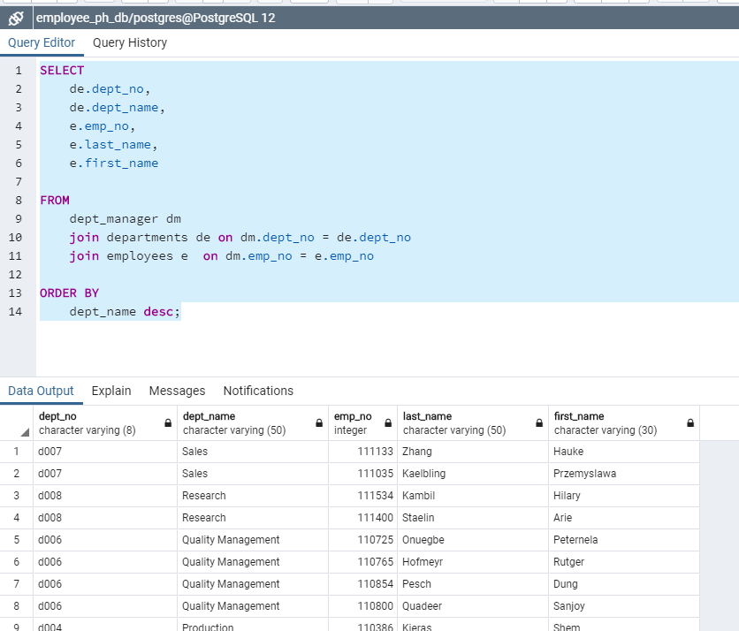
QUERY Problems - Q3
3. List the manager of each department with the following information: department number, department name, the manager's employee number, last name, first name.

Slide 7
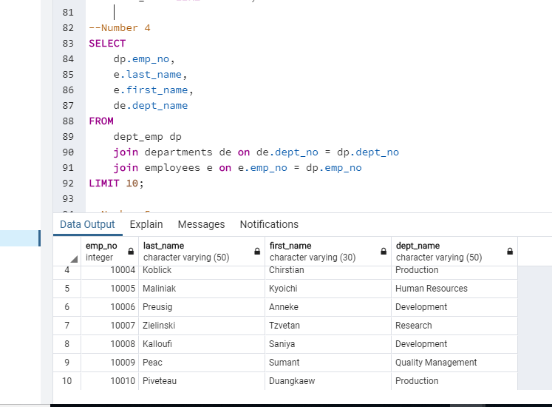
QUERY Problems - Q4
4. List the department of each employee with the following information: employee number, last name, first name, and department name.

Slide 8
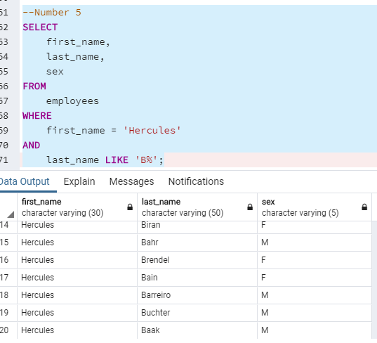
QUERY Problems - Q5
5. List first name, last name, and sex for employees whose first name is "Hercules" and last names begin with "B."

Slide 9
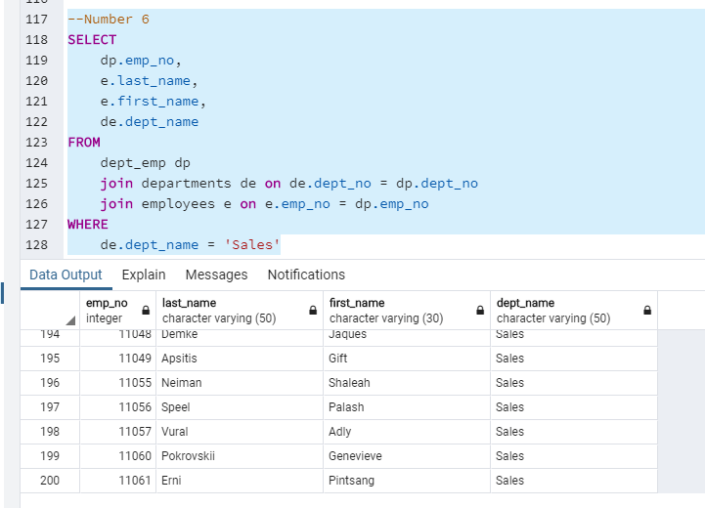
QUERY Problems - Q6
6. List all employees in the Sales department, including their employee number, last name, first name, and department name.

Slide 10
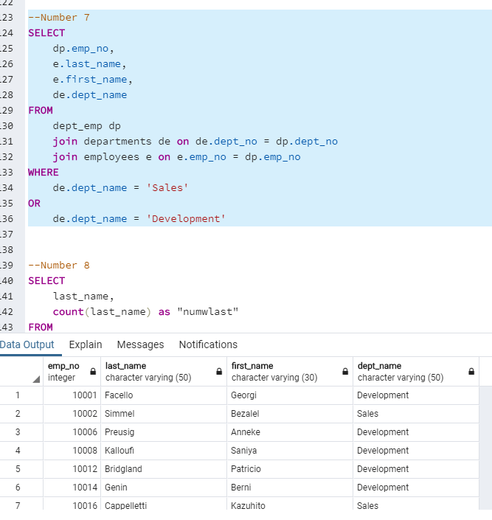
QUERY Problems - Q7
7. List all employees in the Sales and Development departments, including their employee number, last name, first name, and department name.

Slide 11
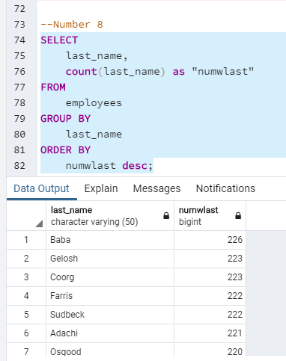
QUERY Problems - Q8
8. In descending order, list the frequency count of employee last names, i.e., how many employees share each last name.

