Slide 1
Fundamentals of Information Systems, Seventh Edition
Chapter 5
Electronic and Mobile Commerce and Enterprise Systems
Fundamentals of Information Systems, Seventh Edition

Slide 2
Principles and Learning Objectives
Electronic and mobile commerce are evolving, providing new ways of conducting business that present both potential benefits and problems
  Describe the current status of various forms of e-commerce, including B2B, B2C, C2C, and m-commerce
  Identify several e-commerce and m-commerce applications
  Identify several advantages associated with the use of e-commerce and m-commerce
Fundamentals of Information Systems, Seventh Edition

Slide 3
Principles and Learning Objectives (continued)
E-commerce and m-commerce require the careful planning and integration of a number of technology infrastructure components
  Identify the key components of technology infrastructure that must be in place for e-commerce and m-commerce to work
  Discuss the key features of the electronic payment systems needed to support e-commerce and m-commerce
Fundamentals of Information Systems, Seventh Edition

Slide 4
Principles and Learning Objectives (continued)
An organization must have information systems that support the routine, day-to-day activities that occur in the normal course of business and help a company add value to its products and services
  Identify the basic activities and business objectives common to all transaction processing systems
Fundamentals of Information Systems, Seventh Edition

Slide 5
Why Learn About Electronic and Mobile Commerce and Enterprise Systems?
Electronic and mobile commerce and enterprise systems:
  Have transformed many areas of our lives and careers
One fundamental change has been:
  The manner in which companies interact with their suppliers, customers, government agencies, and other business partners
Fundamentals of Information Systems, Seventh Edition

Slide 6
An Introduction to Electronic Commerce
Electronic commerce:
  Conducting business activities electronically over computer networks
Business activities that are strong candidates for conversion to e-commerce:
  Paper-based
  Time-consuming
  Inconvenient for customers
Fundamentals of Information Systems, Seventh Edition

Slide 7
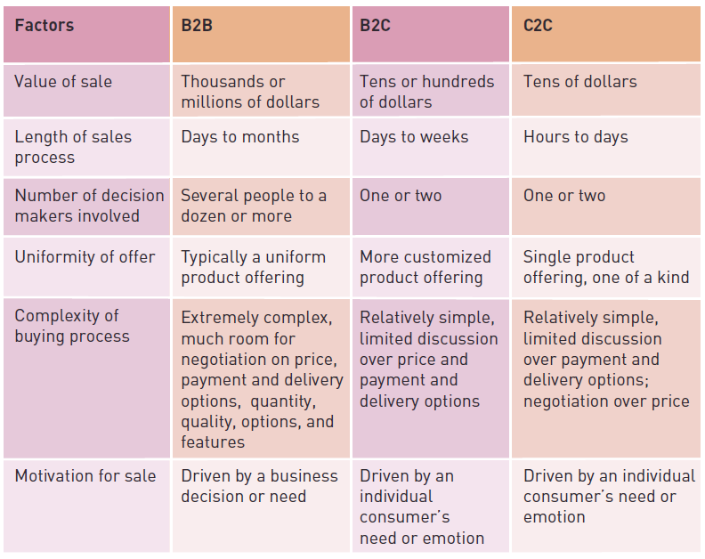
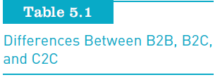
Consumer-to-Consumer (C2C)
E-Commerce (continued)
disintermediation
Fundamentals of Information Systems, Seventh Edition

Slide 8
e-Government
Use of information and communications technology to:
  Simplify the sharing of information
  Speed formerly paper-based processes
  Improve the relationship between citizen and government
Forms of e-Government
  Government-to-consumer (G2C)
  Government-to-business (G2B)
  Government-to-government (G2G)
Fundamentals of Information Systems, Seventh Edition

Slide 9
Mobile Commerce
Mobile commerce (m-commerce) relies on the use of mobile, wireless devices to place orders and conduct business
The Internet Corporation for Assigned Names and Numbers (ICANN):
  Created a .mobi domain to help attract mobile users to the Web
Fundamentals of Information Systems, Seventh Edition

Slide 10
Electronic and Mobile Commerce Applications
Many B2B, B2C, C2C, and m-commerce applications are being used in:
  Retail and wholesale
  Manufacturing
  Marketing and advertising
  Bartering and retargeting
  Price comparison
  Couponing
  Investment and finance
  Banking and e-boutiques
Fundamentals of Information Systems, Seventh Edition

Slide 11
Retail and Wholesale
Manufacturing
Electronic retailing (e-tailing):
  Direct sale from business to consumer through electronic storefronts
Cybermall:
  Single Web site that offers many products and services at one Internet location
Manufacturing, repair, and operations (MRO):
  Purchases often approach 40 percent of a manufacturing company’s total revenues
Electronic exchange:
  Electronic forum where manufacturers, suppliers, and competitors buy and sell goods, trade market information, and run back-office operations
  Private exchanges:
    Owned and operated by a single company
  Consortium-operated exchanges
    Operated by a group of traditionally competing companies with common procurement needs
  Independent exchanges:
    Open to any set of buyers and sellers within a given market
Fundamentals of Information Systems, Seventh Edition

Slide 12
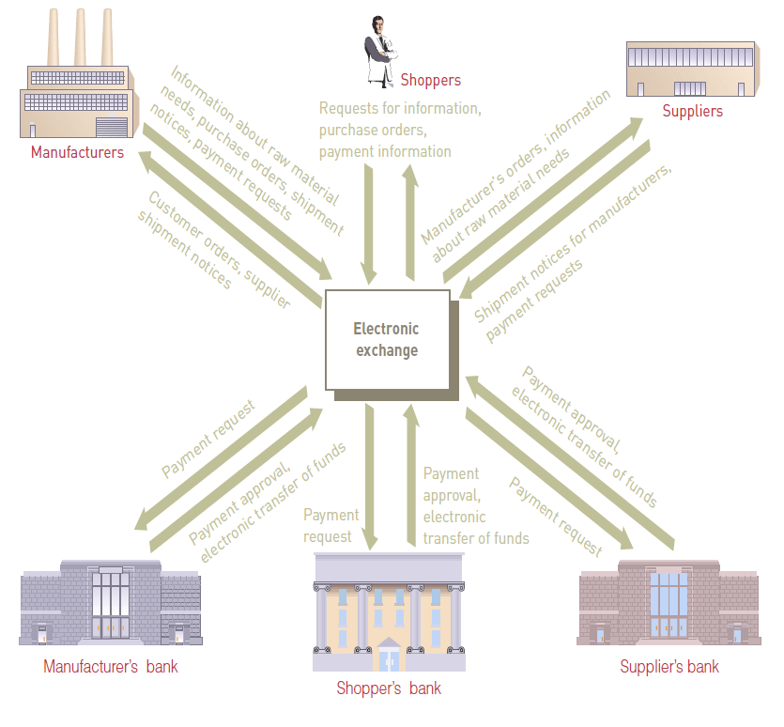
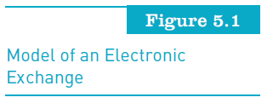
Fundamentals of Information Systems, Seventh Edition

Slide 13
Marketing
Advertising
Market segmentation:
  Identification of specific markets to target them with advertising messages
Nielsen, the marketing and media information company:
  Has developed its Business-Facts database that provides information for more than 12 million businesses
Mobile ad impressions are generally bought at:
  Cost per thousand (CPM), cost per click (CPC), or cost per action (CPA)
  Main measures of success: number of users reached, click through rate ), and the number of actions users take
Fundamentals of Information Systems, Seventh Edition
Fundamentals of Information Systems, Seventh Edition

Slide 14
Bartering
Retargeting
Many people and businesses have turned to bartering as a means to gain goods and services
Number of Web sites have been created to support this activity
Bartering transactions have tax-reporting, accounting, and other record-keeping responsibilities associated with them
Over 95% of Web site visitors leave a shopping site without making a purchase
Retargeting used by advertisers to recapture these shoppers by using targeted and personalized ads to direct shoppers back to a retailer’s site.
Fundamentals of Information Systems, Seventh Edition

Slide 15
Price Comparison
Couponing
  Over 300 billion coupons distributed each year in North America, only1.1% of these coupons are redeemed
  Many manufacturers and retailers now send mobile coupons directly to consumers’ smartphones
  Standard red scanners used at checkout stands have difficulty reading information displayed on smartphones
  Consumer must print out coupon, have it scanned and present to the clerk for scanning
Price comparison:
  Mobile phone services enable shoppers to compare prices and products on the Web
Fundamentals of Information Systems, Seventh Edition

Slide 16
Investment and Finance
Banking
Online banking customers:
  Can check balances of their savings, checking, and loan accounts
  Transfer money among accounts
  Pay their bills
Many banks support bill payment via cell phone
The Internet:
  Has revolutionized the world of investment and finance
The brokerage business:
  Adapted to the Internet faster than any other arm of finance
Fundamentals of Information Systems, Seventh Edition

Slide 17
E-Boutiques
Offer personalized shopping consultations for shoppers
Operate on a philosophy of high customer service and strong, personal client relationships
Fundamentals of Information Systems, Seventh Edition

Slide 18
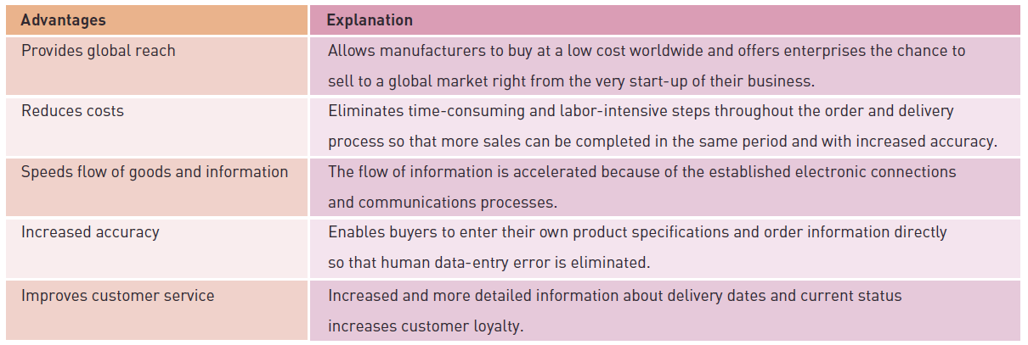
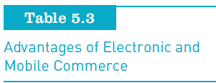
Advantages of Electronic and Mobile Commerce
Fundamentals of Information Systems, Seventh Edition

Slide 19
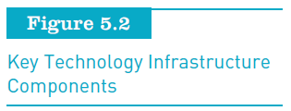
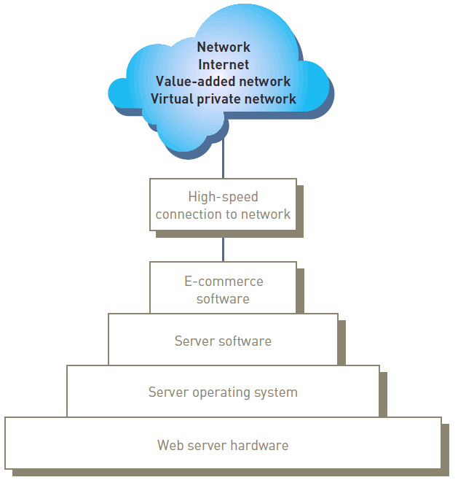
E-Commerce and M-Commerce Technology Infrastructure
Fundamentals of Information Systems, Seventh Edition

Slide 20
E-Commerce and M-Commerce Technology Infrastructure
Hardware
Key e-commerce infrastructure ingredient:
  Web server hardware platform complete with the appropriate software
Key decision facing new e-commerce companies:
  Whether to host their own Web site or to let someone else do it
  Important to have adequate hardware backup to avoid a major disruption in case of a hardware failure
Fundamentals of Information Systems, Seventh Edition

Slide 21
E-Commerce and M-Commerce Technology Infrastructure
Web Server Software
Each e-commerce Web site must have Web server software to perform fundamental services:
  Security and identification
  Retrieval and sending of Web pages
  Web site tracking
  Web site development
  Web page development
Fundamentals of Information Systems, Seventh Edition

Slide 22
E-Commerce and M-Commerce Technology Infrastructure
E-Commerce Software
Investigate and install e-commerce software to support five core tasks:
  Catalog management to create and update the product catalog
  Product configuration to help customers select the necessary components and options
  Shopping cart facilities to track the items selected for purchase
  E-commerce transaction processing
  Web traffic data analysis to provide details to adjust the operations of the Web site
Fundamentals of Information Systems, Seventh Edition

Slide 23
E-Commerce and M-Commerce Technology Infrastructure
Mobile Commerce Hardware and Software
For m-commerce to work effectively:
  The interface between the wireless, handheld device and its user must improve
Encryption can provide secure transmission
Wireless Application Protocol (WAP):
  Standard set of specifications for Internet applications that run on handheld, wireless devices
Fundamentals of Information Systems, Seventh Edition

Slide 24
E-Commerce and M-Commerce Technology Infrastructure
Electronic Payment Systems
Digital certificate:
  Attachment to an e-mail message or data embedded in a Web site that verifies the identity of a sender or Web Site
Certificate authority (CA):
  Trusted third-party organization or company that issues digital certificates
  Responsible for guaranteeing that the people or organizations granted these unique certificates are, in fact, who they claim to be
Fundamentals of Information Systems, Seventh Edition

Slide 25
E-Commerce and M-Commerce Technology Infrastructure
Electronic Payment Systems
Secure Sockets Layer (SSL):
  Used to secure sensitive data
Electronic cash:
  An amount of money that is computerized, stored, and used as cash for e-commerce transactions
Credit, charge, debit, p-, and smart cards:
  Smart card:
    Credit card-sized device with an embedded microchip to provide electronic memory and processing capability
Fundamentals of Information Systems, Seventh Edition

Slide 26
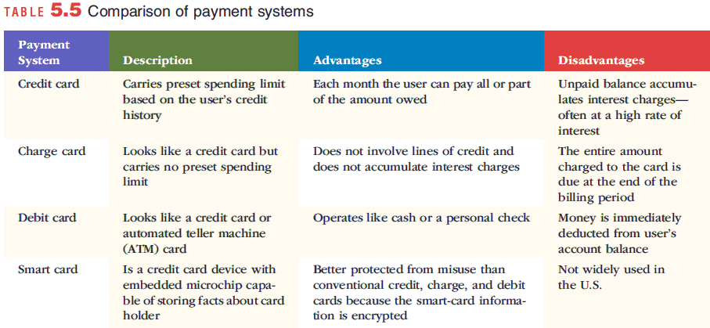
Electronic Payment Systems (continued)
Fundamentals of Information Systems, Seventh Edition

Slide 27
E-Commerce and M-Commerce Technology Infrastructure
Electronic Payment Systems
P-Card:
  Credit card used to streamline the traditional purchase order and invoice payment processes
  Issued to selected employees who must follow company rules and guidelines for its use
Payments using cell phones:
  Available options:
    Payments linked to your bank account
    Payments added to your phone bill
Fundamentals of Information Systems, Seventh Edition

Slide 28
Mobile Commerce in Perspective
The market for m-commerce in North America:
  Maturing much later than in Western Europe and Japan
M-commerce spending in the United States:
  Forecast to grow to $31 billion by 2016 representing about 7% of total B2C e-commerce sales
M-commerce will succeed only if it provides services that truly meet customers’ needs
How about the Philippines?
Fundamentals of Information Systems, Seventh Edition

Slide 29
Mobile App Final Project
Let’s choose your assignments now…..
GROUP | MEMBERS | ASSIGNMENT | MT Presentation
A | Acuna, Binag, Burgos, Carillaga, Chong, Cruz, De Ocampo | Interview | March 2
B | Dimapilis, Donina, Elizondo, Gaoaen, Gapay, Gonzales, Hidalgo | Research | March 2
C | Lino, Logronio, Luangco, Macasero, Maddatu, Mayo, Mendoza, Miranda | Survey | March 2
D | Papna, Parian, Sagun, Samson, Sia, Urquiza, Uy | Focus Group | March 2
ASSIGNMENT
Survey
  MT presentation:
  March 2 initial findings
Interview
  MT presentation
  March 2 init findings
Focus Group Discussion
  MT presentation
  March 2 init findings
Research on Mobile App Design
  MT presentation:
  March 2 init findings

Slide 30
To survey and interview
Students (private and public, NCR)
Out of school youth (18 -20 yrs old)
Survey type
  Semi-structured
  Open-ended
Fundamentals of Information Systems, Seventh Edition

Slide 31
To survey and interview
Major Classification | Factors | Examples
Individual | Physical characteristics | Age, gender, physical abilities / disabilities
 | Learning History | Level of attainment, familiarity with technology
Contextual | Socio Economic and recreational factors | class
 | Geographic location | urban
Technology | HW/ Device type, software, platform, connectivity preferences, expectations and needs
 | Type / preferences of mobile apps to downloaded and use
Pedagogical | Accessibility issues, flexibility, visual, cognitive, and emotional parameters, values, culture, habits risks
Fundamentals of Information Systems, Seventh Edition

Slide 32
Interviews
Open-ended, either in English or Tagalog depending on who you are interviewing
Observe the behavior of the interviewee (body languages, choices of words, changes in intonation)
Can you tell me about your ideas and expectations in the design of the mobile apps?
What is your influence in the design process? Who are you in the design process?
Could you say more about the issues in the design of apps?
Can you give some examples on why there are mismatched expectations on apps design?
What are your views regarding the apps?
What frustrates you in the design of the apps? How do you think these frustrations can be solved?
Fundamentals of Information Systems, Seventh Edition

Slide 33
Interviews
Schedule appropriately, with letter
Better to take a video of the interview (get approval from interviewee)
Fundamentals of Information Systems, Seventh Edition

Slide 34
Focus Group
Assemble a group of developers and each to respond to a series of questions, with you serving as facilitators. The goal is for the focus group to discuss process, expectations and risks in the design of app.
Observe developers
Idea, to confirm preliminary findings of other groups.
Should be video taped (with audio of course). Notes taking to also be done
Fundamentals of Information Systems, Seventh Edition

Slide 35
Data Analysis
Goal:
  Discourse analysis, q-sort method (high light words that go together to identify themes)
  Frequency of issues raised, ranking of topics / concerns
  See initial findings
Fundamentals of Information Systems, Seventh Edition

