Slide 1
Fundamentals of Information Systems, Seventh Edition
Chapter 5
Electronic and Mobile Commerce and Enterprise Systems
Fundamentals of Information Systems, Seventh Edition

Slide 2
Mobile Commerce
Mobile commerce (m-commerce) relies on the use of mobile, wireless devices to place orders and conduct business
The Internet Corporation for Assigned Names and Numbers (ICANN):
  Created a .mobi domain to help attract mobile users to the Web
Fundamentals of Information Systems, Seventh Edition

Slide 3
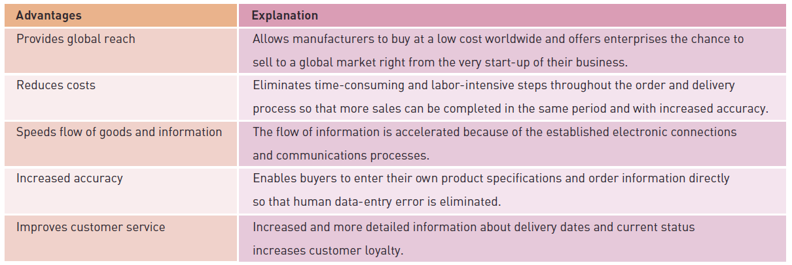
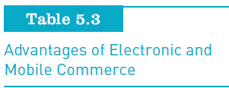
Advantages of Electronic and Mobile Commerce
Fundamentals of Information Systems, Seventh Edition

Slide 4
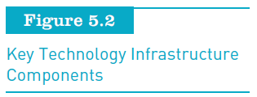
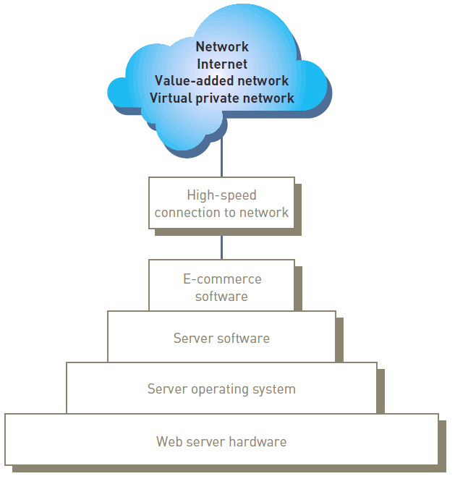
E-Commerce and M-Commerce Technology Infrastructure
Fundamentals of Information Systems, Seventh Edition

Slide 5
Transaction Processing Activities
TPSs:
  Capture and process data that describes fundamental business transactions
  Update databases
  Produce a variety of reports
Transaction processing cycle:
  The process of data collection, data editing, data correction, data manipulation, data storage, and document production
Do the same for app analysis
Fundamentals of Information Systems, Seventh Edition

Slide 6
Data Editing
Checking data for validity and completeness to detect any problems
Fundamentals of Information Systems, Seventh Edition

Slide 7
Data Correction
Reentering data that was not typed or scanned properly
Error messages must specify the problem so proper corrections can be made
Fundamentals of Information Systems, Seventh Edition

Slide 8
Data Manipulation
Performing calculations and other data transformations related to business transactions
Can include:
  Classifying data
  Sorting data into categories
  Performing calculations
  Summarizing results
  Storing data in the organization’s database for further processing
Fundamentals of Information Systems, Seventh Edition

Slide 9
Data Storage
Updating one or more databases with new transactions
After being updated, this data can be further processed and manipulated by other systems
Fundamentals of Information Systems, Seventh Edition

Slide 10
Document Production and Reports
Generating output records, documents, and reports:
  Hard-copy paper reports
  Displays on computer screens
Can be inputs to another system
Fundamentals of Information Systems, Seventh Edition

Slide 11
Mobile Commerce in Perspective
The market for m-commerce in North America:
  Maturing much later than in Western Europe and Japan
M-commerce spending in the United States:
  Forecast to grow to $31 billion by 2016 representing about 7% of total B2C e-commerce sales
M-commerce will succeed only if it provides services that truly meet customers’ needs
How about the Philippines?
Fundamentals of Information Systems, Seventh Edition

Slide 12
Mobile App Final Project
GROUP | MEMBERS | ASSIGNMENT
A | Acuna, Binag, Burgos, Carillaga, Chong, Cruz, De Ocampo
B | Dimapilis, Donina, Elizondo, Gaoaen, Gapay, Gonzales, Hidalgo
C | Lino, Logronio, Luangco, Macasero, Maddatu, Mayo, Mendoza, Miranda
D | Papna, Parian, Sagun, Samson, Sia, Urquiza, Uy
METHODS
Survey
Interview
Focus Group* see video
Research on Mobile App Design

Slide 13
Reminder: Goals & Objectives of Project
To study how the design of mobile apps is socially constructed to shed light on significant issues involving the development of mobile apps particularly those catered by the youth in the Philippines.
To investigate how the actors in the development process shape the design of the mobile apps.
Fundamentals of Information Systems, Seventh Edition

Slide 14
Reminder: Goals & Objectives of Project
In examining how the design and development of the mobile apps is socially constructed, we will address the following questions:
Who are the actors in the design of mobile apps?
How do these actors shape the design of mobile apps and what is the nature of the influence?
What are the implications of these dynamics in the design process?
Fundamentals of Information Systems, Seventh Edition

Slide 15
Reminder: Goals & Objectives of Project
The design process involves the identification and creation of a blueprint that will be used to construct the mobile apps.
This may include but not limited to decisions on features, navigation, color schemes, fonts, and screen designs of the mobile apps.
The development process on the other hand are the actual steps in constructing the mobile apps based on the design specification. The development process includes program coding and testing phase of the mobile apps.
Fundamentals of Information Systems, Seventh Edition

Slide 16
Discourse Analysis
Discourse Analysis is a process that uncovers and produces social reality (Alvesson & Karreman, 2000) or context (Phillips & Hardy, 2002) from what is currently seen.
Initially, discourse analysis refers to the interpretation of language used (Laffey & Weldes, 2004)
Fundamentals of Information Systems, Seventh Edition

Slide 17
Discourse Analysis
But as time progresses, this approach has been used to evaluate written text, spoken words, pictures, artifacts (Grant & Oswick, 1998), practices (Laffey & Weldes, 2004), relationships and interactions (Parker, 1992) to produce meanings.
Phillips and Hardy (2002) further explain that texts alone do not produce meanings individually. They claim that it is only through interconnection with other texts that meanings are generated.
Fundamentals of Information Systems, Seventh Edition

Slide 18
Discourse Analysis
Other authors describe discourse analysis as concerned with power relations (Herrera & Braumoeller, 2004).
As we aim to identify the actors and their influences in the mobile apps development process, this process in turn also identifies the power dynamics of actors in the apps development.
Fundamentals of Information Systems, Seventh Edition

Slide 19
Research
Quantitative
Qualitative (Interpretative, Constructionist)
Fundamentals of Information Systems, Seventh Edition

Slide 20
For Survey, Interview and Focus Group:
MARCH PRESENTATION
Submit the survey, interview and focus group questions
Submit the survey forms (filled and unfilled)
For interview and focus group, submit the interview results (with videos)
Submit the analysis for survey, interview and focus group
Prepare a presentation (30 mins for each)
Fundamentals of Information Systems, Seventh Edition

