Slide 1
YPS Your Personal Stylist
Bridge Mobile Phils., Inc.

Slide 2

PROBLEM
There are people who have a hard time choosing what to wear every day, there are those who prefer to buy their clothing online, and there are also those who look for clothes to wear for different occasions that they need to attend.
The problem of shopping online, but not seeing how it would look like *on you*

Slide 3
NO MORE EXCUSES!!

Slide 4



SOLUTION

Slide 5
FEATURES
Personalized Virtual Stylist (customized fashion tips)
Virtual Wardrobe and Fitting
Online Shopping (Clothing Brands and Online Boutiques)
Planner ( Outfit for everyday and special Occasions)

Slide 6
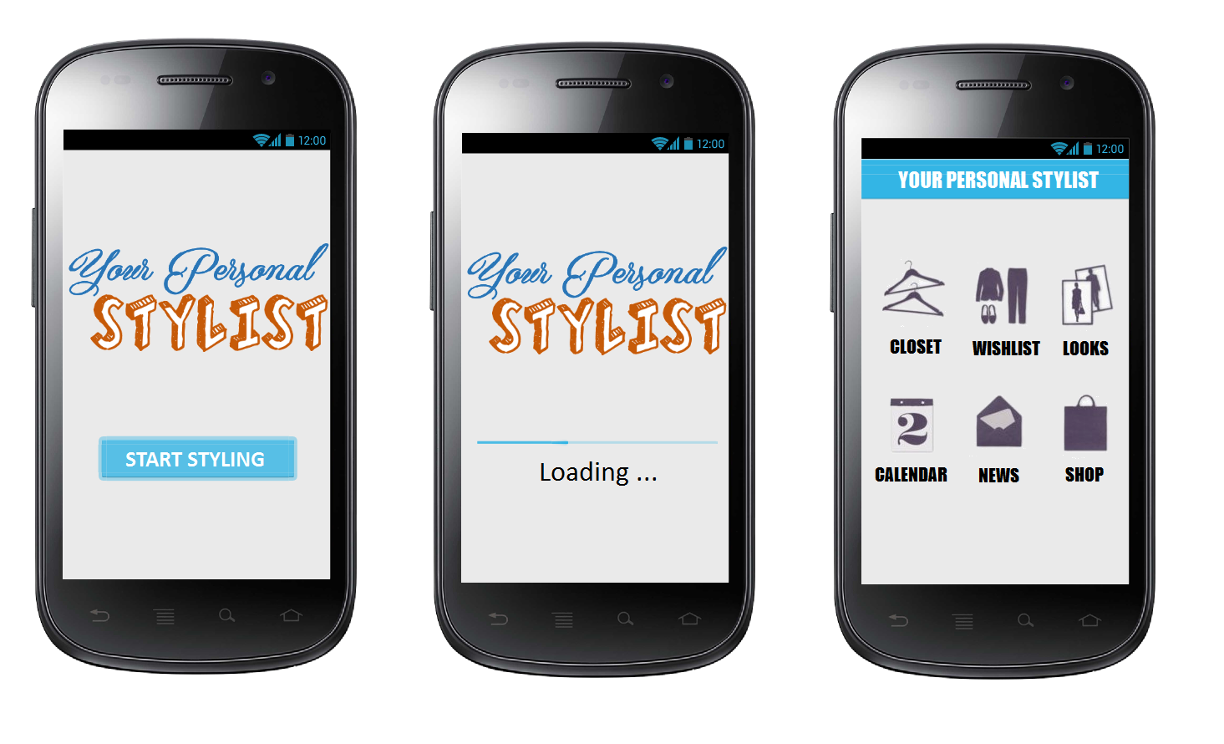

Slide 7
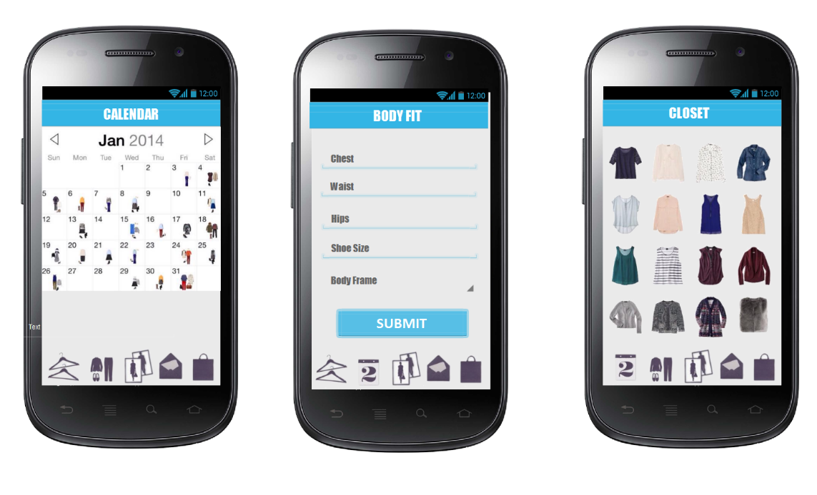

Slide 8
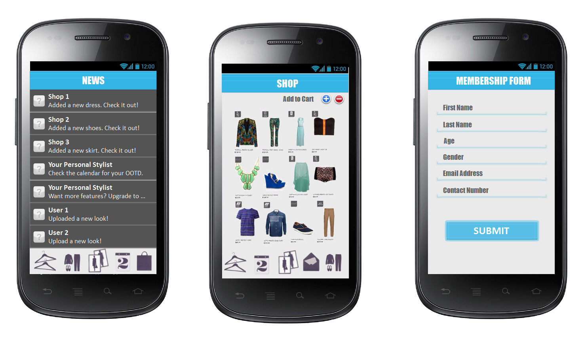

Slide 9
FINANCIAL ANALYSIS
Capital Requirement
Individual contributions
Bank Loan
Payables
Interest
Sales Forecast
Sales during 1st Year
Estimated Profit (4 Years)
1st and 2nd Year
3rd and 4th Year
Differences (Growth? Relapse?)
Estimated Expenses (4 Years)
Payable for How many Years?
Recovery from Expenses?
Revenue / Return of Investment
Should I invest? Why?

