Slide 1
YPS Your Personal Stylist

Slide 2

PROBLEM
There are people who have a hard time choosing what to wear every day, there are those who prefer to buy their clothing online, and there are also those who look for clothes to wear for different occasions that they need to attend.
The problem of shopping online, but not seeing how it would look like *on you*

Slide 3
NO MORE EXCUSES!!

Slide 4



SOLUTION

Slide 5
FEATURES
Personalized Virtual Stylist (customized fashion tips)
Virtual Wardrobe and Fitting
Online Shopping (Clothing Brands and Online Boutiques)
Planner ( Outfit for everyday and special Occasions)

Slide 6
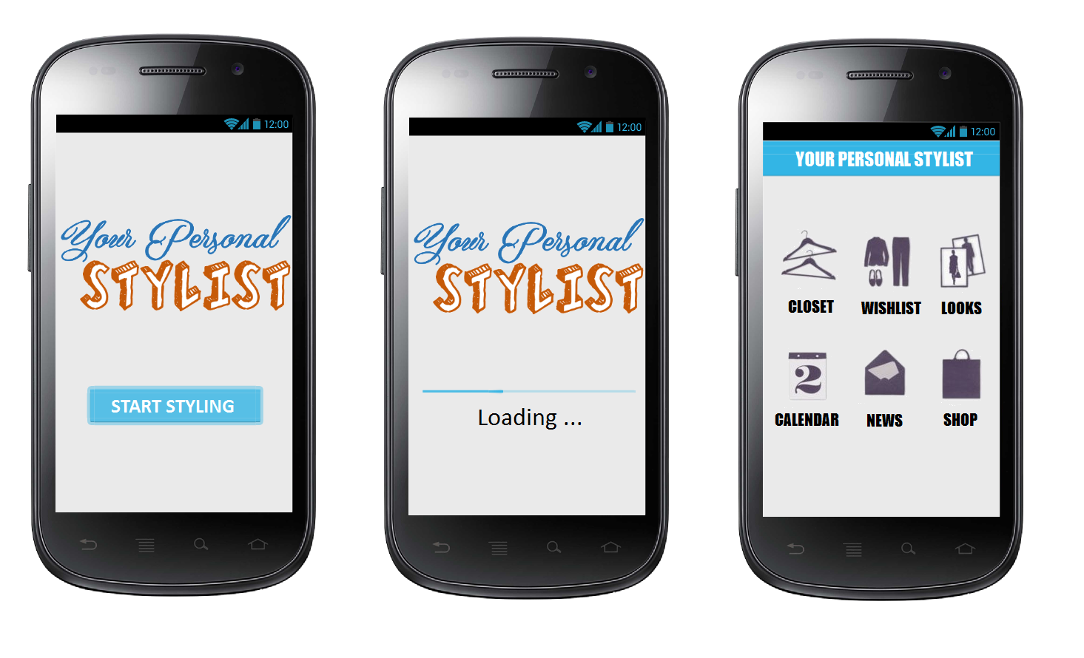

Slide 7
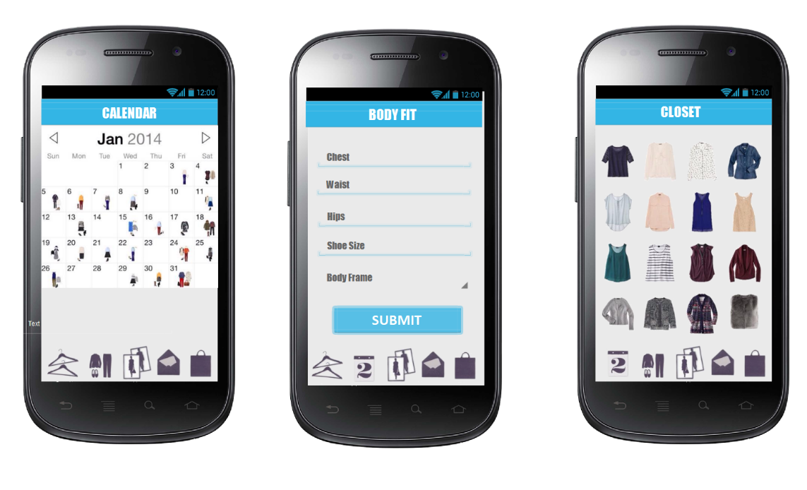

Slide 8
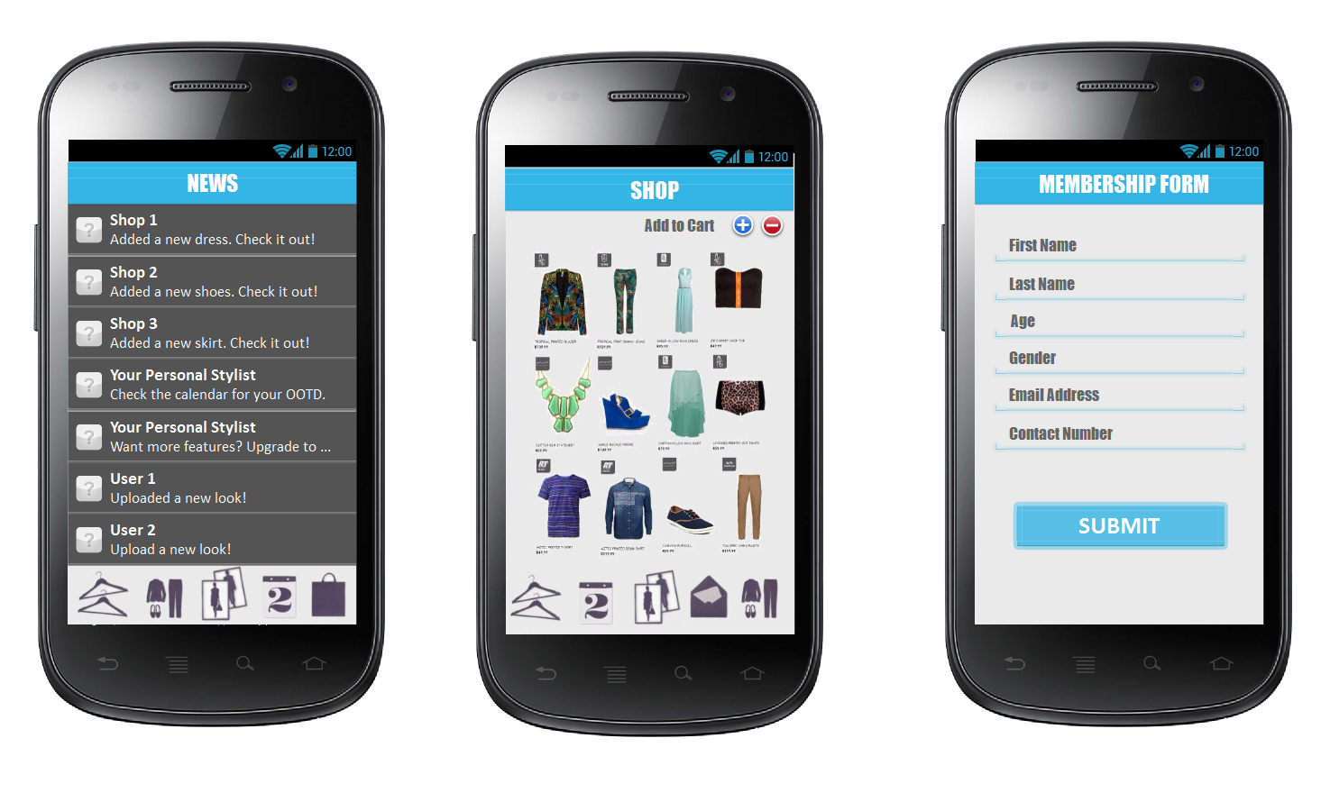

Slide 9
FINANCIAL ANALYSIS
Capital requirements
Capital -
Loan -
Profit (refer to profit and loss projection)

