Slide 1
YPS Your Personal Stylist
Bridge Mobile Phils., Inc.

Slide 2

PROBLEM
There are people who have a hard time choosing what to wear every day, there are those who prefer to buy their clothing online, and there are also those who look for clothes to wear for different occasions that they need to attend.
The problem of shopping online, but not seeing how it would look like *on you*

Slide 3
NO MORE EXCUSES!!

Slide 4
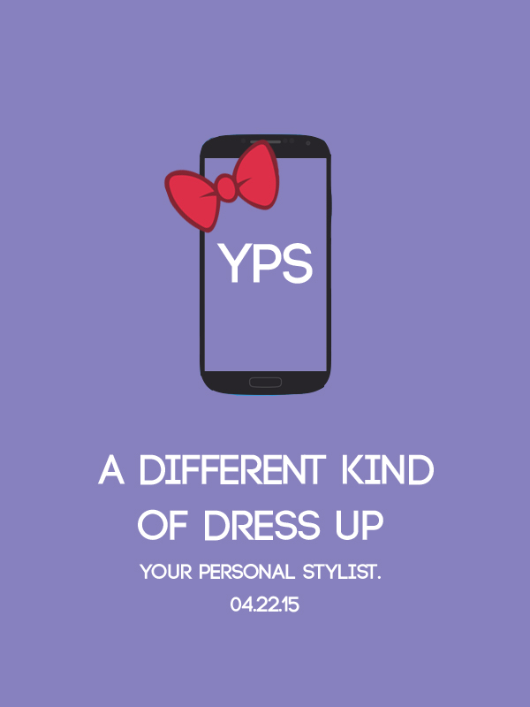


FASHION at the TIP of YOUR FINGERS

Slide 5
FEATURES
Personalized Virtual Stylist (customized fashion tips)
Virtual Wardrobe and Fitting
Online Shopping (Clothing Brands and Online Boutiques)
Planner ( Outfit for everyday and special Occasions)

Slide 6
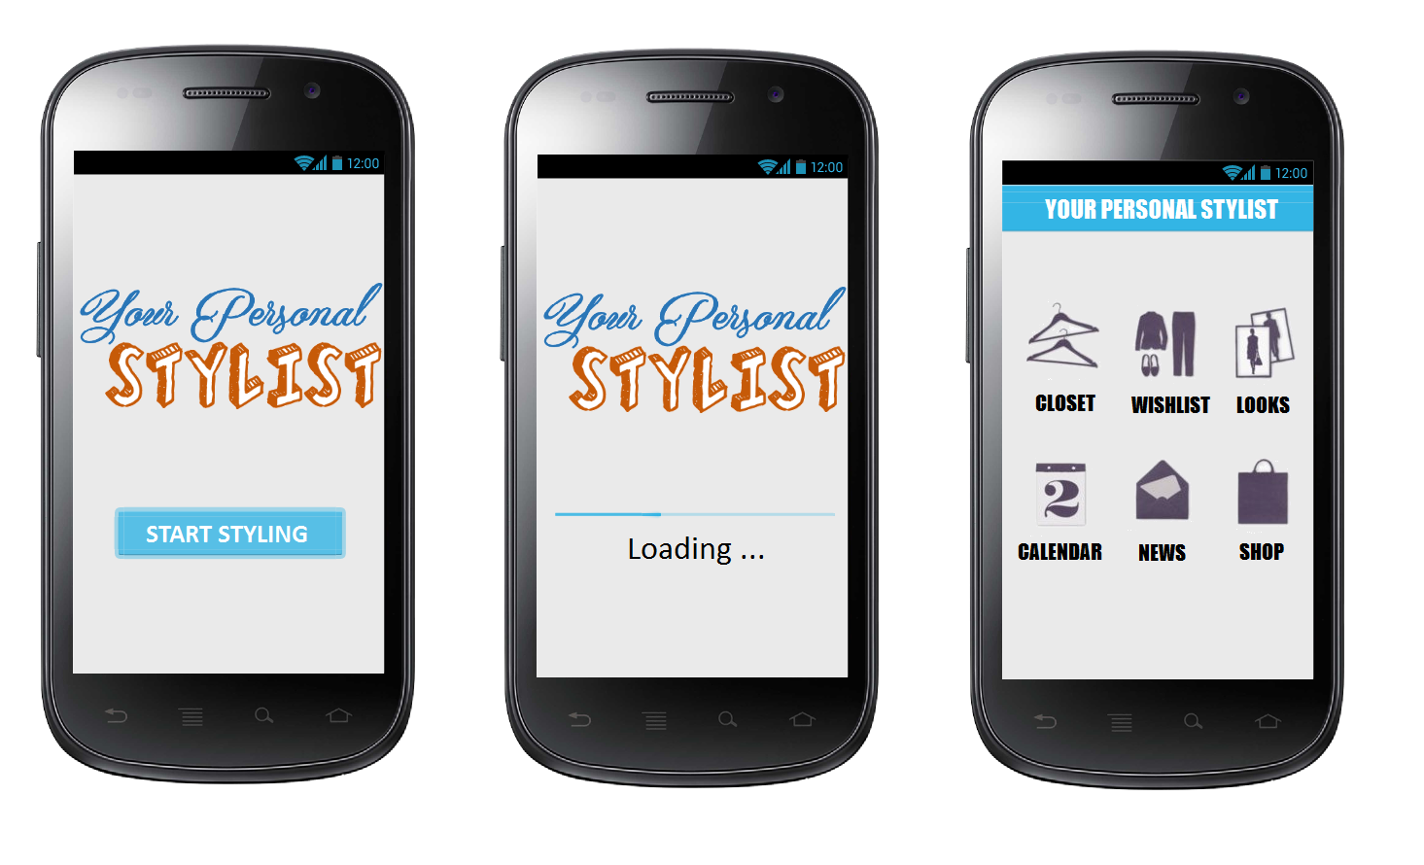

Slide 7
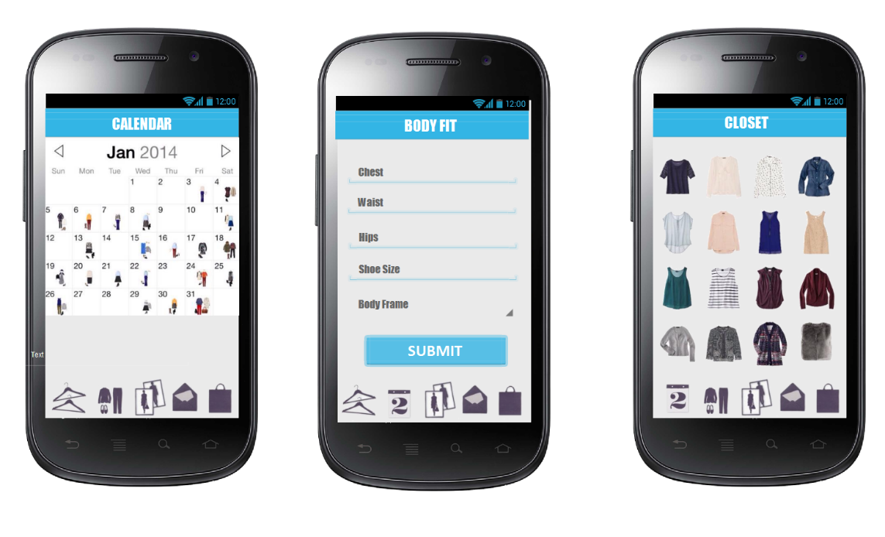

Slide 8
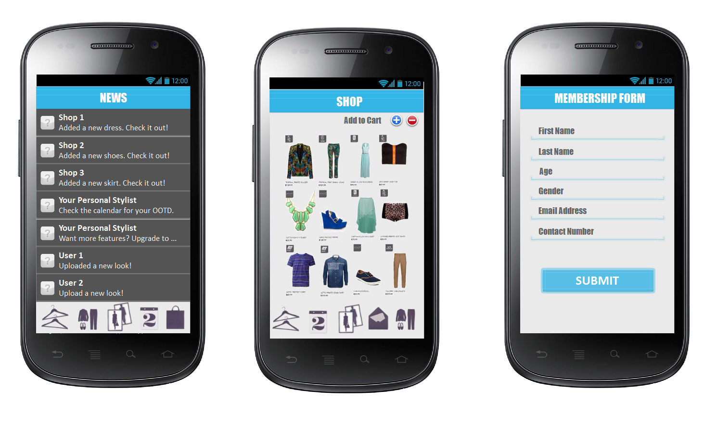

Slide 9
Financial analysis

Slide 10
Return of Investment
• Every download of free version of the application (Ads)
• User’s monthly Subscription of Premium version of the application
• Yearly Membership of the Clothing Brands
• Clothing Brands Advertisements of their featured product (per item)
• User’s subscription of Upgrade wardrobe capacity

