Slide 1

Java Variables and Data Types
Chapter 2,
Dimitar josifov

Slide 2
What is a Variable in Java?
Variable in Java is a data container that stores the data values during Java program execution. Every variable is assigned data type which designates the type and quantity of value it can hold. Variable is a memory location name of the data.
The Java variables have mainly three types : Local, Instance and Static.
In order to use a variable in a program you to need to perform 2 steps
Variable Declaration
Variable Initialization

Slide 3
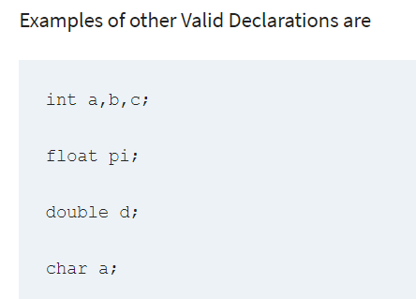
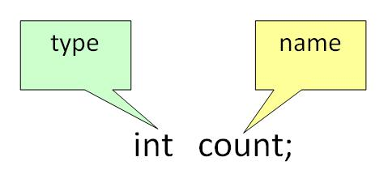
Variable Declaration:
To declare a variable, you must specify the data type & give the variable a unique name.

Slide 4
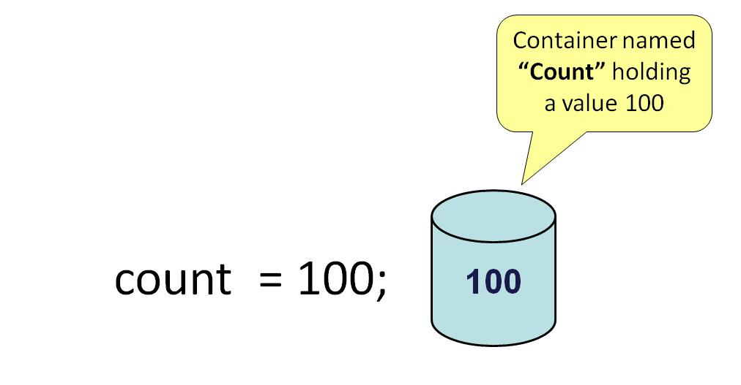
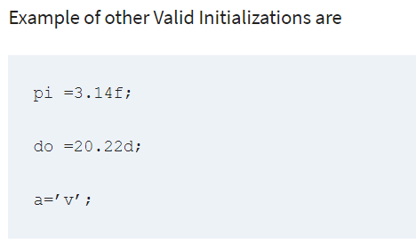
Variable Initialization:
To initialize a variable, you must assign it a valid value.

Slide 5

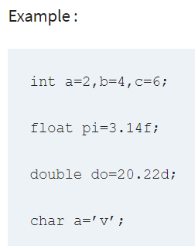
Java Variables
You can combine variable declaration and initialization.

Slide 6
Types of variables
In Java, there are three types of variables:
Local Variables
Instance Variables
Static Variables
1) Local Variables
Local Variables are a variable that are declared inside the body of a method.
2) Instance Variables
Instance variables are defined without the STATIC keyword .They are defined Outside a method declaration. They are Object specific and are known as instance variables.
3) Static Variables
Static variables are initialized only once, at the start of the program execution. These variables should be initialized first, before the initialization of any instance variables.

Slide 7
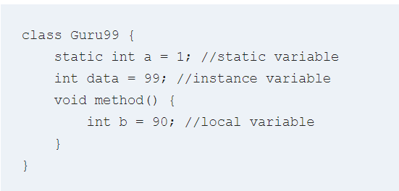
Example: Types of Variables in Java

Slide 8
What is Data Types in Java?
Data Types in Java are defined as specifiers that allocate different sizes and types of values that can be stored in the variable or an identifier. Java has a rich set of data types. Data types in Java can be divided into two parts :
Primitive Data Types :- which include integer, character, boolean, and float
Non-primitive Data Types :- which include classes, arrays and interfaces.

Slide 9
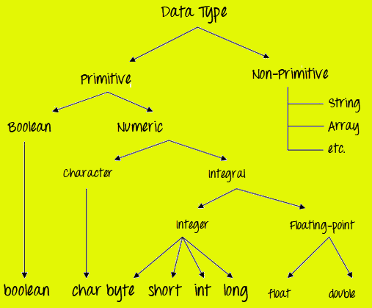
What is Data Types in Java?

Slide 10
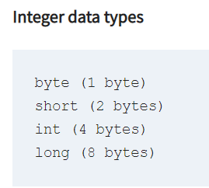
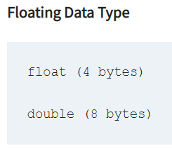
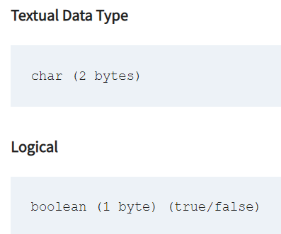
What is Data Types in Java?
Primitive Data Types
Primitive Data Types are predefined and available within the Java language. Primitive values do not share state with other primitive values.
There are 8 primitive types: byte, short, int, long, char, float, double, and Boolean

Slide 11
What is Data Types in Java?
Data Type | Default Value | Default size
byte | 0 | 1 byte
short | 0 | 2 bytes
int | 0 | 4 bytes
long | 0L | 8 bytes
float | 0.0f | 4 bytes
double | 0.0d | 8 bytes
boolean | false | 1 bit
char | ‘\u0000’ | 2 bytes

Slide 12
Java Data types
Points to Remember:
All numeric data types are signed(+/-).
The size of data types remain the same on all platforms (standardized)
char data type in Java is 2 bytes because it uses UNICODE character set. By virtue of it, Java supports internationalization. UNICODE is a character set which covers all known scripts and language in the world

Slide 13
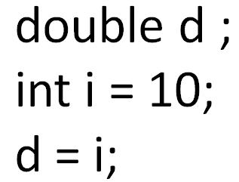
Java Variable Type Conversion & Type Casting
A variable of one type can receive the value of another type. Here there are 2 cases –
Case 1) Variable of smaller capacity is be assigned to another variable of bigger capacity.
This process is Automatic, and non-explicit is known as Conversion

Slide 14
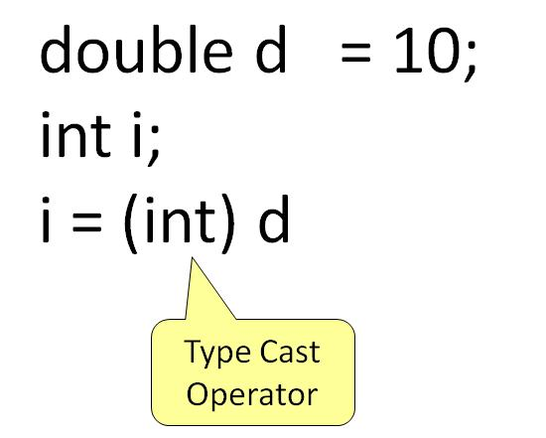
Java Variable Type Conversion & Type Casting
Case 2) Variable of larger capacity is be assigned to another variable of smaller capacity
In such cases, you have to explicitly specify the type cast operator. This process is known as Type Casting.
In case, you do not specify a type cast operator; the compiler gives an error. Since this rule is enforced by the compiler, it makes the programmer aware that the conversion he is about to do may cause some loss in data and prevents accidental losses.

Slide 15
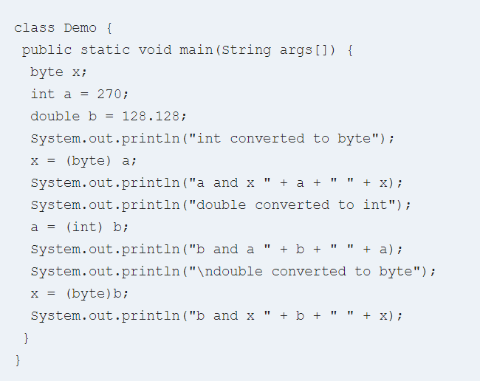
Example: To Understand Type Casting

Slide 16
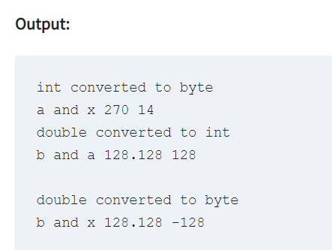
Step 2) Save, Compile & Run the code.

Slide 17
Java Arrays Tutorial: Declare, Create, Initialize
Chapter 2,
Dimitar josifov

Slide 18
What is Java Array?
Java Array is a very common type of data structure which contains all the data values of the same data type. The data items put in the array are called elements and the first element in the array starts with index zero. Arrays inherit the object class and implement the serializable and cloneable interfaces. We can store primitive values or objects in an array.

Slide 19
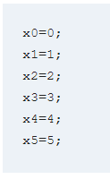
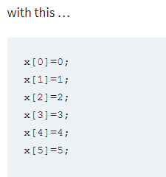
What is Java Array?
In simple words, it’s a programming construct which helps to replace this

Slide 20
Array Variables
Using an array in your program is a 3 step process –
1) Declaring your Array
2) Constructing your Array
3) Initialize your Array

Slide 21
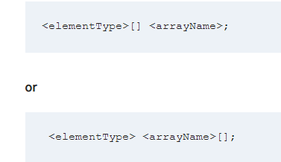
Array Variables
1) Declaring your Array

Slide 22
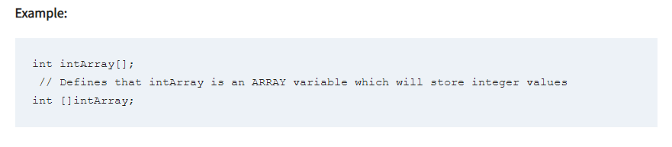
Array Variables

Slide 23
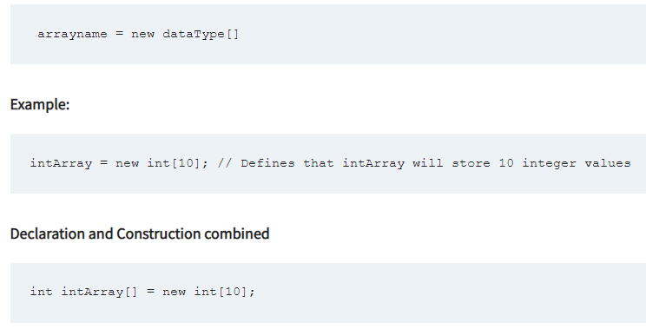
Array Variables
2) Constructing an Array

Slide 24
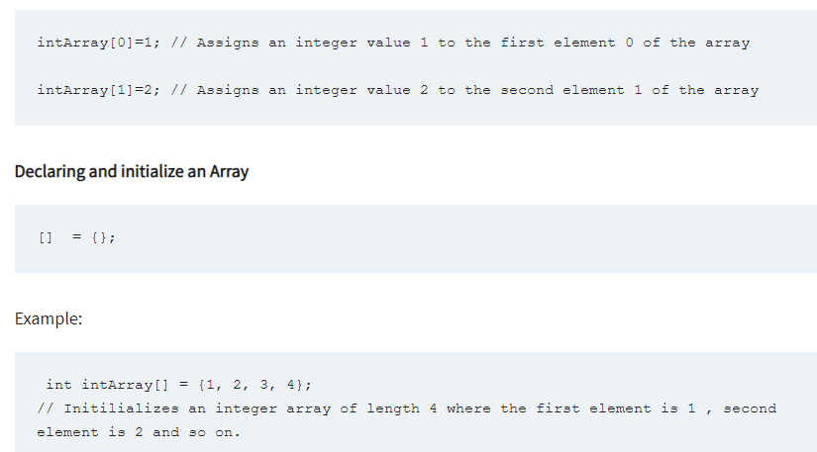
Array Variables
3) Initialize an Array

Slide 25
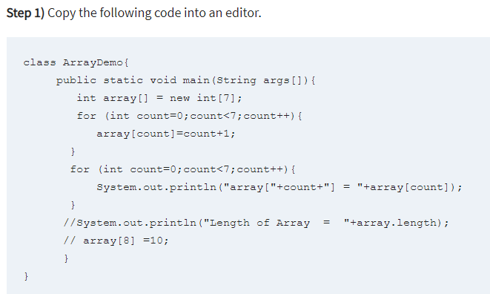
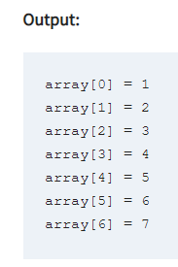
First Array Program

Slide 26
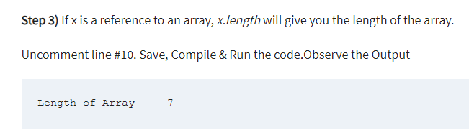
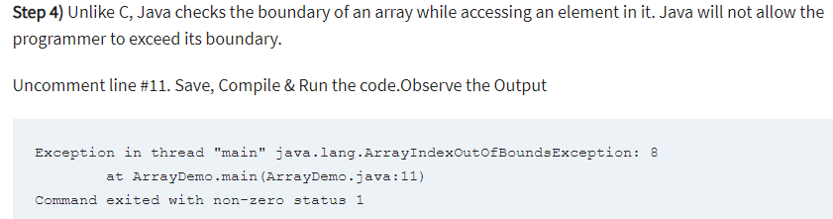
First Array Program

Slide 27
Java Array: Pass by reference
Arrays are passed to functions by reference, or as a pointer to the original. This means anything you do to the Array inside the function affects the original.
Example: To understand Array are passed by reference

Slide 28
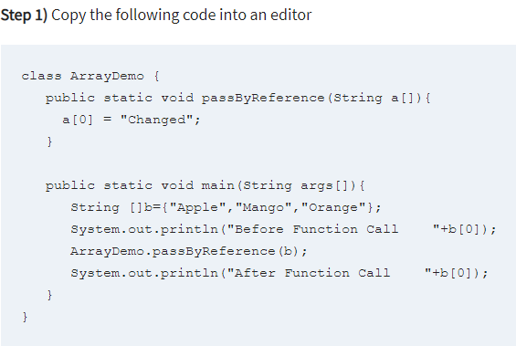
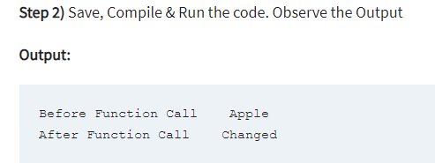
Java Array: Pass by reference

Slide 29

Multidimensional arrays
Multidimensional arrays are actually arrays of arrays.
To declare a multidimensional array variable, specify each additional index using another set of square brackets.
When you allocate memory for a multidimensional array, you need only specify the memory for the first (leftmost) dimension.
You can allocate the remaining dimensions separately.
In Java, array length of each array in a multidimensional array is under your control.

Slide 30
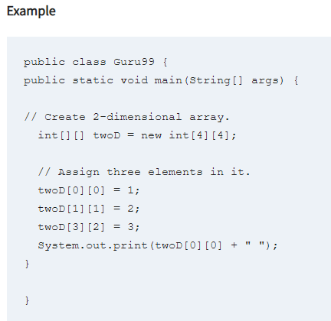
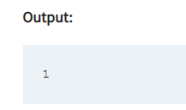
Multidimensional arrays

Slide 31
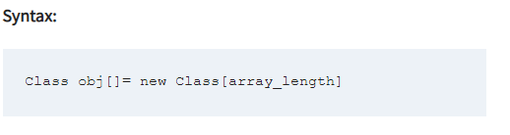
What Is An Array Of Objects?
JAVA ARRAY OF OBJECT, as defined by its name, stores an array of objects. Unlike a traditional array that store values like string, integer, Boolean, etc an array of objects stores OBJECTS. The array elements store the location of the reference variables of the object.

Slide 32
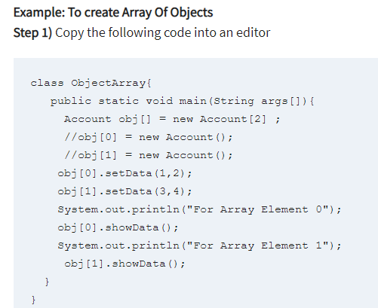
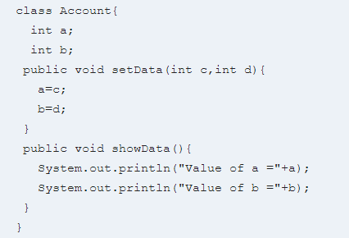
What Is An Array Of Objects?

Slide 33
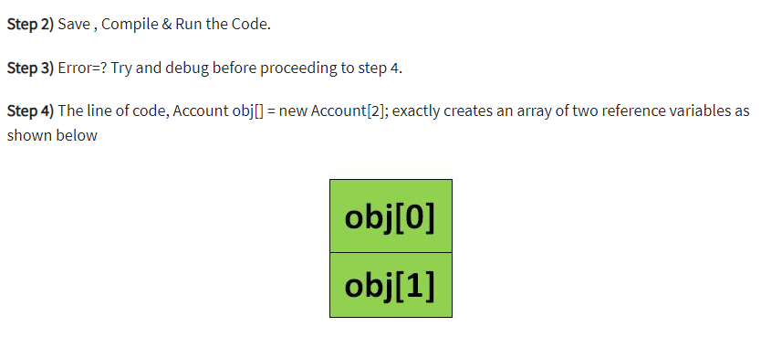
What Is An Array Of Objects?

Slide 34
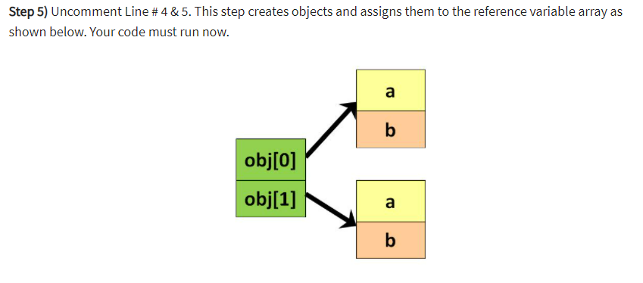
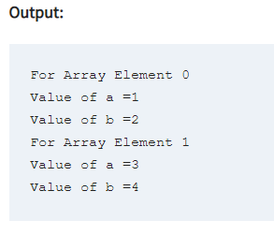
What Is An Array Of Objects?

