Slide 1

Java Variables and Data Types
Chapter 2,
Dimitar josifov

Slide 2
What is a Variable in Java?
Variable in Java is a data container that stores the data values during Java program execution. Every variable is assigned data type which designates the type and quantity of value it can hold. Variable is a memory location name of the data.
The Java variables have mainly three types : Local, Instance and Static.
In order to use a variable in a program you to need to perform 2 steps
Variable Declaration
Variable Initialization

Slide 3
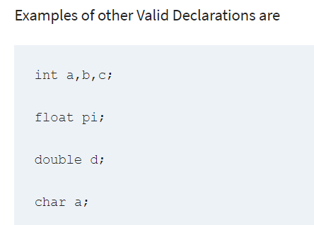
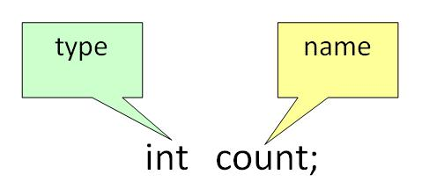
Variable Declaration:
To declare a variable, you must specify the data type & give the variable a unique name.

Slide 4
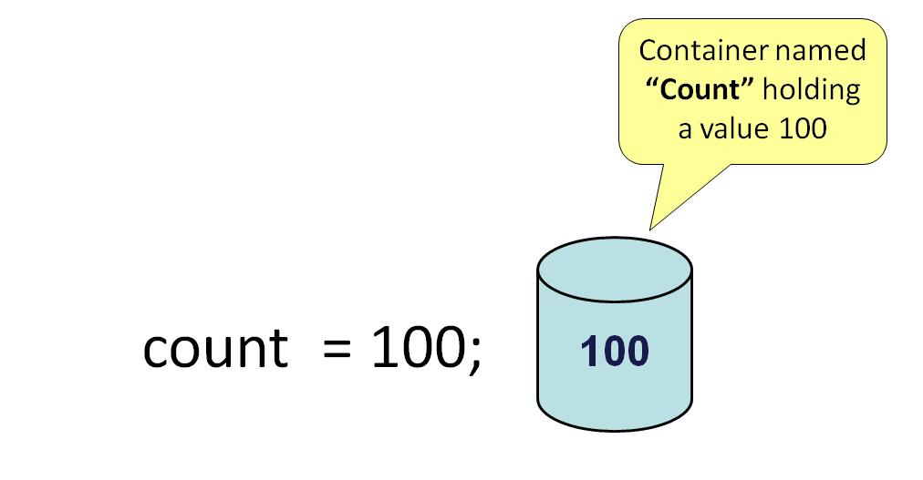
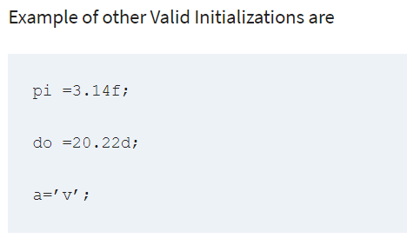
Variable Initialization:
To initialize a variable, you must assign it a valid value.

Slide 5

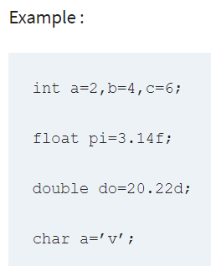
Java Variables
You can combine variable declaration and initialization.

Slide 6
Types of variables
In Java, there are three types of variables:
Local Variables
Instance Variables
Static Variables
1) Local Variables
Local Variables are a variable that are declared inside the body of a method.
2) Instance Variables
Instance variables are defined without the STATIC keyword .They are defined Outside a method declaration. They are Object specific and are known as instance variables.
3) Static Variables
Static variables are initialized only once, at the start of the program execution. These variables should be initialized first, before the initialization of any instance variables.

Slide 7
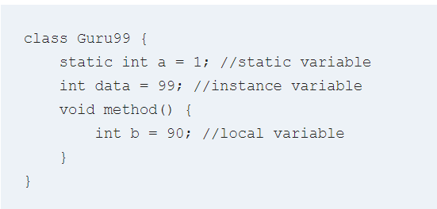
Example: Types of Variables in Java

Slide 8
What is Data Types in Java?
Data Types in Java are defined as specifiers that allocate different sizes and types of values that can be stored in the variable or an identifier. Java has a rich set of data types. Data types in Java can be divided into two parts :
Primitive Data Types :- which include integer, character, boolean, and float
Non-primitive Data Types :- which include classes, arrays and interfaces.

Slide 9
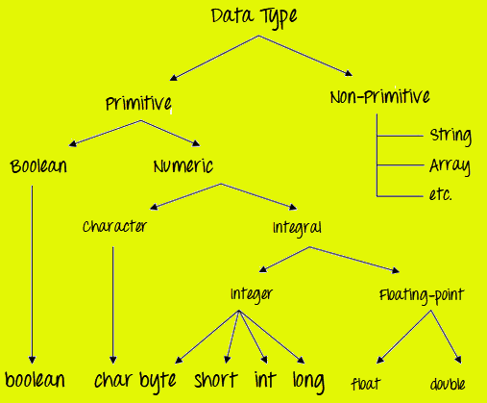
What is Data Types in Java?

Slide 10
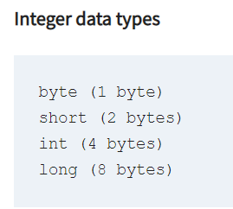
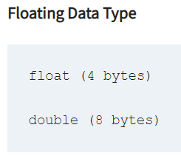
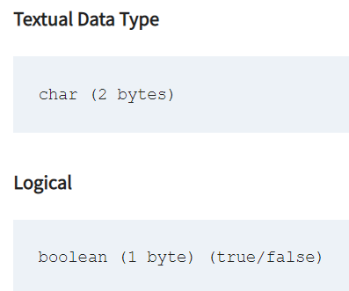
What is Data Types in Java?
Primitive Data Types
Primitive Data Types are predefined and available within the Java language. Primitive values do not share state with other primitive values.
There are 8 primitive types: byte, short, int, long, char, float, double, and Boolean

Slide 11
What is Data Types in Java?
Data Type | Default Value | Default size
byte | 0 | 1 byte
short | 0 | 2 bytes
int | 0 | 4 bytes
long | 0L | 8 bytes
float | 0.0f | 4 bytes
double | 0.0d | 8 bytes
boolean | false | 1 bit
char | ‘\u0000’ | 2 bytes

Slide 12
Java Data types
Points to Remember:
All numeric data types are signed(+/-).
The size of data types remain the same on all platforms (standardized)
char data type in Java is 2 bytes because it uses UNICODE character set. By virtue of it, Java supports internationalization. UNICODE is a character set which covers all known scripts and language in the world

Slide 13
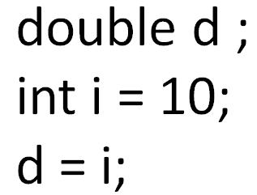
Java Variable Type Conversion & Type Casting
A variable of one type can receive the value of another type. Here there are 2 cases –
Case 1) Variable of smaller capacity is be assigned to another variable of bigger capacity.
This process is Automatic, and non-explicit is known as Conversion

Slide 14
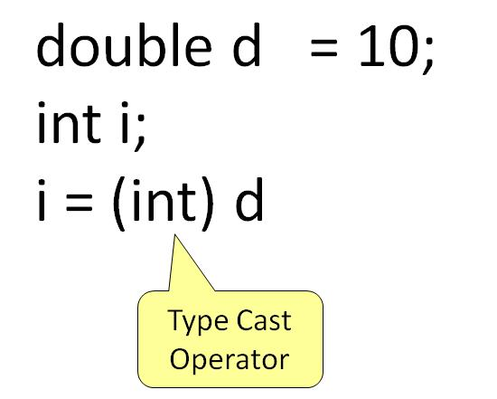
Java Variable Type Conversion & Type Casting
Case 2) Variable of larger capacity is be assigned to another variable of smaller capacity
In such cases, you have to explicitly specify the type cast operator. This process is known as Type Casting.
In case, you do not specify a type cast operator; the compiler gives an error. Since this rule is enforced by the compiler, it makes the programmer aware that the conversion he is about to do may cause some loss in data and prevents accidental losses.

Slide 15
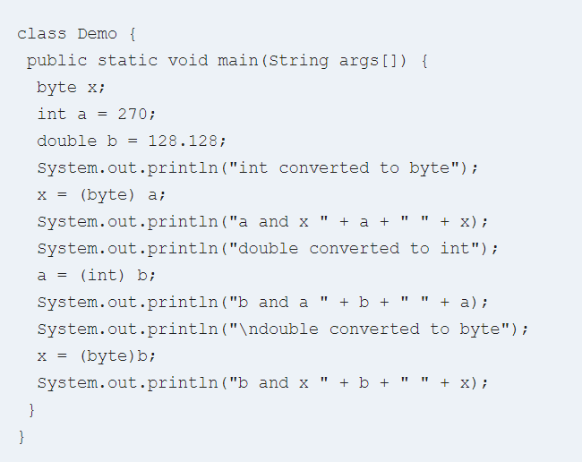
Example: To Understand Type Casting

Slide 16
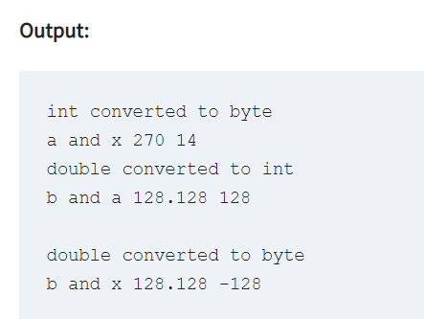
Step 2) Save, Compile & Run the code.

Slide 17
Java Arrays Tutorial: Declare, Create, Initialize
Chapter 2,
Dimitar josifov

Slide 18
What is Java Array?
Java Array is a very common type of data structure which contains all the data values of the same data type. The data items put in the array are called elements and the first element in the array starts with index zero. Arrays inherit the object class and implement the serializable and cloneable interfaces. We can store primitive values or objects in an array.

Slide 19
What is Java Array?
In Java all arrays are dynamically allocated.(discussed below)
Since arrays are objects in Java, we can find their length using the object property length. This is different from C/C++ where we find length using sizeof.
A Java array variable can also be declared like other variables with [] after the data type.
The variables in the array are ordered and each have an index beginning from 0.
Java array can be also be used as a static field, a local variable or a method parameter.
The size of an array must be specified by an int or short value and not long.
The direct superclass of an array type is Object.
Every array type implements the interfaces Cloneable and java.io.Serializable.

Slide 20
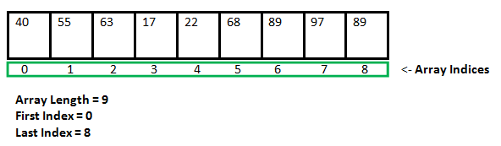
What is Java Array?
Array can contain primitives (int, char, etc.) as well as object (or non-primitive) references of a class depending on the definition of the array. In case of primitive data types, the actual values are stored in contiguous memory locations.

Slide 21
Instantiating an Array in Java
When an array is declared, only a reference of array is created. To actually create or give memory to array, you create an array like this:The general form of new as it applies to one-dimensional arrays appears as follows:
var-name = new type [size];
Here, type specifies the type of data being allocated, size specifies the number of elements in the array, and var-name is the name of array variable that is linked to the array. That is, to use new to allocate an array, you must specify the type and number of elements to allocate.
Example:
int intArray[]; //declaring array intArray = new int[20]; // allocating memory to array
OR
int[] intArray = new int[20]; // combining both statements in one

Slide 22
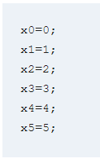
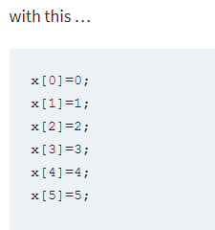
What is Java Array?
In simple words, it’s a programming construct which helps to replace this

Slide 23
Array Variables
Using an array in your program is a 3 step process –
1) Declaring your Array
2) Constructing your Array
3) Initialize your Array

Slide 24
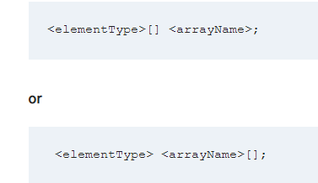
Array Variables
1) Declaring your Array

Slide 25
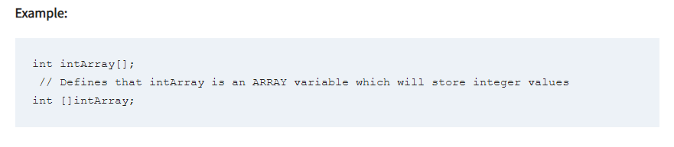
Array Variables

Slide 26
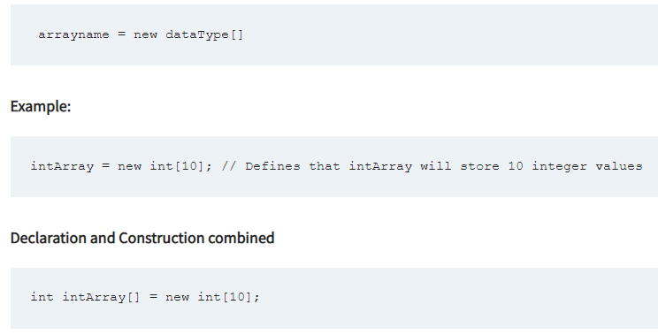
Array Variables
2) Constructing an Array

Slide 27
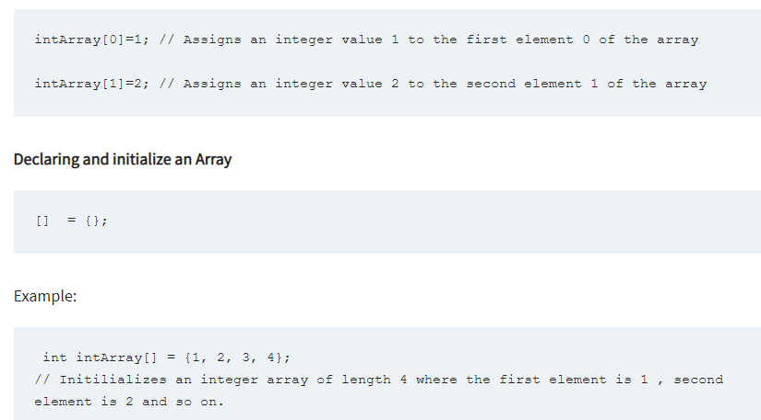
Array Variables
3) Initialize an Array

Slide 28
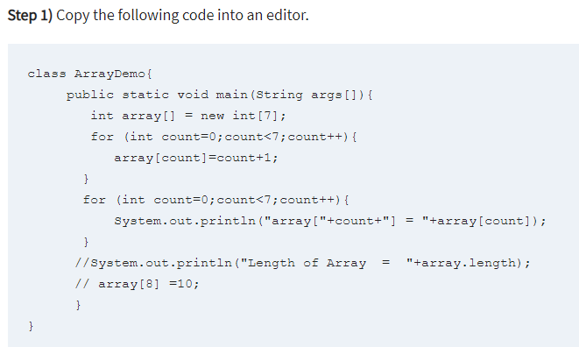
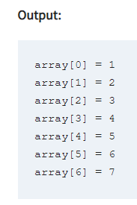
First Array Program

Slide 29
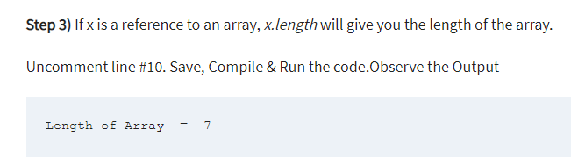
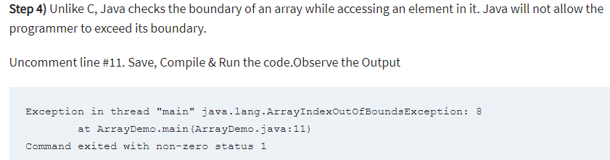
First Array Program

Slide 30
Java Array: Pass by reference
Arrays are passed to functions by reference, or as a pointer to the original. This means anything you do to the Array inside the function affects the original.
Example: To understand Array are passed by reference

Slide 31
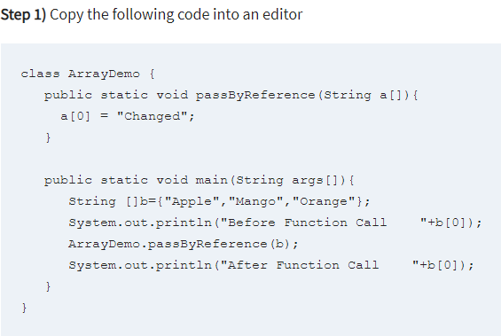
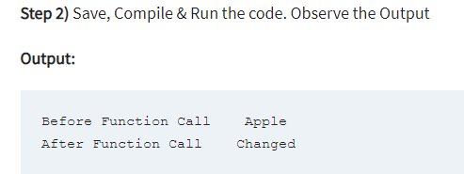
Java Array: Pass by reference

Slide 32

Multidimensional arrays
Multidimensional arrays are actually arrays of arrays.
To declare a multidimensional array variable, specify each additional index using another set of square brackets.
When you allocate memory for a multidimensional array, you need only specify the memory for the first (leftmost) dimension.
You can allocate the remaining dimensions separately.
In Java, array length of each array in a multidimensional array is under your control.

Slide 33
Multidimensional arrays
Multidimensional arrays are arrays of arrays with each element of the array holding the reference of other array. These are also known as Jagged Arrays. A multidimensional array is created by appending one set of square brackets ([]) per dimension. Examples:
int[][] intArray = new int[10][20]; //a 2D array or matrix int[][][] intArray = new int[10][20][10]; //a 3D array

Slide 34
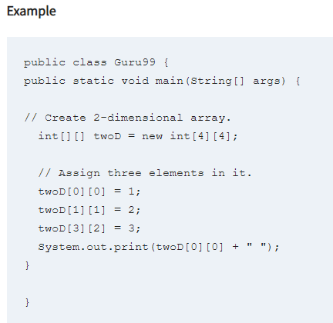
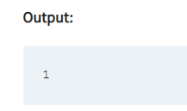
Multidimensional arrays

Slide 35
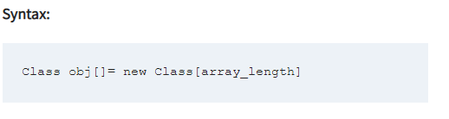
What Is An Array Of Objects?
JAVA ARRAY OF OBJECT, as defined by its name, stores an array of objects. Unlike a traditional array that store values like string, integer, Boolean, etc an array of objects stores OBJECTS. The array elements store the location of the reference variables of the object.

Slide 36
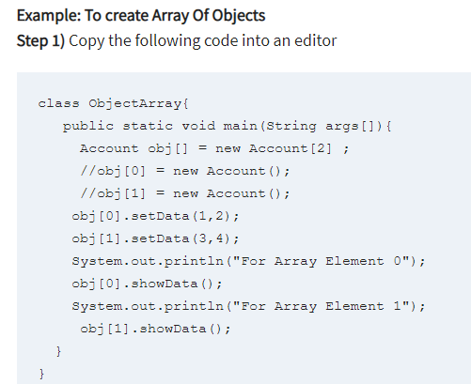
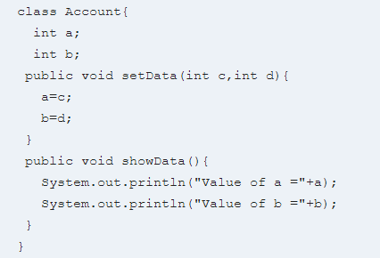
What Is An Array Of Objects?

Slide 37
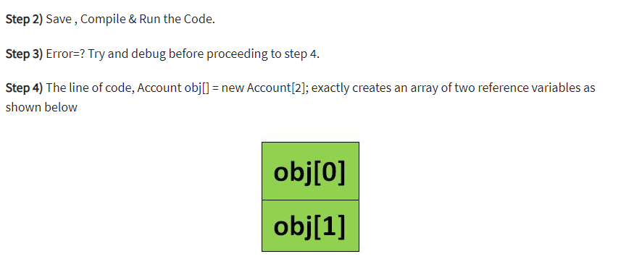
What Is An Array Of Objects?

Slide 38
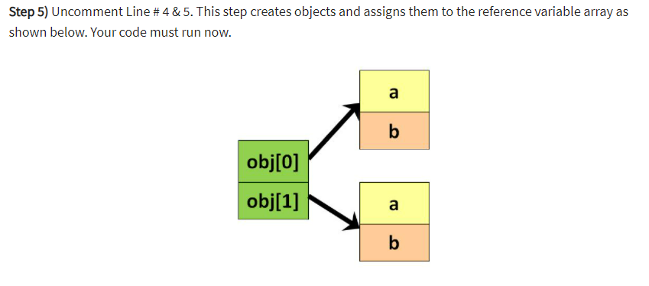
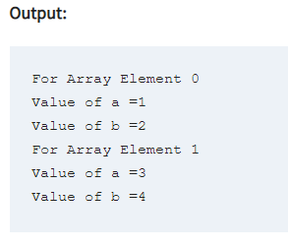
What Is An Array Of Objects?

Slide 39
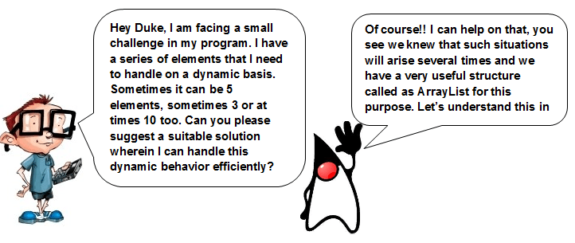
Java ArrayList: How to Use, ArrayList Methods & Examples
What is ArrayList in Java?
ArrayList in Java is a data structure that can be stretched to accommodate additional elements within itself and shrink back to a smaller size when elements are removed. It is a very important data structure useful in handling the dynamic behavior of elements.

Slide 40
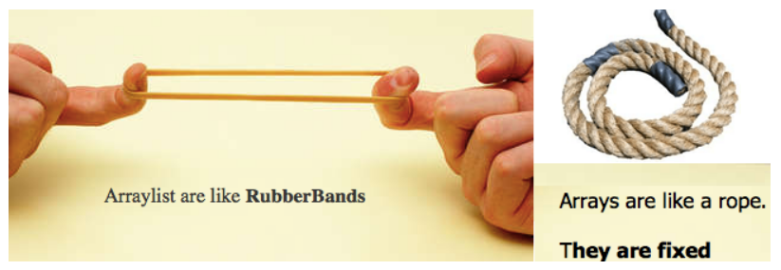
Java ArrayList: How to Use, ArrayList Methods & Examples
For Java ArrayList Example, see the following picture of a man stretching an elastic rubber band.
The actual length of the rubber band is much smaller, but when stretched it can extend a lot more than its actual length and can be used to hold/bind much larger objects with it.
Now, consider the next picture, that of a simple rope, it cannot stretch and will have a fixed length.

Slide 41
Java ArrayList: How to Use, ArrayList Methods & Examples
It can grow as, and when required to accommodate the elements it needs to store and when elements are removed, it can shrink back to a smaller size.
So as our friend has an issue with the array he is using cannot be expanded or made to shrink, we will be using ArrayList.
Arrays are like the rope shown in the above picture; they will have a fixed length, cannot be expanded nor reduced from the original length.
So our stretchable rubber-band is much like the Array List whereas the rope can be considered as the array.
Technically speaking, ArrayList Java is like a dynamic array or a variable-length array.

Slide 42

Java ArrayList: How to Use, ArrayList Methods & Examples
Let us see and understand the following code snippet of Java ArrayList Syntax that will help you work around with ArrayList.

Slide 43
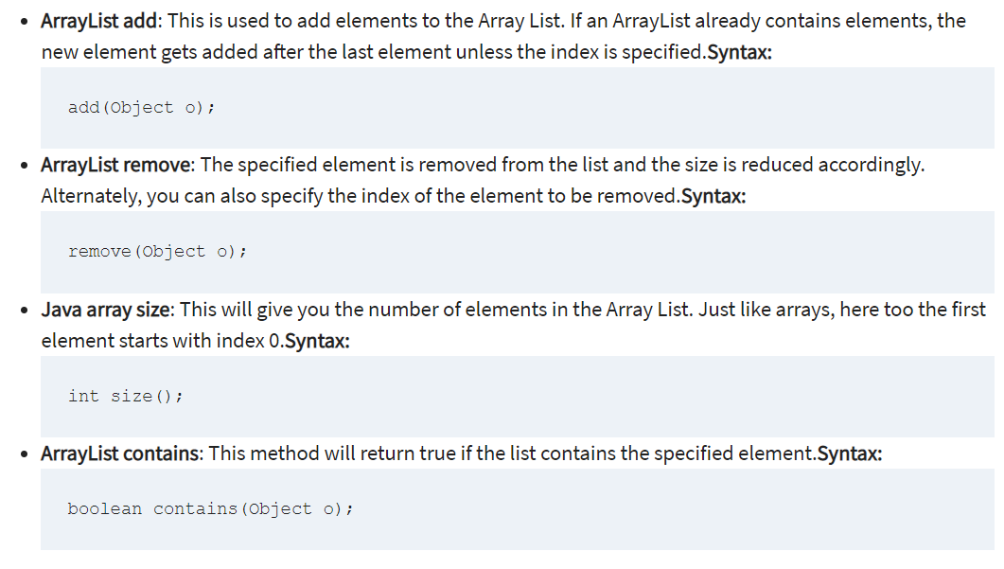
ArrayList Methods

Slide 44
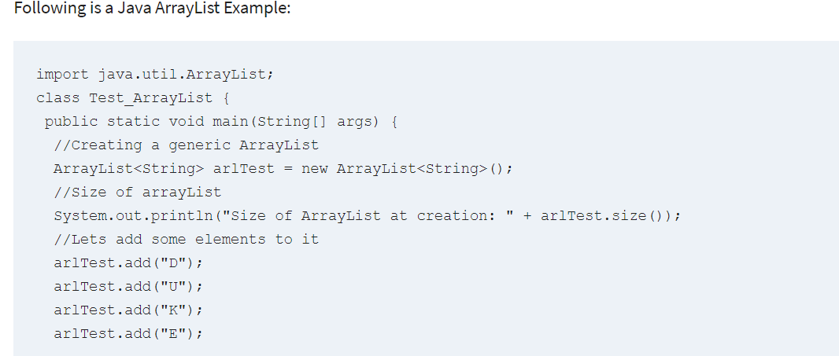
Java ArrayList Example

Slide 45
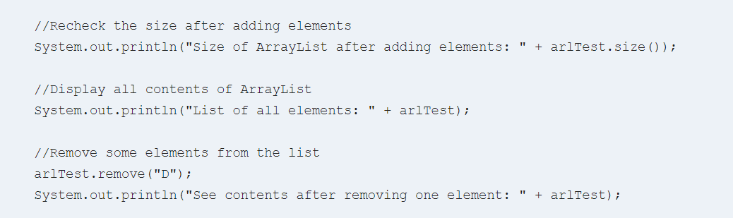
Java ArrayList Example

Slide 46
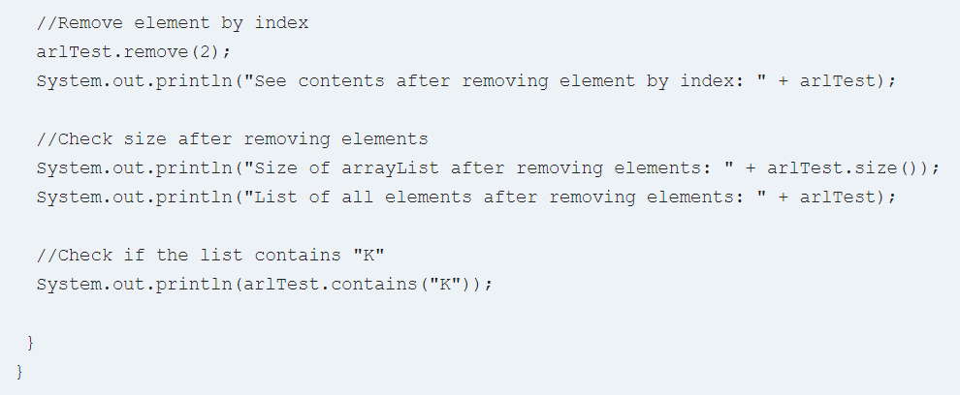
Java ArrayList Example

Slide 47
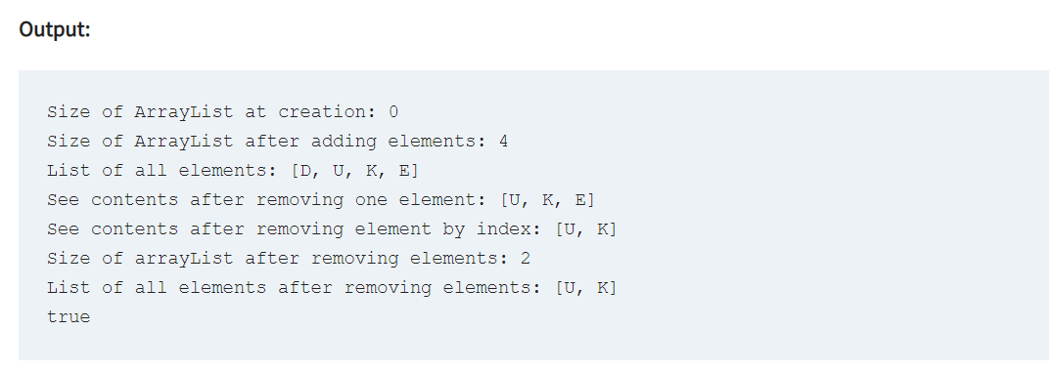
Java ArrayList Example

Slide 48
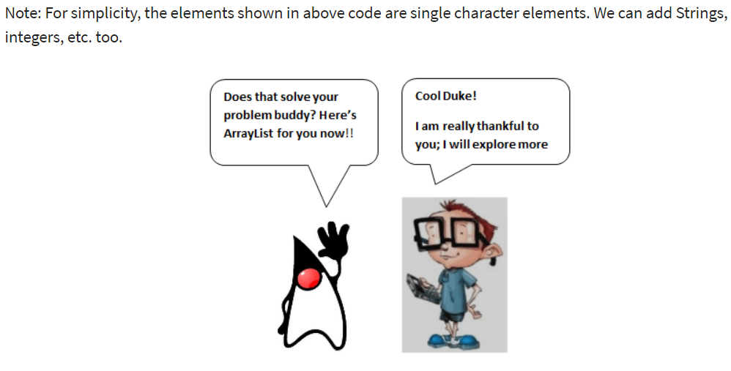

Slide 49
Java String Manipulation: Functions and Methods
Chapter 4,
Dimitar josifov

Slide 50
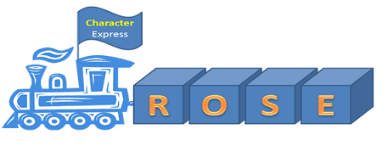
What are Strings?
A string in literal terms is a series of characters. Hey, did you say characters, isn’t it a primitive data type in Java. Yes, so in technical terms, the basic Java String is basically an array of characters.
So my above string of “ROSE” can be represented as the following

Slide 51
Why use Strings?
One of the primary functions of modern computer science, is processing human language.
Similarly to how numbers are important to math, language symbols are important to meaning and decision making. Although it may not be visible to computer users, computers process language in the background as precisely and accurately as a calculator. Help dialogs provide instructions. Menus provide choices. And data displays show statuses, errors, and real-time changes to the language.
As a Java programmer, one of your main tools for storing and processing language is going to be the String class.

Slide 52
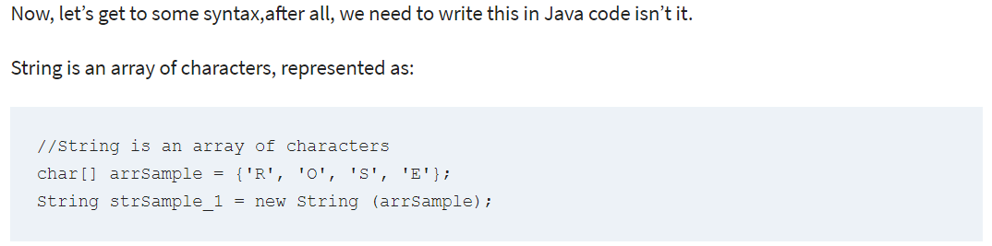
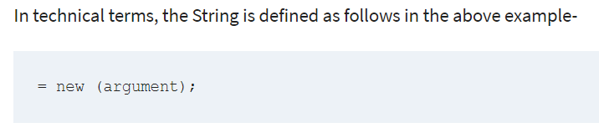
String Syntax Examples

Slide 53
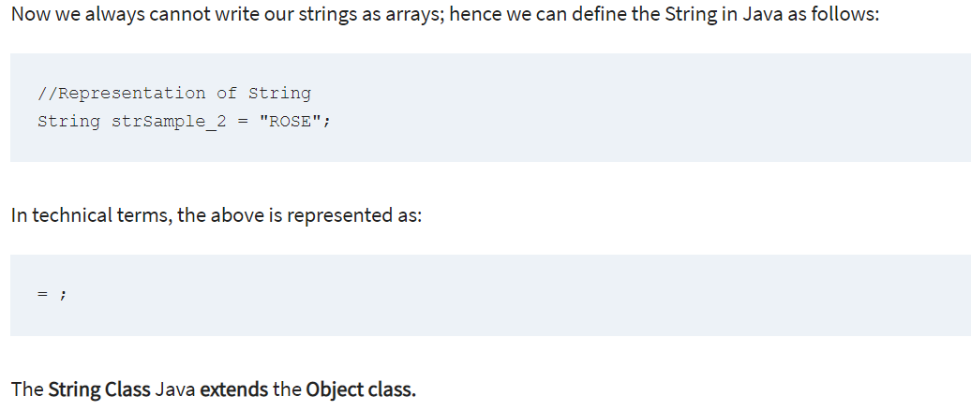
String Syntax Examples

Slide 54
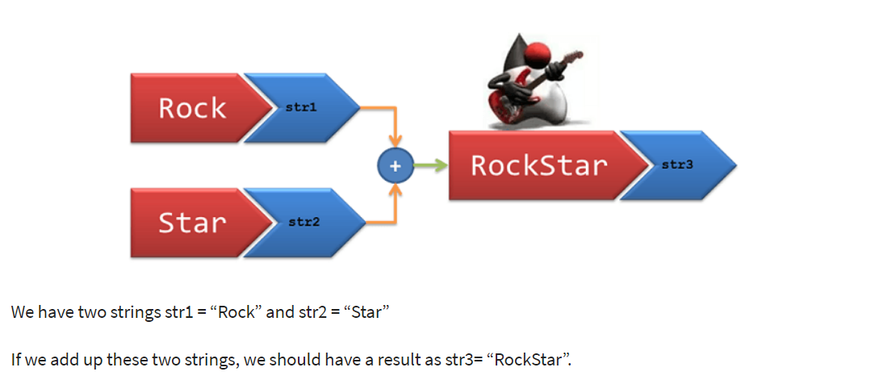
String Concatenation:
Concatenation is joining of two or more strings.

Slide 55
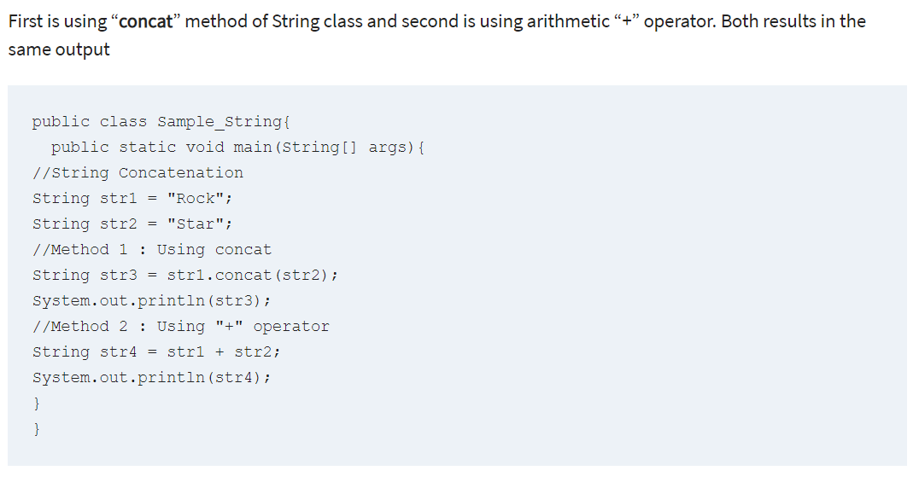
String Concatenation:

Slide 56
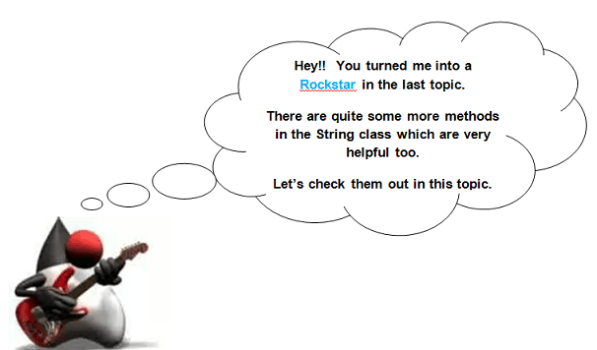
Important Java string methods:

Slide 57

Important Java string methods:

Slide 58

Important Java string methods:

Slide 59

Important Java string methods:

Slide 60


Important Java string methods:

Slide 61

Important Java string methods:

Slide 62

Important Java string methods:

Slide 63

Important Java string methods

Slide 64

Important Java string methods

Slide 65

Important Points to Note:

Slide 66

Important Points to Note:

Slide 67

Important Points to Note:

