Slide 1

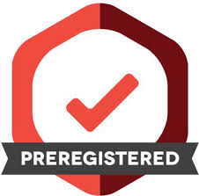
Session 2
Pre-registrations

Slide 2
Post- and Pre-diction
Post-diction: the use of data to generate hypotheses about why something occurred
Pre-diction: the acquisition of data to test ideas about what will occur, establishing diagnostic evidence for explanatory claims
Presenting post-dictions as predictions—post-hoc theorising—can lead to overconfidence in post hoc explanations. That is, we generate a hypothesis based on observing data, and then evaluate the validity of the hypothesis based on the same data.

Slide 3
Post- and Pre-diction
!!Some tests in some studies will show significant effects/differences/relationships, even if there is no true effect.!!
False-positives can occur also when we test hypotheses (prediction), but then we control its likelihood (alpha).
Pre-registration allows us to avoid this and enables researchers to distinguish whether results are pre- or postdictions.

Slide 4
So, pre-register!
You already do it!
grant applications
thesis proposals
ethics applications …

Slide 5
How to?
Commit to analytic steps without advance knowledge of the research outcomes
post the analysis plan on an independent registry
time-stamp the registration, make it discoverable
Run the study
Add the link to the pre-registration in your paper
Distinguish confirmatory and exploratory analyses in your results section / explain deviations from the pre-registration

Slide 6
A template (for empirical research)

Slide 7
Template: OSF social psychology van ‘t Veer & Giner-Sorolla, 2016: https://osf.io/t6m9v/
Hypotheses Essential: directionality, shape of interactions, manipulation checks Recommended: figure/table, underlying theories
Methods Essential: design (IVs, DVs, covariates), planned sample + justification, exclusion criteria, procedure
Analysis plan Essential: variables and how they are calculated, statistical techniques, role of each variable (IV/DV etc.), rationale for covariates Recommended: correction for multiple tests, missing data handling, reliability criteria for item inclusion, anticipated data transformations, assumptions, corrections when assumptions are violated
Has data collection begun and/or have you looked at the data?

Slide 8
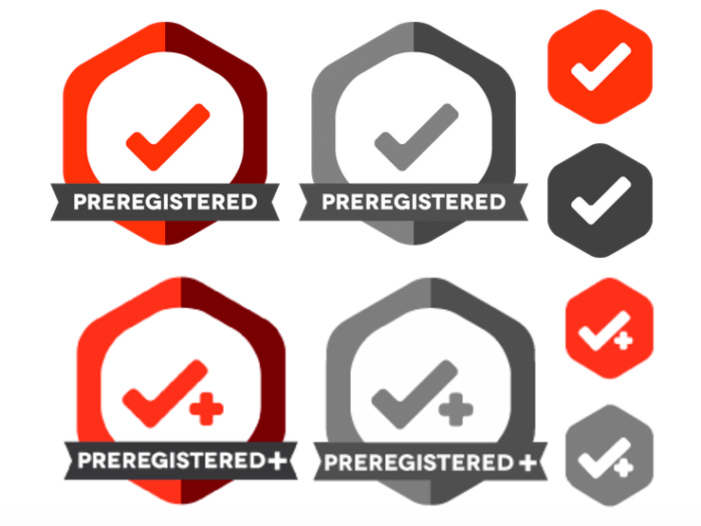
How to: open science framework
Open a project on OSF
Complete (offline) pre-registration form with collaborators
Different templates available
Register the project, this ‘freezes’ it
Make public or keep under embargo
Badges awarded by journals during peer review
List: https://osf.io/tvyxz/wiki/5.%20Adoptions%20and%20Endorsements/

Slide 9
What if…
Deviations during data collection: report these transparently, reasons why
Assumptions are violated during analyses: pre-register a decision tress
I work with existing data: as long as data has not been observed pre-registration is possible, be transparent about what you know
I run many similar studies: pre-register a ‘programme’ and minor changes in each study, be transparent about the Nr of studies conducted
I have few predictions: Exploratory studies should be pre-registered as such.
I can’t collect data for pre- and post-diction: Split data set and seal half
I don’t do original research (systematic review, meta-analyses): Pre-register your protocol (e.g., decision/inclusion rules, coding guidelines)

Slide 10
