Slide 1

Meta-science

Slide 2
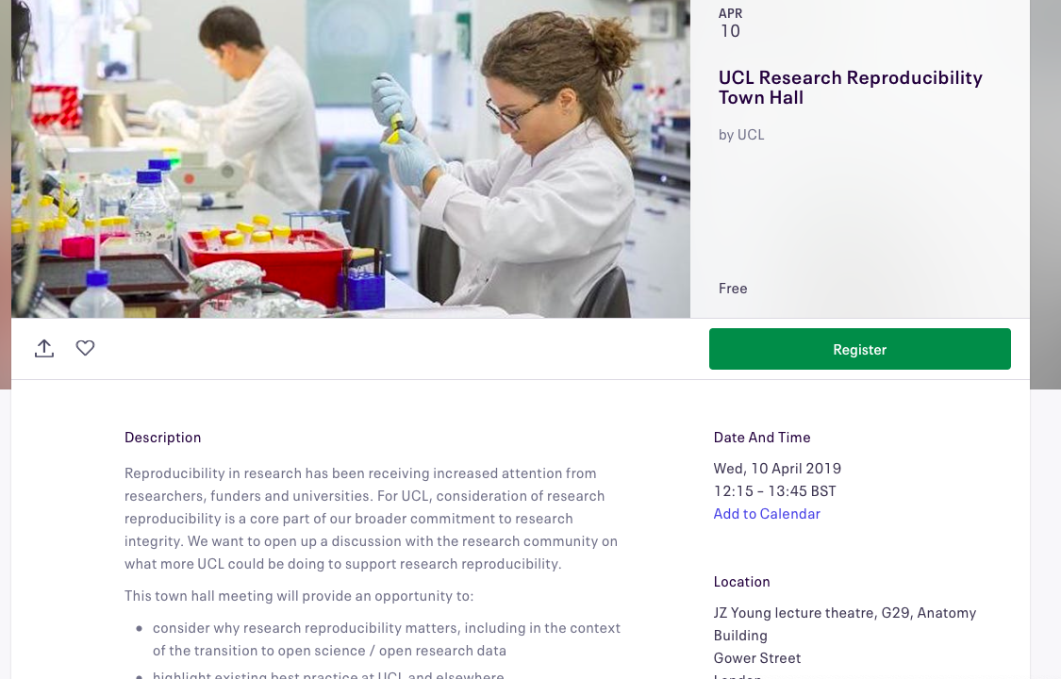

Slide 3
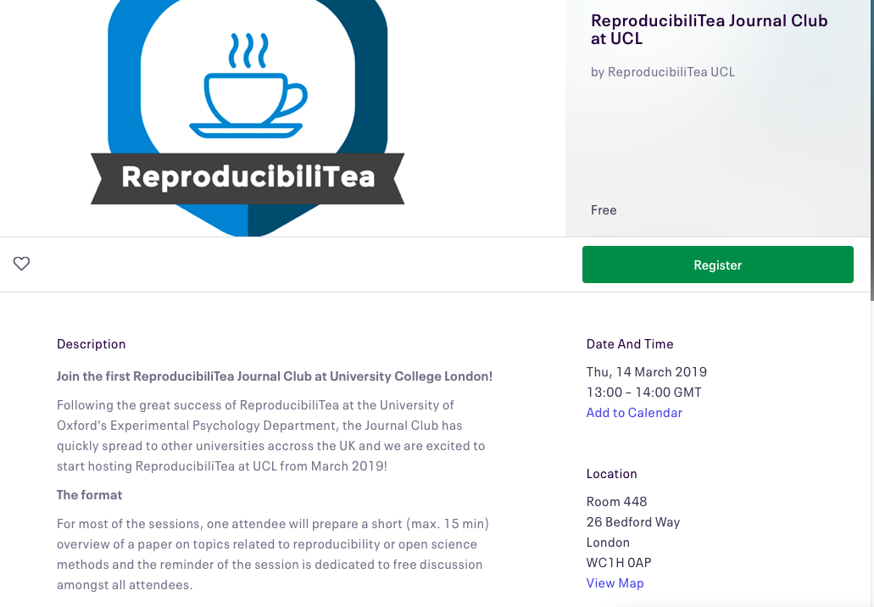

Slide 4
Meta-science
… is science about science.
Who does science?
Where is science done?
How is science done?
Which publishing method has the most impact?
How to transfer science into policies?
etc..

Slide 5
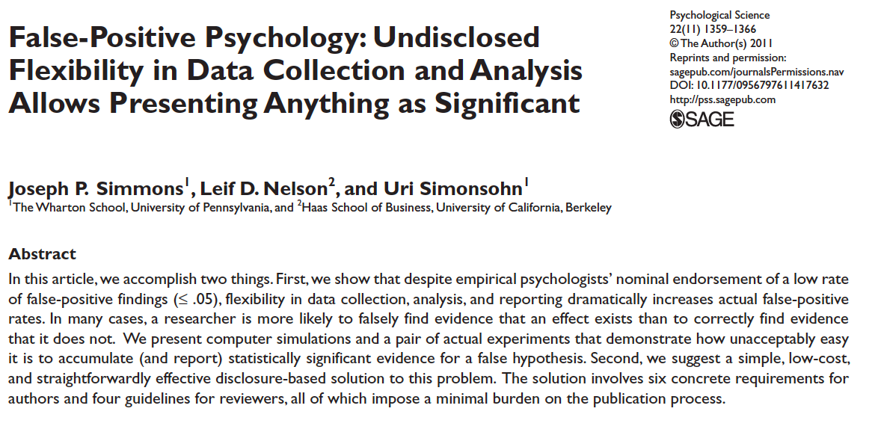
Meta-science and Open Science
In a way, meta-science facilitated the proliferation of the open science movement.

Slide 6
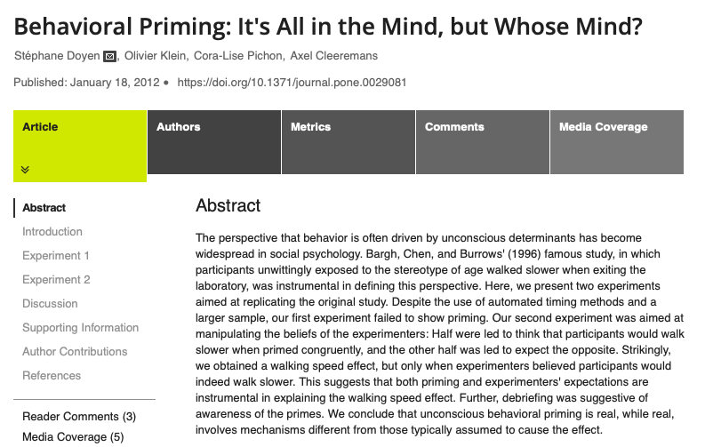
Meta-science and Open Science

Slide 7
Meta-science
Meta-science is central to…
creating and maintaining high research standards
improving the impact of scientific research

Slide 8
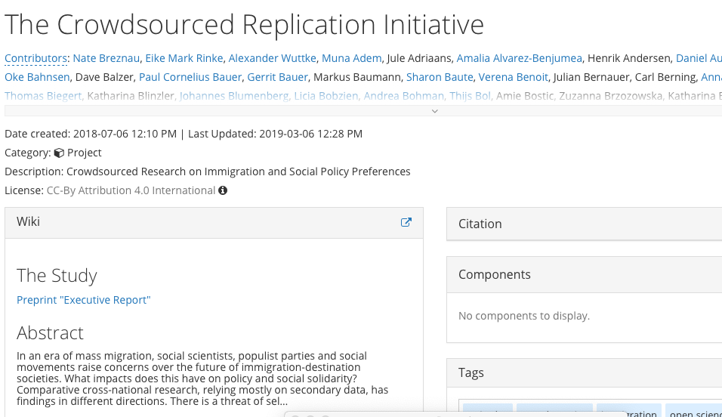
Some More Examples of Meta-science

Slide 9
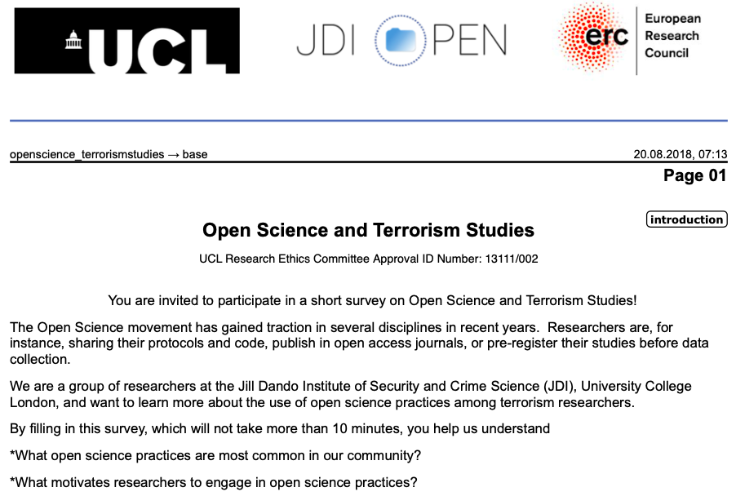
Some More Examples of Meta-science

Slide 10
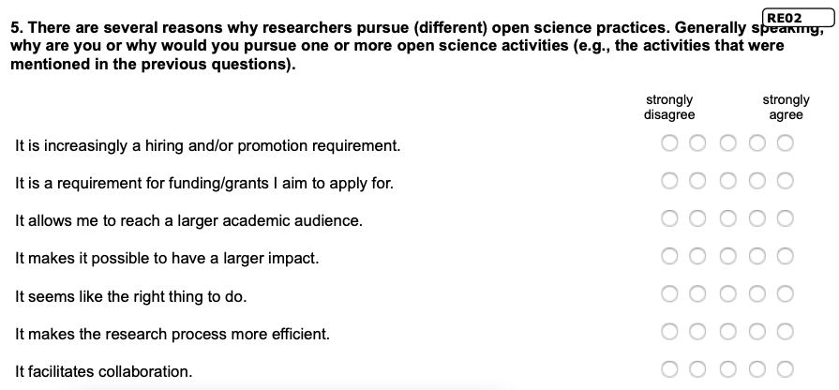
Some More Examples of Meta-science

Slide 11
What examples of meta-science do you know from your field?

