Slide 1
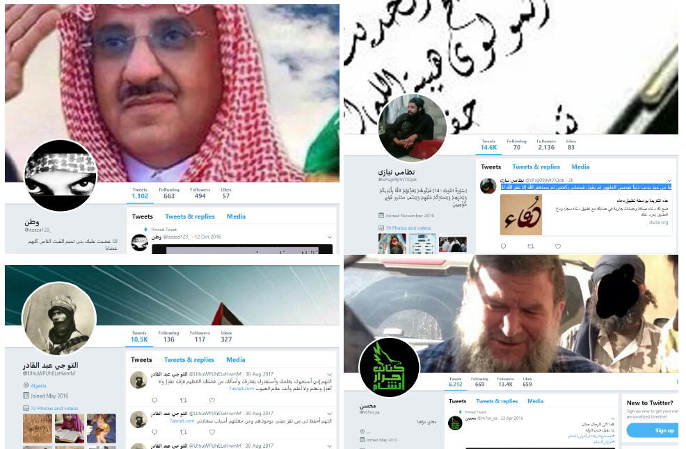
A Tale of Two Papers
Original title: “Eying Recruitment Effects of Credit-Taking using Twitter-Follower Data”
JDI Open
Winter 2019
Tanja Marie Hansen
tahan@sam.sdu.dk
PhD candidate
9. December

Slide 2
A tale of two papers
From separate contribution to research note.
Produce research note
Find article
Attempt analysis
Learn scraping
Contact authors
Methodological questions arise
January 2019
March 2019
July 2019
August 2019
September 2019
January 2020?

Slide 3
Food for thought
Sharing data/code → potential window dressing?
Dataverse = increased public scrutiny
Legitimizing proces = decreased review scrutiny?
Concerns about publishing results
PhD-supervisor: ‘replications count as ½ paper’
Co-workers: ‘wasted effort, no one will publish it’
Early career / job insecurity: academic ”enemies”

Slide 4
Thank you for your time ☺
Tanja Marie Hansen

