Slide 1

Why waste your time doing open science?
— Introduction and Q&A

Slide 2
Open Science
… practices and activities that make scientific endeavours more transparent and inclusive by increasing the availability of information that allows others to evaluate and use the research

Slide 3
Open Science
Advantages
encouraging collaboration
promoting appropriate allocation of credit to researchers
enabling scientists to more easily build on prior work
supporting meta-science
facilitating theory development
increasing the return on investment from grant funding …

Slide 4
A Brief History of the Open Science Movement
In 2010, a confluence of events raised questions about the integrity of psychological science.
* Fraud: Stapel (2010)
* Simmons, Nelson, and Simonsohn (2011): because of the leeway built into the design, analysis, and reporting of studies, researchers can “discover” just about anything; “questionable research practice” (QRPs)

Slide 5

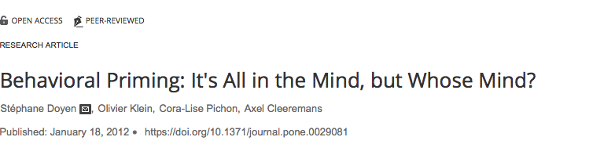
A Brief History of the Open Science Movement
Growing concerns about non-replicability

Slide 6
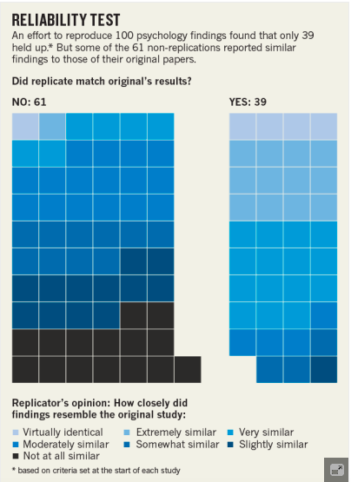
A Brief History of the Open Science Movement
* The Many Labs Project: Many Labs 1 (Klein et al., 2014), researchers from 36 international laboratories replicated 13 studies. Aggregating data across the labs (N = 6,344), 10 of 13 effects were replicated as measured by 99% confidence intervals.
* Reproducibility Project: Psychology, estimated reproducibility of 100 semi-randomly selected findings.

Slide 7
Pillars of Open Science —
Be Open
Theorise before you analyse!
Document and pre-register your hypotheses and research questions before you collect data or analyse data
Distinguish confirmatory and exploratory analyses

Slide 8
Pillars of Open Science —
Open Data
Save your data and material (in formats that are flexible, easily used by others)
Organise, label, and annotate data in a way that third parties (and you) can understand and use them
Deposit data and material in stable, secure online repositories (—> osf.io)
Assign DOIs (i.e., digital object identifiers) to archived materials
Make data accessible (for certain user groups)
Publish data sets as data descriptors, e.g., Scientific Data (Nature Groups)

Slide 9
Pillars of Open Science —
Open Source Software/Code
Preserve and annotate code that is used to analyse data
Use version control systems
Work with software that can be used by anyone (vs. licensed software)

Slide 10
Pillars of Open Science —
Open Access
Publish in outlets that can be accessed by anyone with an internet access (no license)
Some publishers require authors to pay publishing fees
Publish pre-print or post-prints

Slide 11
Take Home Activity
Register with the Open Science Framework — osf.io

Slide 12
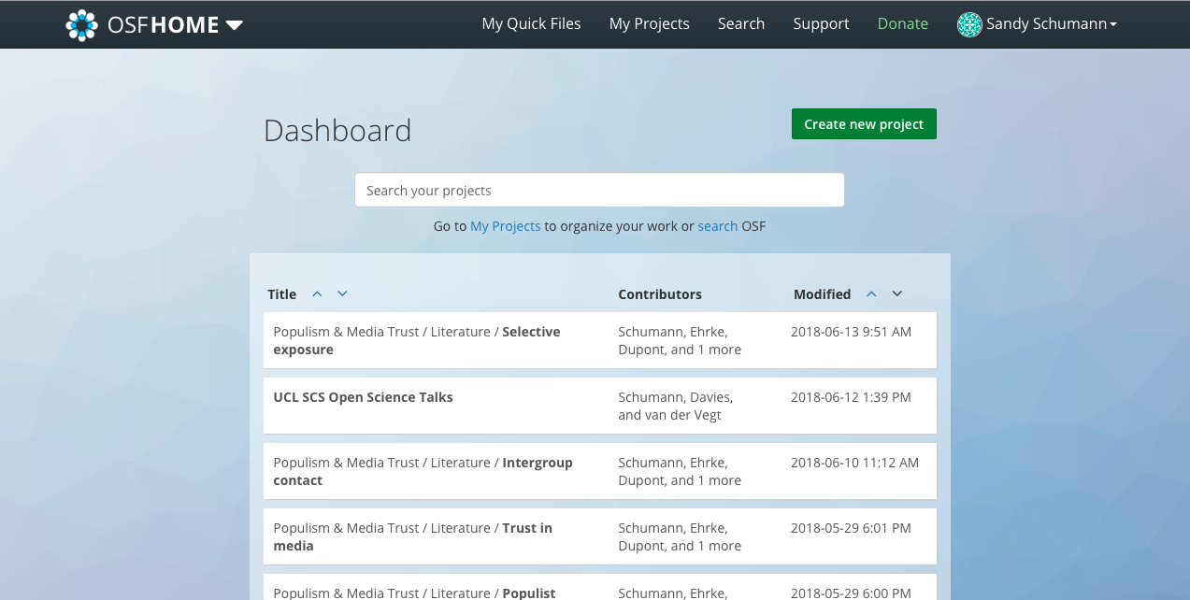

Slide 13
Your Questions and Concerns?

