Slide 1

Data Sharing

Slide 2


Why share?

Slide 3
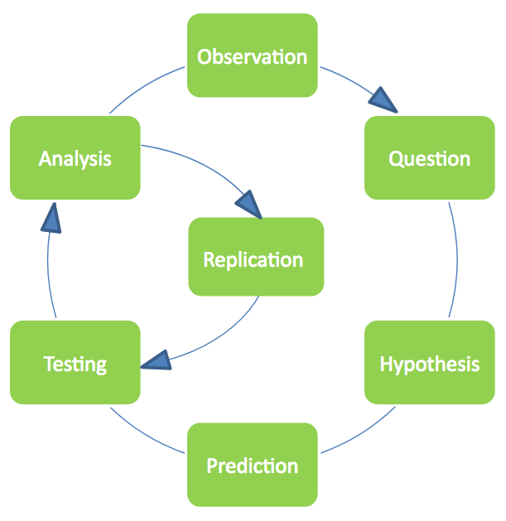
Reproducibility
We all already know…

Slide 4
Reproducibility
We all already know…
Replication and reproduction is at the heart of the scientific method

Slide 5
Reproducibility
We all already know…
Replication and reproduction is at the heart of the scientific method
Findings are only credible if they reproduce – highest standard of evidence

Slide 6
Reproducibility
We all already know…
Replication and reproduction is at the heart of the scientific method
Findings are only credible if they reproduce – highest standard of evidence
Re-use of methods allows extension of knowledge

Slide 7
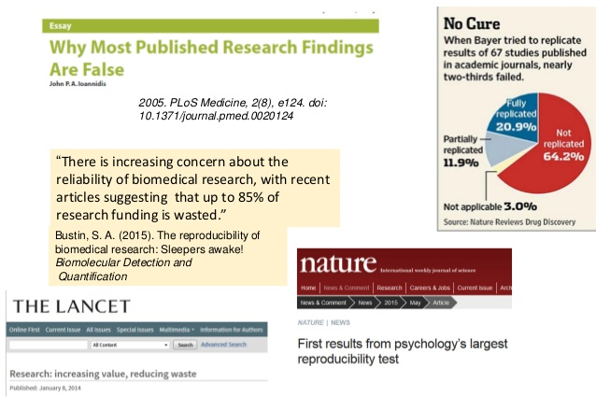
Reproducibility Crisis

Slide 8
Reproducibility Crisis
We’ve discussed the (probable) reasons for this:

Slide 9
Reproducibility Crisis
We’ve discussed the (probable) reasons for this:
Genuine Mistakes
Questionable Research Practices
Wilful Misconduct

Slide 10
Reproducibility Crisis
We’ve discussed the (probable) reasons for this:
Genuine Mistakes
Questionable Research Practices
Wilful Misconduct
?
?
RAW DATA
RESULTS

Slide 11
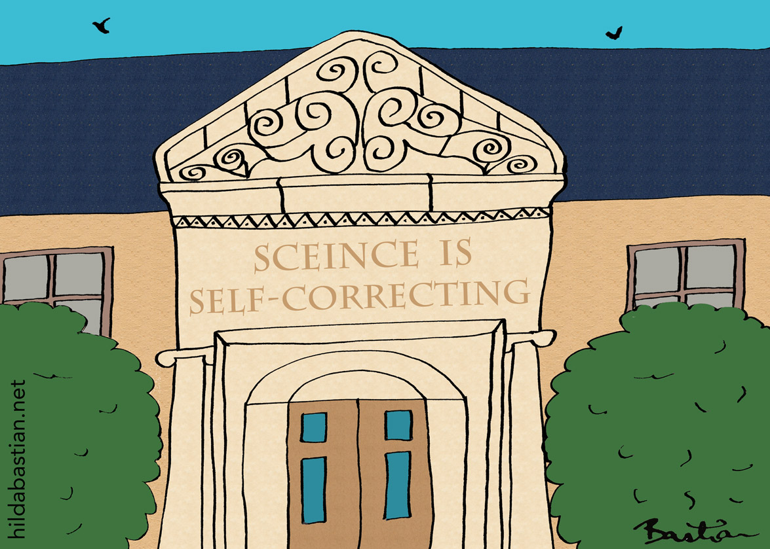

Scientific rigour
So being as open as possible with data is good because it promotes:

Slide 12
Scientific rigour
So being as open as possible with data is good because it promotes:
Analytic reproducibility – whether the analysis ‘works’; checking for errors in the analysis pipeline

Slide 13
Scientific rigour
So being as open as possible with data is good because it promotes:
Analytic reproducibility – whether the analysis ‘works’; checking for errors in the analysis pipeline
Analytic robustness – whether conclusions are still valid under alternative specifications

Slide 14

Why else?
More generally, greater transparency is good for the field:

Slide 15
Why else?
More generally, greater transparency is good for the field:
Allows others to adapt and build on your work

Slide 16
Why else?
More generally, greater transparency is good for the field:
Allows others to adapt and build on your work
…and do it ‘properly’

Slide 17
Why else?
More generally, greater transparency is good for the field:
Allows others to adapt and build on your work
…and do it ‘properly’
Makes scientific discovery more efficient

Slide 18
Why else?
More generally, greater transparency is good for the field:
Allows others to adapt and build on your work
…and do it ‘properly’
Makes scientific discovery more efficient
Promotes (genuine) replication – particularly important in a field where data sharing is challenging

Slide 19
Why else?
More generally, greater transparency is good for the field:
Allows others to adapt and build on your work
…and do it ‘properly’
Makes scientific discovery more efficient
Promotes (genuine) replication – particularly important in a field where data sharing is challenging
Ethically ‘right’ – someone paid for the work

Slide 20
Kudos
People will think you are cool.

Slide 21
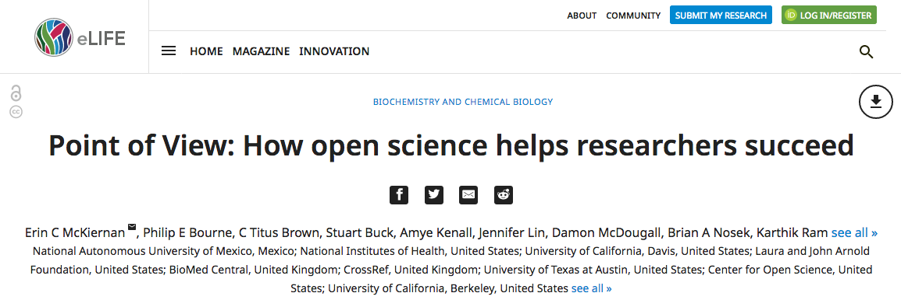
Kudos
People will think you are cool.

Slide 22
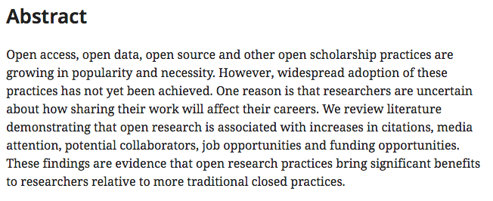
Kudos
People will think you are cool.

Slide 23
Kudos
People will think you are cool.

Slide 24
How to Share Data? - Platforms
in public repositories: osf.io, FigShare, UCL Research Data Repository, Syracuse Qualitative Data Repository (provide link) — some do not accept non- and pseudo-anonymous data
access-controlled: access agreements, manual assessment of requests, providing access to approved individuals (indicate that data is available by request)

Slide 25
How to Share Data? - Data plus Documentation
data must be useable
develop code books, including full items, answer options, codes for missing data
document data transformations
provide instructions for data use, such as, weighting

Slide 26
How to Share Data? -
IRB process
For human participant research:
get explicit consent - not only, but especially, for personal/sensitive data
tell participants who will get access
tell participants for what purposes data will be used (tired options)
make data sharing part of IRB process

Slide 27
How to Share Data? -
Anonymisation
For personal and sensitive human participant research quantitative:
participants must not be identifiable
remove identifiable data
‘abstract’ identifiable data, e.g. age brackets instead of age
replace identifiable data such that data properties remain
qualitative: netanos.io

Slide 28
Will you share your data?

