Slide 1
Open Science talks
UCL DEPARTMENT OF SECURITY AND CRIME SCIENCE
Welcome!

Slide 2
Goal
UCL DEPARTMENT OF SECURITY AND CRIME SCIENCE
To provide a space where people can learn about open science and discuss concrete actions to implement open science practices in their research.

Slide 3
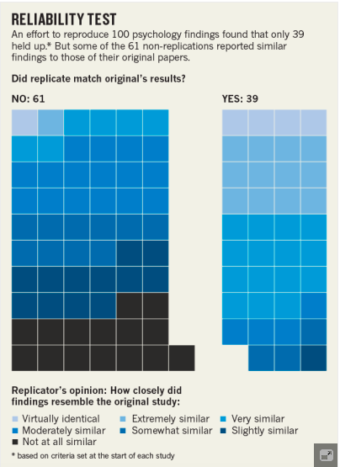
motivation
UCL DEPARTMENT OF SECURITY AND CRIME SCIENCE
Social psychology: a discipline in crisis
Do social psychologists not know how to run studies? Are these just a few individuals making ‘bad’ choices?
Rather, research has become a ‘closed’ enterprise…
…when it should be cumulative, self-corrective, and collaborative.

Slide 4
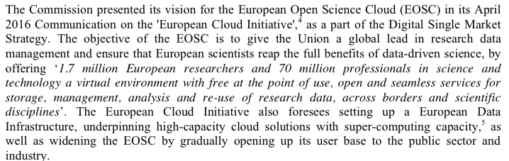

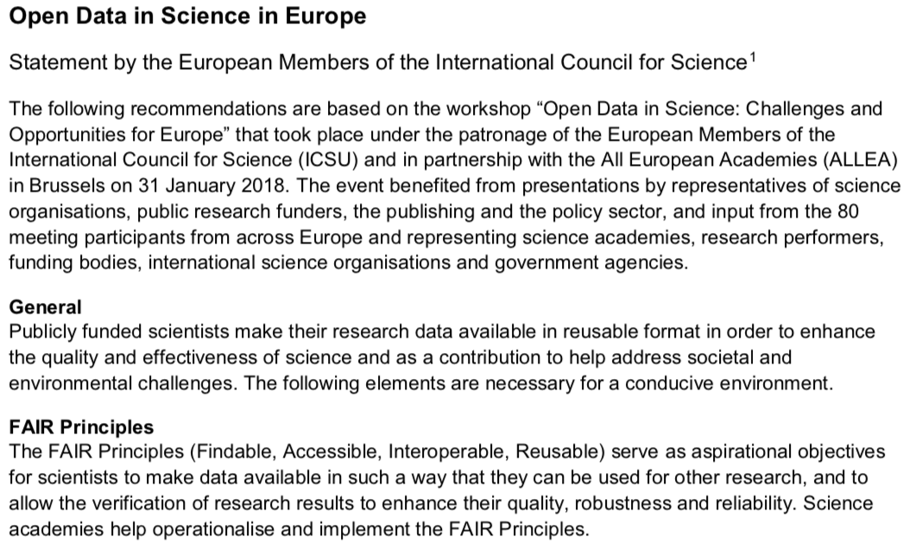
motivation
UCL DEPARTMENT OF SECURITY AND CRIME SCIENCE
The Open Science movements seeks to address these concerns.
And it’s not a niche movement…

Slide 5
But its not all that easy…
UCL DEPARTMENT OF SECURITY AND CRIME SCIENCE
* There is a lot of information online.
We need to adapt general principles to the kind of data/material/analyses used in fields/disciplines like crime science/policing/forensic sciences.

Slide 6
concept
UCL DEPARTMENT OF SECURITY AND CRIME SCIENCE
* Journal club / peer mentoring
* Each week we set a reading that focuses on a specific topic.
* We present the main ideas/tools/techniques and discuss how these could be implemented.
* Important: The goal is to leave with a ‘take home activity’.
Ideally, we also develop broader suggestions.

Slide 7
Topics
UCL DEPARTMENT OF SECURITY AND CRIME SCIENCE
* What is ‘open science’?
* Platforms/Networks/MOOCs/Resources
* Pre-Registration
* Data plans/management
* Open access publishing
* Open peer review
* Data sharing
* Pre-prints
…

Slide 8
practicalities
UCL DEPARTMENT OF SECURITY AND CRIME SCIENCE
* Every 2 weeks in term time
* 1h, lunch time
* For staff, PhD students, and perhaps also MSc students
* A core team plans/moderates sessions

Slide 9
questions
UCL DEPARTMENT OF SECURITY AND CRIME SCIENCE
* What should we do to make this a success?
* What questions/topics should be covered?
* Who should we connect with?
* Who wants to be involved? :-)

Slide 10
first step
UCL DEPARTMENT OF SECURITY AND CRIME SCIENCE
Set up an Open Science Framework account (osf.io) to access all material and start doing open science.
Come here on 19.06., 1pm for the first Open Science Talk.

