Slide 1
Responsible bibliometrics for open science
Andrew Gray UCL Libraries andrew.gray@ucl.ac.uk

Slide 2
A short history of metrics
Uses - and abuses
The development of "responsible metrics"
Responsible metrics at UCL
Implications for Open Science

Slide 3
Bibliometrics?
The study of publications in a quantitative fashion
Generally very focused on journal articles & citation analysis (because those are the things people can measure most easily…)
Increasingly used as an unchallenged marker of "quality" (despite the obvious conceptual problems with this)

Slide 4
History
1960s - Release of the original Science Citation Index; corresponding growth of bibliometric analysis
1970s - Journal Impact Factor proposed, and published through the Journal Citation Reports. First dedicated journal (Scientometrics)
1990s - Growth of the JIF and idea of metrics as "badge of quality"
2000s - Google Scholar & Scopus databases launched; explosion of new bibliometrics (eg the h-index)
2010s - Development of "altmetrics" and "responsible metrics"

Slide 5
Misuse of metrics
Frequent assumptions that…
...articles can be described by journal metrics
...researchers can be described by article (journal) metrics
...metrics are neutral, reliable, and uncontroversial
...metrics are easily defined algorithms with single values
...that there is a single value, to three decimal places, ...which Means Something Important

Slide 6
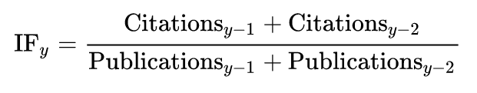
Offender #1: the impact factor
For a long time, the only easily available metric
Describes journals, not individual papers
Effectively impossible to compare across fields
Often treated as single "magic number"
Widely misunderstood, widely misused

Slide 7
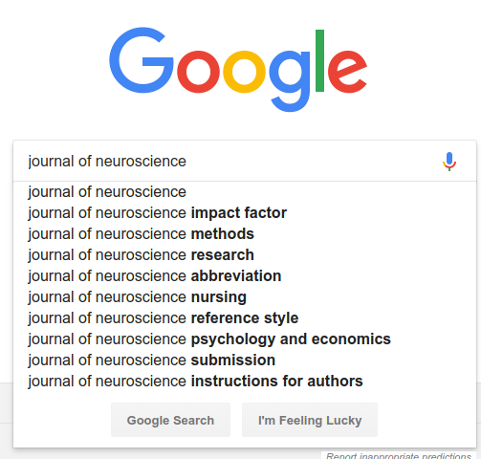
Clearly, this is the most important thing to know about any journal...

Slide 8
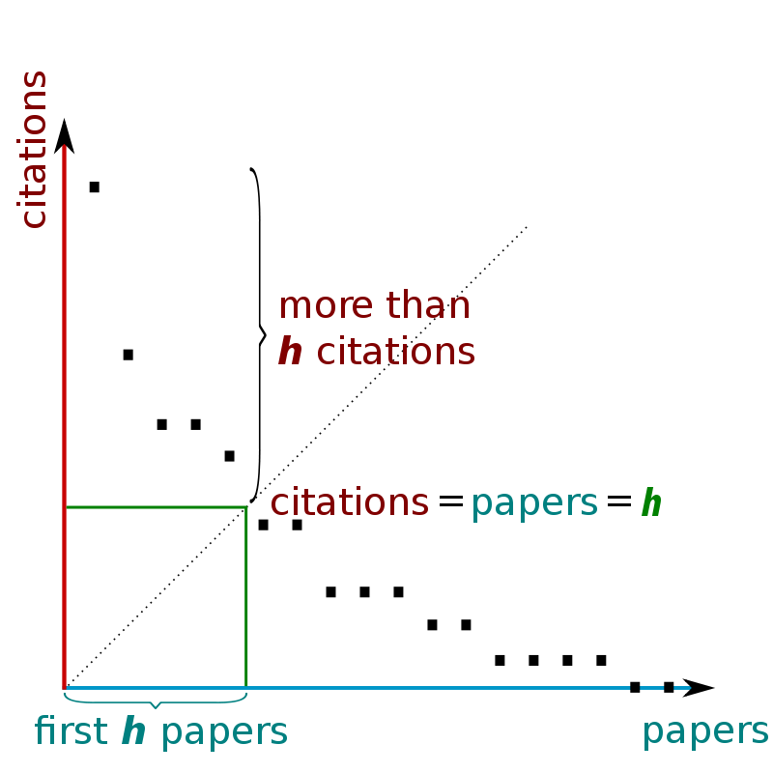
Offender #2: the h-index
Describes authors (not papers)
Directly relates to age/career status
Highly dependent on field
Continues to increase indefinitely (even after death/retirement)
Often treated as single "magic number"

Slide 9
Offender #3: assumption of universality
Bibliometrics ultimately measures publications, but every field has distinctive publication practices (often unknown to outsiders) which makes them difficult to compare
Hidden assumptions about data sources & cut-offs can dramatically alter results
Different services draw on different data for different conclusions
Metrics presented as single "magic numbers" conceal all of this

Slide 10
So why count citations at all?
"Quality" is contested and shifting, but citations can tell us something
such as "interest" or "attention" of the scholarly community
- of course, that attention can be strongly negative!
General overall correlations between citations and other indicators
such as peer review, post-facto identification of significance, etc
More practical to deploy citation-counting at scale than anything else

Slide 11
Development of "responsible metrics"
2013 - San Francisco Declaration on Research Assessment First major statement; challenged misuse of the Journal Impact Factor
2015.4 - Leiden Manifesto for Research Metrics Ten principles for research measurement & evaluation, set out by experts in the field
2015.7 - The Metric Tide report (HEFCE) HEFCE-driven review of the role of metrics in research assessment; coined (and called for) "responsible metrics"

Slide 12
Declaration on Research Assessment
1. Do not use journal-based metrics, such as Journal Impact Factors, as a surrogate measure of the quality of individual research articles, to assess an individual scientist’s contributions, or in hiring, promotion, or funding decisions.
https://sfdora.org/
First major move to challenge inappropriate use of metrics
Rapidly taken up - widespread interest and support
Recommendations for funders, publishers, institutions, researchers

Slide 13
Leiden Manifesto
Data are increasingly used to govern science. Research evaluations that were once bespoke and performed by peers are now routine and reliant on metrics. The problem is that evaluation is now led by the data rather than by judgement.
http://www.leidenmanifesto.org/
Ten principles for responsible use
Broader than DORA - not as heavily focused on "journal metrics"
Presented as "distillation of best practice" - methods already known and used by bibliometric researchers

Slide 14
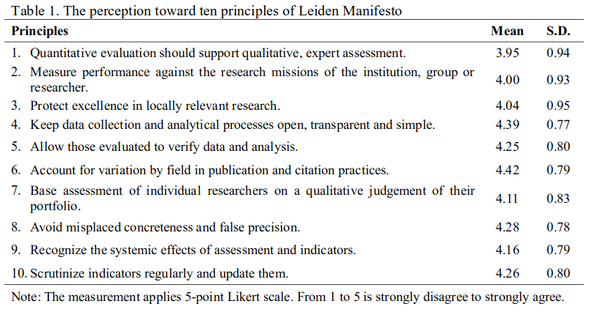
https://arxiv.org/abs/1809.02953

Slide 15
The Metric Tide
Yet we only have to look around us, at the blunt use of metrics such as journal impact factors, h-indices and grant income targets to be reminded of the pitfalls. Some of the most precious qualities of academic culture resist simple quantification.
https://responsiblemetrics.org/the-metric-tide/
UK-focused (and with an eye to the 2021 REF)
Coined "responsible metrics" - crystallised a growing trend
20 specific recommendations for all parties, some broad, some technical

Slide 16
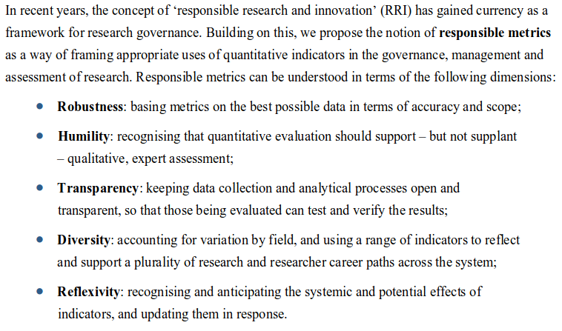

Slide 17
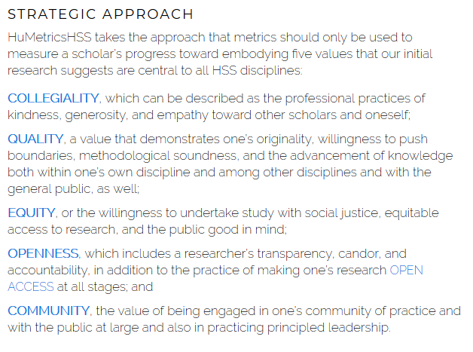

Other approaches - "humane metrics"
https://humetricshss.org/about/

Slide 18
Responsible metrics at UCL
2013 - Working group on metrics formed
2015 - Signed the Declaration on Research Assessment
2017 - Principles of DORA brought into Academic Careers Framework
2018 - Released draft principles for responsible use of metrics
2019 - Ongoing consultations, discussions, revisions
2019/20 ...a formal Policy?

Slide 19
UCL principles for the responsible use of metrics
Quality cannot be directly measured, and metrics are proxies
Value all research outputs, not just traditional publications, in the context of their fields
Quantitative approaches must support and be secondary to qualitative ones
Not all indicators mean something, and they can be useful but not universal
Avoid applying metrics to individual researchers, especially without accounting for circumstances
Metrics should be applied at an appropriate scale (article, person, etc)
Performance should be compared to departmental contexts & goals
Processes and benchmarks should be scrutinised, and metrics should be well-understood
Goals & benchmarks should not become targets in their own right
New metrics should be treated cautiously
IRIS/RPS data should be used where possible, as it is subject-controlled

Slide 20
Framework for responsible metrics work
Policy has broad principles - avoid being overly prescriptive
Not requiring or encouraging the use of metrics - this decision should be made locally, in the context of a faculty/group
Setting out hard limits on where metrics are always inappropriate
Guidance and support for when metrics are used expected to evolve & develop as we gain experience reflective of best practice in broader community

Slide 21
The implications for Open Science
Adoption of Open Science involves challenging existing traditional structures and frameworks surrounding research
But!
Most metrics-driven approaches rely on these structures to confer value
eg/ the Impact Factor assumes publication in a narrow set of journals
Incentive & assessment systems built around metrics can thus penalise open approaches or discourage experimentation
Over-emphasis on metrics can even incentivise clearly problematic behaviour

Slide 22
And in conclusion (finally)
A messy and skewed system
Lots of inappropriate use out there
"Responsible metrics" offers a way forward
UCL working to support this approach
Supports the growth of Open Science

