Slide 1

Crime Science Open Science Seminar Series:
Open Access Publishing
Catherine Sharp, Patrycja Barczynska
Open Access Team
open-access@ucl.ac.uk

Slide 2
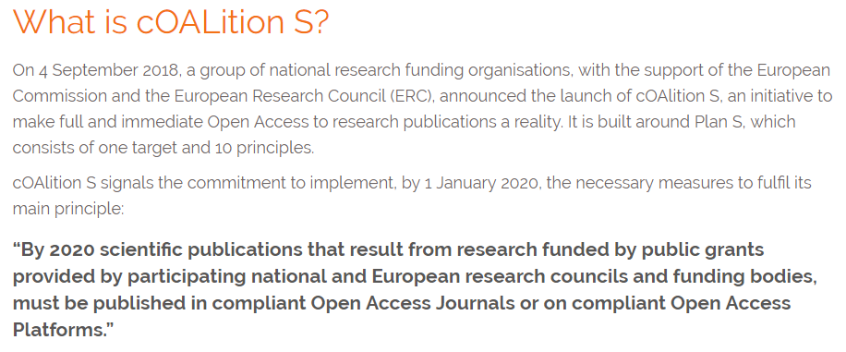
Plan S

Slide 3




Slide 4
Plan S
“After 1 January 2020 scientific publications on the results from research funded by public grants provided by national and European research councils and funding bodies, must be published in compliant Open Access Journals or on compliant Open Access Platforms.”
UKRI, Wellcome Trust, EC (including ERC)
Cannot comply through hybrid open access (paying for open access in subscription journals). This could mean that authors cannot publish in journals like Science & Justice, Forensic Science International, Policing, Terrorism and Political Violence, Security Journal
Open access in repositories with 0 embargo and CC BY may be allowed (Sage? Emerald?)
Subscription journals permitted where UCL has a transformative agreement (eg. Springer)

Slide 5
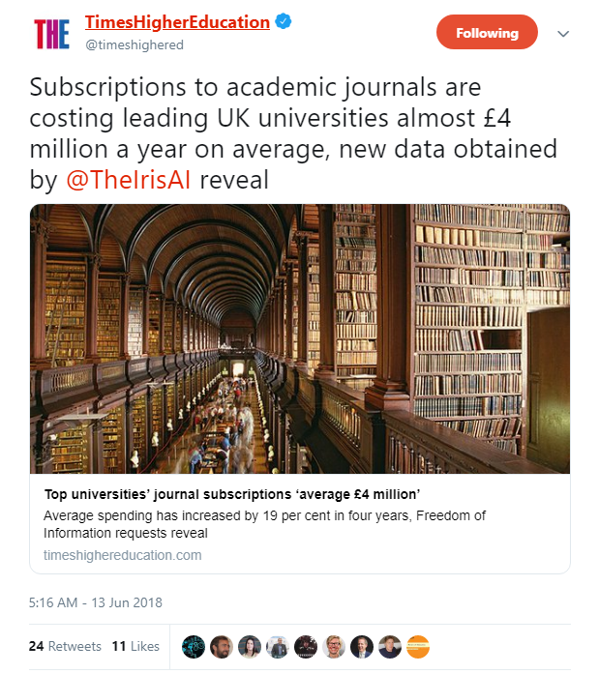

Slide 6
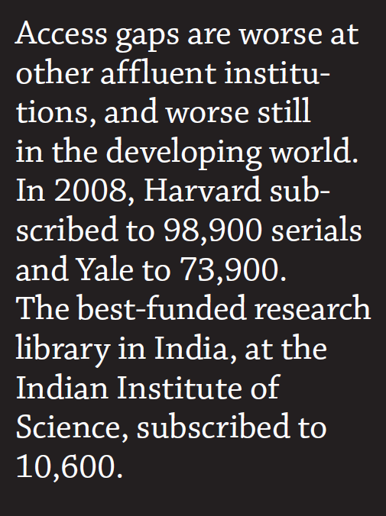
Suber, P., Open Access https://mitpress.mit.edu/books/open-access Cambridge, MA: MIT Press

Slide 7
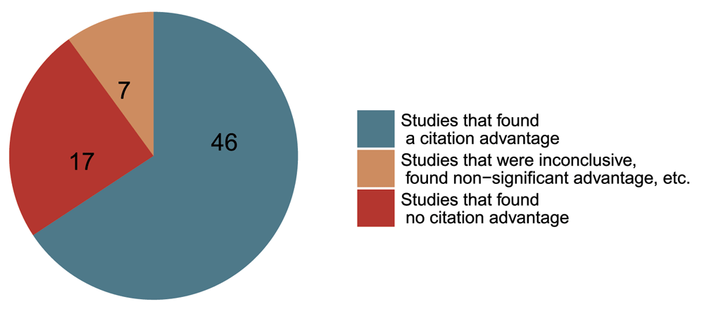
Academic impact (and academic access)
Studies that investigated the open access citation advantage grouped by their conclusion
Tennant JP, Waldner F, Jacques DC et al. The academic, economic and societal impacts of Open Access: an evidence-based review [version 3]. F1000Research 2016, 5:632 (doi: 10.12688/f1000research.8460.3)

Slide 8
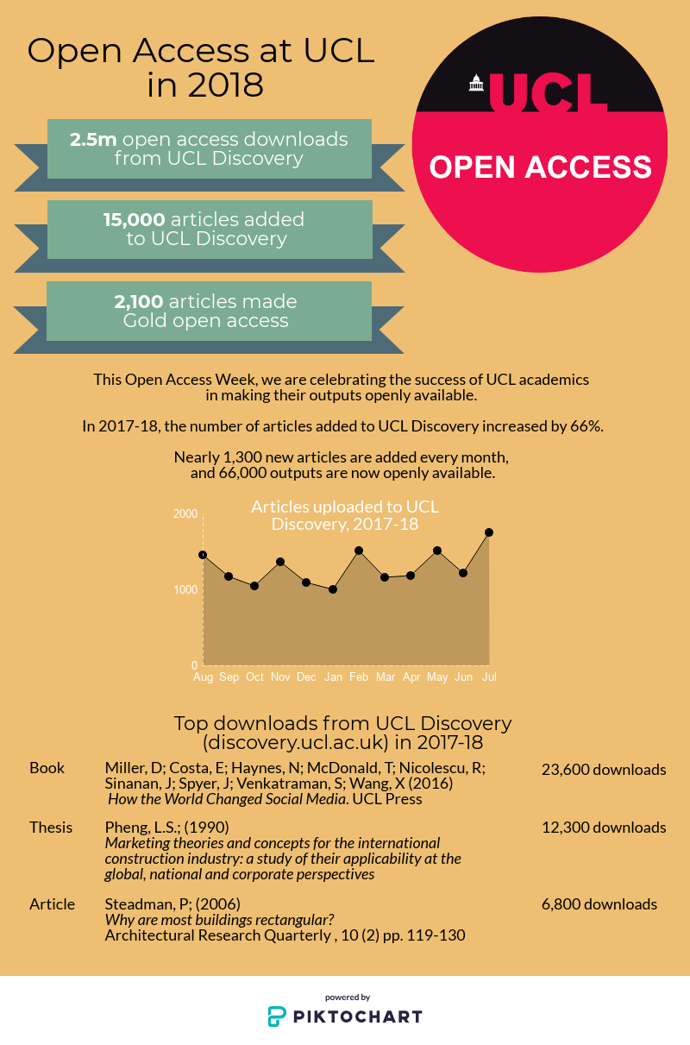

Slide 9
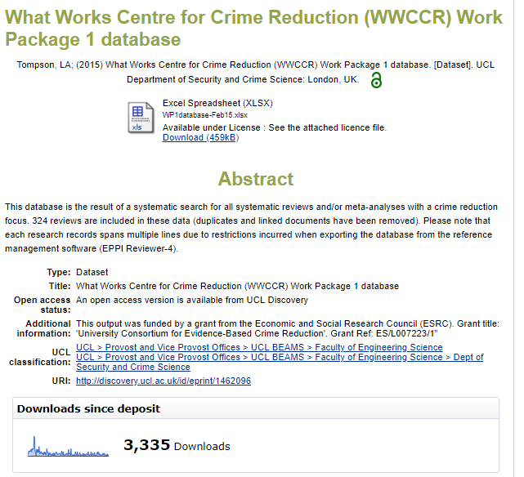
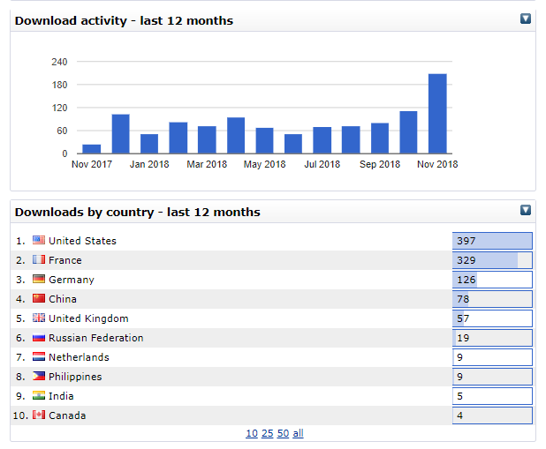

Slide 10
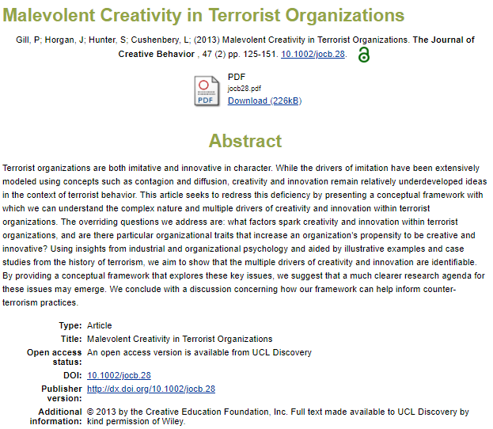
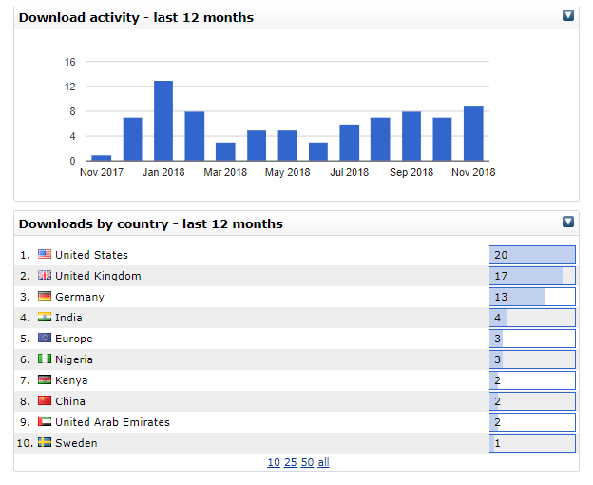


Slide 11
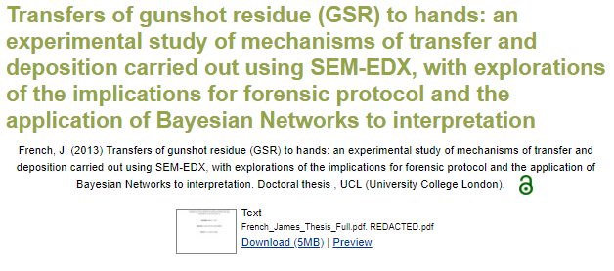
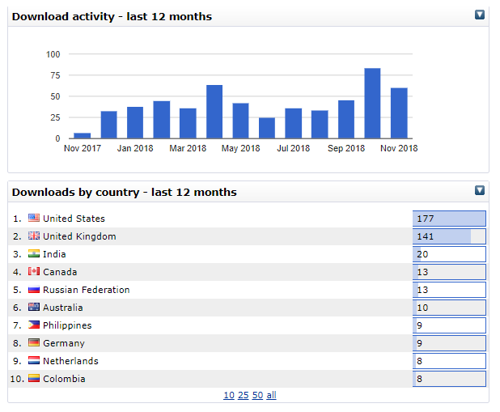


Slide 12
Types of open access
Gold open access
  Published version made openly available immediately with a Creative Commons licence
Green open access
  Final accepted version made openly available in an open access repository after an embargo period

Slide 13
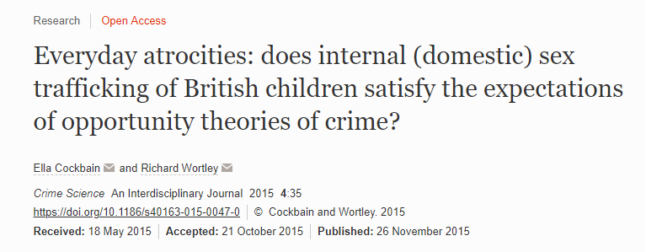
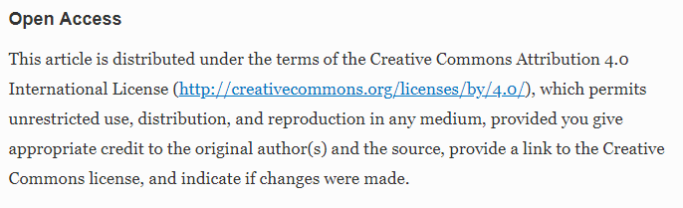
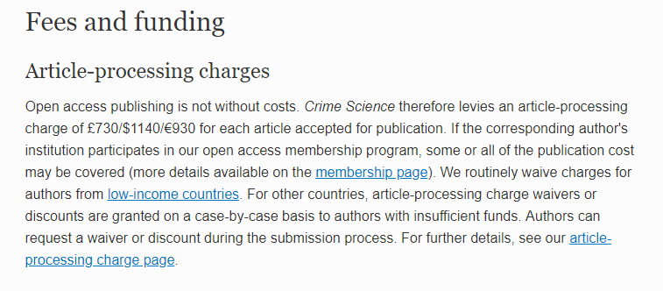

Slide 14

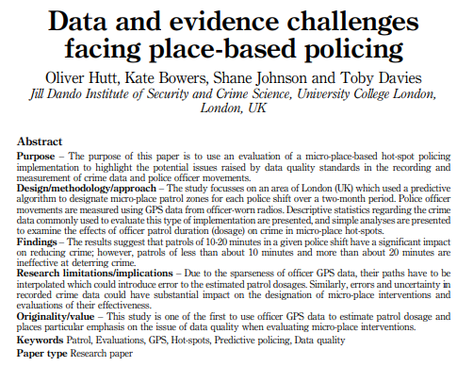
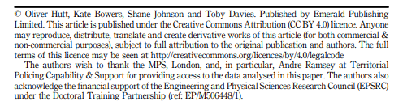

Slide 15
Funders
AHRC, BBSRC, EPSRC, ESRC, MRC, NERC, STFC
  Green with 6 month (MRC), 24 month (AHRC, ESRC) or 12 month embargo (other Research Councils) currently complies
Wellcome Trust
  Green with 6 month embargo on deposit in PMC currently complies

Slide 16
UCL open access funding
Funds are currently available for papers in fully open access journals and subscription journals funded by the COAF funders:
Arthritis Research UK, Bloodwise, British Heart Foundation, Cancer Research UK, Parkinson's UK, Wellcome Trust
From 1/12/18 until at least 31/3/18, UKRI open access funds for papers in subscription journals are no longer available, except for:
some MRC-funded papers
publishers with a transformative offsetting deal (eg. Springer)
UCL’s open access budget can fund papers in fully open access journals only until 31/12/18

Slide 17
Plan S
“After 1 January 2020 scientific publications on the results from research funded by public grants provided by national and European research councils and funding bodies, must be published in compliant Open Access Journals or on compliant Open Access Platforms.”
UKRI, Wellcome Trust, EC (including ERC)
Cannot comply through hybrid open access (paying for open access in subscription journals). This could mean that authors cannot publish in journals like Science & Justice, Forensic Science International, Policing, Terrorism and Political Violence, Security Journal
Open access in repositories with 0 embargo and CC BY may be allowed (Sage? Emerald?)
Subscription journals permitted where UCL has a transformative agreement (eg. Springer)

Slide 18
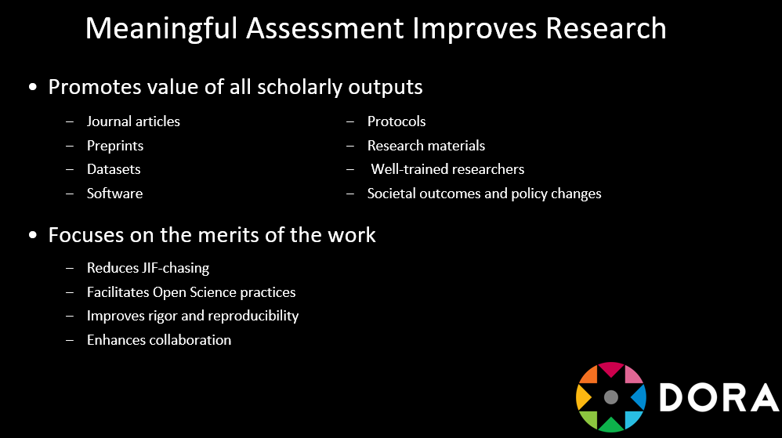
San Francisco Declaration on Research Assessment

Slide 19


UCL open access
www.ucl.ac.uk/library/open-access
open-access@ucl.ac.uk
@UCLopenaccess
This work is licensed under a Creative Commons Attribution 4.0 International License: http://creativecommons.org/licenses/by/4.0/

