Slide 1

Writing Reproducible Methods
Nadine Salman

Slide 2


You may have heard of a crisis…
…and it’s not just in psychology!

Slide 3
But what do we mean by reproducibility?
Repeat my study i.e. obtain the same tables/graphs/results using the same setup (data, software, …) in the same lab or on the same computer.
Reproduce a study (not mine) i.e. obtain the same tables/graphs/results in a different lab or on a different computer, using the same setup.
Replicate a study, i.e. obtain the same (similar enough) tables/graphs/results in a different set up.
Finally, re-use the information/knowledge from one study to run a different study with the aim to confirm results from scratch.
Gatto (2019)

Slide 4
Why is reproducibility important?
It’s just good science!
Public trust

Slide 5
Five selfish reasons to work reproducibly
Reproducibility helps to avoid disaster
Reproducibility makes it easier to write papers
Reproducibility helps reviewers see it your way
Reproducibility enables continuity of your work
Reproducibility helps to build your reputation
(Markowetz, 2015)

Slide 6
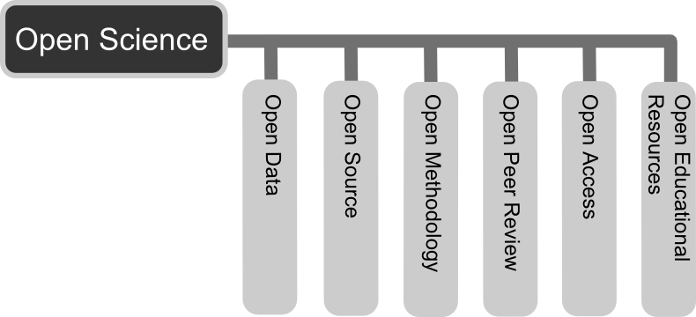
Six principles of Open Science
https://en.wikipedia.org/wiki/Open_science

Slide 7
Reproducible methods
“The provision of enough detail about study procedures and data so the same procedures could, in theory or in actuality, be exactly repeated.”
(Goodman et al., 2016)

Slide 8
A case study: social priming
Original experiment: participants who unscrambled words relating to old age walked out of the lab more slowly (Bargh et al.,1996)
Doyen et al. (2012): only replicated when researchers expected participants to walk slower and used a manual stopwatch
Small details make a big difference!

Slide 9
Doesn’t everyone already do this?
Franco et al. (2016): underreporting in pre-registered psychology experiments
40% did not report all experimental conditions and 70% did not report all outcome variables measured in final report
Kilkenny et al. (2009): systematic review of research using animals for biomedical research
4% did not report the number of animals used!

Slide 10
Could you reproduce this?
“This study aims at gaining insight into the relationship between ENSM [exposure to extremist content through new social media] and self-reported political violence among Belgian adolescents. Data were collected through a classic paper-and-pencil survey of pupils in the third cycle (ages 16–18) of secondary education in Antwerp and Liège.
The paper-and-pencil survey was restricted to the cities of Liège and Antwerp for practical reasons: Liège and Antwerp are, except for Brussels, the two largest cities of Belgium (+100,000 inhabitants). All schools in the third cycle of the secondary education in Antwerp and Liège were contacted and invited to participate in the study. A total of 34 schools in Antwerp and 32 schools in Liège were contacted.”
…continues to details about scales used.
Lieven & Schils (2016)

Slide 11
Could you reproduce this?
“This study aims at gaining insight into the relationship between ENSM [exposure to extremist content through new social media] and self-reported political violence among Belgian adolescents. Data were collected through a classic paper-and-pencil survey of pupils in the third cycle (ages 16–18) of secondary education in Antwerp and Liège.
The paper-and-pencil survey was restricted to the cities of Liège and Antwerp for practical reasons: Liège and Antwerp are, except for Brussels, the two largest cities of Belgium (+100,000 inhabitants). All schools in the third cycle of the secondary education in Antwerp and Liège were contacted and invited to participate in the study. A total of 34 schools in Antwerp and 32 schools in Liège were contacted.”
…continues to details about scales used.
Lieven & Schils (2016)

Slide 12
Writing reproducible methods
Transparency and Openness Promotion guidelines (Nosek et al., 2015):
Include all variables, treatment conditions, and observations described in the manuscript
Provide a full account of the procedures used to collect, preprocess, clean, or generate the data
Provide program code, scripts, codebooks, and other documentation sufficient to precisely reproduce all published results
Provide research materials and description of procedures necessary to conduct an independent replication of the research
https://cos.io/top/

Slide 13
Some tips…
Pre-registration
Save and organise all materials, code, etc. as you go along
Phone a friend

Slide 14
Some concerns…
I don’t have time for this/it’s too much effort!
It could cost you more if you don’t
I don’t want people copying my work!
That’s the whole point
Extra citations for you
Good for your reputation
My paper is already too long!
Supplementary material
Benefits of pre-registration

Slide 15
References
Bargh, J. A., Chen, M., & Burrows, L. (1996). Automaticity of social behavior: Direct effects of trait construct and stereotype activation on action. Journal of Personality and Social Psychology, 71(2), 230–244. https://doi.org/10.1037/0022-3514.71.2.230
Doyen S, Klein O, Pichon CL, Cleeremans A (2012) Behavioral Priming: It's All in the Mind, but Whose Mind?. PLOS ONE 7(1): e29081. https://doi.org/10.1371/journal.pone.0029081
Franco, A., Malhotra, N., & Simonovits, G. (2016). Underreporting in Psychology Experiments: Evidence From a Study Registry. Social Psychological and Personality Science, 7(1), 8–12. https://doi.org/10.1177/1948550615598377
Gatto, L. (2019, May 15). Becoming a better scientist with open and reproducible research. Retrieved from https://lgatto.github.io/rr-publ/
Goodman, S. N., Fanelli, D., & Ioannidis, J. P. (2016). What does research reproducibility mean?. Science translational medicine, 8(341).
Kilkenny C, Parsons N, Kadyszewski E, Festing MFW, Cuthill IC, et al. (2009) Survey of the Quality of Experimental Design, Statistical Analysis and Reporting of Research Using Animals. PLOS ONE 4(11): e7824. https://doi.org/10.1371/journal.pone.0007824
Lieven, P. and Schils, N. (2016). Differential Online Exposure to Extremist Content and Political Violence: Testing the Relative Strength of Social Learning and Competing Perspectives, Terrorism and Political Violence, 28:1, 1-29, DOI: 10.1080/09546553.2013.876414
Markowetz, F. Five selfish reasons to work reproducibly. Genome Biol 16, 274 (2015) doi:10.1186/s13059-015-0850-7
Nosek, B. A., Alter, G., Banks, G. C., Borsboom, D., Bowman, S. D., Breckler, S. J., ... & Contestabile, M. (2015). Promoting an open research culture. Science, 348(6242), 1422-1425. Full guidelines: https://cos.io/top/

Slide 16
Some Examples of reproducible and open methods
Barberá, P., Jost, J. T., Nagler, J., Tucker, J. A., & Bonneau, R. (2015). Tweeting From Left to Right: Is Online Political Communication More Than an Echo Chamber? Psychological Science, 26(10), 1531–1542. https://doi.org/10.1177/0956797615594620
Christensen, G. (2017). Occupational Fatalities and the Labor Supply: Evidence from the Wars in Iraq and Afghanistan. Journal of Economic Behavior & Organization, 139, 182-195. https://doi.org/10.1016/j.jebo.2017.04.020
Wingen, T., Berkessel, J. B., & Englich, B. (2019). No Replication, No Trust? How Low Replicability Influences Trust in Psychology. Social Psychological and Personality Science. https://doi.org/10.1177/1948550619877412

