Slide 1
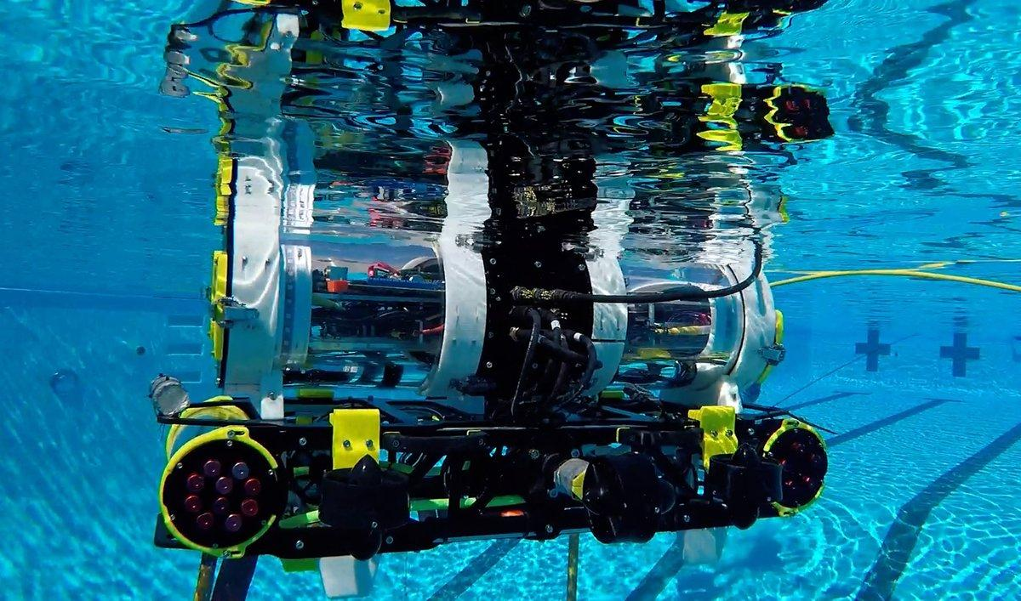
CSULA RoboSub

Slide 2
Who are we?
We are a team aiming to create an autonomous submarine to compete at the yearly international RoboSub competition in San Diego
Members of all different majors - just need a passion for engineering

Slide 3
Information
General Meetings (in E&T C-153F):
Wednesdays 3:30pm-4:30pm
Saturdays 2:00pm-3:00pm
Contact us:
Email: auvcalstatela@gmail.com
Facebook: AUV CalStateLA
Instagram: @auvcalstatela
Twitter: @AUVCalStateLA

