Slide 1
What does it take to create with domain-appropriate tools?
Joel Jakubovic
PhD year 1
University of Kent
Supervisor: Tomas Petricek

Slide 2
Talk structure
Motivations and themes
System demos
Technical challenges

Slide 3
“Use The Right Tool For The Job”
Right Tool For The Job
One Size Fits All
(Same tool regardless of domain)

Slide 4
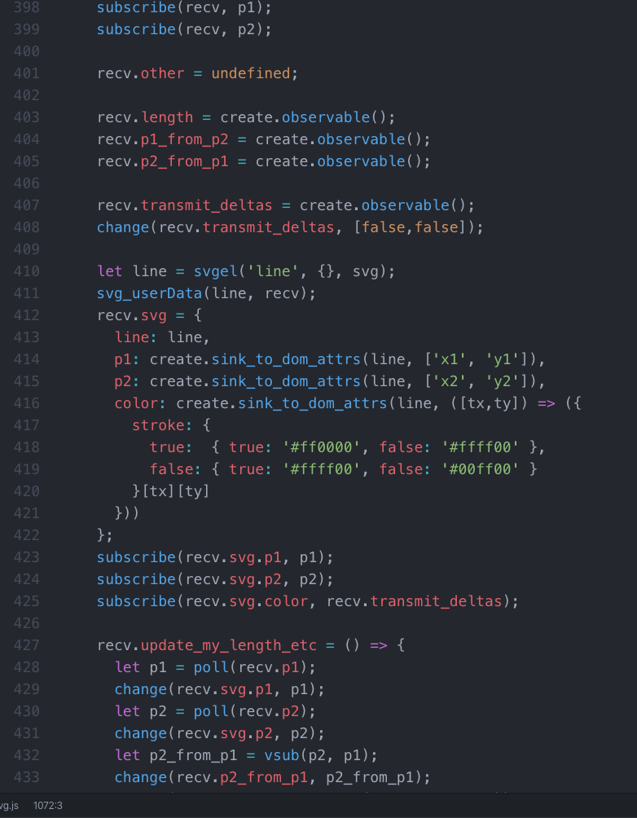
Textual source code
Not saying text is universally inappropriate
But it’s not universally appropriate either…

Slide 5

One Size Fits All
circ 100 100 50
circ 85 85 8
circ 115 85 8
bezier 85 115 100 130 115 115

Slide 6
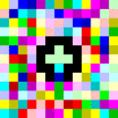
Development as “use”
End-user programming: make programming more like using (GUI)
Changing Excel via Excel-as-a-spreadsheet?
Benefit: programming doesn’t require “code” skills, only existing “use” skills
but … MS Paint in MS Paint? Must users now be trained in esoteric languages like Piet??
^ “Hello World” in Piet

Slide 7
Development as “use”
Already exists in some forms:
Text editors are software => written in text editors.
You program your “whole” computer solely via the computer.
“Self-describing” programming languages (LISP, Smalltalk) - see next slide…

Slide 8
“Open, Reusable Object Models”
Ian Piumarta, Alessandro Warth, Viewpoints Research Institute 2006
The “Id” object system:
1) Meta-circular: change system from within, instead of going to its source code
(evolving Id is just another use of Id)
2) Small; minimal necessary structure
(Smalltalk is big and complicated, Id gets at the “essence”)

Slide 9
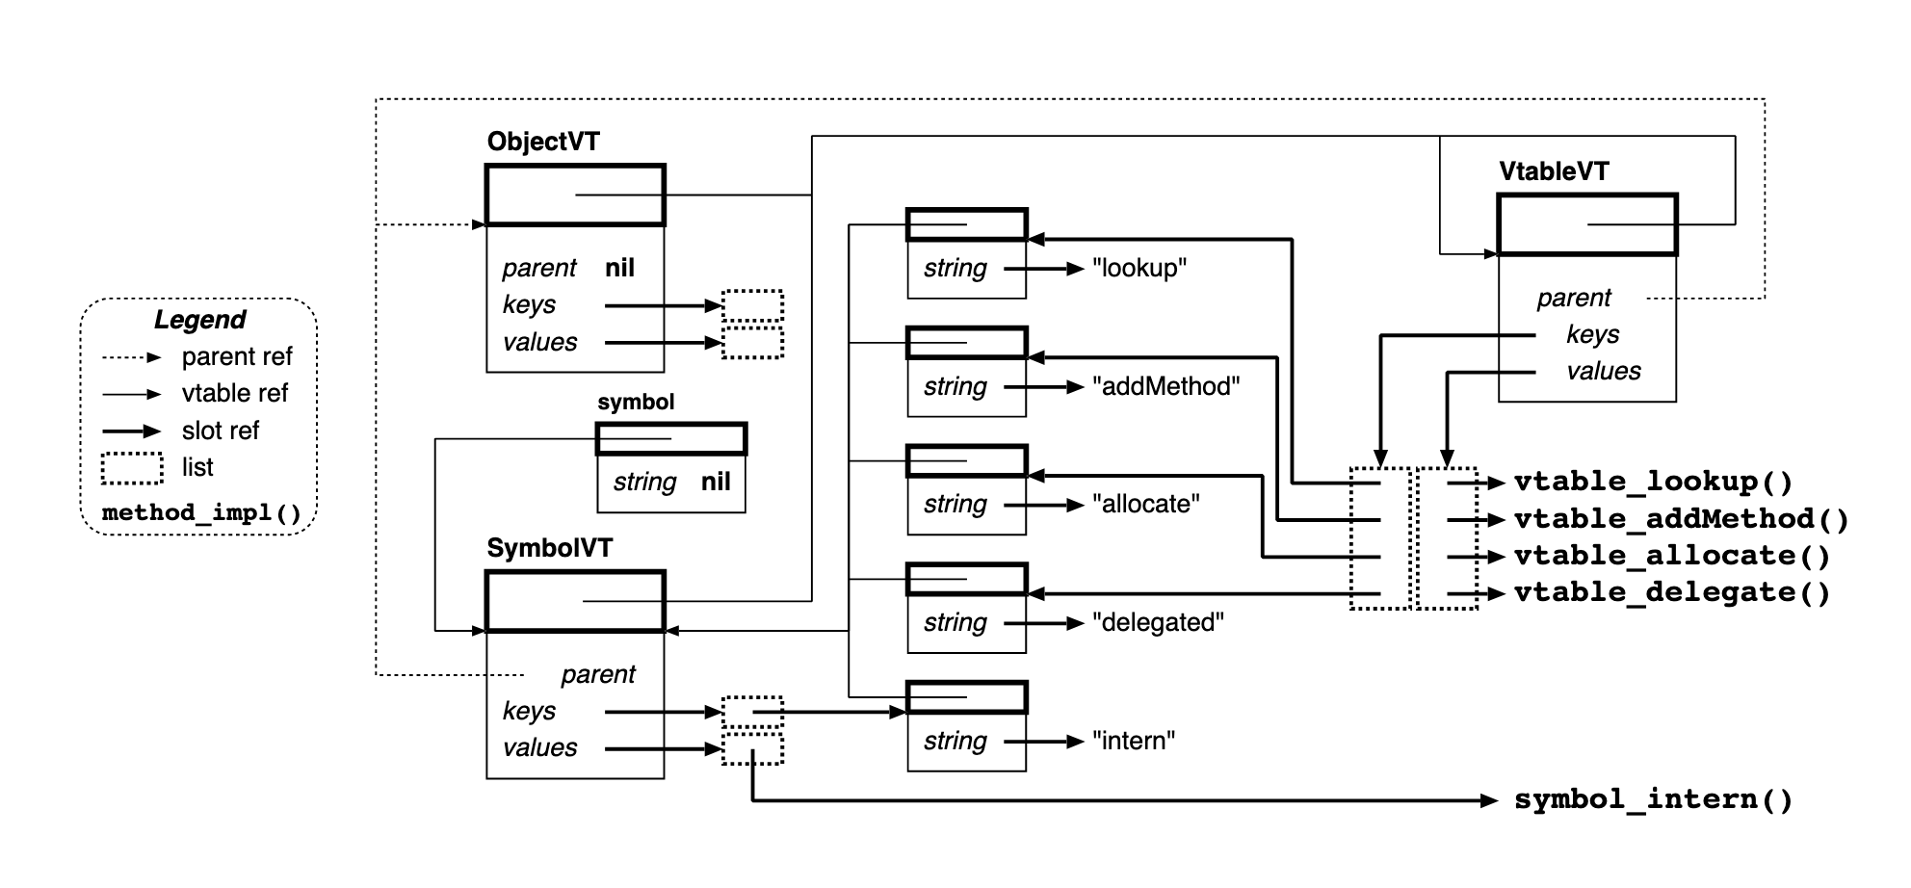
C implementation…
Not even a command-line UI included, yet…
^ like this, but “live”

Slide 10
Do I even want a CLI?
> …
> get my-object.property1
23
> call my-object.method1
> get my-object.property1 again…
24

Slide 11
Like this, but “live”
Demo time!

Slide 12
Summary so far
I found an interesting paper
I wanted to explore with the system it describes (1)
The paper decided on a representation (box diagrams) that I agreed was appropriate
I built a running version of that representation to achieve goal (1)

Slide 13
What did it take to do this?
Predictably: too much work!
A lot of boilerplate
SVG, JavaScript
Movable nested boxes

Slide 14
Classic Polyfilling
Javascript used to lack a list “map” function.
But it just lets you fill in this gap by directly augmenting a “built-in” class.
Array.map = (f, xs) => {
let ys = [];
xs.forEach(x => ys.push(f(x)));
return ys;
}

Slide 15
UI “Physics”
e.g.
Translationally rigid bodies
Resizable boxes
“Solid objects don’t intersect”
l
o
H
e
l
l
o
l
e
H

Slide 16
UI “Physics”
“Realistic” physics engines would be over-engineered for this subset.
No:
Mass
Rotation
Fluid flow…
etc…

Slide 17
“Dumb” state
object.property := new value
Box
!!
\( ಠ 皿 ಠ )/

Slide 18
“live state” polyfill
Observable / “live state”
[200, 300]
<rect x=“200” y=“300” width=“400” height=“300”></rect>
External change
… other Observables that change in response

Slide 19
Design Pattern vs language feature
(Functional) Reactive Programming?
“Observer pattern”
Dumb state by default
Live state implemented manually, used verbosely
Default expectation of change over time which is interconnected
“Strategy pattern”
first-class function
class Add5Strategy {
public static int run(int x) {
return x+5;
}
}
…
funcToUse = new Add5Strategy();
funcToUse = (x) => x+5;

Slide 20
Cycles in graphs…
Functional reactive Programming?
Distributed algorithms?
Internet routing?

Slide 21
Ontologies of a simple rectangle
top-left [x,y]
width
top-right [x,y]
top-right [x,y]
half-height
half-width
centre [x,y]
height
bottom-left [x,y]
bottom-left [x,y]
bottom-right [x,y]
Lots of them…

Slide 22

SVG’s view
A rectangle is defined as:
<rect x=“5” y=“5” width=“10” height=“8”>
So whatever you’re thinking, you must boil it down to these four parameters.
One Size Fits All approach

Slide 23
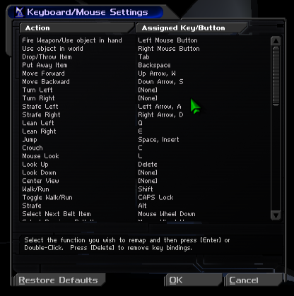
Key binding in PC games
Relies on the basic interchangeability of keyboard keys and mouse buttons

Slide 24
Web event listeners
“Cartesian Product” style
Button State | Mouse buttons | Keyboard keys
DOWN | onmousedown(button) | onkeydown(key)
UP | onmouseup(button) | onkeyup(key)
3D space, with many possible slices:
Device (mouse, keyboard)
Button (LMB, RMB, keyboard keys)
State (pressed or not)

Slide 25
Web event listeners
Web model | My polyfill
onmouseup | LMB_is_down (current value=false)
onmousedown | LMB_is_down (current value=true)
onmousemove | pointer.position (current value=[123,456])
“Follow the mouse pointer until further notice”:
subscribe(object.position, pointer.position)

Slide 26
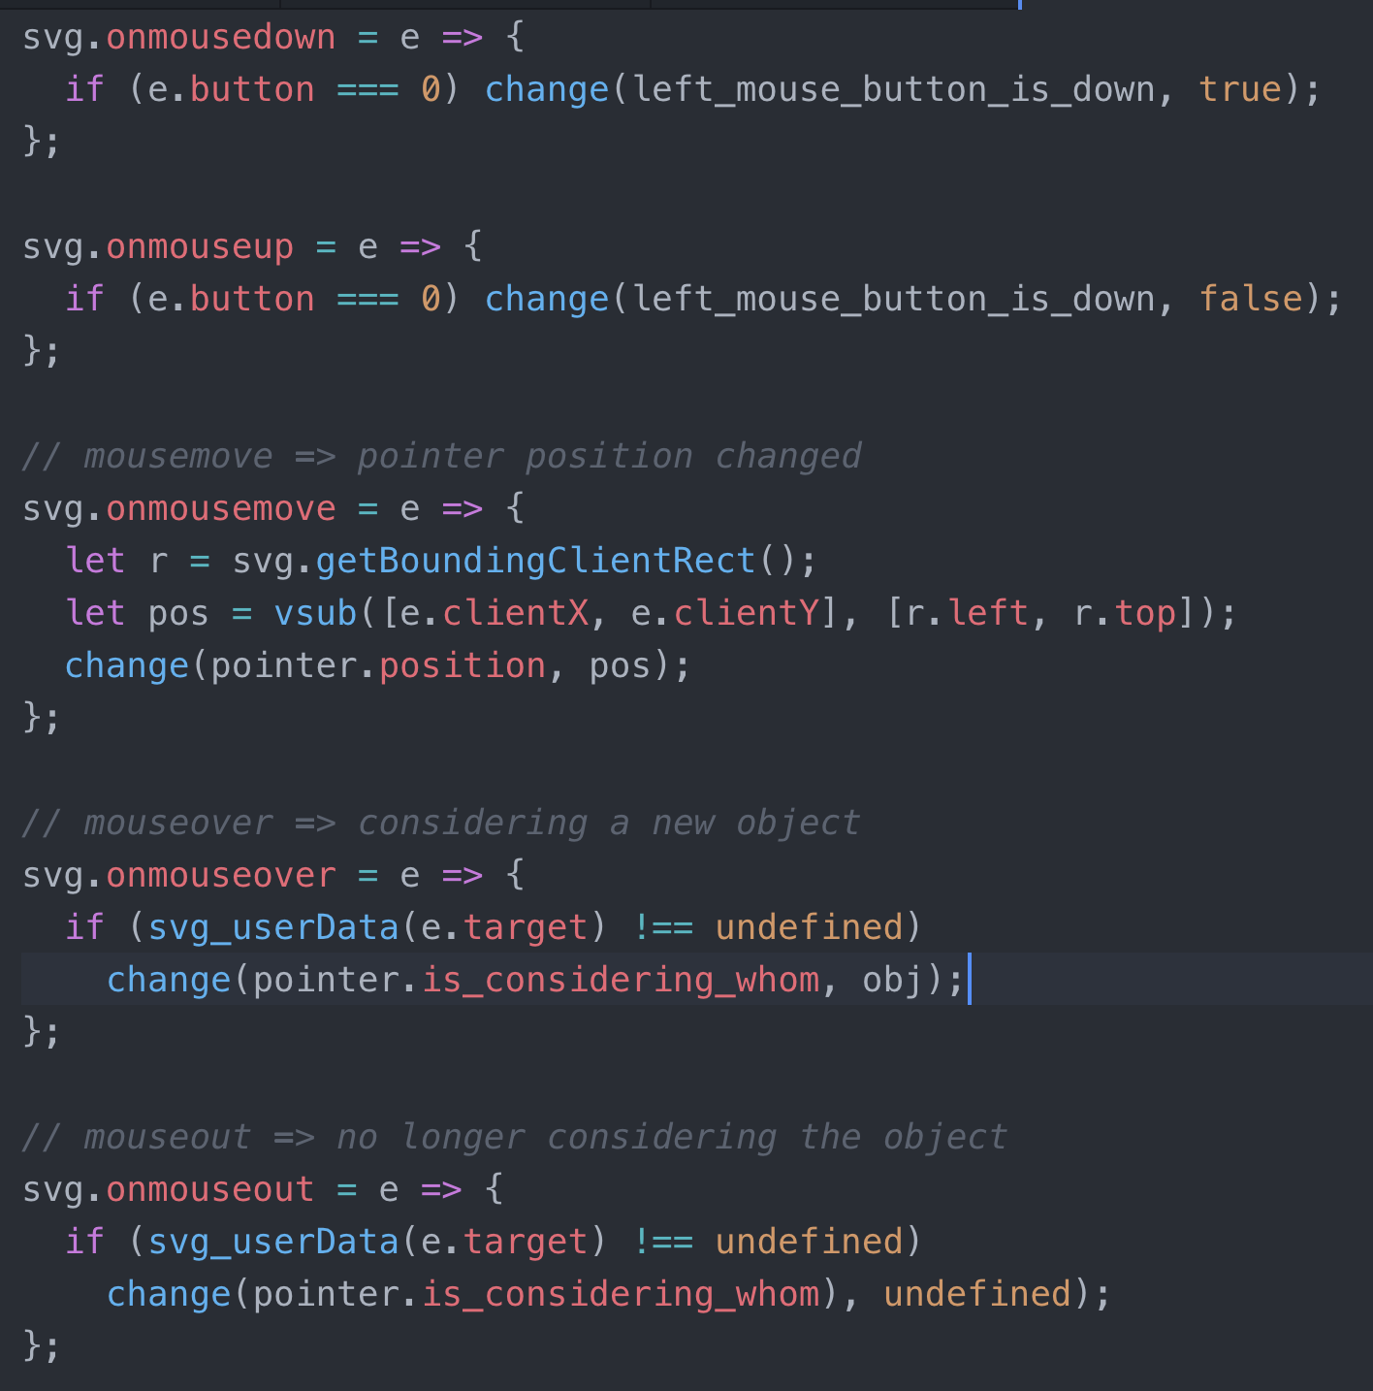
“Device Drivers”
Replaced Web’s ontology with mine
Good for me…
Not so good for someone else!
Literature:
context/subject/aspect/semiotic oriented programming
Stephen Kell on integration domains, pluralism and languages as views onto the same thing

Slide 27
Ontology co-existence
Permit multiple incompatible views of the same thing
Subject-oriented programming?
Context-oriented programming?
Aspect-oriented programming?
Semiotic programming?
Stephen Kell’s 2014 Strange Loop talk "Liberating the Smalltalk lurking in C and Unix”:
Despite plurality of PL’s, interop between languages is very costly
Currently, each language ecosystem defines its own private universe
Why can’t languages just be interchangeable views onto the same program?

Slide 28
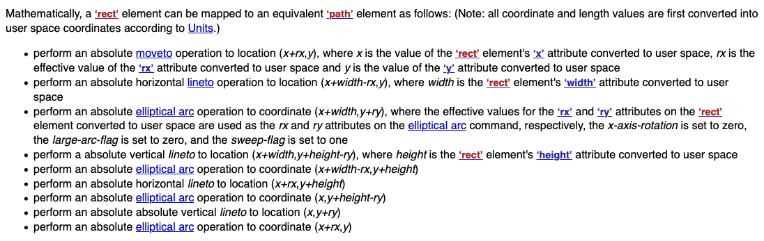
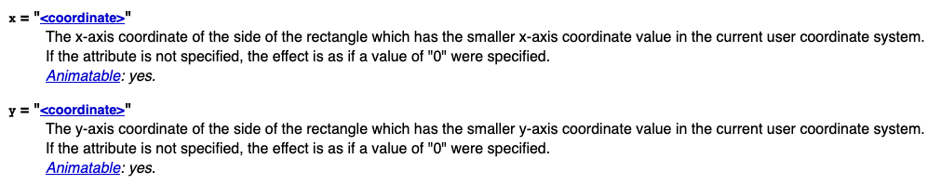
SVG spec
^ Can’t this be made machine-readable?

Slide 29
Next steps
Id system:
Text layout demo:
Move code out of JS file and into system
Express code as nested boxes as well as data
Make box data presentation more flexible (currently uniform)
Build it on top of Id (words are objects, word vtable, etc.)
Lift out more params (e.g. right-to-left)
Define the algorithm via pattern-matching diagrams e.g.
n
n+1
n
n+1

Slide 30
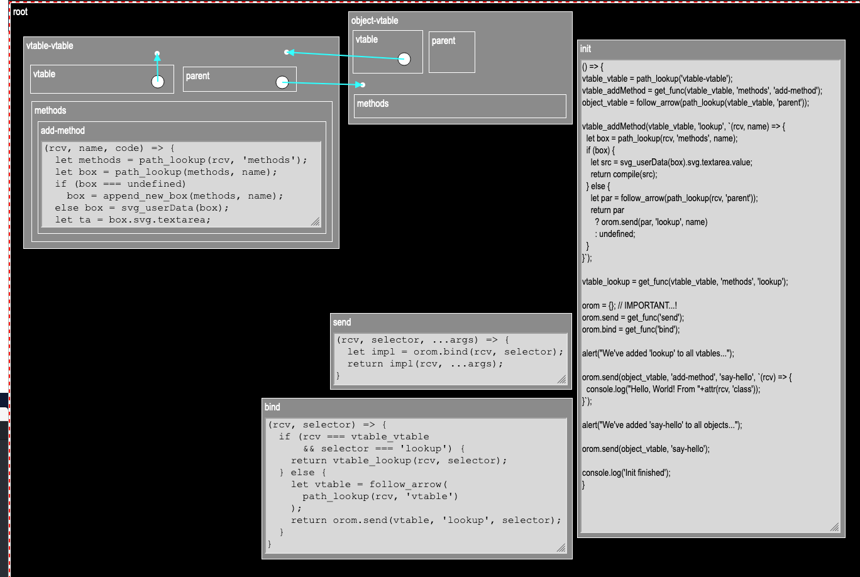
What am I aiming towards?
Impl. new notation
Id: free the language designer from ever having to say “I’m sorry”! (to programmers using the language)
Can’t use it here
Sys development can take advantage of its own fruits
Free the programmer from ever having to say “I’m sorry”? (to users of their software)

