Slide 1
Analyzing air quality in Stuttgart using official and Citizen-Science data
Seminar: GIS Analyses with FOSSGIS Speakers: Amandus Butzer, Julian Käflein Teacher: Christina Ludwig 29.01.2019

Slide 2
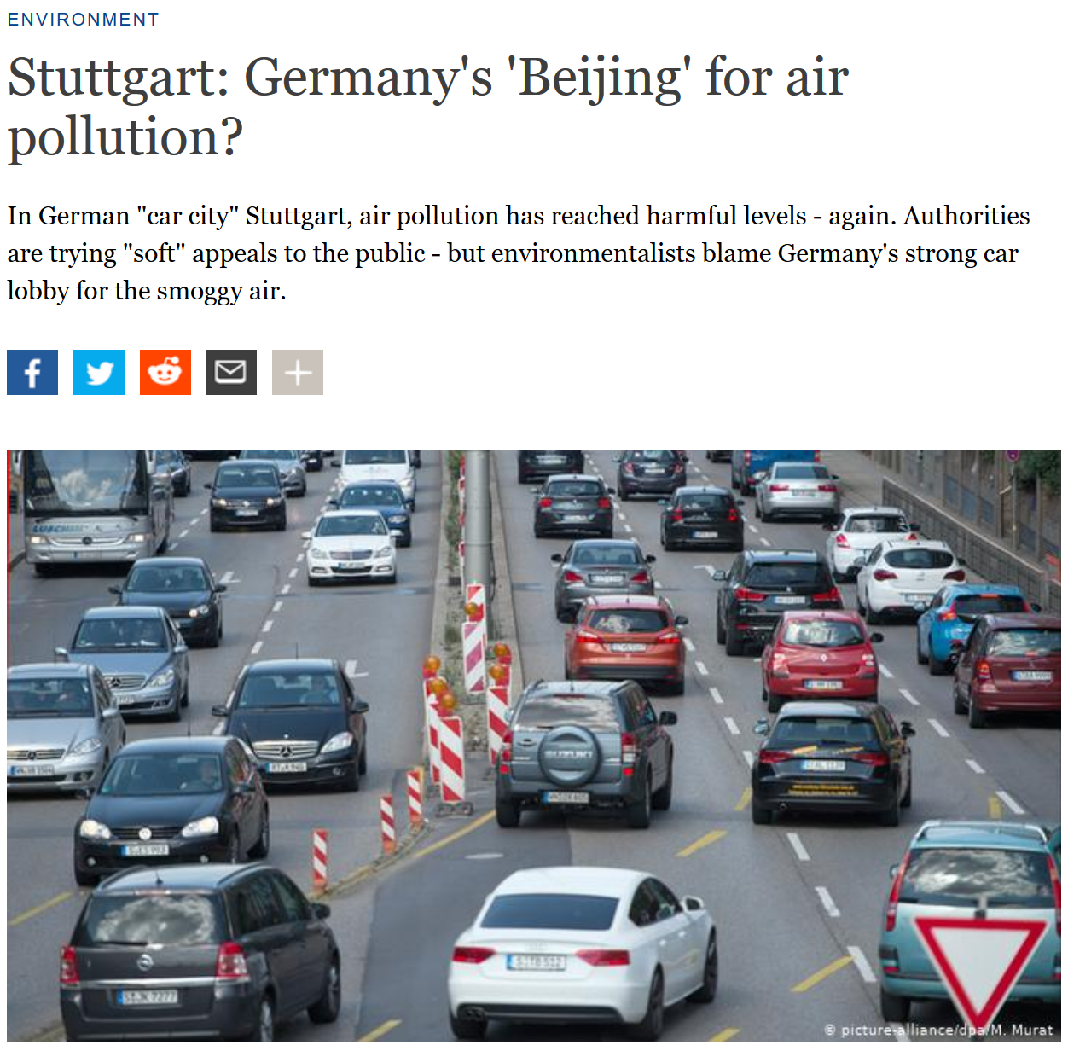
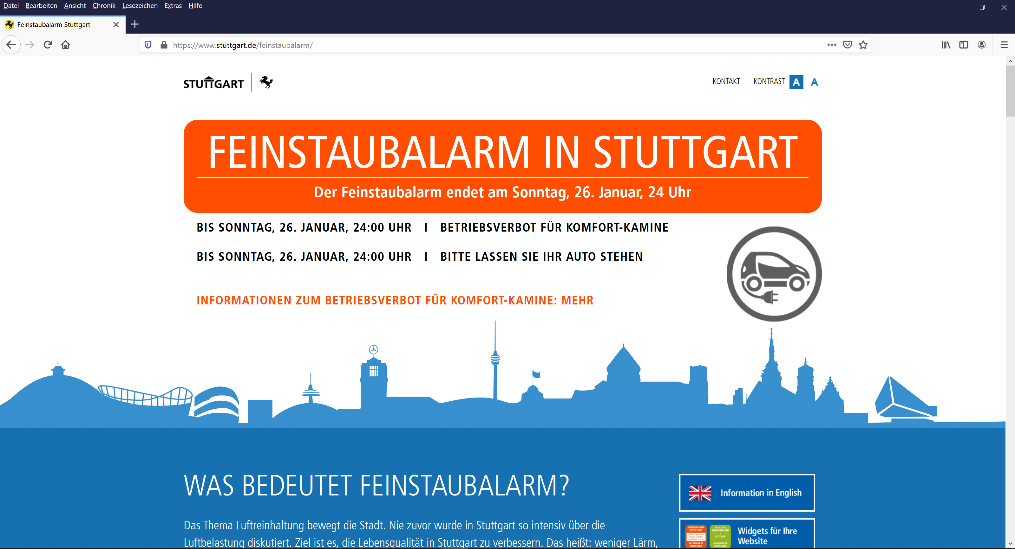
Motivation
Source: https://www.stuttgart.de/feinstaubalarm/
https://www.dw.com/en/stuttgart-germanys-beijing-for-air-pollution/a-18991064

Slide 3

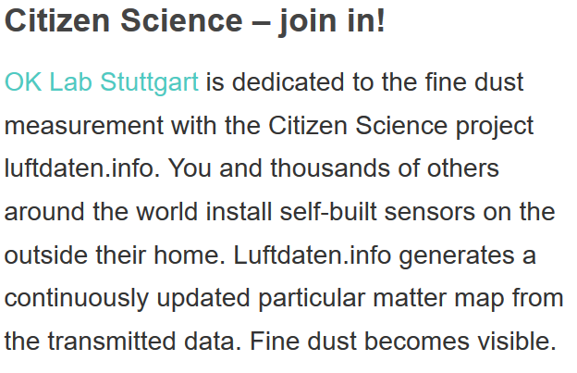
Motivation
Source: https://luftdaten.info/en/home-en/

Slide 4
Motivation
Particulate Matter (PM) Defintion: Solid and liquid airborne particles under 10/25µm diameter (PM10/PM25)
Health hazards: Short term irritation/ inflammation of respiratory system, allergic reactions, asthma
Long-term increase of cardiovascular, respiratory diseases
Sources: Industrial processes, Heating, Traffic
Stuttgart:
Problem (1): Concentration of PM exceeding German/ European limits in recent
Reaction: Introduction of „Feinstaubalarm“ – plea to use public transport, ban of ‚comfort heating‘
Problem (2): Amount of PM sensors – 3 sensors by Landesanstalt für Umwelt Baden-Württemberg (LUBW)

Slide 5
Scientific goal
(How) can we analyze the particulate matter concentration
in the city of Stuttgart
based on Volunteered Geographic Information (VGI)
using Free and Open Source Geographic Information Systems (FOSSGIS)
in an automated process?

Slide 6
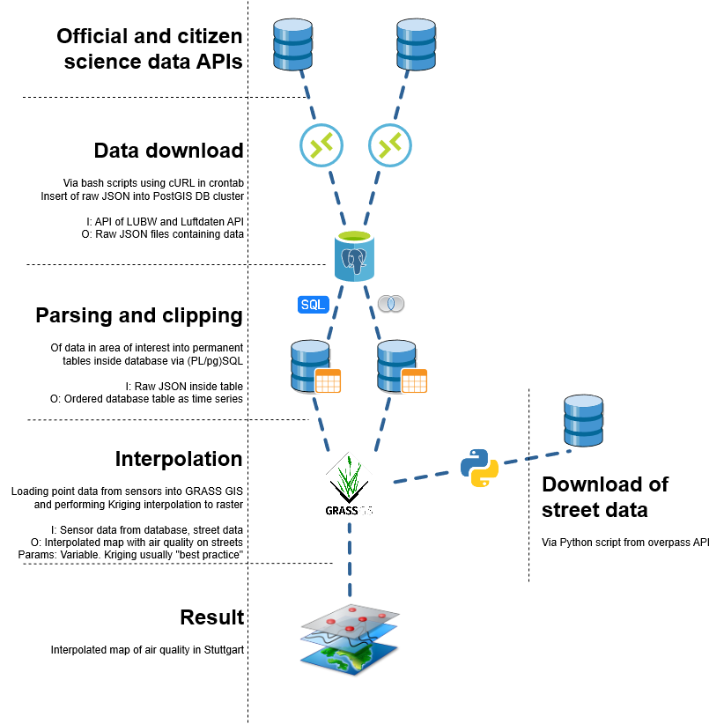
Workflow
e
Luftdaten:
Rate: Hourly values
Sensors All (global)
Format: JSON
URL: https://data.sensor.community/static/v2/data.1h.json
Size: ~ 9MB (!)

Slide 7
Workflow
LUBW
Rate: Hourly values
Sensor: All (Baden-Württemberg)
Format: GeoJSON
URL: https://lupo-messwerte.appspot.com/ generic?table=bw_luft_stammdaten&limit= 999&filter=aktiv:true;type:- Spot&order=NO2-today-latest-class
Size: 228KB

Slide 8
Workflow
e
1. Insert raw data into database
2.
e

Slide 9
[{"id":6206354893,"sampling_rate":null,"timestamp":"2020-01-25 18:02:38","location":{"id":13208,"latitude":"51.044","longitude":"13.746","altitude":"115.3","country":"DE","exact_location":0,"indoor":1},"sensor":{"id":36,"pin":"1","sensor_type":{"id":14,"name":"SDS011","manufacturer":"Nova Fitness"}},"sensordatavalues":[{"id":13187712927,"value":"39.32","value_type":"humidity"}]},{"id":6206354847,"sampling_rate":null,"timestamp":"2020-01-25 18:02:38","location":{"id":13208,"latitude":"51.044","longitude":"13.746","altitude":"115.3","country":"DE","exact_location":0,"indoor":1},"sensor":{"id":36,"pin":"1","sensor_type":{"id":14,"name":"SDS011","manufacturer":"Nova Fitness"}},"sensordatavalues":[{"id":13187712827,"value":"0.39","value_type":"P1"},{"id":13187712828,"value":"0.39","value_type":"P2"}]},{"id":6206354893,"sampling_rate":null,"timestamp":"2020-01-25 18:02:38","location":{"id":13208,"latitude":"51.044","longitude":"13.746","altitude":"115.3","country":"DE","exact_location":0,"indoor":1},"sensor":{"id":36,"pin":"1","sensor_type":{"id":14,"name":"SDS011","manufacturer":"Nova
ID: 1
Name: Stuttgart am Neckator
Time: 2020-01-01 00:00
PM10: 8
PM25: 10
Location: [8.123,49.123]

Slide 10
WITH data AS
(
SELECT
d_lubw.time_stamp,
d_luft.time_stamp,
d_lubw.p10,
d_luft.p10,
date_trunc('day',d_lubw.time_stamp) AS daily,
(((d_lubw.p10/d_luft.p10)-1)*100) AS abweichung
FROM daten.lut_lubw_stations l_lubw
CROSS JOIN daten.lut_luftdaten_stations l_luft
JOIN daten.dt_lubw d_lubw ON l_lubw.idpk = d_lubw.fk_station_id
JOIN daten.dt_luftdaten d_luft ON l_luft.station_id = d_luft.station_id
WHERE ST_DistanceSphere(l_lubw.geom, l_luft.geom) <= 1000
AND d_luft.p10 < 100
AND d_lubw.time_stamp = d_luft.time_stamp
)
SELECT DISTINCT ON (daily)
daily,
avg(abweichung) OVER (ORDER BY daily ASC)
FROM data
GROUP BY daily,data.abweichung

Slide 11
Getting the data

Slide 13
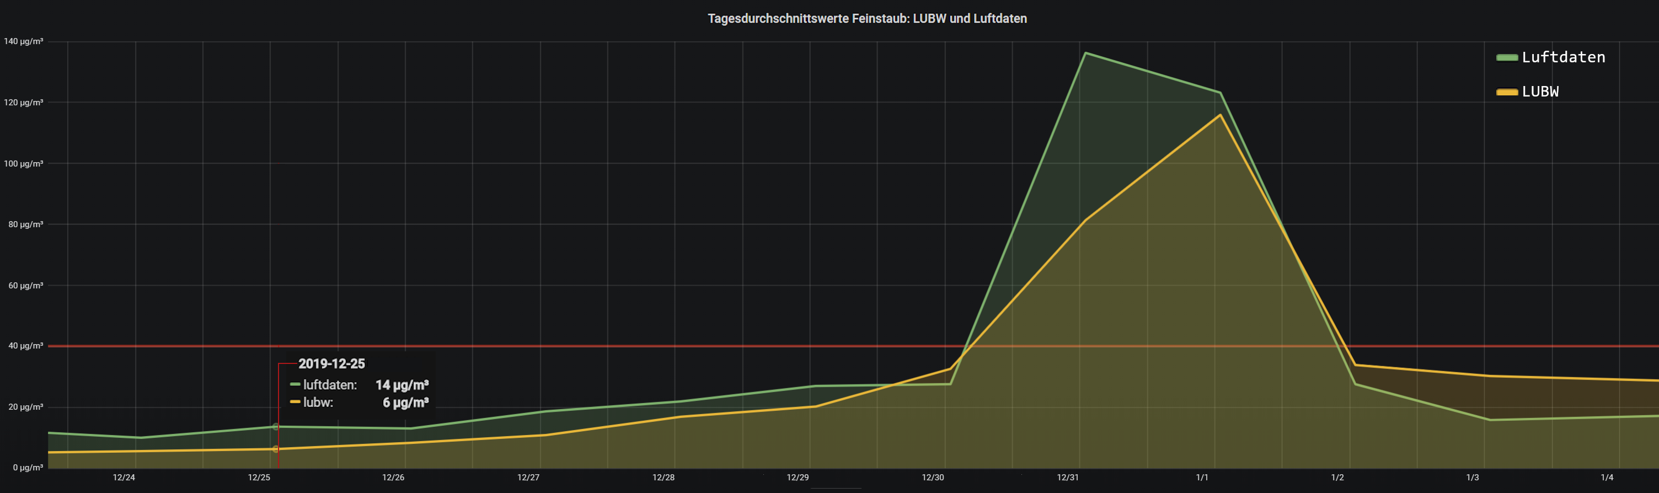
Data analyis
Daily average PM10 concentration for LUBW sensors vs Luftdaten sensors within 1000m distance

Slide 14
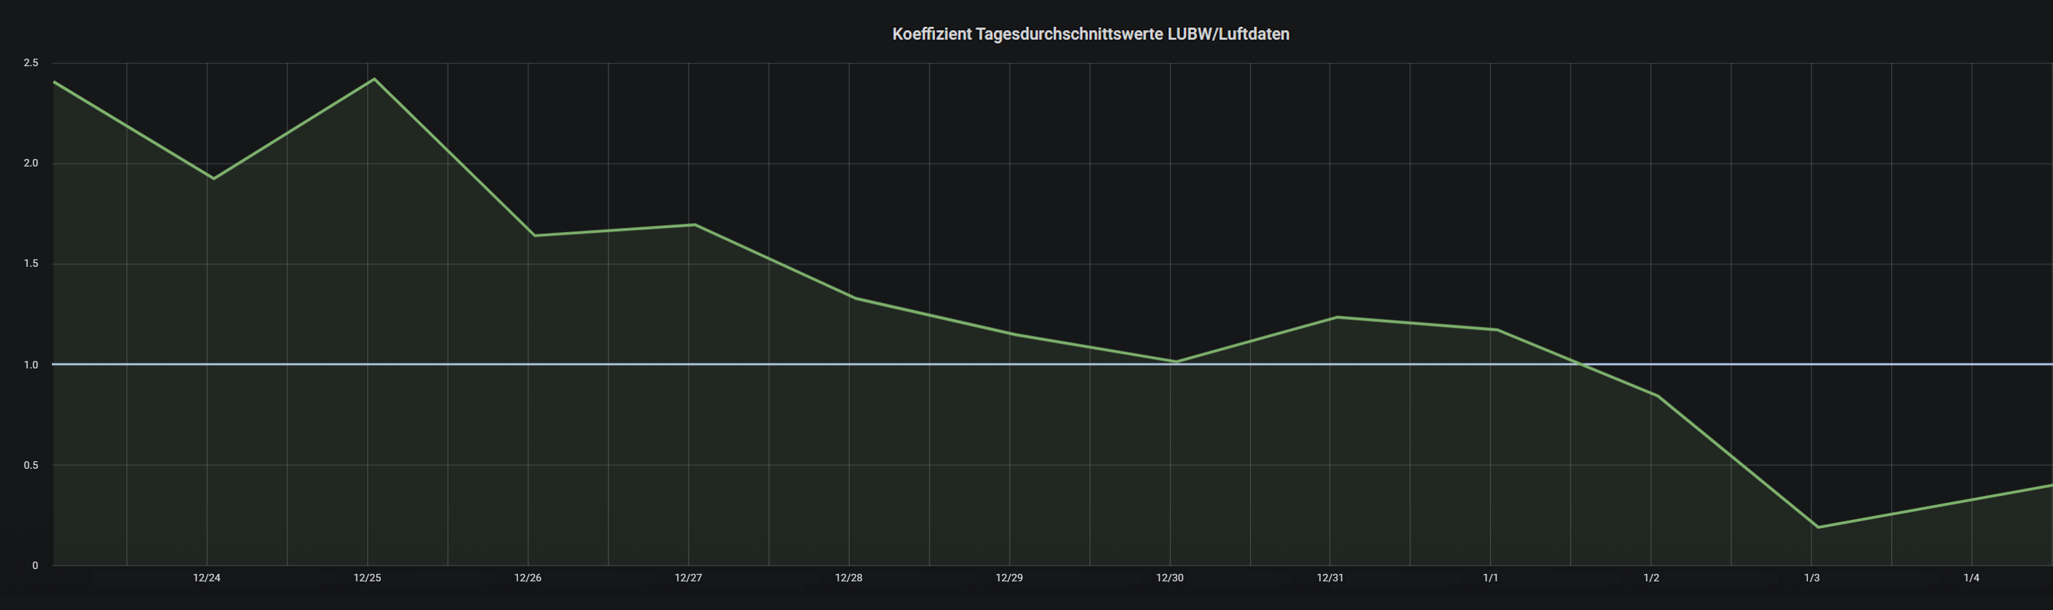
Data analysis
Daily average PM10 concentration – difference coefficient

Slide 15



Modelling air pollution - Interpolation
24µg/m³
12µg/m³

Slide 17
Milestones so far
Automated download of data
Automated ingestion of data into database
Automated parsing and filtering of extreme values
Connection of GRASS GIS modules to database
Import of stations and data
Automated interpolation of air quality data to raster

Slide 18
Results
Luftdaten.info sensors
Relatively large, non-systematic discrepancy between Luftdaten and LUBW sensors (cf. LUBW 2017)
BUT
Luftdaten network can sense general particulate matter trend in Stuttgart

Slide 19
Limitations of the analysis
Accuracy of Luftdaten sensors
Need to filter extreme values (both absolute and relative)
Constant discrepancy to official measurements
Interpolation parameters are „best fit“
No ‚correct‘ solution to model pollution rasters from sensors
Small scale of study area
Large effects of additional factors, i.e atmospheric conditions (wind / precipitation) /
land cover (buildings / parks)
Short amount of sensing time

Slide 20
Sources

Slide 21
Data used
o3_today_min_limit
no2_yesterday_max_limit
pm25_yesterday_max_class
no2_udolink
pm25_today_avg
o3_today_max
luqx_today_max_comps
o3_yesterday_min
o3_today_latest_ts
o3_today_latest
pm10_yesterday_min_class
luqx_yesterday_max_class
no2_yesterday_latest_limit
pm25_yesterday_avg_limit
pm10_h_today_max_limit
pm10_yesterday_latest
pm25_h_yesterday_latest
o3_yesterday_latest_class
no2_yesterday_avg_class
o3_yesterday_avg_limit
o3_yesterday_max_limit
luqx_today_latest_text
luqx_yesterday_max
no2_today_latest_limit
pm10_udolink
pm10_h_today_avg_limit
pm10_h_today_max

Slide 22
rw
o3_today_avg_class
pm10_yesterday_min_limit
no2_yesterday_latest_class
pm10_yesterday_latest_class
luqx_today_max_class
o3_yesterday_latest_limit
pm10_yesterday_latest_ts
pm10_yesterday_max
pm25_h_today_min_class
pm25_h_yesterday_avg
no2_yesterday_min
o3_yesterday_latest
hoehe
luqx_yesterday_max_comps
pm25_yesterday_avg_class
o3_today_max_class
pm10_h_today_latest
luqx_yesterday_max_text
pm10_h_today_latest_ts
strasse
pm25_h_today_min_limit
pm10_h_today_latest_limit
pm25_h_today_latest_ts
no2_today_latest_class
no2_yesterday_avg_limit
pm10_today_max
pm25_today_min
pm10_yesterday_avg_limit
pm25_yesterday_latest
no2_today_min_class
pm25_h_yesterday_min_limit
no2_today_latest
luqx_today_latest_ts
no2_yesterday_latest_ts
pm25_h_yesterday_min
no2_yesterday_avg

Slide 23
pm10_yesterday_max_limit
luqx_today_max_text
o3_today_min_class
pm25_yesterday_latest_limit
pm10_today_latest_limit
pm25_h_yesterday_latest_ts
o3_today_min
o3_yesterday_avg_class
no2_yesterday_min_limit
pm25_h_today_avg_class
pm25_yesterday_min_limit
o3_yesterday_max_class
pm10_h_yesterday_latest_limit
ort
pm25_yesterday_latest_ts
pm25_h_udolink
nuts_unit
pm25_today_latest_limit
type
hw
pm25_yesterday_latest_class
pm10_h_yesterday_min_limit
pm10_today_avg_limit
no2_today_avg
luqx_yesterday_max_ts_raw
pm10_h_yesterday_avg_class
no2_today_avg_limit
pm25_h_yesterday_max_limit
pm10_h_yesterday_min
foto
pm10_today_max_limit
pm25_h_yesterday_avg_limit
pm25_today_latest_class
pm25_today_max_limit
pm25_h_today_avg
pm10_h_yesterday_latest_ts
no2_yesterday_max

Slide 24
luqx_today_latest
pm10_today_min
lon
pm10_h_today_min
no2_today_avg_class
luqx_today_max
pm10_today_avg_class
o3_today_avg
keyattname
luqx_yesterday_max_ts
kurzname
o3_yesterday_max
yesterday_ts
pm10_yesterday_min
pm10_h_yesterday_max_class
pm25_h_yesterday_max_class
pm25_yesterday_min
no2_today_max_limit
pm10_h_today_min_class
pm25_today_max_class
pm10_today_max_class
o3_yesterday_min_class
pm25_h_yesterday_avg_class
pm10_today_latest
pm25_h_today_latest
luqx_today_max_ts_raw
no2_today_latest_ts
pm25_today_latest
statkenn
pm25_h_yesterday_min_class
pm10_yesterday_max_class
no2_today_min_limit
no2_yesterday_min_class
o3_yesterday_latest_ts
luqx_today_max_ts
lat
pm10_today_latest_class

Slide 25
pm10_h_yesterday_latest_class
luqx_today_latest_ts_raw
pm10_h_yesterday_latest
pm10_h_yesterday_max_limit
pm25_yesterday_min_class
pm10_h_udolink
no2_today_max
o3_yesterday_min_limit
o3_udolink
pm25_h_today_min
aktiv
o3_today_latest_limit
pm10_h_today_max_class
pm10_today_avg
pm25_h_today_max_limit
pm10_h_yesterday_min_class
pm10_h_today_avg
pm25_today_max
pm25_h_today_avg_limit
pm25_today_avg_limit
publication_ts
no2_yesterday_max_class
pm10_h_yesterday_max
no2_yesterday_latest
pm10_h_yesterday_avg_limit
pm25_h_yesterday_max
pm10_yesterday_avg
pm25_yesterday_avg
pm10_today_min_class
pm25_today_min_class
pm10_h_today_avg_class
pm25_h_today_latest_class
pm10_yesterday_avg_class
pm25_h_yesterday_latest_limit
plz

