Slide 1
Growing Plants with the Power of Robotany
Jacob Kirkland, Nathaniel Kuhn, and Kevin Shelton

Slide 2
The System
A multi-component system to semi-autonomously care for a houseplant

Slide 3
Motivations
Personal botany experience has led to doubt of human ability
Studies indicate that as many as 75% of households have houseplants

Slide 4
Components
Hardware (Arduino and sensors)
Server (Desktop python script)
Mobile App (Android application)

Slide 5
How to use it

Slide 6
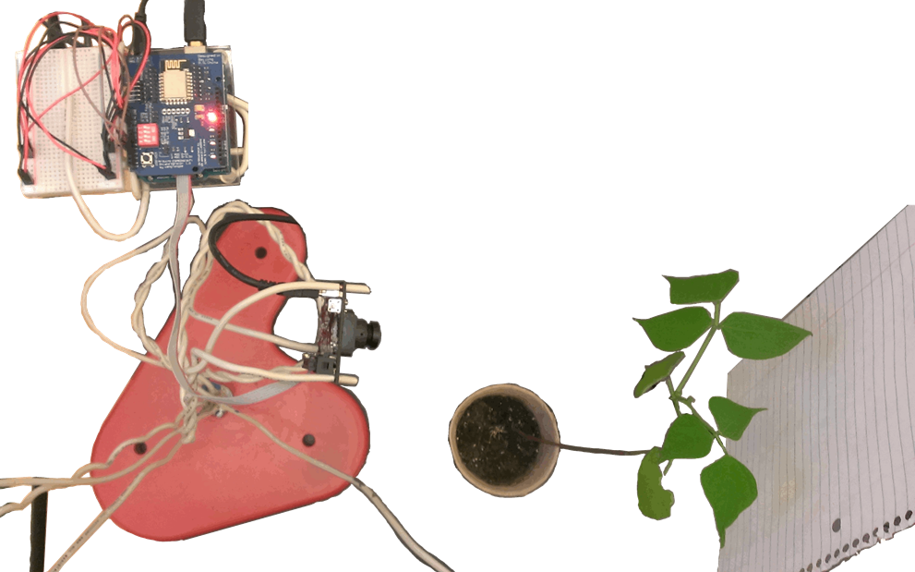
Step 1
Attach sensors to plant

Slide 7
Hardware Components
Arduino/breadboard
Sensors
Pixy camera
Water solenoid valve
Light relay
WiFi shield

Slide 8
Sensor array
Soil moisture sensor
UV sensor
Temperature/humidity sensor
[graphic w/ units]

Slide 9
Step 2
Run desktop server
Python script
OS independent
[more server slides]

Slide 10
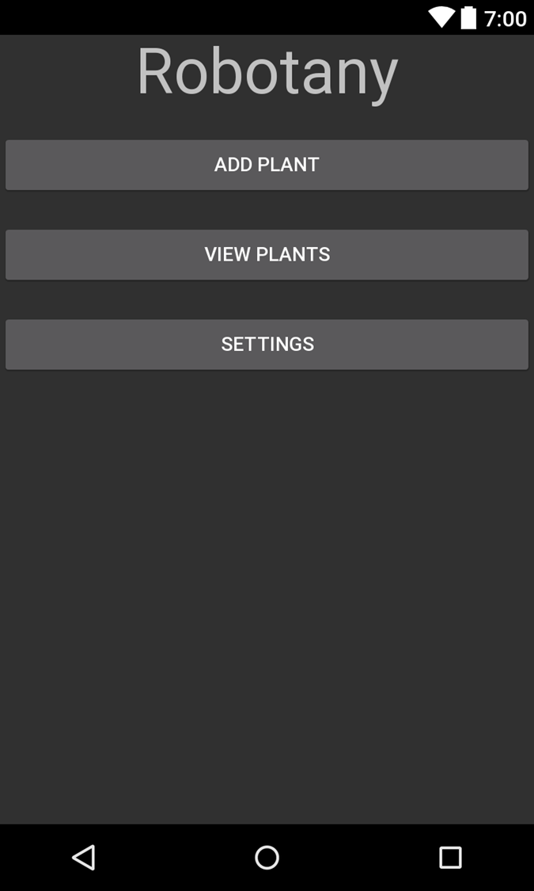
Step 3
Set app settings to connect to correct IP
Home Screen

Slide 11
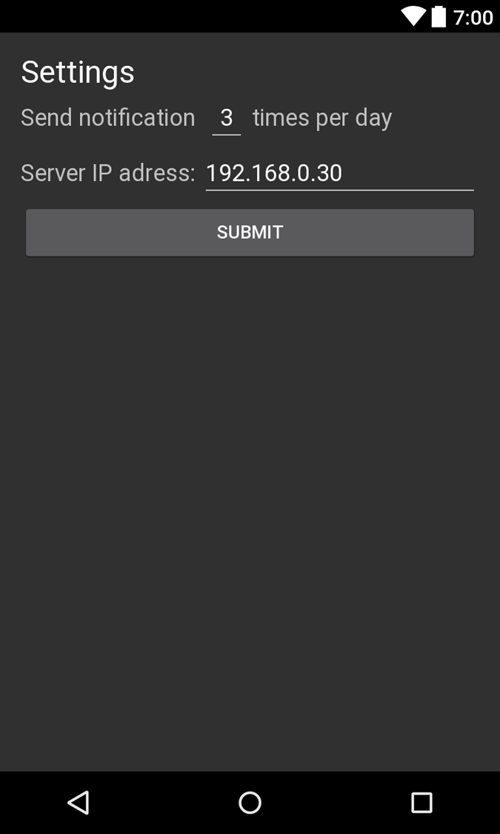
Step 3
Set app settings to connect to correct IP
Settings screen

Slide 12
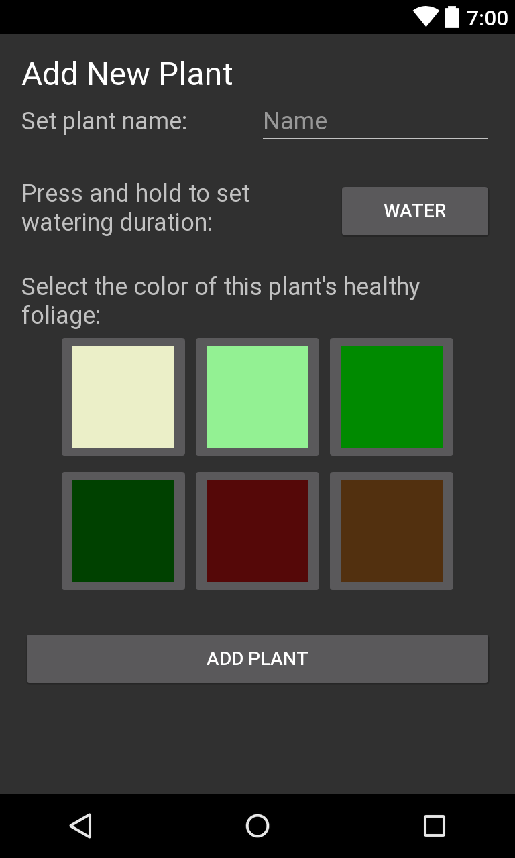
Step 4
Add new plant in app
Server creates new entry in XML

Slide 13
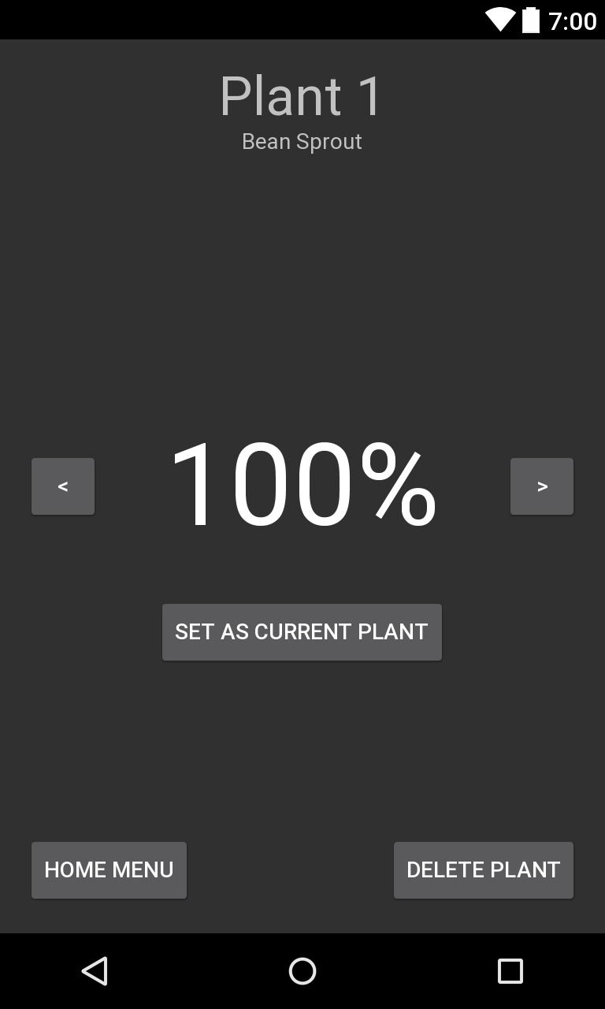
Step 5
Rate plant health daily
View plants screen

Slide 14
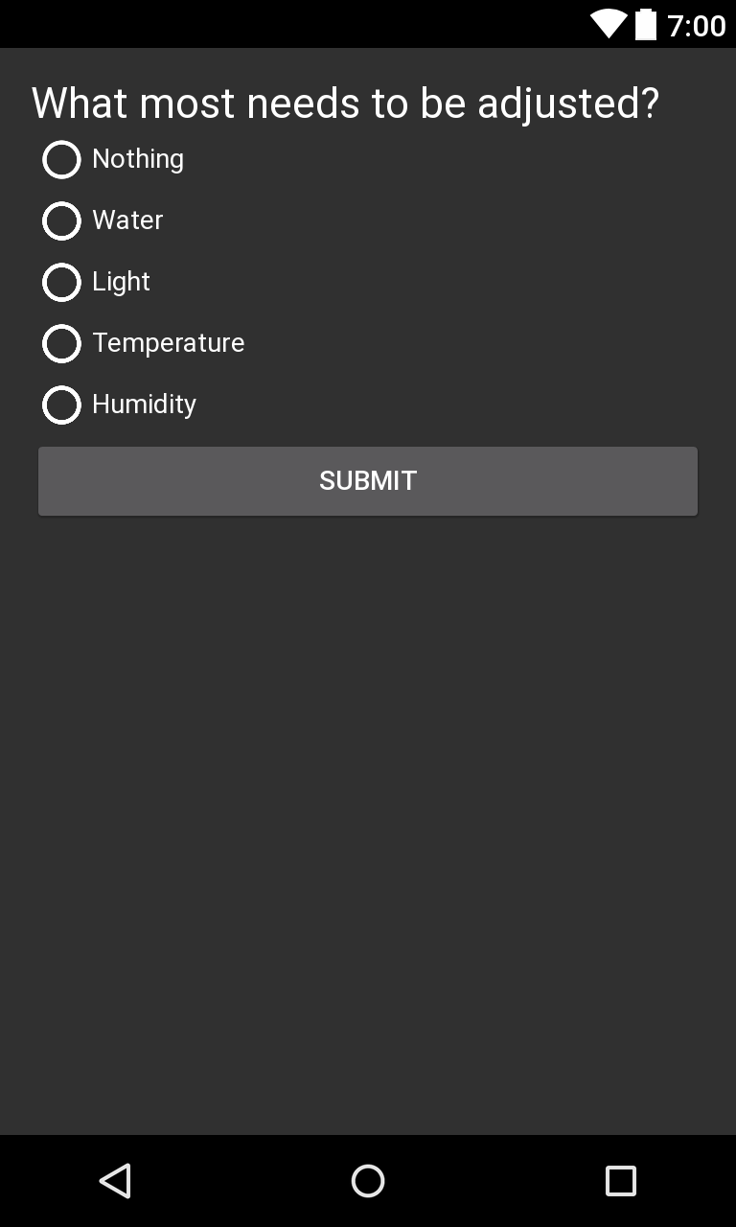
Step 5
Rate plant health daily
Rate screen

Slide 15
Step 6
Server adjusts water and light based on user rating using decision trees
[insert decision tree graphic]

Slide 16
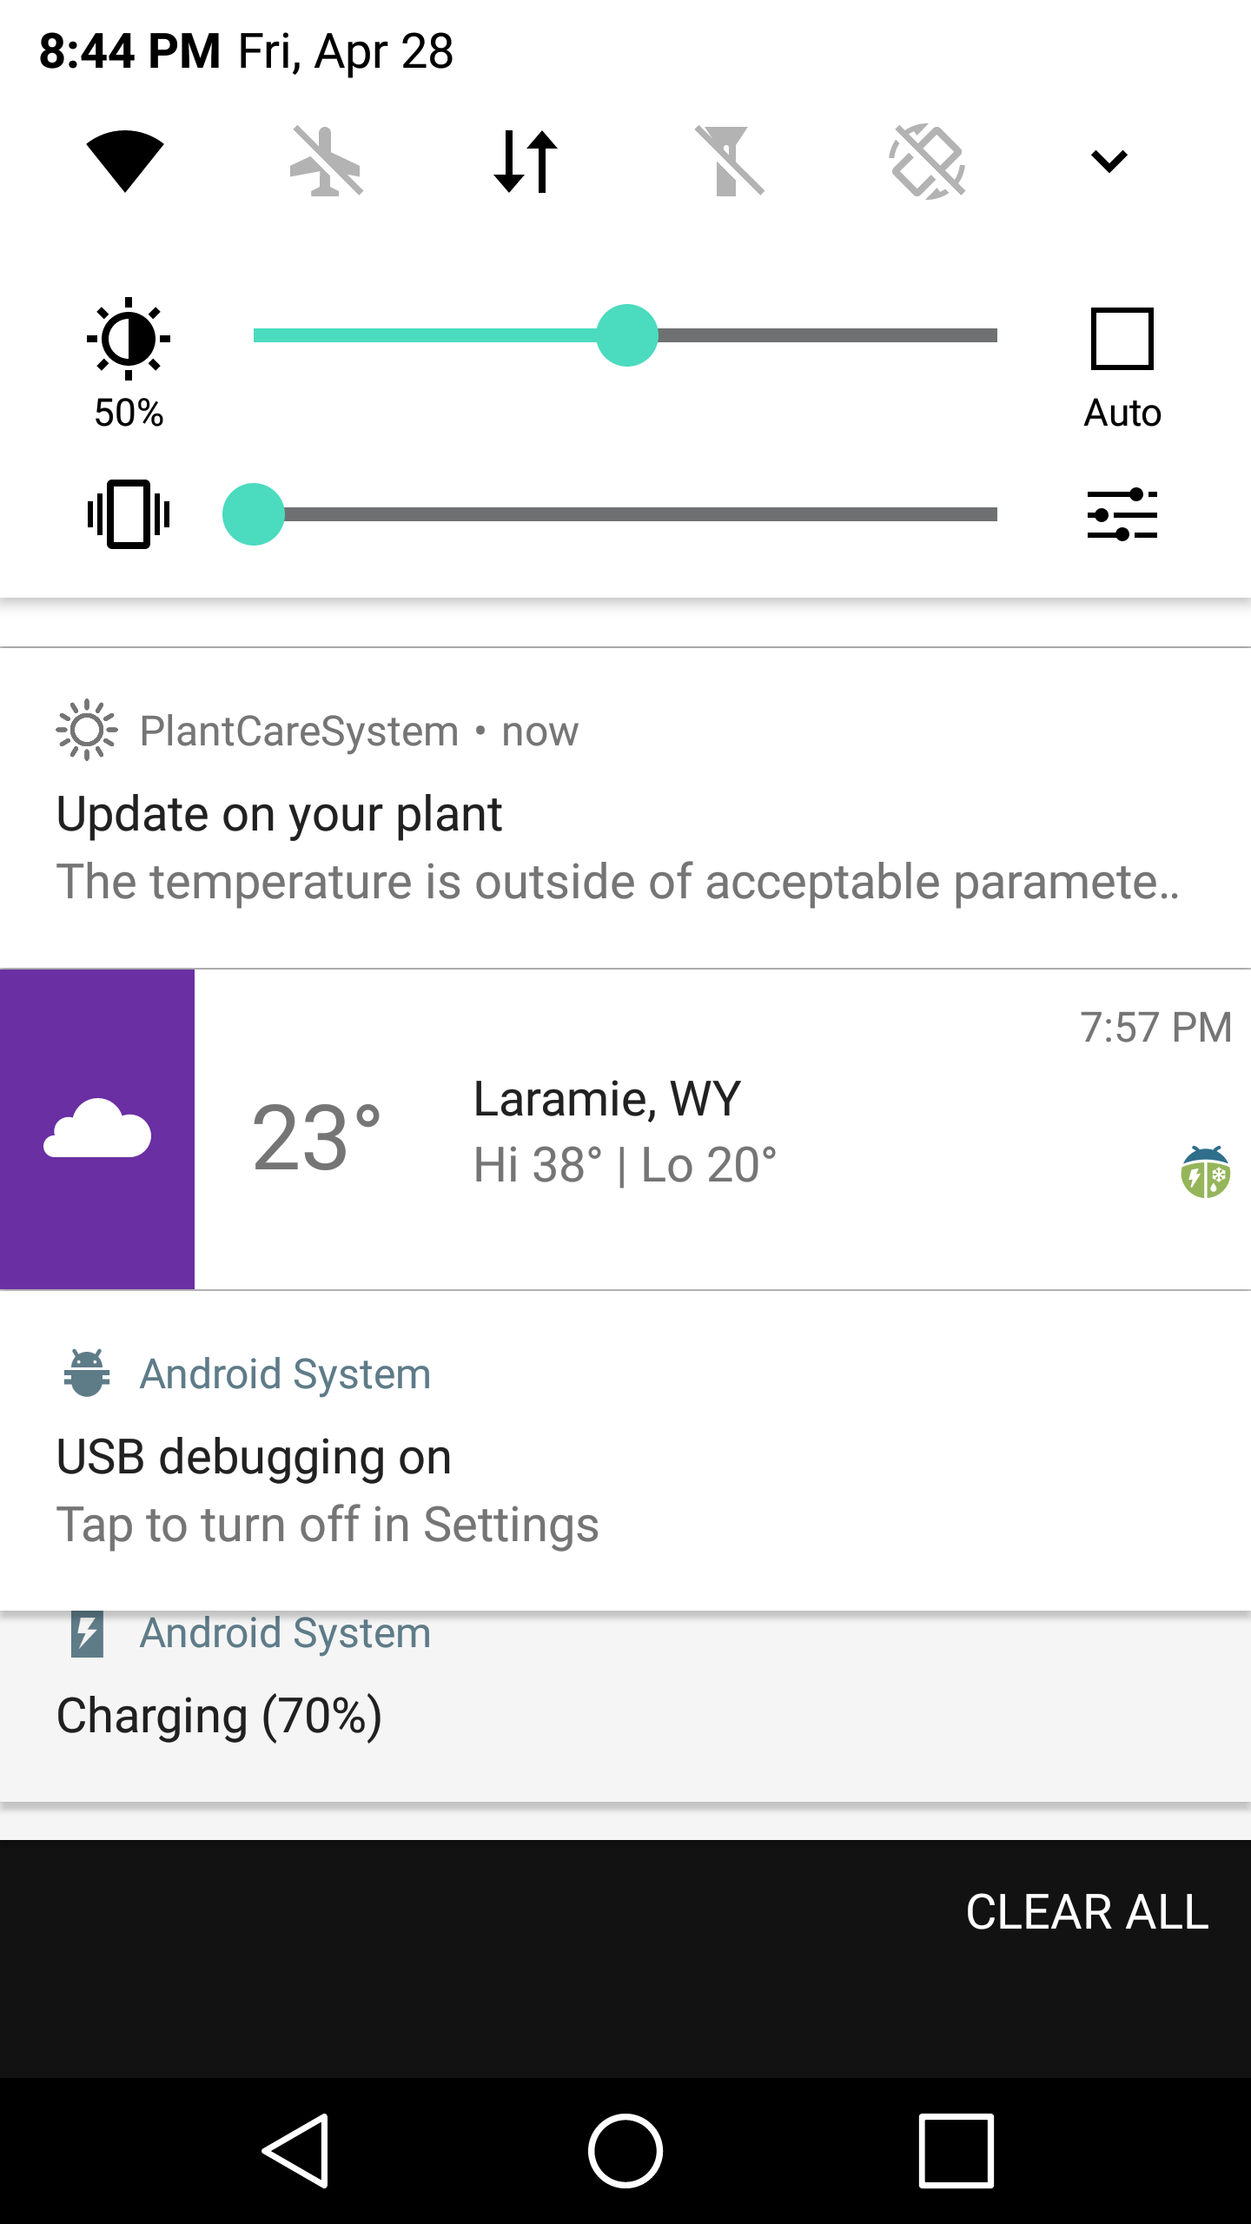
Step 7
App notifies user if temperature or humidity needs to be adjusted

Slide 17
Organization
Python
ReST Server Decision Tree AI
Add/Remove Plants Format Data (Attach Timestamp)
Calculate Plant Health Builds Decision Trees
Update Plants Outputs Tree
Track a Current Plant Trees Decide Settings
Application
Display Plant Info Display Sensor Info
Plant Status Scoring Set a Current Plant
Set Water Timers Plant Data-basing to Server
Arduino
Read Settings Adjust Water Valve/Light
Read Sensors Read Camera
Send Sensor Data Send Camera Data

Slide 18
Difficulties
Almost all hardware

Slide 19
Final Product

