Slide 1
Growing Plants with the Power of Robotany
Jacob Kirkland, Nathaniel Kuhn, and Kevin Shelton

Slide 2
Goal:
To empower a user to grow plants autonomously utilizing robotany, and to provide ease of plant care.
To create a system that will monitor the state of a plant’s environment and, given limited input from the user, regulate environmental variables to optimize the plant’s growth.

Slide 3
Component 1: Hardware
Arduino & breadboard
Light, soil moisture, temperature, and humidity sensors
Pixy camera
Water solenoid and light relay
WiFi shield
Armature

Slide 4
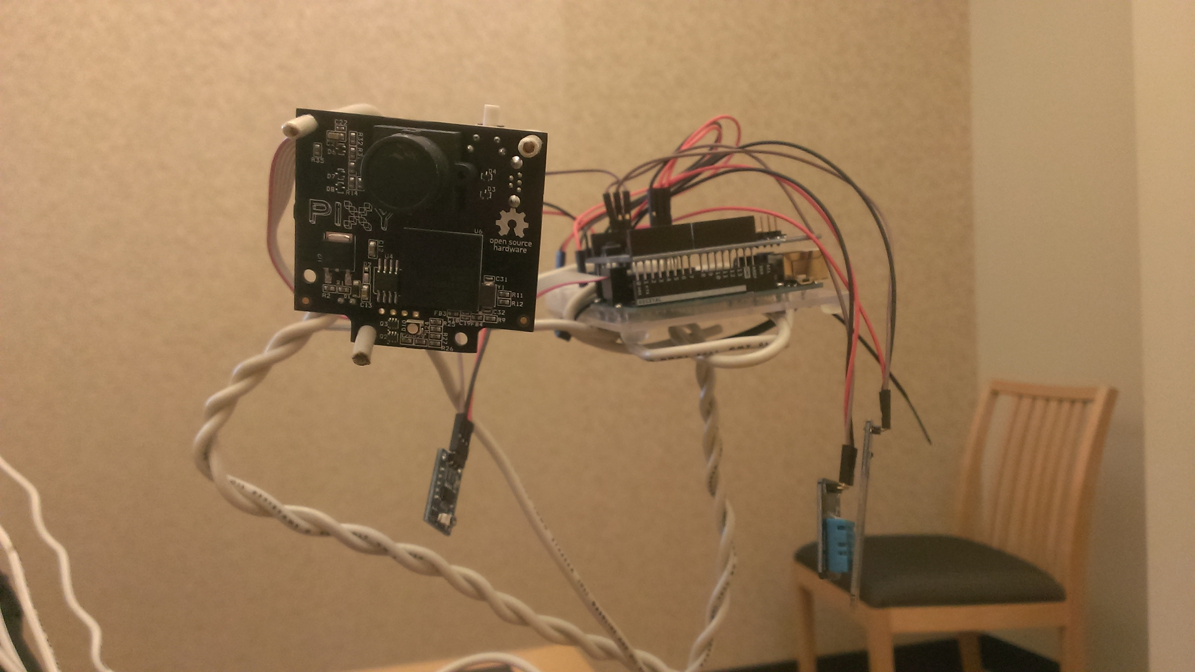
Component 1: Hardware

Slide 5
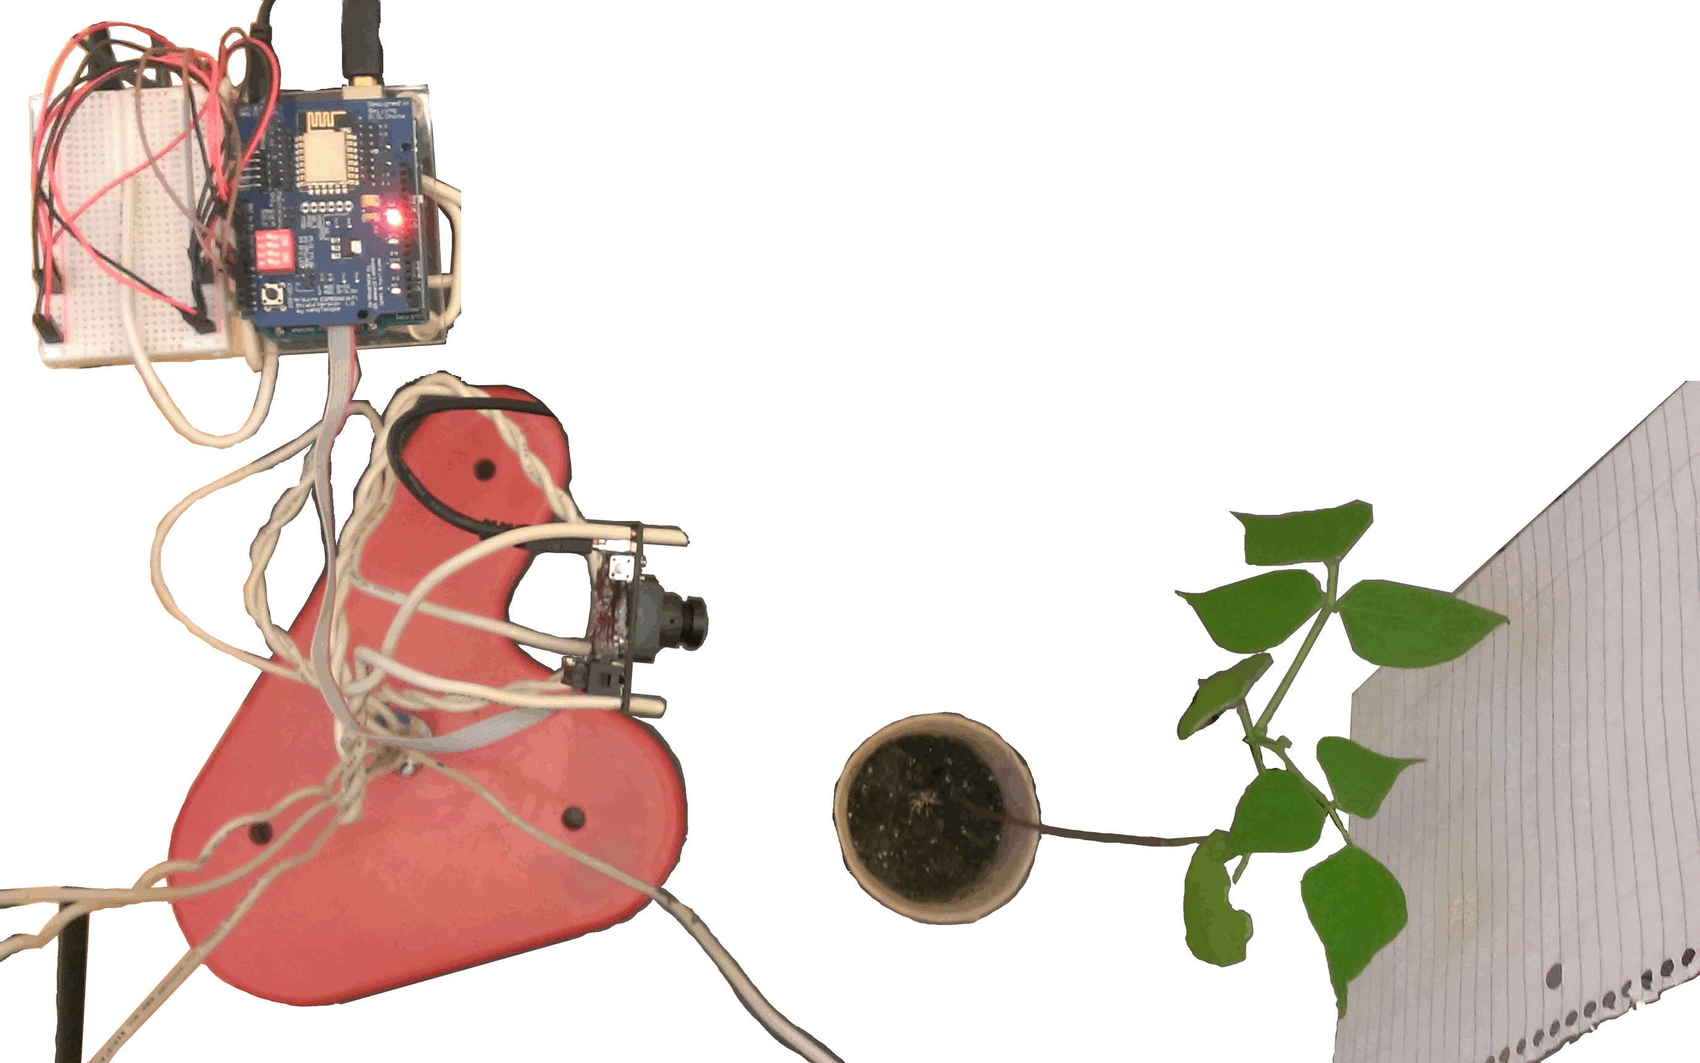
Component 1: Hardware

Slide 6
Component 1: Hardware
Pixy picture

Slide 7
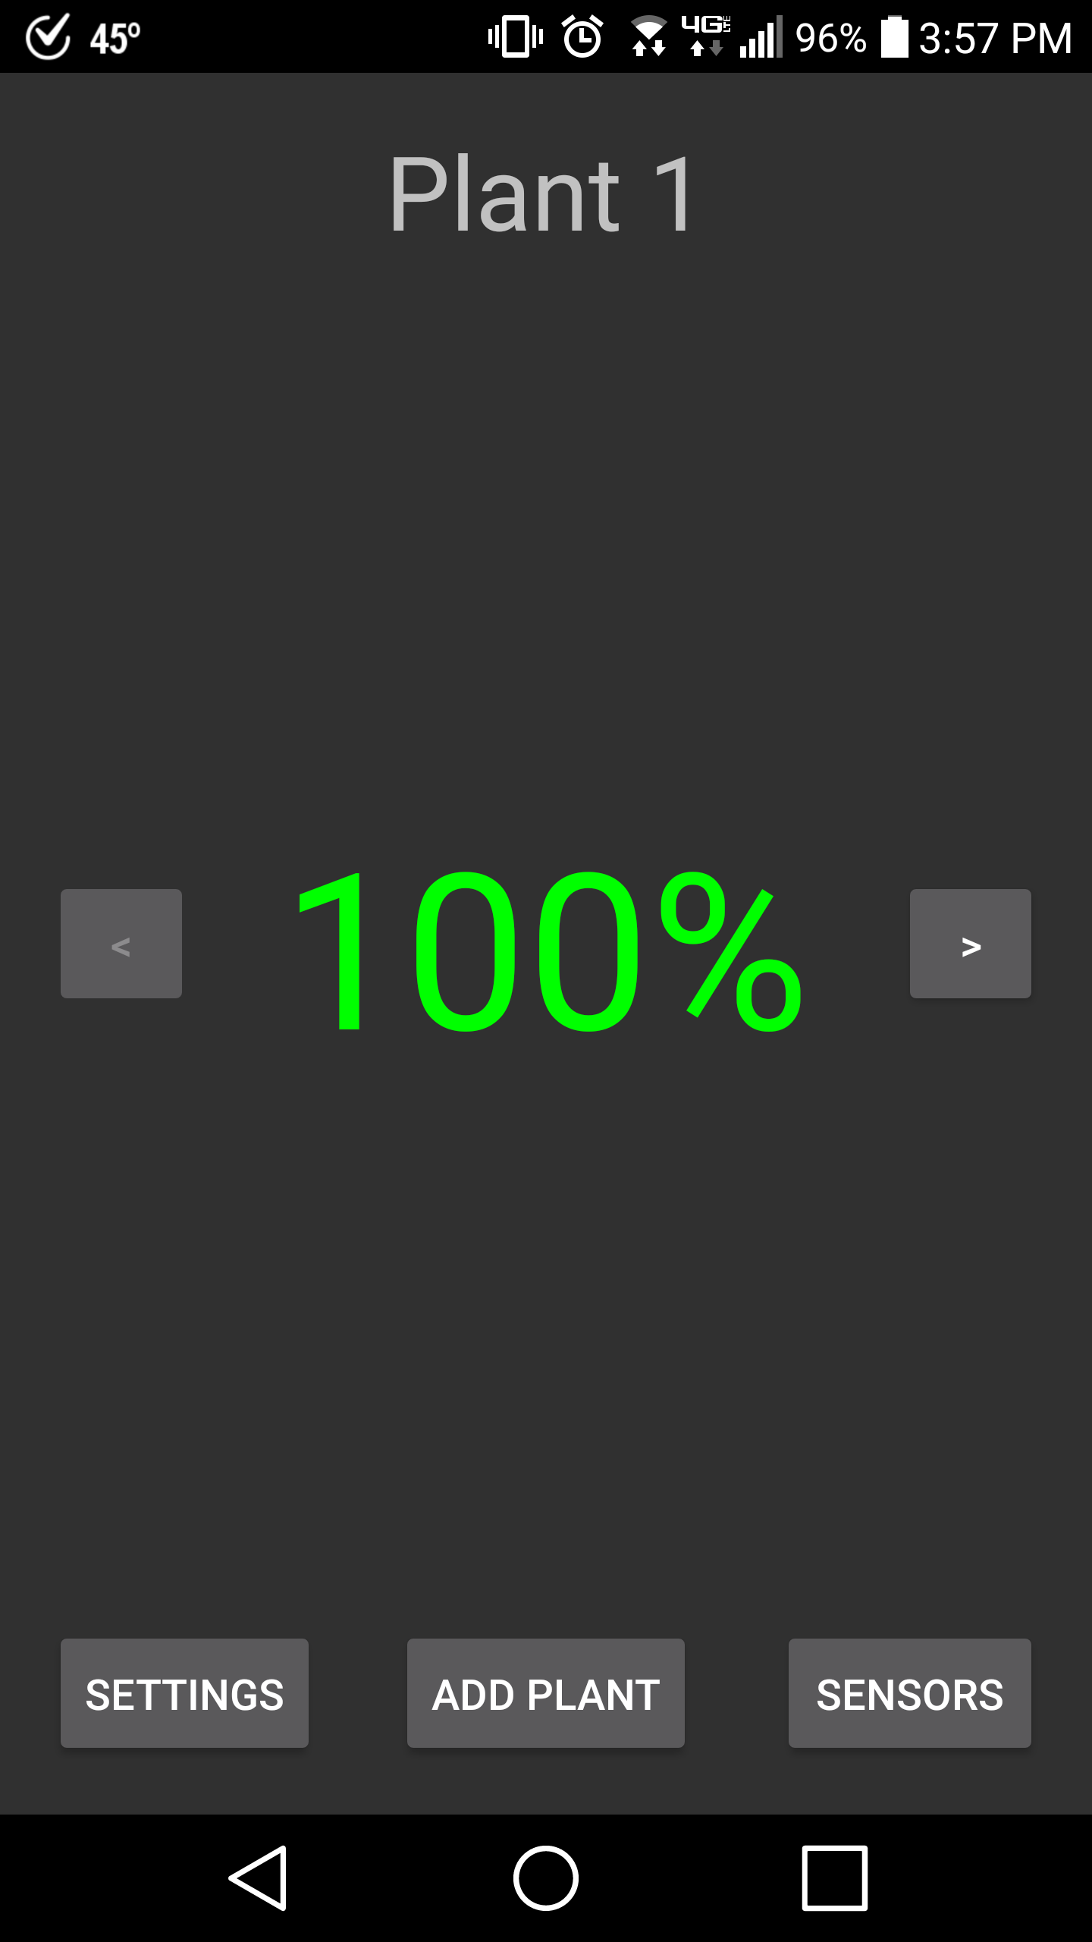
Component 2: App
Plant health

Slide 8
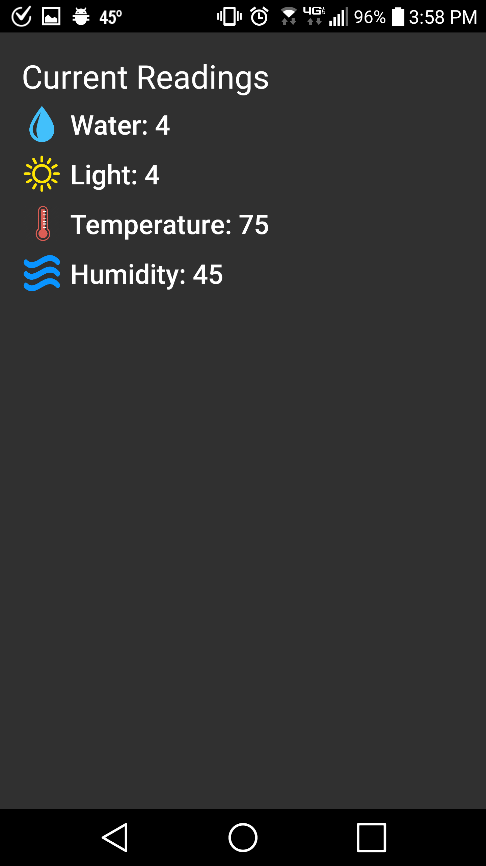
Component 2: App
Sensor readings

Slide 9
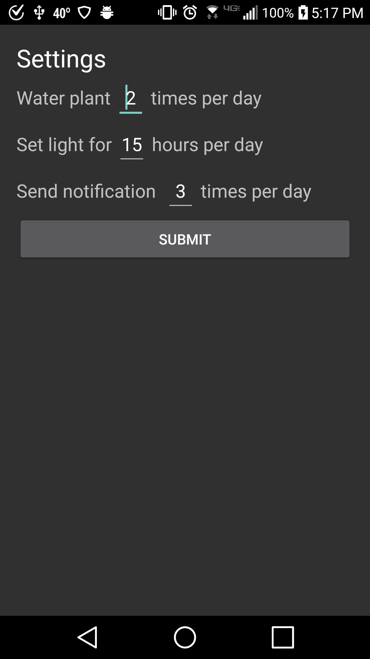
Component 2: App
Settings

Slide 10
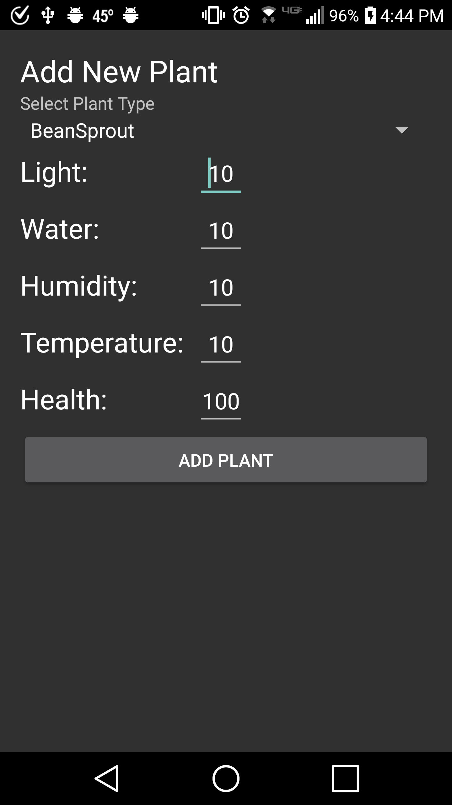
Component 2: App
Add plant

Slide 11
Component 3: Backend
ReST server
Decision trees

Slide 12
Organization
Python
ReST Server Decision Tree AI
Add/Remove Plants Format Data (Attach Timestamp)
Calculate Plant Health Builds Decision Trees
Update Plants Outputs Tree
Track a Current Plant Trees Decide Settings
Application
Display Plant Info Display Sensor Info
Plant Status Scoring Set a Current Plant
Set Water Timers Plant Data-basing to Server
Arduino
Read Settings Adjust Water Valve/Light
Read Sensors Read Camera
Send Sensor Data Send Camera Data

Slide 13
Decision Tree

Slide 14
Difficulties
Cabling and WiFi
ReST communication
Backend

Slide 15
Version changes: Hardware
Sensors
Sensor/Camera
Noise reduced sensors and ReST code
WiFi
Solenoids

Slide 16
Version changes: App
Plant info display
ReST server pull
ReST server update

Slide 17
Version changes: Backend
ReST
Decision trees

Slide 18
Final Product
A system that can input a new plant, take sensor readings on said plant, and report those findings to the user via an App. The server can then use the data that is transmitted, along with scores provided by the user, to build a decision tree based specifically on that plant and container. The decision trees are then used to allow the backend to care for and adjust the environment and plant. The user can then check sensor reports and maintain currently growing plants, and if readings are off, the plant simply needs removed and re-added to start the process again.

