Slide 1
Growing Plants with the Power of Robotany
Jacob Kirkland, Nathaniel Kuhn, and Kevin Shelton

Slide 2
The System
A multi-component system to semi-autonomously care for a houseplant

Slide 3
Motivations
Personal botany experience has led to doubt of human ability
Studies indicate that as many as 75% of households have houseplants

Slide 4
Components
Hardware (Arduino and sensors)
Server (Desktop python script)
Mobile App (Android application)

Slide 5
How to use our project

Slide 6
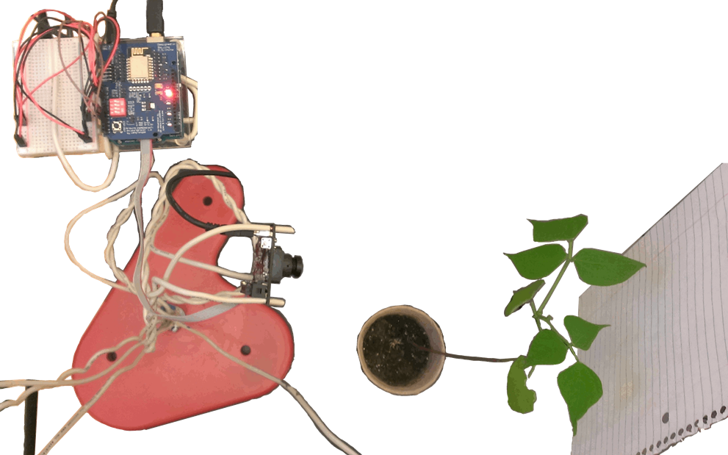
Step 1 - Hardware
Attach sensors to plant

Slide 7
Hardware Components
Arduino/breadboard
Sensors
Pixy camera
Water solenoid valve
Light relay
Wi-Fi shield

Slide 8
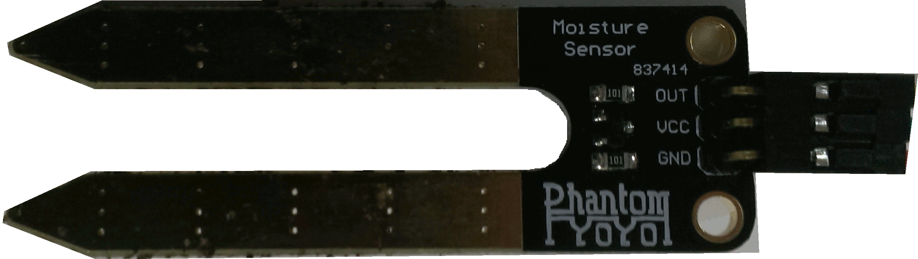
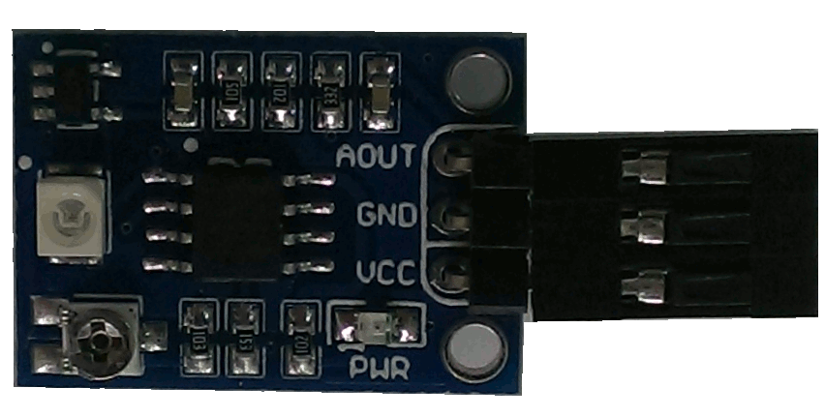
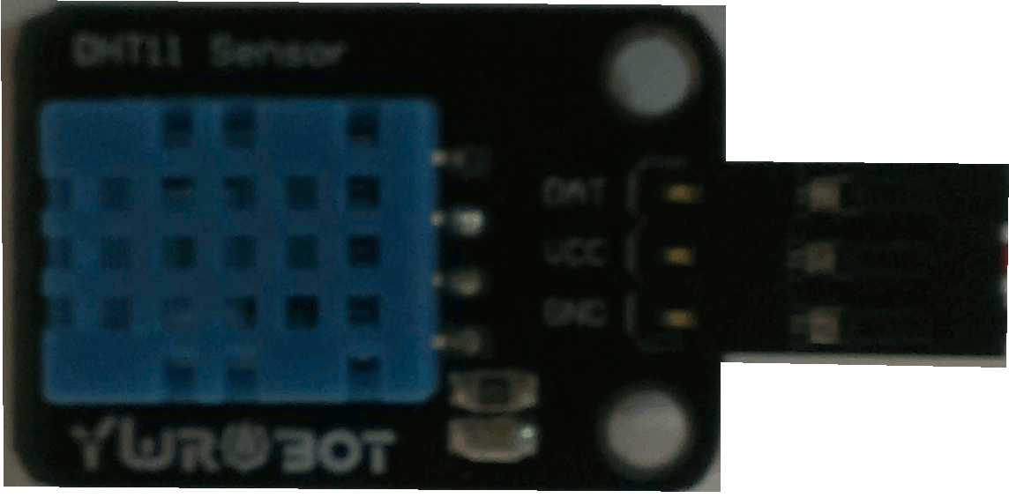
Sensor array
Soil moisture sensor UltraViolet sensor Temperature/humidity sensor
Measured in Voltage Measured from 1-10 Temperature in F
across the fork on UV index Humidity in %
(0 – 500)

Slide 9
Step 2 – The Backend
Setup the desktop server
Runs in Python
OS independent
Uses a ReSTful server and threads

Slide 10
Representational State Transfer Server (ReST)
Accepts HTTP requests for input and output
Uses the camera data to calculate health for the plant
Stores collected data and settings for the hardware in an XML database file

Slide 11
Status Update Thread
In training:
Store plant readings
Accept health ratings from the user and attach them to the plant readings
Done training:
Builds the decision tree
Determines adjustments based on current sensor readings and decision trees

Slide 12
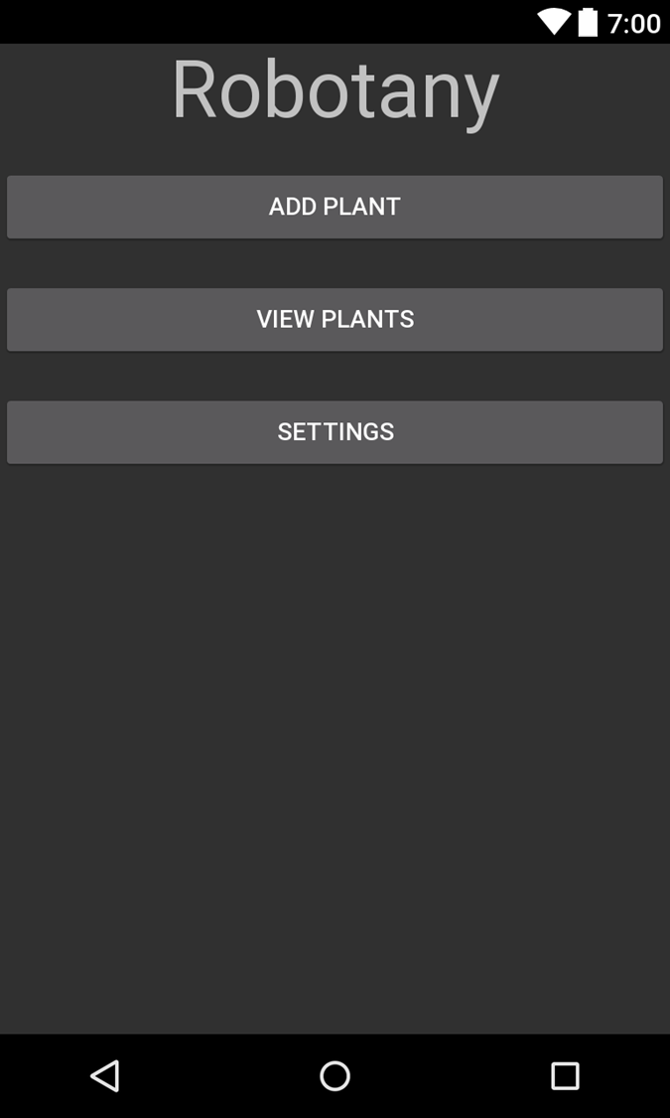
Step 3 - Home
Set app settings to connect to correct IP
Home Screen

Slide 13
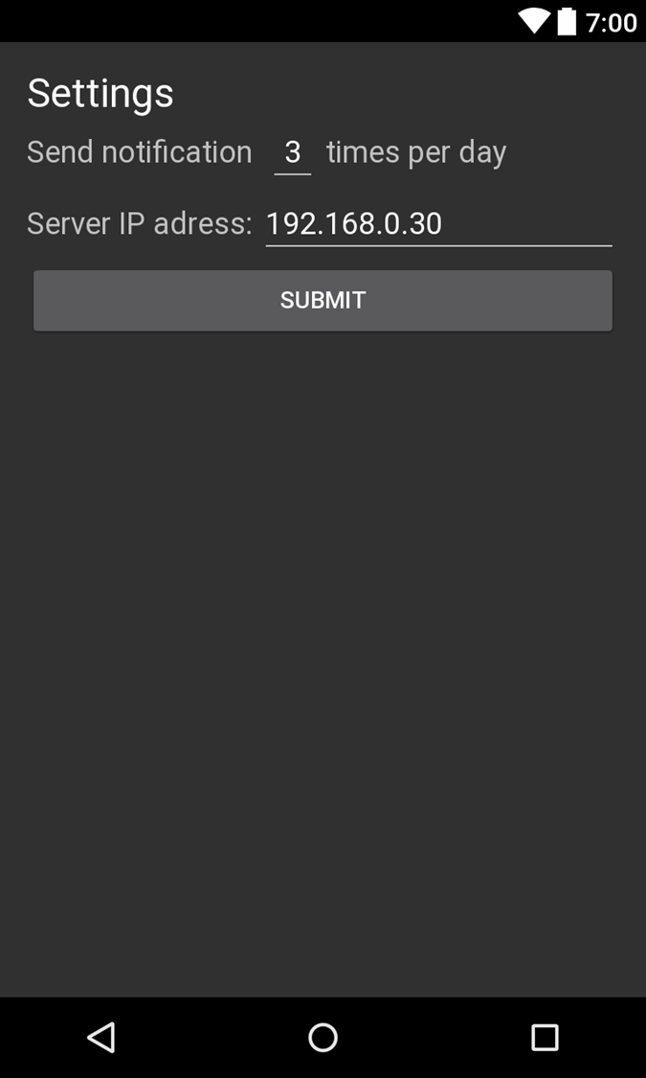
Step 3 - Settings
Set app settings to connect to correct IP
Settings screen

Slide 14
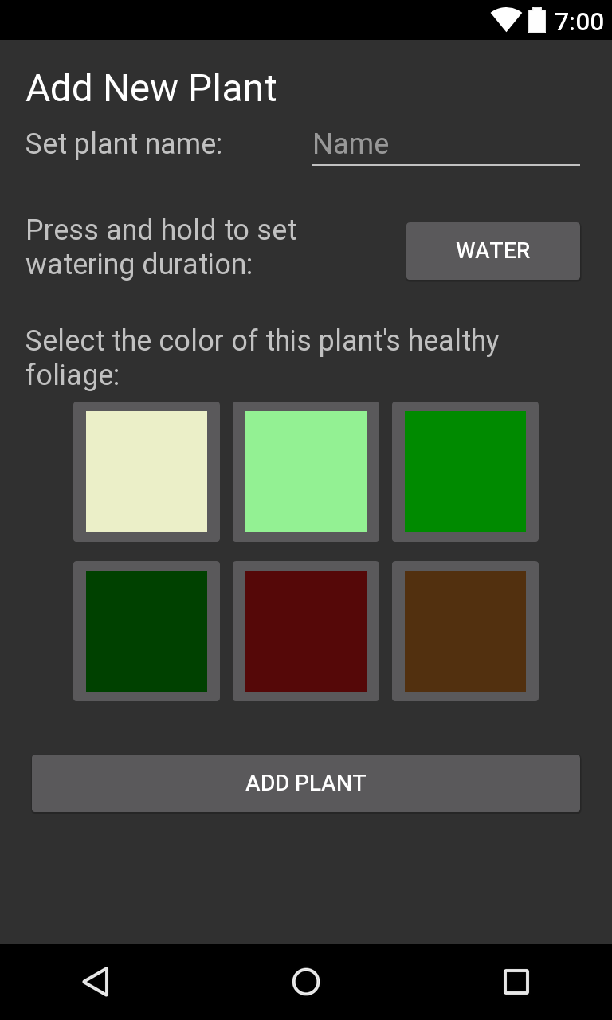
Step 4 – Add Plants
Add new plant in app
Server creates new entry in XML

Slide 15
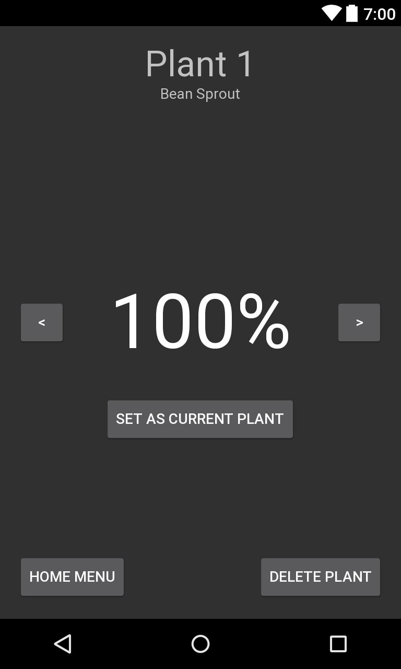
Step 5 – View Plants
Rate plant health daily
View plants screen

Slide 16
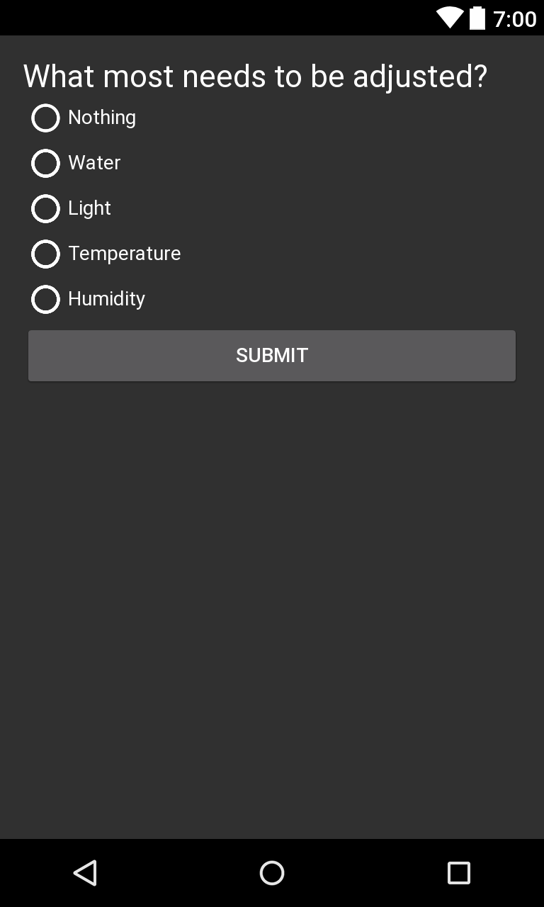
Step 5 – Rate Plants
Rate plant health daily
Rate screen

Slide 17
Step 6 – Decision Trees
Server uses compiled dataset to build a decision tree for each plant
Server adjusts water and light based on user rating using decision trees
Example:
Water reading
is less than 262?
Light reading is less than 4?
Temp reading is more than 82?
Humidity reading is less than 41?
Plant is Ok!
Sensors
No
No
No
No
Yes
Yes
Yes
Yes
Water the plant
Turn on the light
Alert the user appropriately

Slide 18
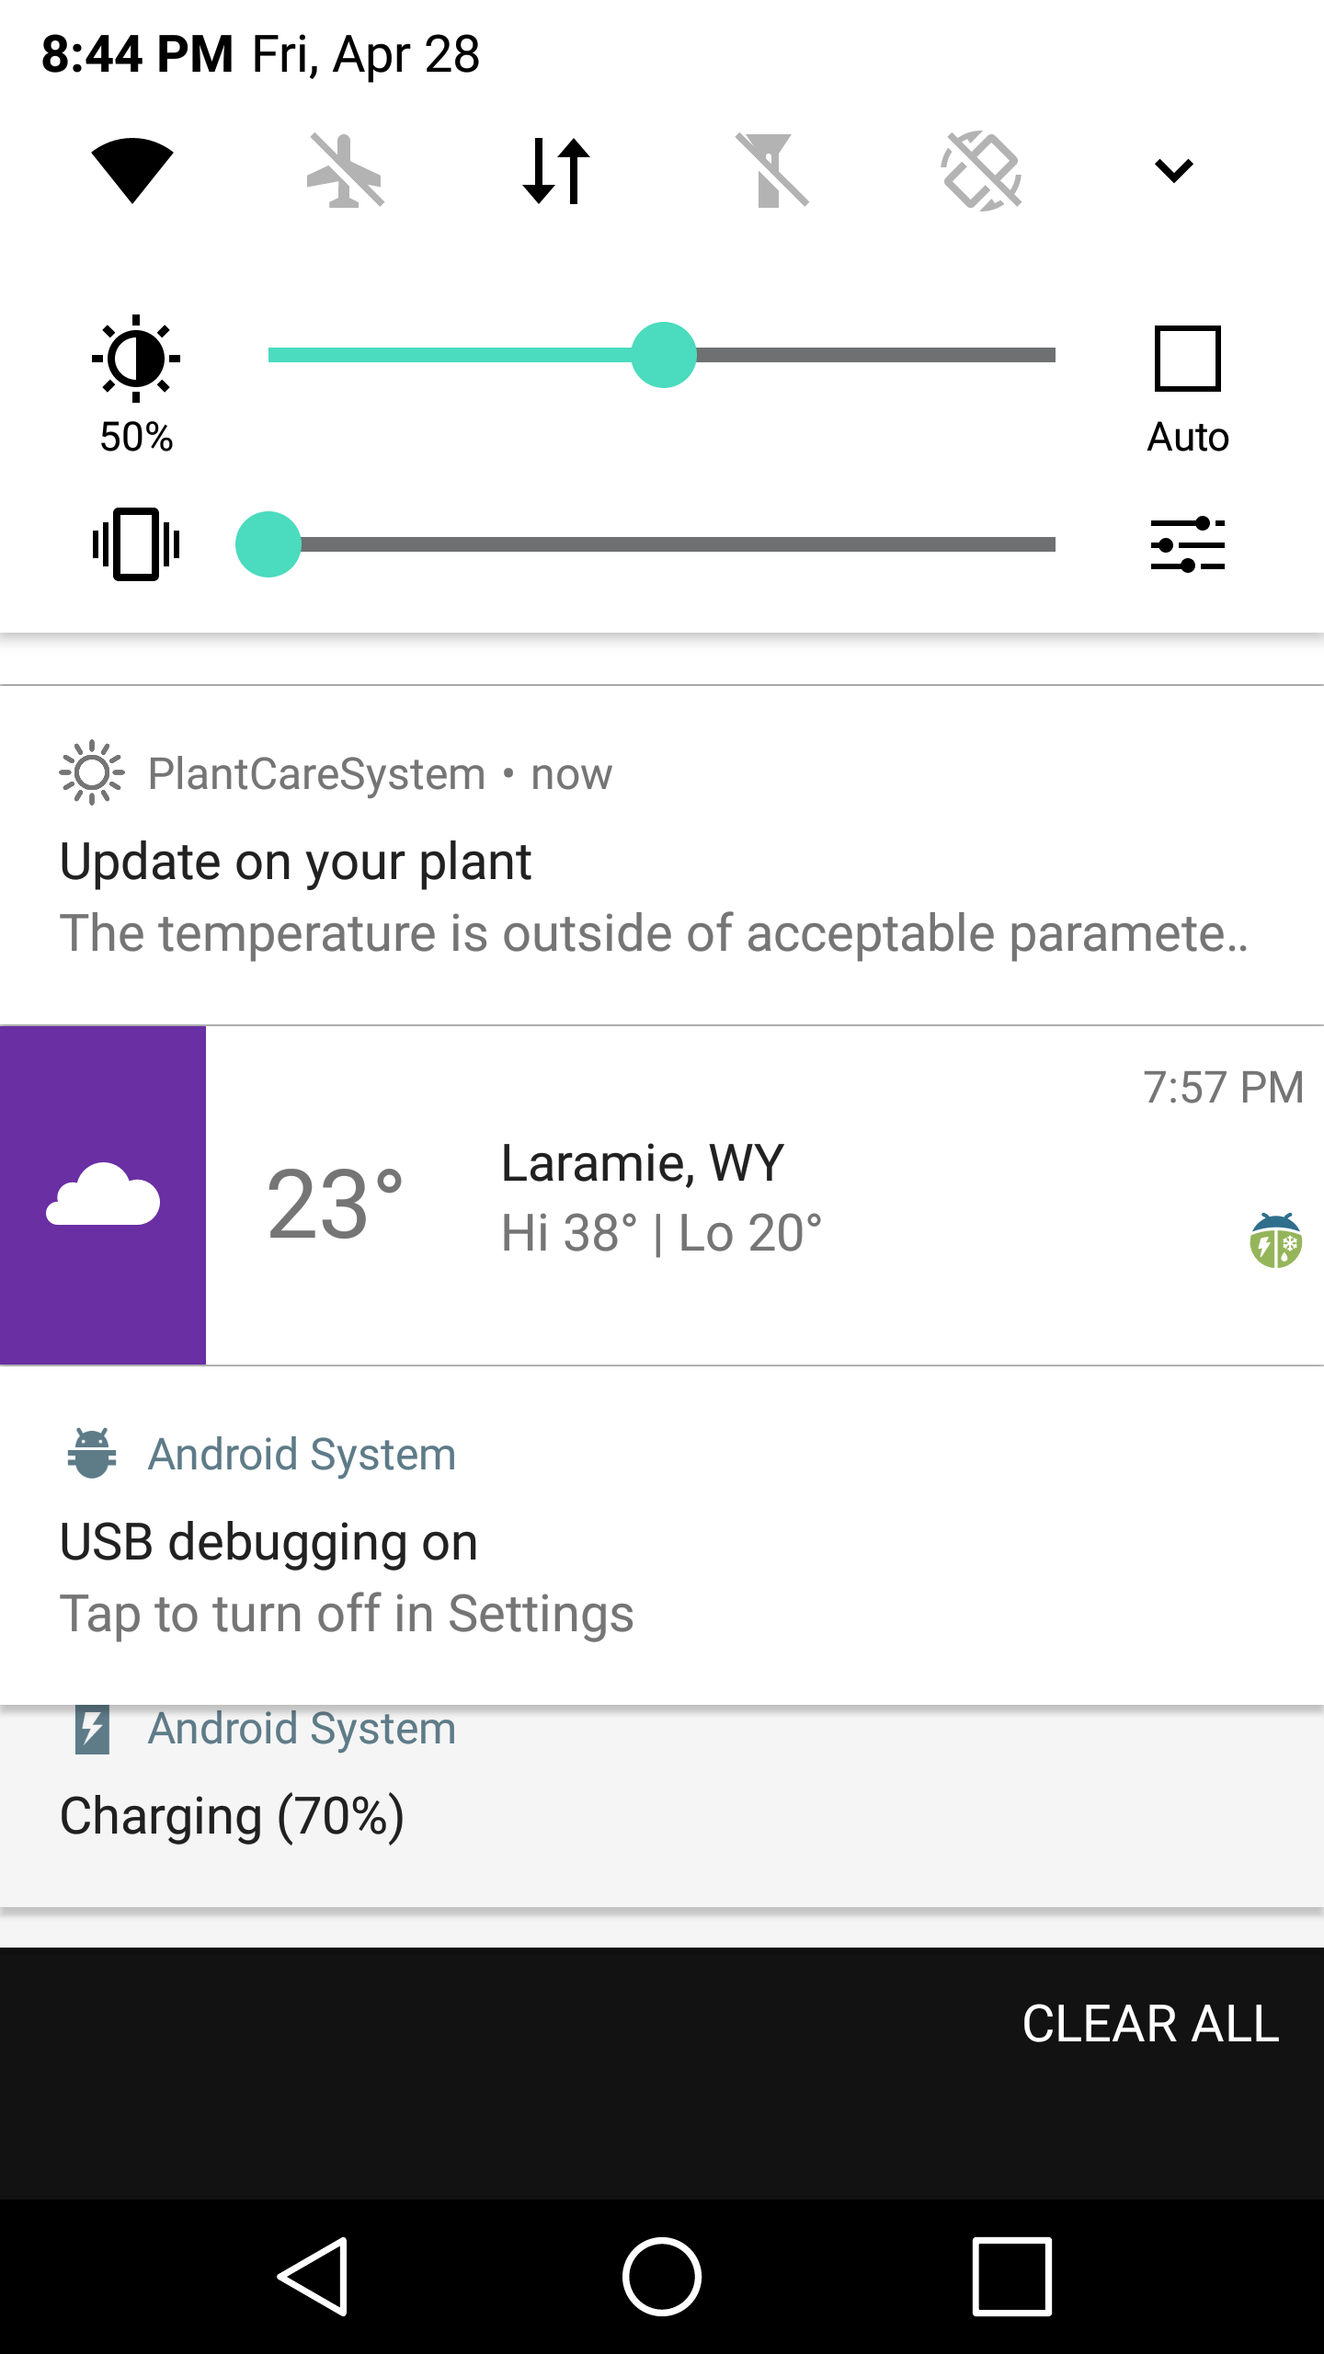
Step 7 – User Feedback
App notifies user if temperature or humidity needs to be adjusted

Slide 19
Organization
Python
ReST Server Decision Tree AI
Add/Remove Plants Format Data (Attach Timestamp)
Calculate Plant Health Builds Decision Trees
Update Plants Outputs Tree
Track a Current Plant Trees Decide Settings
Application
Display Plant Info Display Sensor Info
Plant Status Scoring Set a Current Plant
Set Water Timers Plant Data-basing to Server
Arduino
Read Settings Adjust Water Valve/Light
Read Sensors Read Camera
Send Sensor Data Send Camera Data

Slide 20
Difficulties
Almost all hardware

Slide 21
Final Product

