Slide 1
Reinforcement Learning
Jason Lee

Slide 2

Environment + Agent
Environment
State (What the agent sees to get best action)
Reward
Typically start with a start state (e.g. starting point of a game)
Agent
Action (based on policy)
After action, get new state and reward of the picked action from environment

Slide 3
Value based approaches
Value:
What is the value of being in a given state = V(S) (expected rewards from this state onwards)
What is the value of picking an action given this state? = Q(S,A)
Policy (How an agent picks actions given state):
Can act according to the value of state (pick action that maximizes Q or V functions)
Greedy
E-Greedy
What is the probability of picking an action based on state? P(A|S)
Policy gradient- adjust policy in the direction of the value function

Slide 4
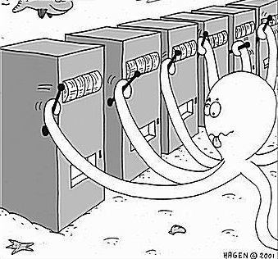
K-armed Bandit approach
K-number of actions (arms) to pick from regardless of state
Each arm has a probabilistic reward distribution, e.g. normal distribution with mean and std
State = features (or context)
Best for our use case!

Slide 5
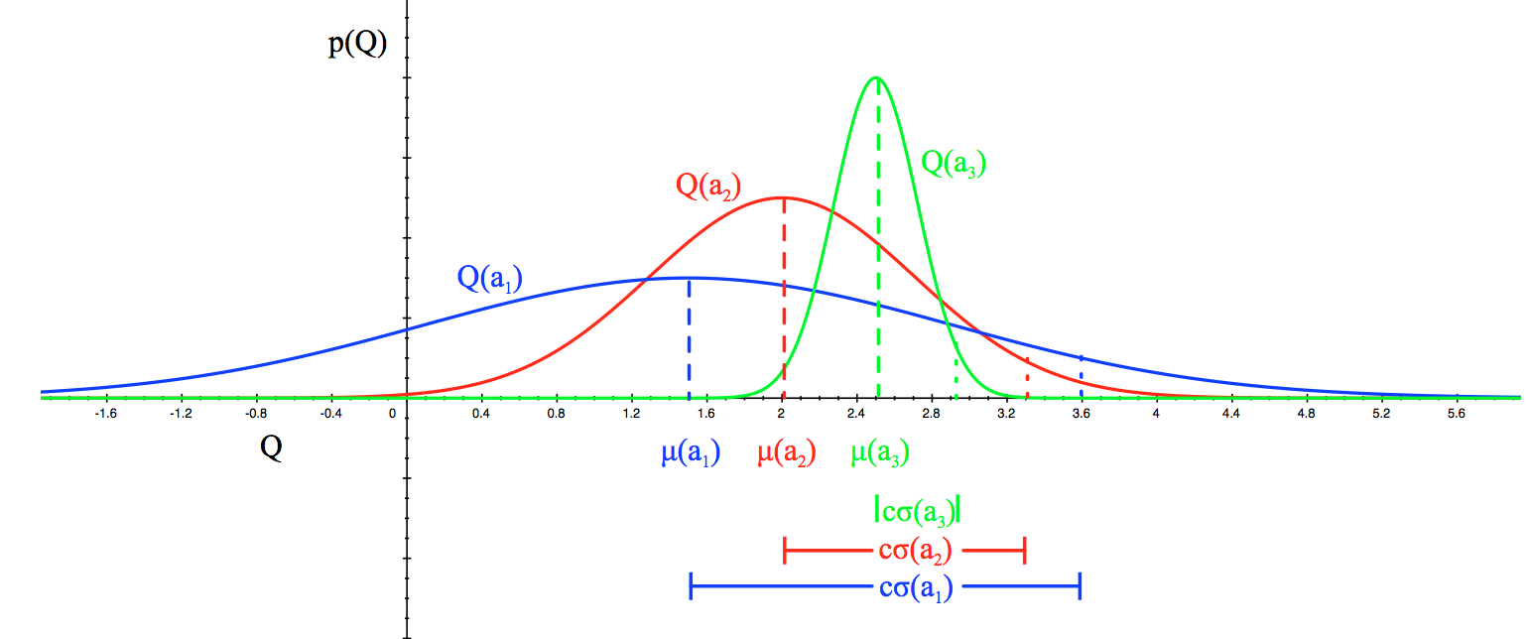
Exploration vs. Exploitation
Exploitation:
Exploiting an action that has been historically good may lead to missing out on a better arm
If we know the true values (true expected reward of action), exploiting the arm will yield better rewards
Exploration:
We test actions that have not been historically tested- we do not have an accurate confidence bound for the expected rewards (mean reward)

Slide 6
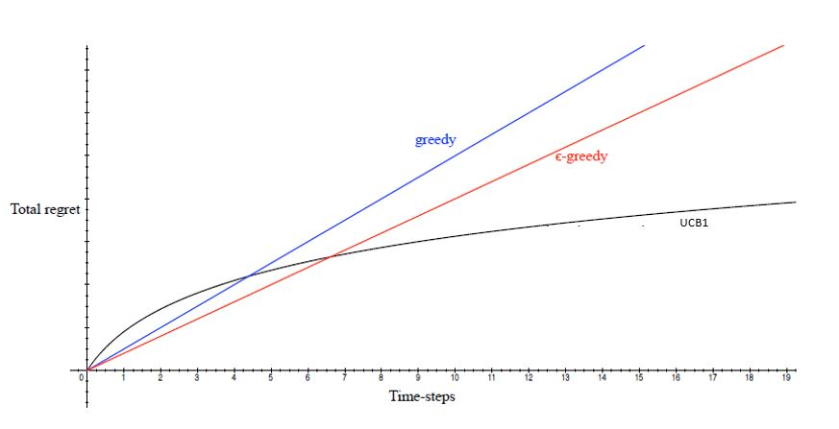
Regret
Regret = Q(optimal action) – Q(action picked)
We look to minimize this regret over time
Greedy: picks action that has the highest average return, no exploration
E-greedy: acts greedily with probability of 1-eps, explores actions randomly with probability of eps
Linear regret
Greedy
E-Greedy
Even with e-greedy, we will still pick sub-optimal actions as t → ∞ Linear regret
Logarithmic regret
UCB
Linear UCB
Thompson sampling (Bayesian approach)

Slide 7
Upper-confidence bound bandits example
A3 was picked many times
is well known: has a higher mean that a1 or a2 and a smaller standard deviation
= narrow confidence interval with high confidence
A1, A2 are not well known- the confidence interval is very broad and we do not know what the exact mean is
UCB gives more value to under-explored arms by using their upper-confidence bound:
A higher upper confidence bound = probability to be a better action than a3 (although it may be low, true mean can be higher!!)

Slide 8
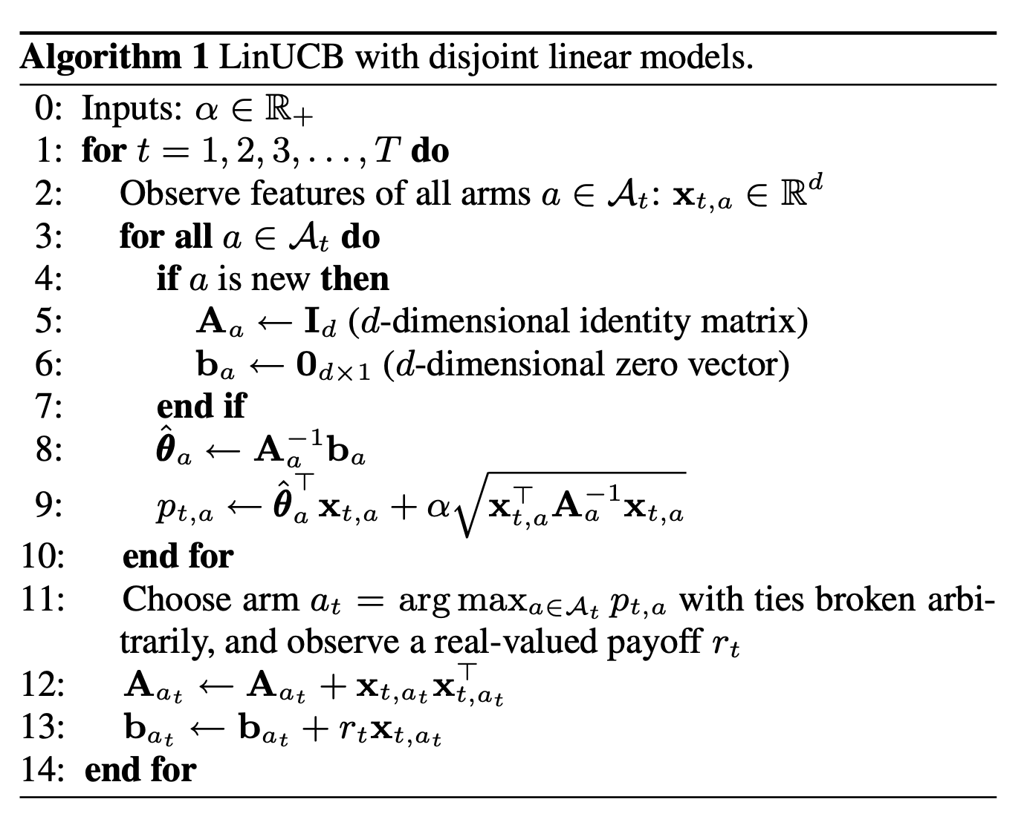
Linear UCB on Contextual Bandit
Track features (context) seen for each arm
Theta for each arm
Dx1 matrix, where d=number of features
Linear regression on probability of reward (expected reward)
Updated in the direction of the reward signal
Picks arm that outputs the highest probability for given feature
Linear regression can be turned into more powerful non-linear approximators like neural network to leverage representation in higher dimensions
https://arxiv.org/pdf/1911.04462.pdf
Best for our use case!
Yahoo article recommender
Netflix video recommender

Slide 9
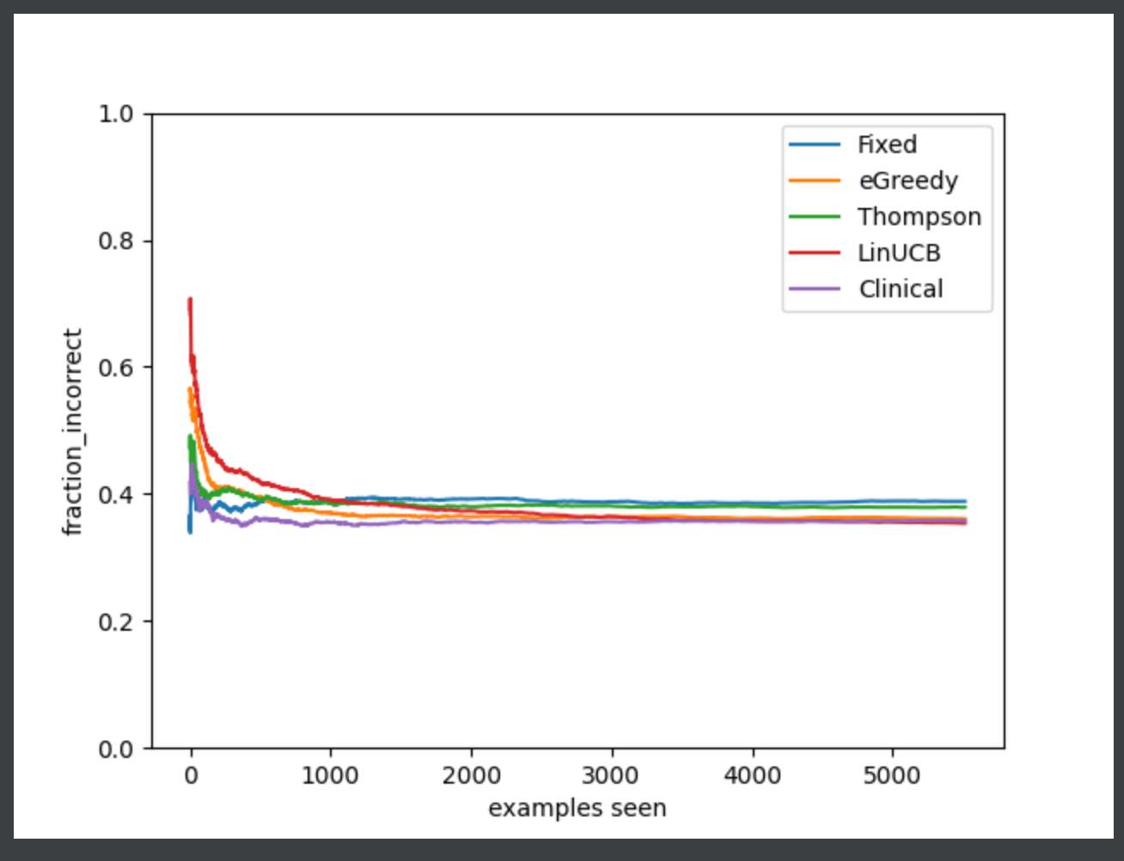
Code + Results
Warfaring dosage experiment
3 arms: [low, medium, high]
81 patient features like age, height, weight, gender, etc.
Linear UCB performs best over time
logarithmic regret

