Slide 1
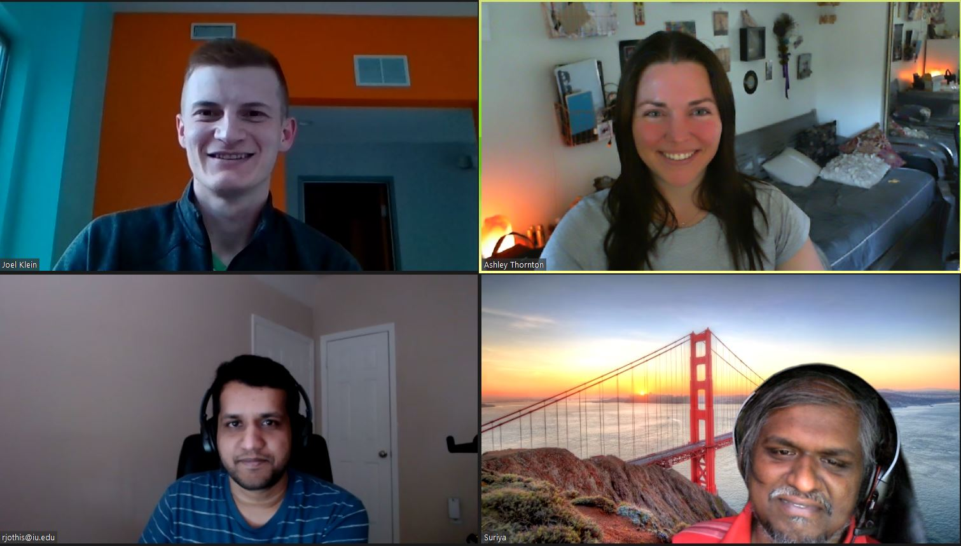
Home Credit Default Risk
Phase 2, Group 9 Rakesh Jothishankar, Joel Klein, Suriyadeepan Narayanasamy, & Ashley Thornton
INDIANA UNIVERSITY
Notes:
Hi everyone, we are group 9 and this is our phase 2 presentation for the home credit default risk project. Our group members are Rakesh, Joel, Suriya, and Ashley.

Slide 2
Contents
Overview
Data Prep
Exploratory Data Analysis
Pipelines
Results
Issues
Conclusion
Notes:
We will give you an overview of our project, review the data prep, EDA, and modeling we performed, display our results, discuss the issues that arose, and define our next steps.

Slide 3
Overview
Goal: Improve method of approving or declining loan applications.
Data: Home Credit data from Kaggle.
Methods: Logistic regression, XGBoost, & Light GBM.
Notes:
For phase 2 of our project, we focused on improving our phase 1 results by testing additional algorithms, incorporating the additional datasets, and feature engineering.

Slide 4
Data Prep
POS cash balance, installment payment, and credit card balance files get rolled up to the previous applications file joined by SK_ID_PREV.
Bureau balance file gets rolled up to the bureau file joined by SK_ID_BUREAU.
Joined previous application data and joined bureau data get rolled up to the applications file on SK_ID_CURR.
Features with a large amount of missing data or highly correlated to other features were removed.
Notes:
We joined all the data sources together and removed features that either had a high amount of missing data or were highly correlated with other features.

Slide 5
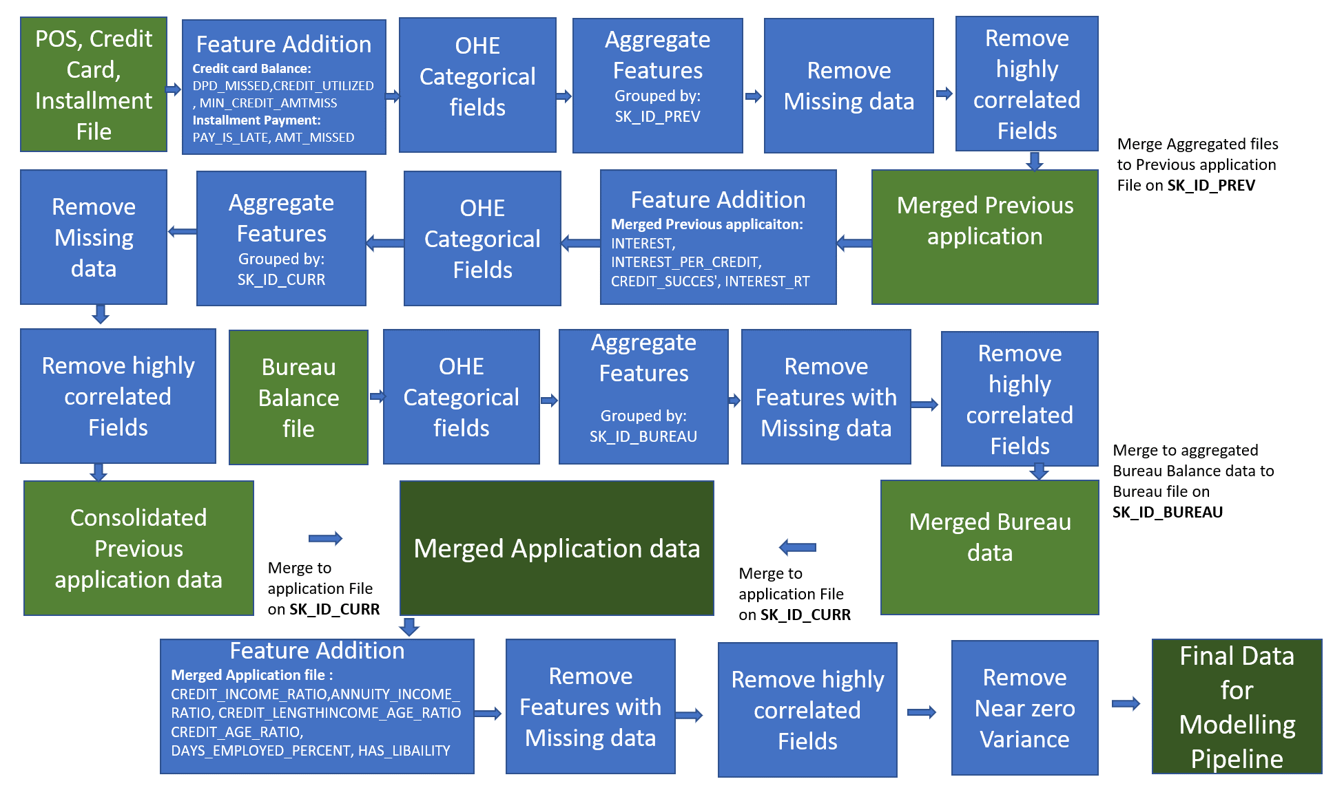
Data Prep
Notes:
Here we can see the details behind the data consolidation.

Slide 6
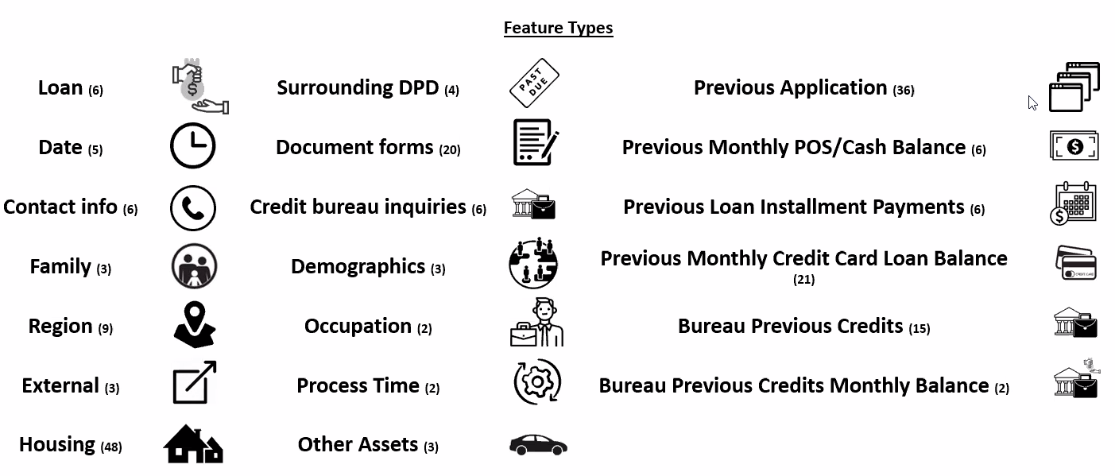
Feature List
Notes:
We utilized a total of 206 features.

Slide 7
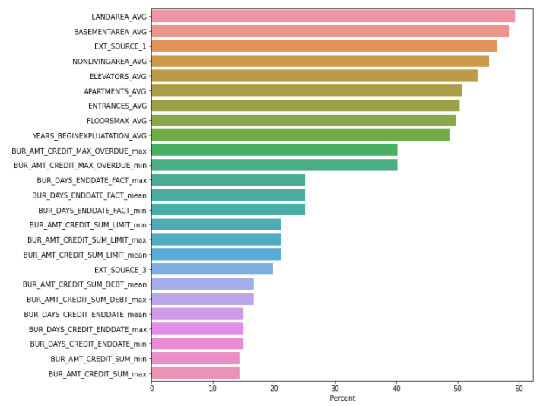
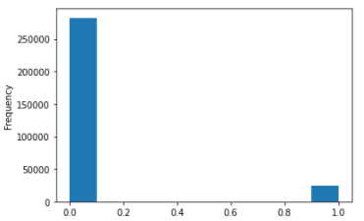
New EDA
Features with Most Missing Data
Target Frequency Distribution
Notes:
This slide displays the features with the most missing values and our target frequency distribution.

Slide 8
Data Handling Pipeline
New Engineered Features:
Late payment
Amount missed
Credit utilized
Min credit amount missed
Interest
Interest per credit
Credit success
Interest rate
Credit to income ratio
Annuity to income ratio
Credit length
Income to age ratio
Credit to age ratio
Percent of days employed
Liability
Imputed missing numeric values with median.
Standardized numeric features.
Imputed missing categorical values with “Unknown.”
OHE categorical features.
Featured engineered new features.
Removed near zero variance features.
Removed features with zero importance from previous model (for some test runs).
Notes:
Throughout our pipeline, we engineered many new features, imputed missing numeric values with the median, standardized numeric features, imputed missing categorical values with “unknown,” and one-hot encoded categorical features. Additionally, we removed features with near zero variance and with no importance.

Slide 9
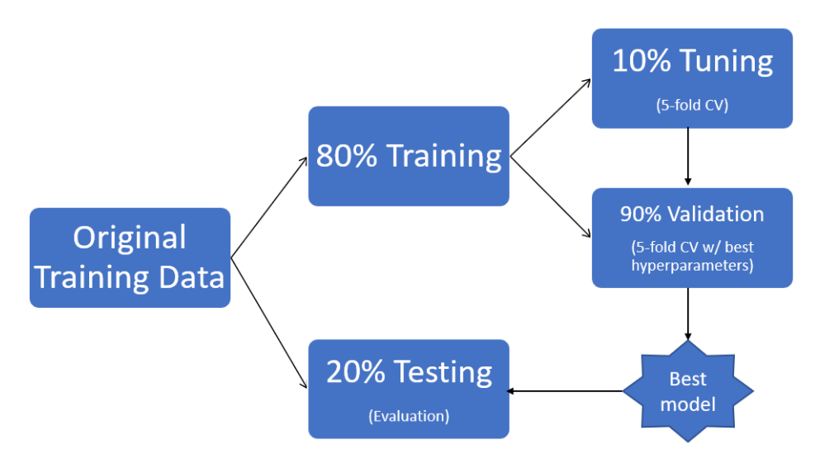
Sampling Method
Notes:
We randomly split the data into 80% for train and 20% for test. We used 5 fold cross validation for tuning and estimating accuracy.

Slide 10
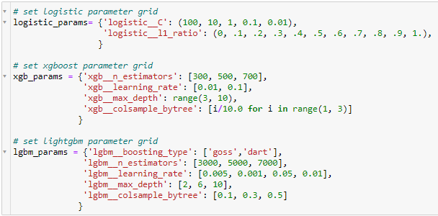
Modeling Pipeline
Models: - Logistic Regression - XGBoost - Light GBM - Random Forest
Hyperparameter Tuning:
Preprocessing: - All features - PCA (95% of variance) - Feature Selection - Synthetic Minority Over-sampling TEchnique (SMOTE)
Notes:
We ran many experiments, utilizing logistic regression, XGBoost, Light GBM, and random forest. We tried these algorithms with all features, using PCA to explain 95% of the variance, using feature selection, and tried oversampling with SMOTE because of the target imbalance. We ran grid search against a variety of parameters listed on this slide.

Slide 11
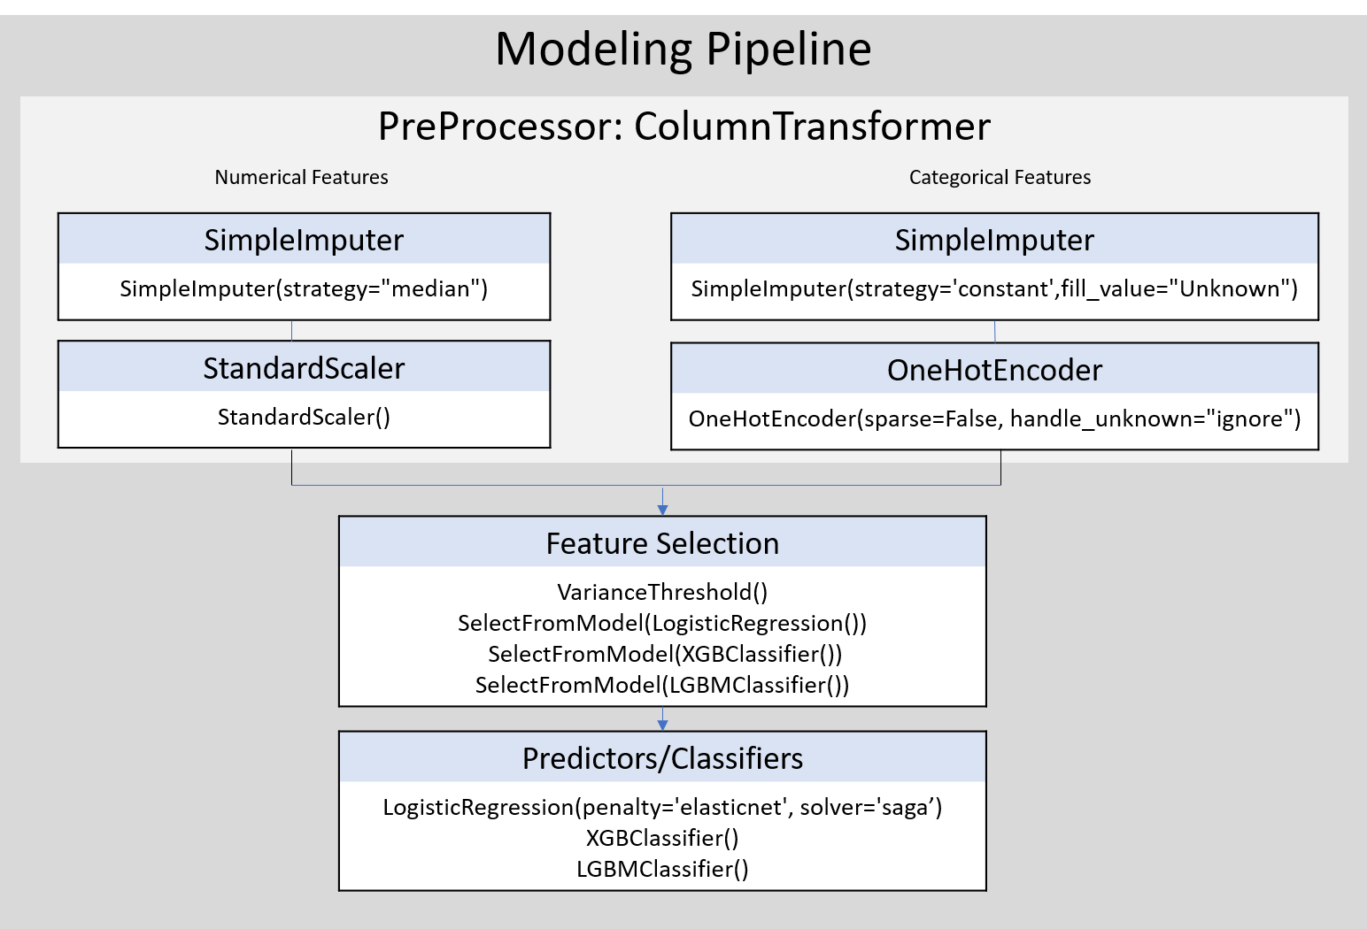
Modeling Pipeline
Notes:
This slide visually shows our entire pipeline.

Slide 12
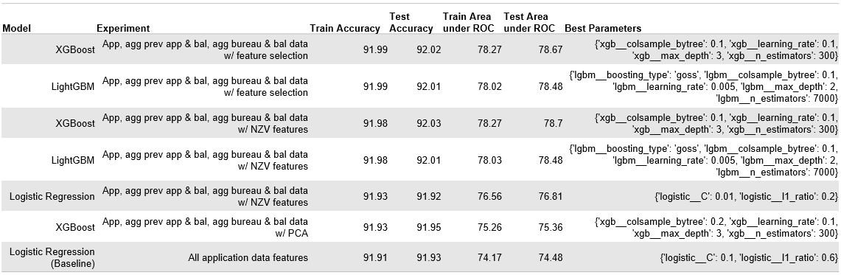
Results
Notes:
The best performing model was an XGBoost with feature selection, which scored 78.27 for train area under the ROC.

Slide 13
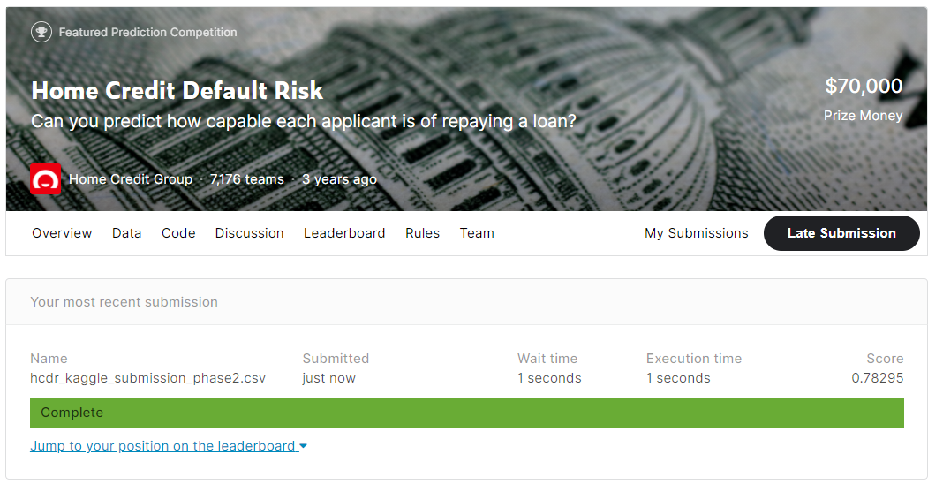
Kaggle Submission
Place: 3,834 out of 7,176
Notes:
After submitting our best run for this phase to Kaggle, we are currently in 3,834th place.

Slide 14
Issues
Size of data
Time constraint
Resource constraints
Notes:
In addition to the phase 1 issues, the new issue that arose this phase was resource constraints. We were able to work through this issue by using Google Colab.

Slide 15
Conclusion & Next Steps
Past
Defined project, performed EDA, and ran baseline model.
Present
Improved model through hyperparameter tuning and additional algorithms.
Future
Neural Network with PyTorch
Perceptron and SVM
Notes:
For phase 3, we plan to implement a neural network with Pytorch and experiment with a perceptron and support vector machine with Sklearn’s built in functions.

