Slide 1
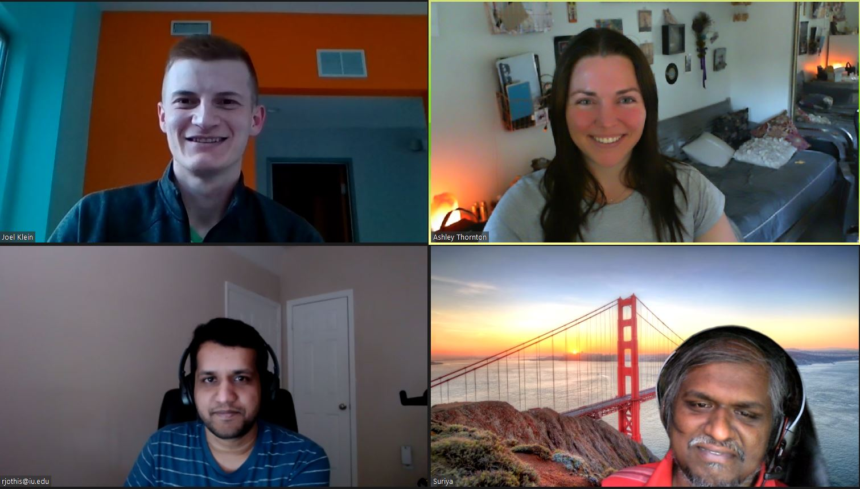
Home Credit Default Risk
Phase 3, Group 9 Rakesh Jothishankar, Joel Klein, Suriyadeepan Narayanasamy, & Ashley Thornton
INDIANA UNIVERSITY
Notes:
Hi class, we are group 9 and this is our phase 3 presentation for the home credit default risk project. Our group members are Rakesh, Joel, Suriya, and Ashley.

Slide 2
Contents
Overview
Data Prep
Exploratory Data Analysis
Pipelines
Results
Issues
Conclusion
Notes:
We will give you an overview of our project, review the data prep, EDA, and modeling we performed, display our results, and discuss the issues that arose.

Slide 3
Overview
Goal: Improve method of approving or declining loan applications.
Data: Home Credit data from Kaggle.
Methods: Logistic regression, XGBoost, Light GBM, Random Forest, SVM, & Neural Network.
Notes:
For phase 3 of our project, we focused on improving our phase 2 results by incorporating a neural network.

Slide 4
Data Prep
POS cash balance, installment payment, and credit card balance files get rolled up to the previous applications file joined by SK_ID_PREV.
Bureau balance file gets rolled up to the bureau file joined by SK_ID_BUREAU.
Joined previous application data and joined bureau data get rolled up to the applications file on SK_ID_CURR.
Features with a large amount of missing data or highly correlated to other features were removed.
Notes:
Previously, we joined all the data sources together and removed features that either had a high amount of missing data or were highly correlated with other features.

Slide 5
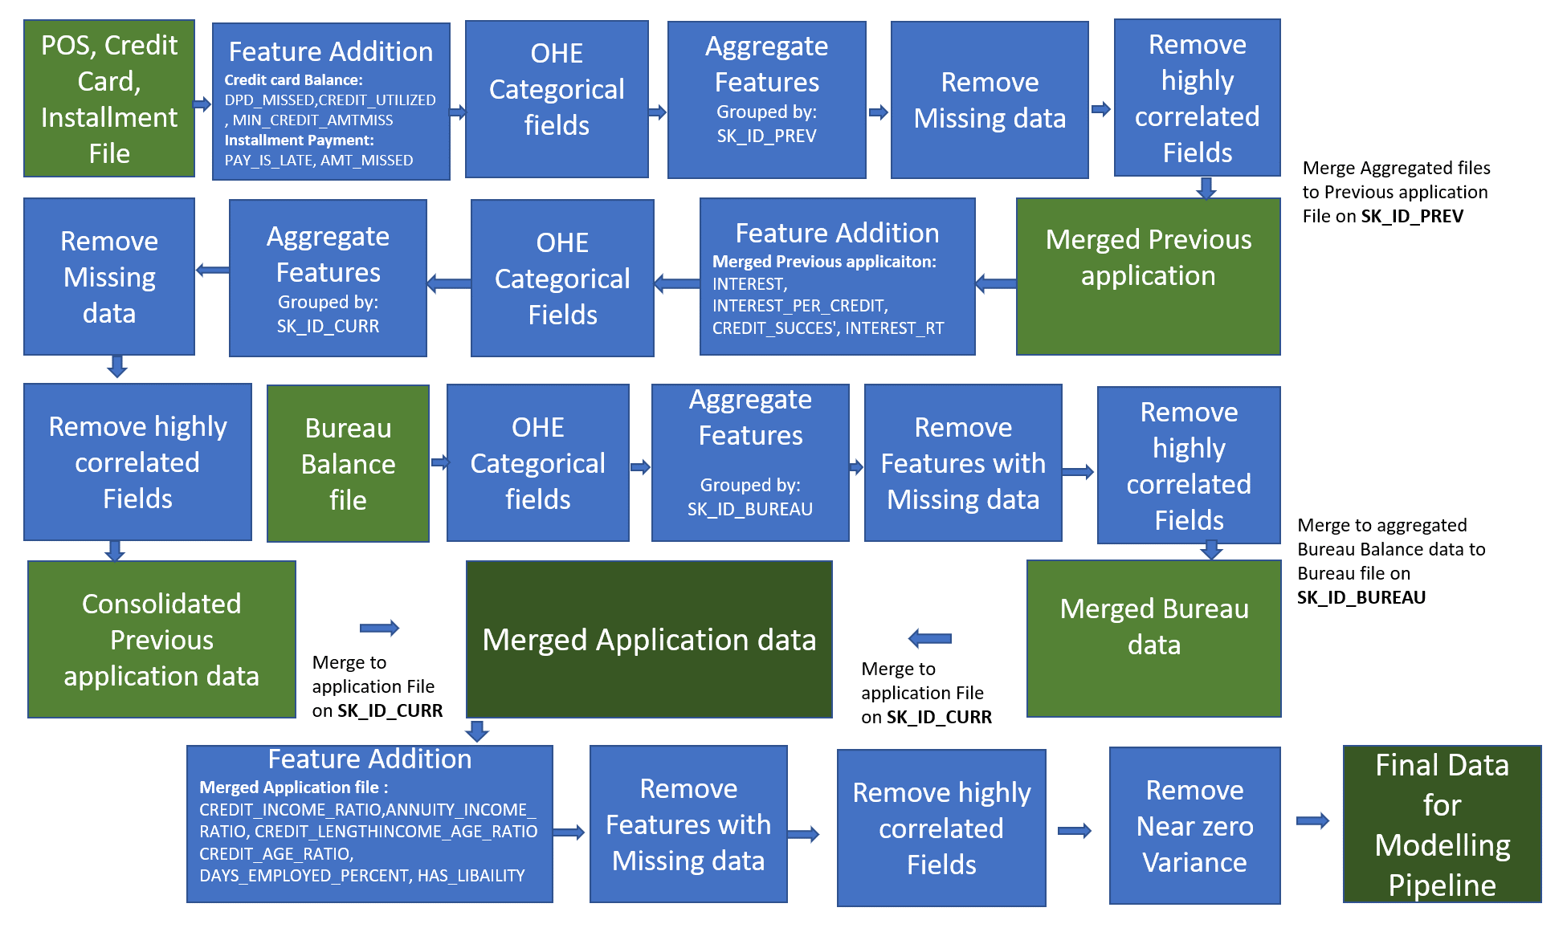
Data Prep
Notes:
Here we can see the details behind the data consolidation.

Slide 6
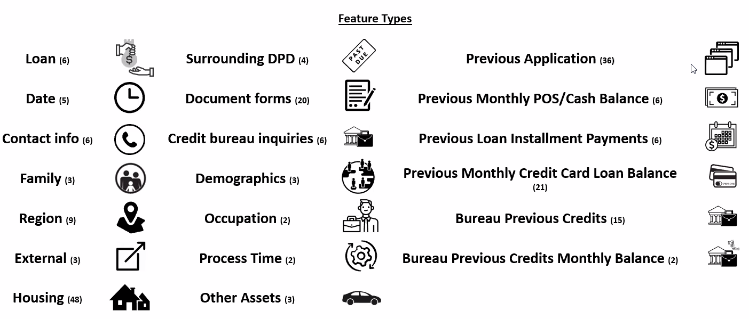
Feature List
Notes:
We utilized a total of 240 features.

Slide 7
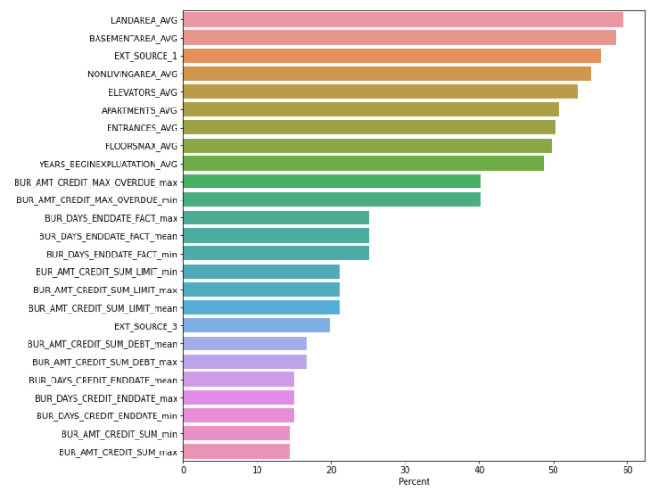
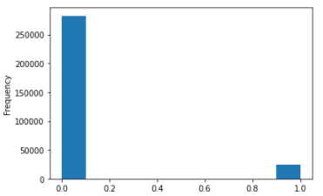
Exploratory Data Analysis
Features with Most Missing Data
Target Frequency Distribution
Notes:
This slide displays some of our EDA.

Slide 8
Data Handling Pipeline
New Engineered Features:
Late payment
Amount missed
Credit utilized
Min credit amount missed
Interest
Interest per credit
Credit success
Interest rate
Credit to income ratio
Annuity to income ratio
Credit length
Income to age ratio
Credit to age ratio
Percent of days employed
Liability
Imputed missing numeric values with median.
Standardized numeric features.
Imputed missing categorical values with “Unknown.”
OHE categorical features.
Feature engineered new features.
Removed near zero variance features.
Removed features with zero importance from previous model (for some test runs).
Notes:
Throughout our pipeline, we engineered many new features and cleaned the data.

Slide 9
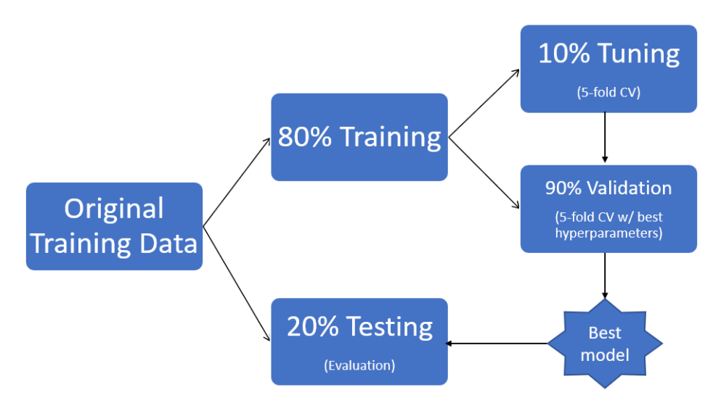
Sampling Method
80% Training
20% Validation
Notes:
We randomly split the data into 80% for train and 20% for test. We then split the training data into 80% train and 20% validation.

Slide 10
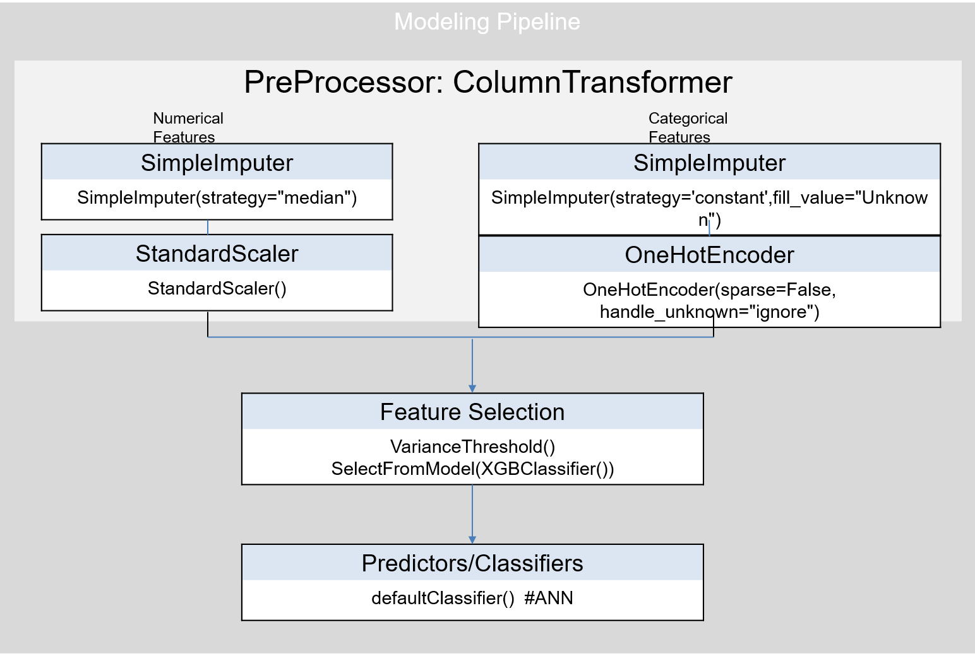
Modeling Pipeline
Notes:
This slide visually shows our pipeline.

Slide 11
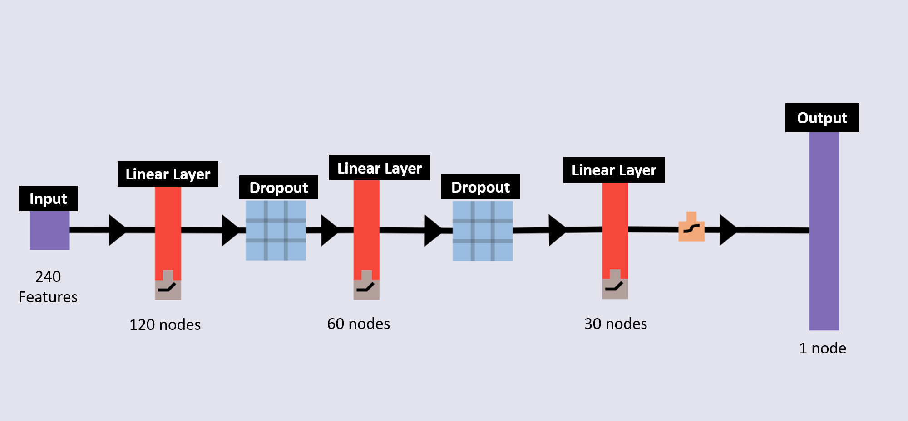
Artificial Neural Network Visualization
Notes:
For this phase, we focused on building a neural network in Pytorch. This slide visually represents our network.

Slide 12
Best Performing Model: Ensemble
Artificial Neural Network
-Batch size: 10,000
-Epochs: 15
-Learning rate: 0.001
XGBoost
-NZV features removed
-Learning rate: 0.1
-Max depth: 3
-Trees: 300
Light GBM
-Feature selection
-Boosting type: dart
-Learning rate: 0.005
-Max depth: 2
-Trees: 7000
Notes:
Our best performing model was an ensemble of models, stacking a neural network, XGBoost, and light GBM.

Slide 13
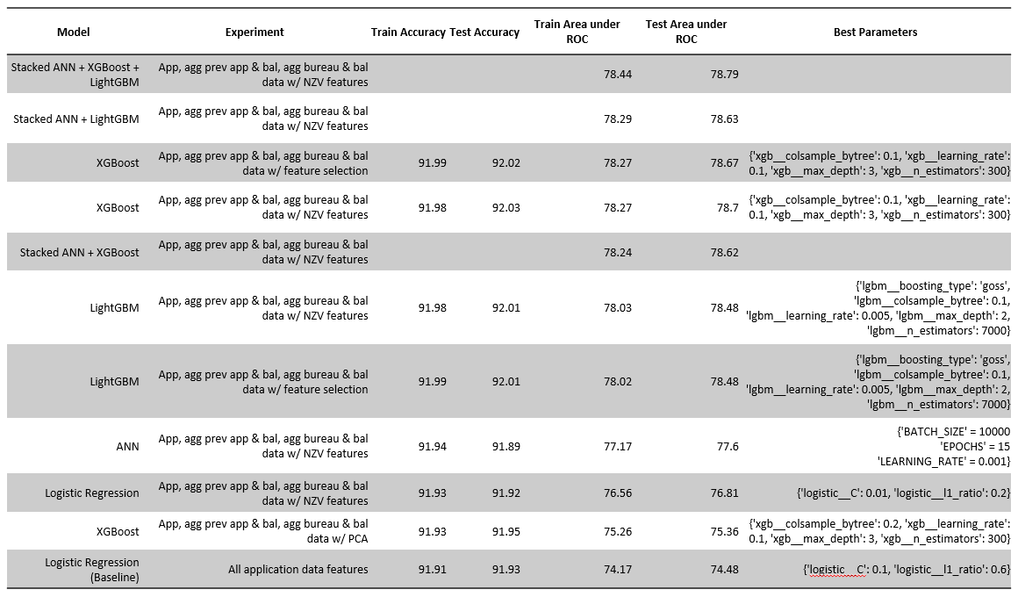
Results
Notes:
This ensemble scored 78.44 for train area under the ROC.

Slide 14
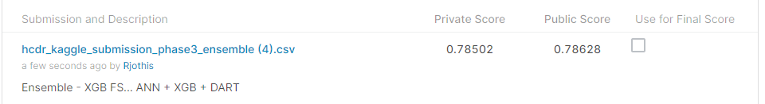
Kaggle Submission
Place: 3,651 out of 7,176
Notes:
After submitting our best run for this phase to Kaggle, we are in 3,651st place.

Slide 15
Phase 3 Issues
Size of data.
Sklearn is not optimized for training neural networks.
Additional experiments with SVM never completed.
Notes:
The main issues that arose in phase 3 include the size of the data and that Sklearn is not optimized for neural networks. Also, SVM never completed due to the data size.

Slide 16
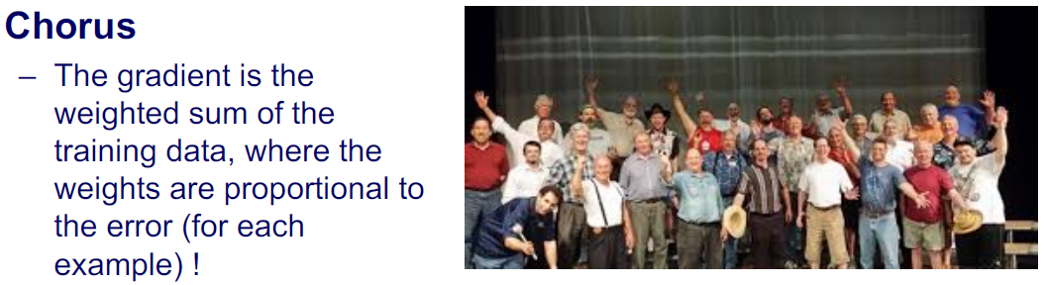
Conclusion
Past
Phase 1: Defined project, performed EDA, and ran baseline model.
Phase 2: Improved model through hyperparameter tuning and additional algorithms.
Present
Phase 3: Neural Network with PyTorch
Future
Professional root finders!
Notes:
In conclusion, we performed EDA, tested a variety of modeling methods, and achieved a respectable score against other Kaggle users.

