Slide 1
Major League Baseball (MLB) Pitcher Scouting Visualization
Joel Klein
INDIANA UNIVERSITY

Slide 2


Background & Motivation
MLB is 2nd highest grossing major sports league
Batting is incredibly challenging
Only $\frac{1}{4}$ second to see pitch
Only 31.7% of hitters reach base
How do hitters prepare?
Pregame detailed scouting reports:
Pitcher tendencies, history, & performance
How challenging is it?

Slide 3
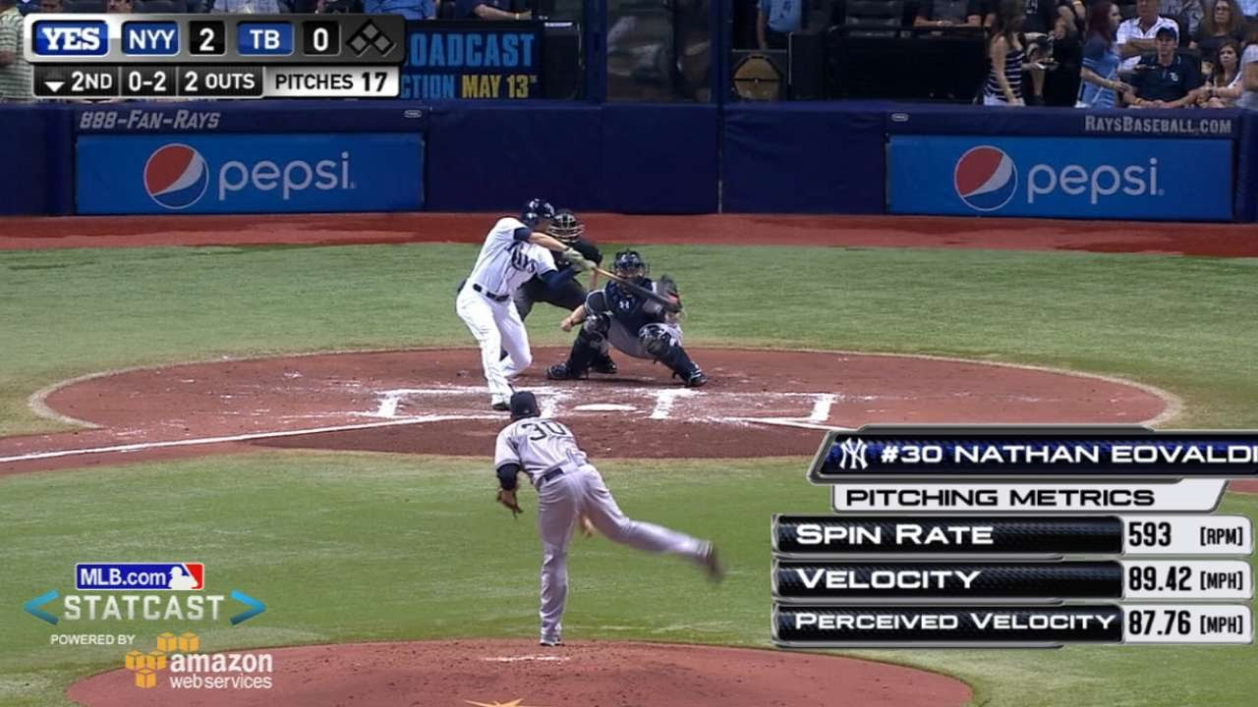
Data: MLB Statcast
MLB Statcast – S.O.T.A. tracking technology for MLB data collection & analysis
Implemented 2015
BaseballSavant.com provides MLB Statcast data via external API
Data set contents:
Pitcher & Hitter IDs
Game state (count, outs, inning, runners on base., etc.)
Pitch action (velocity, spin rate, direction, movement, etc.)
Pitch results (K, 1B, HR, etc., exit velocity, launch angle, etc.)
Scope:
2021 Starting Pitchers w/ 100+ pitches
No extra innings
No rare pitches (i.e. knuckleball, eephus, and screwballs)
In game MLB Statcast Measurements
Source: Youtube

Slide 4
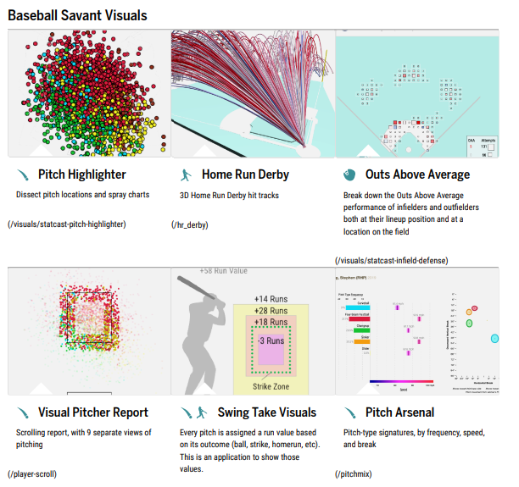
Prior pitcher viz attempts
MLB scouting reports are confidential
Public reports:
Media: ESPN, Fox Sports, etc.
Online articles & analyses
Baseball Savant
Interactive Pitcher Visualization Report

Slide 5
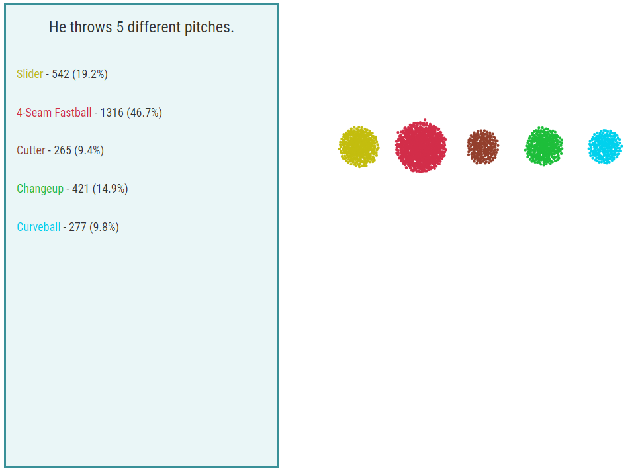
Prior attempts – Pitch Selection
Attempt: Number and percentage of pitches thrown for each pitch type
Critique:
Challenging to interpret and compare area
No sorting
Labels are away from marks
Objective: Sorted bar chart w/ percentages
Scherzer 2021 Pitches by Pitch Type

Slide 6
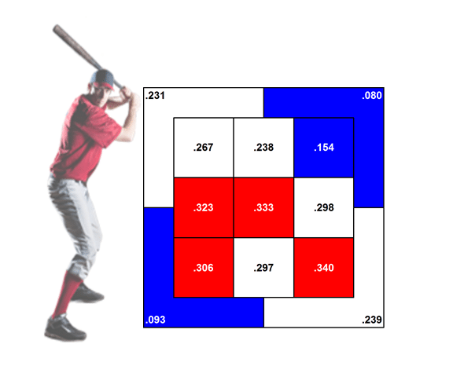
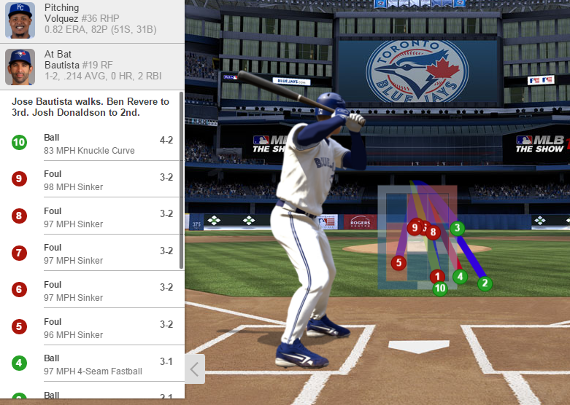
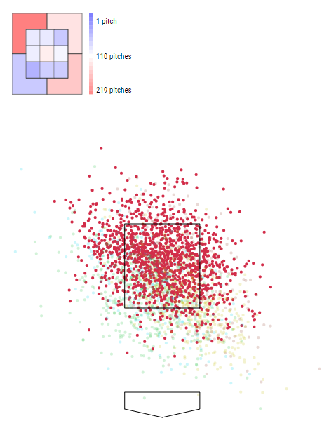
Prior attempts – Pitch Location
At-bat Strike Zone Graph
(Royal Review)
Partitioned Strike Zone Heat Map
(The Athletic)
Scherzer 2021 4-Seam Scatterplot
(Baseball Savant)

Slide 7
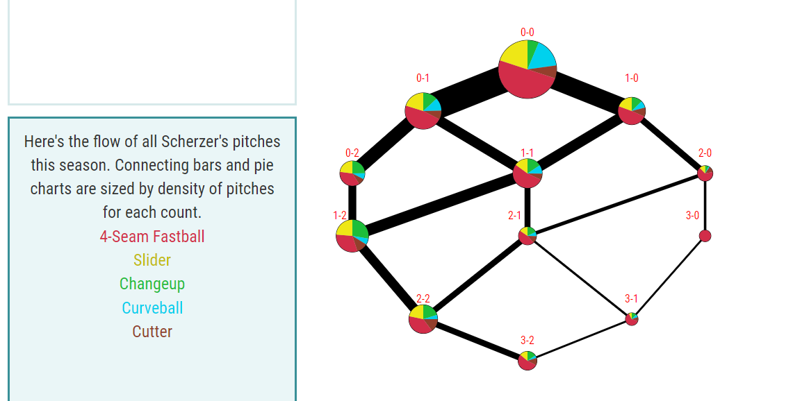
Prior attempts – Pitch Count
Attempt: Pitch type selection and number of pitches thrown by pitch count
Critique:
Challenging to interpret angles
Pie charts differ in size
No direct mark comparison
No data labels
Too many categories
Objective: Split to two charts
Sankey to highlight pitch flow
Stacked bar chart to show change in pitch selection
Scherzer 2021 Pitches and Pitch Type by Pitch Count

Slide 8
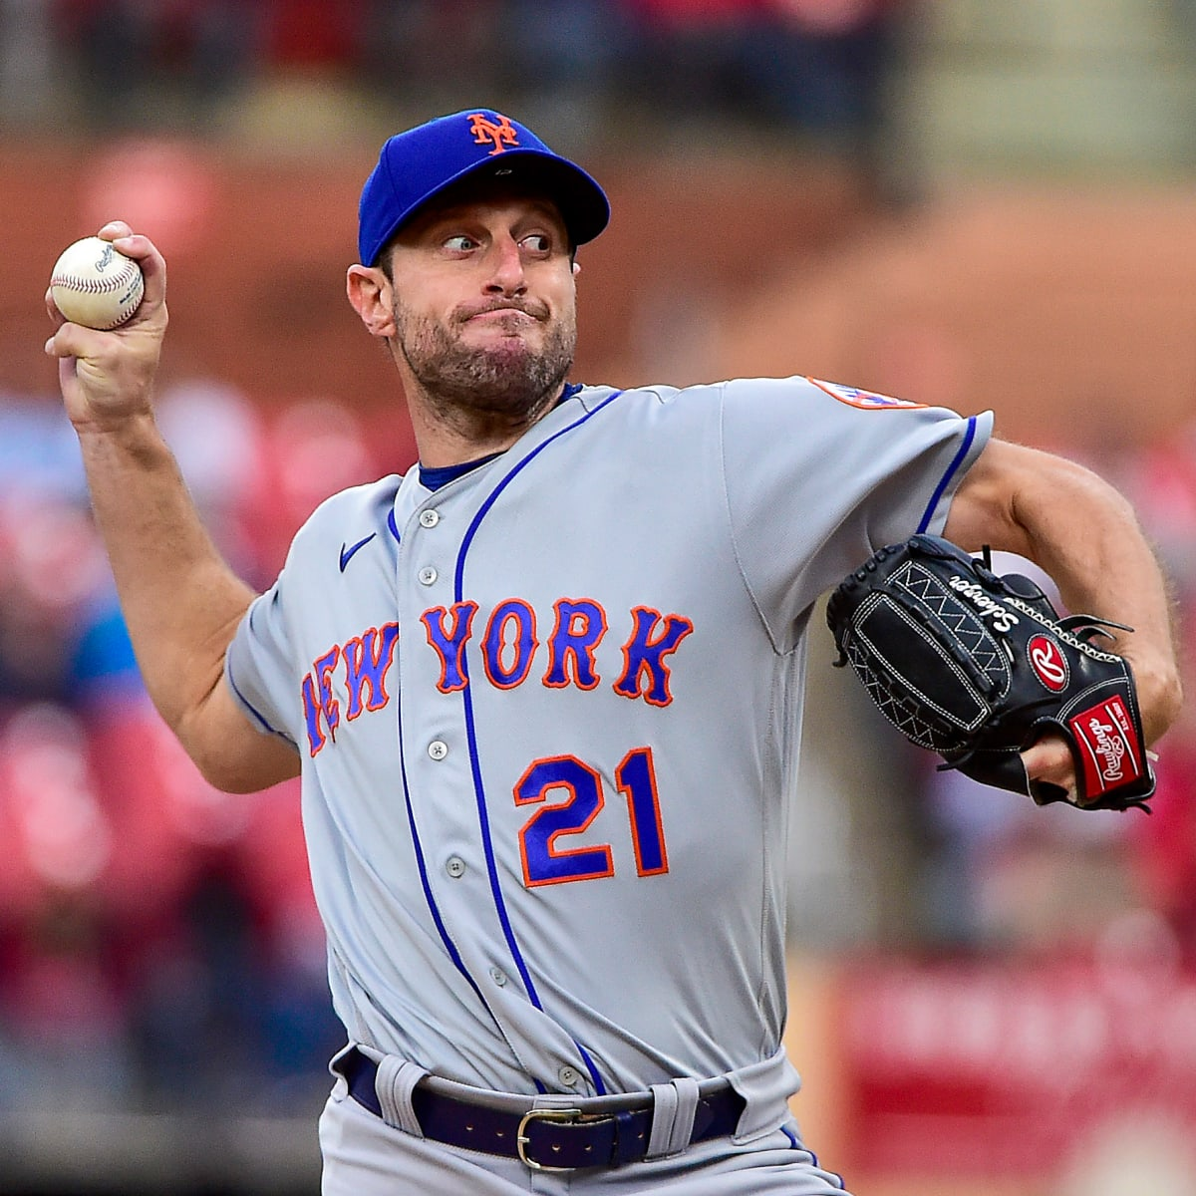
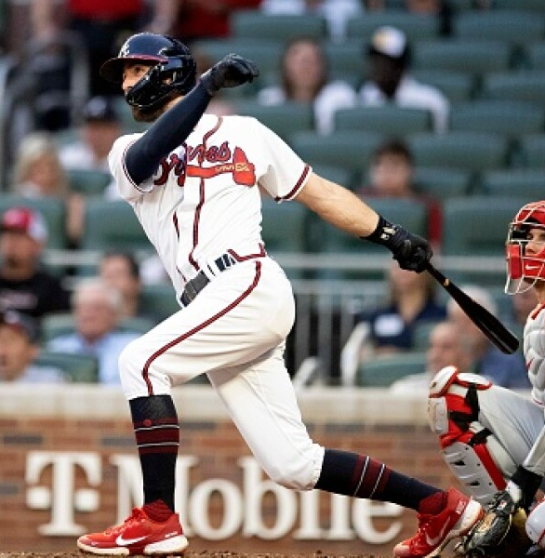
Max Scherzer
v. Dansby Swanson
8× All-Star (2013–2019, 2021)
World Series champion (2019)
2× All-MLB First Team (2019, 2021)
3× Cy Young Award (2013, 2016, 2017)
4× wins leader (2013, 2014, 2016, 2018)
3× NL strikeout leader (2016–2018)
Pitched two no-hitters in 2015
All-Star (2022)
World Series champion (2021)
Career Stats
Batting average .254
Home runs 92
Runs batted in 367

Slide 9
What to visualize?
Pitcher Tendencies | Pitcher Performance
Pitch Selection | At-bat Results
Pitch Location* | Batted Ball Contact Type
Pitch Count Flow | Batted Ball Location
Pitch Movement | MLB Comparison
Pitch Release Point
* Need to adjust strike zone for hitter height

Slide 10
Pitcher Tendencies
Max Scherzer

Slide 11
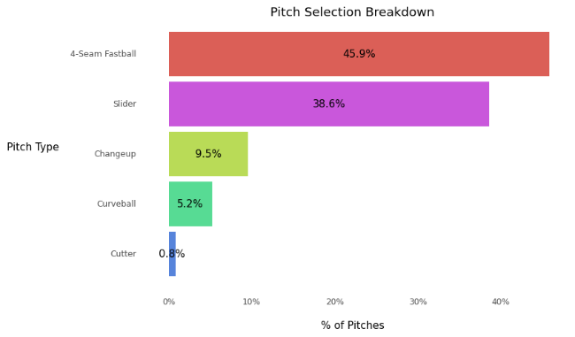
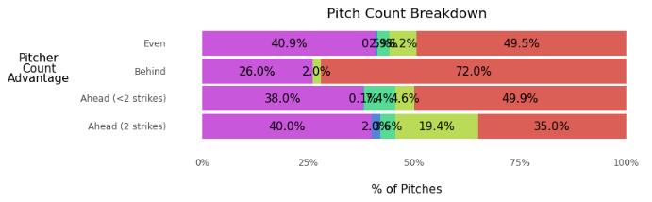
Pitch Selection
Figure: Max Scherzer Pitch Selection v. RH Batters
Figure: Max Scherzer Pitch Selection by Count v. RH Batters

Slide 12
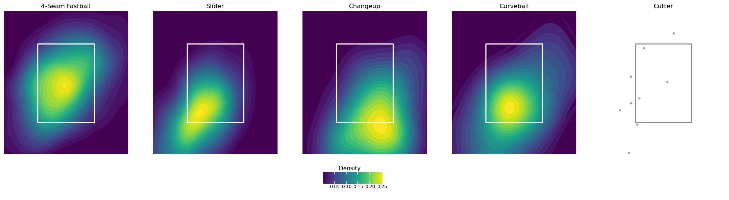
Pitch Location
Figure: Max Scherzer Pitch Location by Pitch Type v. RH Batters

Slide 13
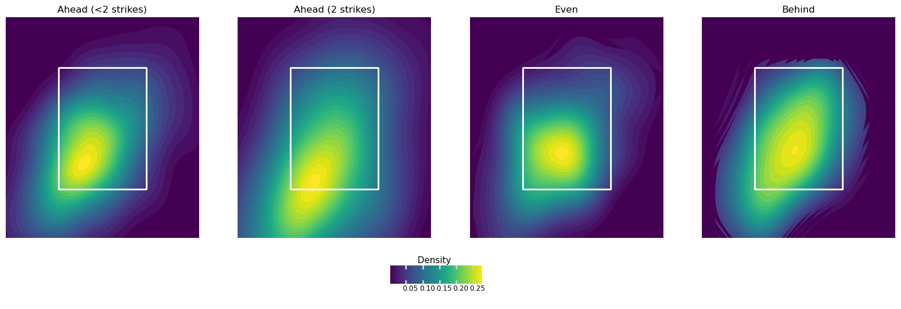
Pitch Location
Figure: Max Scherzer Pitch Location by Count v. RH Batters

Slide 14
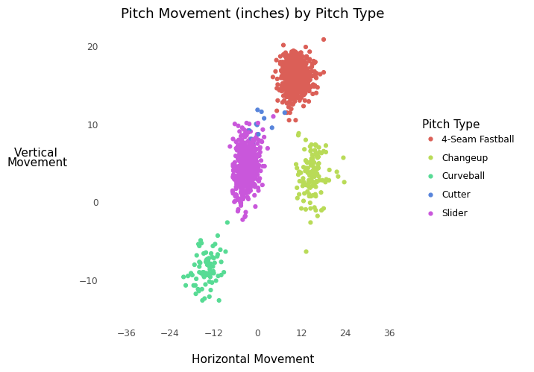
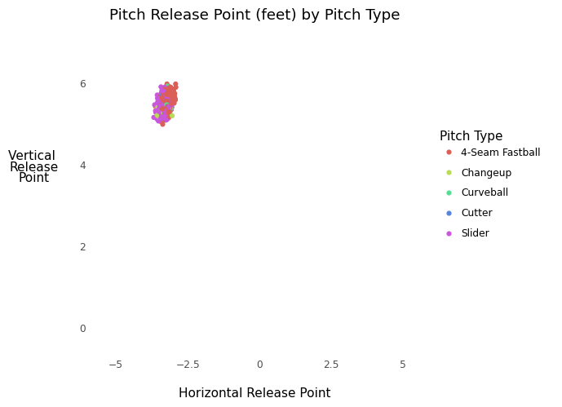
Pitch Action
Figure: Max Scherzer Pitch Release Point by
Pitch Type v. RH Batters
Figure: Max Scherzer Pitch Movement by
Pitch Type v. RH Batters

Slide 15
Pitcher Performance
Max Scherzer

Slide 16
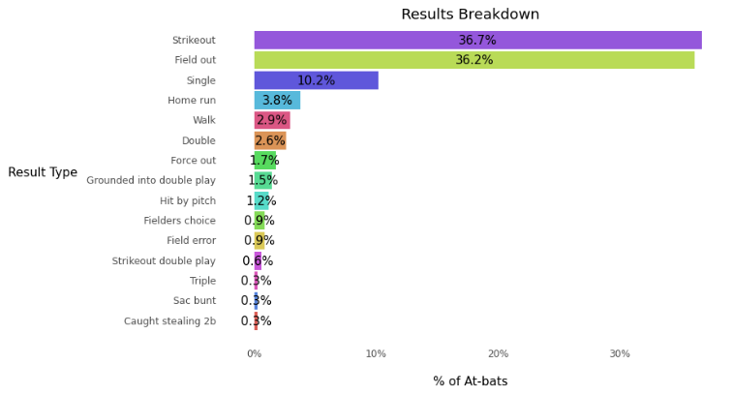
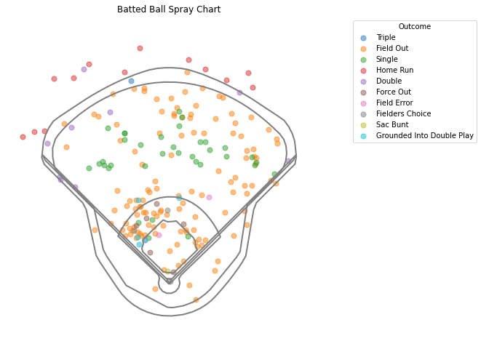
Pitch Results
Figure: Max Scherzer At-bat Results v. RH Batters
Figure: Max Scherzer Batted Ball Location v. RH Batters

Slide 17
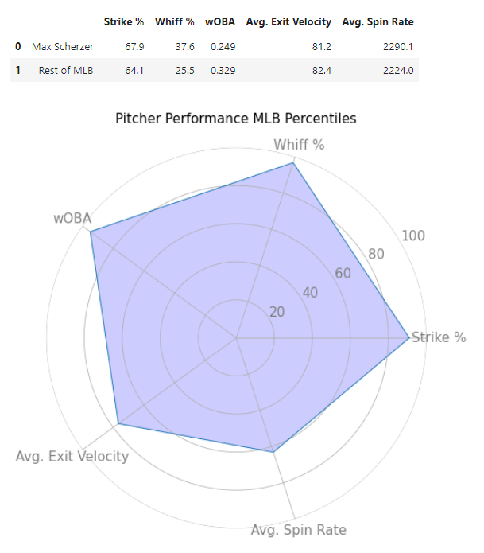
Pitcher Performance
Compare a pitcher to the rest of the league
Analyze their percentile rank
Modern day statistical categories
Strike %: | % of pitches deemed strikes
Whiff %: | % of pitches resulting in a swing and miss
wOBA | A version of on-base percentage accounting for how a player reached base. The value for each method of reaching base is determined by how much that event is worth in relation to projected runs scored (example: a double is worth more than a single)
Exit Velocity | How fast, in miles per hour, a ball was hit by a batter (on avg)
Spin Rate | How much spin, in revolutions per minute, a pitch was thrown (on avg)
Figure: Max Scherzer MLB Pitcher Comparison

Slide 18
Live Demo
Starting Pitcher Interactive Scouting Report

