Slide 1






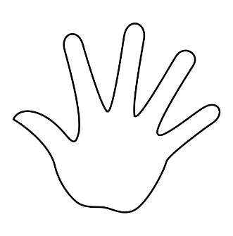

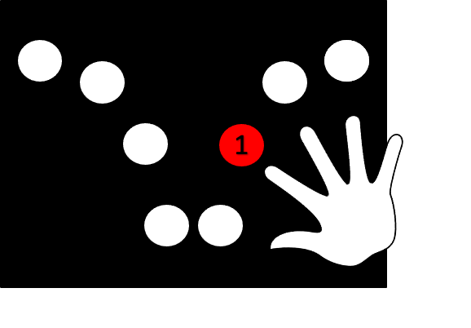
In this task, you will be shown a white circle or square that is presented on top of a picture of a negative or neutral image. When you see an image with the white SQUARE, you should press the button with your right index finger as fast as possible. If the image is with the white CIRCLE, you should NOT press the button with your right index finger. Below is an example trial sequence with a green checkmark for when you should press the button:
+
+
+
+
This is a practice phase. Try to always keep your eyes on the red plus sign.
Do you have any questions?

Slide 2
In this task, you will be shown a white circle or square that is presented on top of a picture of a negative or neutral image. When you see an image with the white SQUARE, you should press the button with your right index finger as fast as possible. If the image is with the white CIRCLE, you should NOT press the button with your right index finger. Below is an example trial sequence with a green checkmark for when you should press the button:
+
+
+
+
This is a real phase. There are 4 parts to this task. Try to always keep your eyes on the red plus sign.
Do you have any questions?

Slide 3
In this task, you will be shown a white circle or square that is presented on top of a picture of a negative or neutral image. When you see an image with the white CIRCLE, you should press the button with your right index finger as fast as possible. If the image is with the white SQUARE, you should NOT press the button with your right index finger. Below is an example trial sequence with a green checkmark for when you should press the button:
+
+
+
+
This is a practice phase. Try to always keep your eyes on the red plus sign.
Do you have any questions?

Slide 4
In this task, you will be shown a white circle or square that is presented on top of a picture of a negative or neutral image. When you see an image with the white CIRCLE, you should press the button with your right index finger as fast as possible. If the image is with the white SQUARE, you should NOT press the button with your right index finger. Below is an example trial sequence with a green checkmark for when you should press the button:
+
+
+
+
This is a real phase. There are 4 parts to this task. Try to always keep your eyes on the red plus sign.
Do you have any questions?

