Slide 1
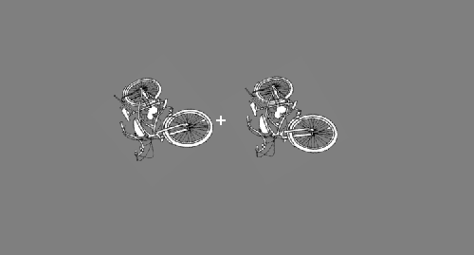
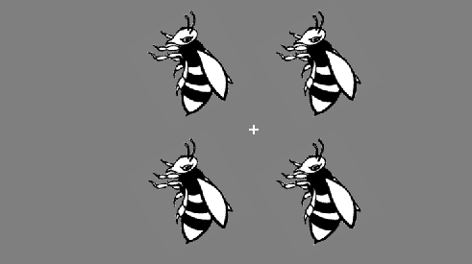
In this task you will be shown an object on the screen in 2 or 4 different locations.
The objects will be presented very briefly. Your task is to determine if the all of the objects on the screen are rotated the same, or if one of the objects in the display had a different rotation. If the all of the objects are rotated the same, press the “F” key. If one of the 2 or 4 objects is rotated differently than the rest, press the “J” key on the keyboard. It is important to keep your eyes fixated on the ‘+’ in the center of the screen at all times.
Different
Same
After the object display disappears, you will see a +. When you see the +, you should enter your response as quickly and accurately as possible. Prior to each new object trial you will see a +. Do you have any questions?

