Slide 1
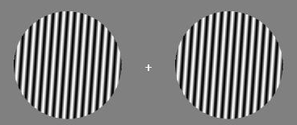

In this task you will be shown a circle with alternating white and black lines on the left and right side of the screen. This image will be presented very briefly. Your task is to determine if the left and right images are the same or if the are different. If the circles are both the same, meaning that they are rotated identically to each other (example on the left), then press the “F” key. If the two images are different, meaning that one circle is rotated differently than the other (example on the right), press the “J” key. It is important to keep your eyes fixated on the ‘+’ in the center of the screen at all times.
After the two images disappear, the + will change to +. When you see the +, you should enter your response for whether the two circles were the same or different using the keys mentioned above. Please enter your responses as quickly and accurately as possible. Do you have any questions?

