Slide 1
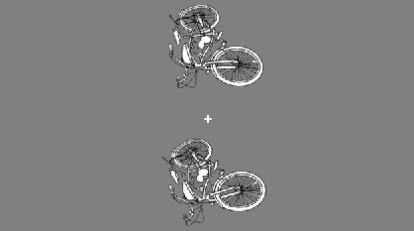
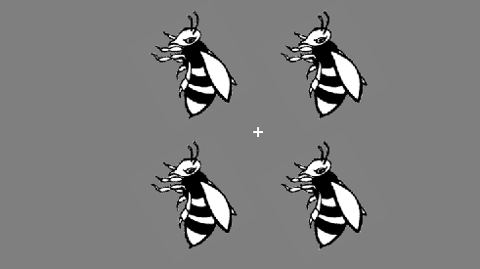
In this task you will be shown an object on the screen in 2 or 4 different locations.
The objects will be presented very briefly. Your task is to determine if the all of the objects on the screen have the same rotation, or if one of the objects in the set has a different rotation. If the all of the objects have the same rotation, press the “F” key. If one of the objects is rotated differently than the rest, press the “J” key on the keyboard. It is important to keep your eyes fixated on the ‘+’ in the center of the screen at all times.
Different
Same
Enter your response when you see the + (with a response scale below it). When you see the +, you should enter your response as quickly and accurately as possible. Prior to trial you will see a +. Do you have any questions?

