Slide 1
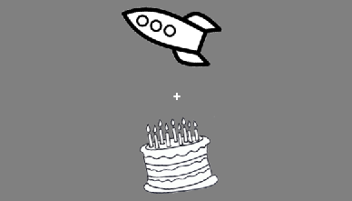
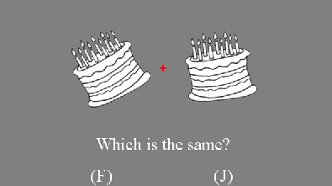
In this task you will be shown a set of 2 or 4 objects that will remain on the screen for a few seconds. Each object in the set will be rotated differently on the screen. Your task is to try and remember the orientation of each object. You will see a + prior to the presentation of a new set of objects to remember.
After seeing the set of objects, there will be a brief delay, and then your memory for the rotation of each object in the set will be tested. On each test trial the object will appear in two locations on the screen (left or right) with two different rotations. Your task is to select the object that has the exact same rotation as when you saw it initially. If you believe the object on the left has the same rotation as the study phase, press the “F” key. Press the “J” key if you believe the object on the right is the same rotation as the study phase. Please enter your responses quickly while trying to remain as accurate as possible. You should enter your response when you see the + on the screen.
Study
Delay
Test
+
+

