Slide 1

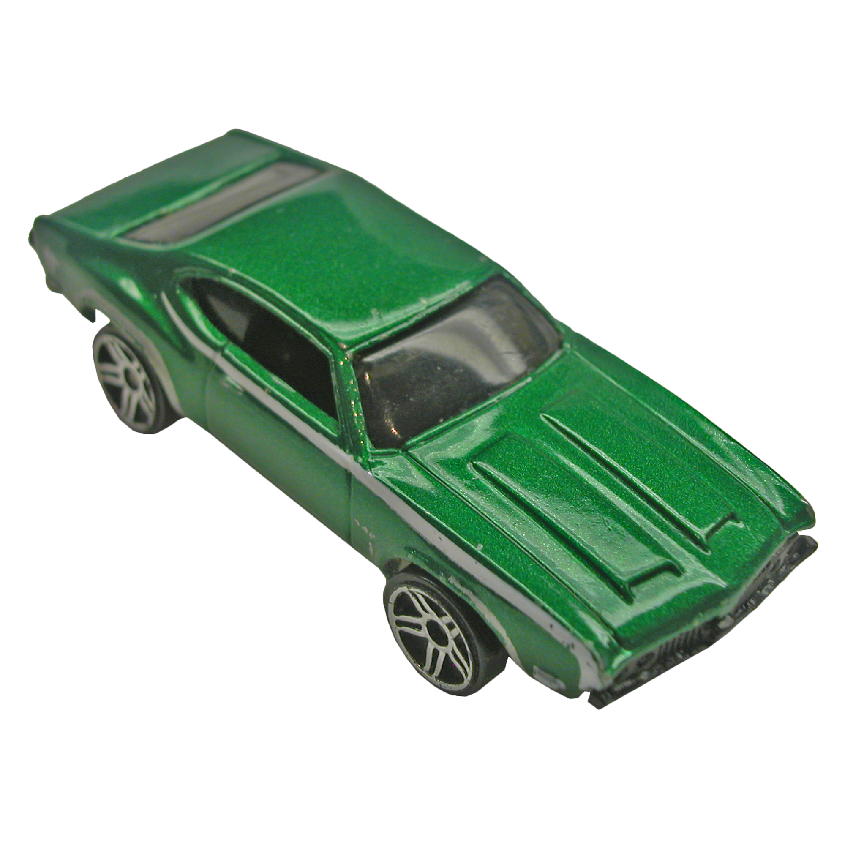
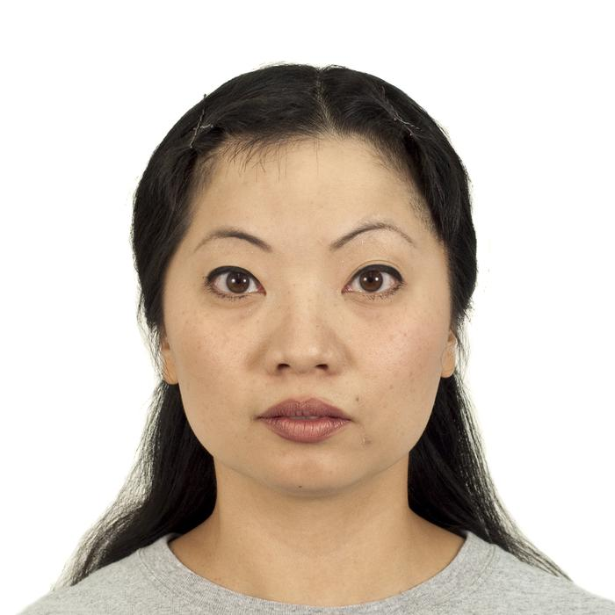


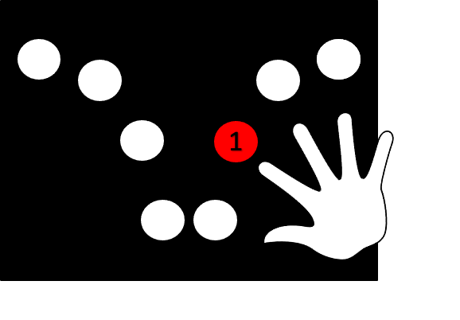
In this task, you will be shown images of faces, scenes, and objects. Most of the images will only be presented once, but on occasion the same image will be shown twice in a row. When you see an image that is IDENTICAL to the prior image, press the button using your right index finger as quickly as possible. Below is an example trial sequence with a green checkmark for when you should press the button:
+
+
+
+
This is a practice phase.
Do you have any questions?

Slide 2
In this task, you will be shown images of faces, scenes, and objects. Most of the images will only be presented once, but on occasion the same image will be shown twice in a row. When you see an image that is IDENTICAL to the prior image, press the button using your right index finger as quickly as possible. Below is an example trial sequence with a green checkmark for when you should press the button:
+
+
+
+
This is a real phase. There are 3 blocks of this phase each lasting around 5 minutes.
Do you have any questions?

Slide 3
In this task, you will be shown images of faces, scenes, and objects. Most of the images will only be presented once, but on occasion the same image will be shown twice in a row. When you see an image that is IDENTICAL to the image presented to you 2 trial ago, press the button using your right index finger as quickly as possible. Below is an example trial sequence with a green checkmark for when you should press the button:
+
+
+
+
This is a practice phase.
Do you have any questions?

Slide 4
In this task, you will be shown images of faces, scenes, and objects. Most of the images will only be presented once, but on occasion the same image will be shown twice in a row. When you see an image that is IDENTICAL to the image presented to you 2 trial ago, press the button using your right index finger as quickly as possible. Below is an example trial sequence with a green checkmark for when you should press the button:
+
+
+
+
This is a real phase. There are 3 blocks of this phase each lasting around 5 minutes.
Do you have any questions?

