Slide 1
Deploying Large Scale AVB Networks
Jeff Koftinoff
infoComm June 18, 2014

Slide 2
Deploying Large Scale AVB Networks
ACT 1
Copyright 2014 by InfoComm International®
Notes:
ACT 1 (00:00:00 - 00:30:00)
The promise of the cloud of IO and what that means to production and operation.

Slide 3
Deploying Large Scale AVB Networks
What does putting audio/video on a network mean to me?
Copyright 2014 by InfoComm International®
Notes:
-What does putting media (audio/video) on a network mean to me?
- why is it better than analog point-to-point
- why is it worth the extra complexity to implement and maintain

Slide 4
Deploying Large Scale AVB Networks
How does media get on a network ?
Copyright 2014 by InfoComm International®
Notes:
Background - the basics of digital audio/video
- How does media get on a network
- converting the source to digital

Slide 5
Deploying Large Scale AVB Networks
The original intent of ethernet...
Copyright 2014 by InfoComm International®
Notes:
Background - some ethernet history (the core rational of ethernet)
- The original intent of ethernet was reliable delivery, not timely delivery
- reliable delivery under adverse conditions

Slide 6
Deploying Large Scale AVB Networks
Network Hardware from the start to today
Copyright 2014 by InfoComm International®
Notes:
Background
- Network Hardware from the start to today
- coax to copper to fiber
- hubs, switches, routers, bridges,

Slide 7
Deploying Large Scale AVB Networks
Making latency as important as reliability
Copyright 2014 by InfoComm International®
Notes:
- Making latency as important as reliability:
Big Reveal = AVB as the solution (presentation time, etc.)

Slide 8
Deploying Large Scale AVB Networks
AVB
Copyright 2014 by InfoComm International®
Notes:
- Making latency as important as reliability:
Big Reveal = AVB as the solution (presentation time, etc.)

Slide 9
AVB Standards
gPTP: IEEE Std 802.1AS
FQTSS: IEEE Std 802.1Q-2011 Clause 34
MSRP: IEEE Std 802.1Q-2011 Clause 35
AVTP: IEEE Std 1722-2011
AVDECC: IEEE Std 1722.1-2013
Copyright 2014 by InfoComm International®

Slide 10
gPTP : IEEE 802.1AS-2011
Based on IEEE Std 1588-2008 (ptpv2)
Generalized Precision Time Protocol
Provides +/- 40 ns clock accuracy - measured +/- 300 ns over 18 hops
Copyright 2014 by InfoComm International®

Slide 11
IEEE 802.1Q-2011 Clause 34 - FQTSS
Forwarding and Queuing of Time Sensitive Streams
Shapes traffic so the worst case latency is bounded for an arbitrary network and with worst case interference packets
Copyright 2014 by InfoComm International®

Slide 12
IEEE 802.1Q-2011 Clause 35 - SRP
Stream Reservation Protocol
A distributed database managed by the switches and the end stations to keep track of all streams and bandwidth reservation on all links in a network
Leverages MRP, MVRP
Copyright 2014 by InfoComm International®

Slide 13
IEEE Std 1722-2011
Audio Video Transport Protocol (AVTP)
Transports various ‘subtypes’ of media and control
Audio, Video, SMPTE Time Code and other formats
Copyright 2014 by InfoComm International®

Slide 14
IEEE Std 1722-2011 Subtypes
iec61883-6: 24 bit fixed point audio transport, 32 bit floating point audio transport
iec61883-4 and iec61883-8: Camera (IIDC) video and MPEG Video
SMPTE Time Code
Audio clocking transport
IEEE 1722.1 (AVDECC)
Copyright 2014 by InfoComm International®

Slide 15
First Question Period
Copyright 2014 by InfoComm International®
Notes:
Topics: IEEE Standards, Time Sync, Traffic Shaping, SRP, Media Formats

Slide 16
Deploying Large Scale AVB Networks
ACT 2
Copyright 2014 by InfoComm International®
Notes:
ACT 2 (00:30:00 - 01:00:00)
Scaling and Managing Networks

Slide 17
Deploying Large Scale AVB Networks
Moving audio/video over ethernet:
The challenges
Copyright 2014 by InfoComm International®
Notes:
Background - moving audio/video over ethernet: the challenges
- Time
- network size

Slide 18
AVB Performance
Low latency
Guaranteed network latency
Guaranteed network bandwidth for media
No need to reconfigure switches because of audio routing changes
Copyright 2014 by InfoComm International®
Notes:
Background - moving audio/video over ethernet: the challenges
- Time
- network size

Slide 19
What happens as a network increases in size?
Tiny networks
Small scale networks
Medium scale networks
Large scale networks
Considerations for deploying large scale networks
Copyright 2014 by InfoComm International®
Notes:
Scaling Networks - what happens as a network increases in size
- number of hops
- time
- amount of data to be moved
- avoiding bottlenecks

Slide 20
Tiny scale AVB networks
Either direct connection or a single low port count switch
One or two talkers
No need for media clock management
Copyright 2014 by InfoComm International®

Slide 21
Tiny scale AVB networks
1 Talker, 1 Listener, 1 Stream
1 to 24 channels of audio @ 48 or 96 kHz
Digital Snake
Computer to AVB Speaker
Audio input box to AVB Speaker
Tunnelling 8 MADI connections point-to-point through a GigE network (448 channels)
Copyright 2014 by InfoComm International®

Slide 22
Small scale AVB networks
Home media centre
Home studio
More than a few different Talker streams
Ability to manage media clock separately from media
Copyright 2014 by InfoComm International®

Slide 23
Small scale AVB networks
One Controller, possibly embedded in a Talker or Listener
One or two switches
All media fits on one network link
Any media can go anywhere
Copyright 2014 by InfoComm International®

Slide 24
Small scale AVB networks (home)
100baseT Ethernet
4 AVB Talker devices
8 channels per stream (48 kHz)
1 stream per AVB Talker device (8 ch)
4 media streams + 1 media clock stream
32 channels
74 688 000 bps
Copyright 2014 by InfoComm International®

Slide 25
Small scale AVB network (studio)
Gigabit Ethernet
One 24 port switch
14 AVB Talker devices
8 channels per stream (48 kHz)
3 streams per AVB Talker device (24 ch)
42 media streams + 1 media clock stream
336 channels
724 032 000 bps
Copyright 2014 by InfoComm International®

Slide 26
Medium scale AVB Networks
Live theatre / musical
Live concert
One or two Controllers
Multiple 24 port switches
Mostly Gigabit Ethernet
One 10 Gigabit Ethernet Fibre link for long runs
Media does not fit on just one link
Copyright 2014 by InfoComm International®

Slide 27
Medium scale AVB networks
50 AVB Talker Devices, each with multiple stream sources
50 AVB Listener Devices
150 talker stream sources (48 or 96 kHz)
200 listener stream sinks
Copyright 2014 by InfoComm International®

Slide 28
Medium scale AVB networks
8 channels per stream (48 kHz)
3 streams per AVB Talker device (24 ch)
150 media streams + 1 clock stream
1200 channels: 2 569 536 000 bps
Copyright 2014 by InfoComm International®

Slide 29
Medium scale AVB networks – Real Example
8 Switches
40 various AVB modules including I/O, Processing, and Media playback
The Following graph was automatically generated by an AVDECC Controller querying the “802.1AS PATH” to the Grand Master of each module.
The path includes the switches
The green dot is the Grand Master device
Copyright 2014 by InfoComm International®

Slide 30
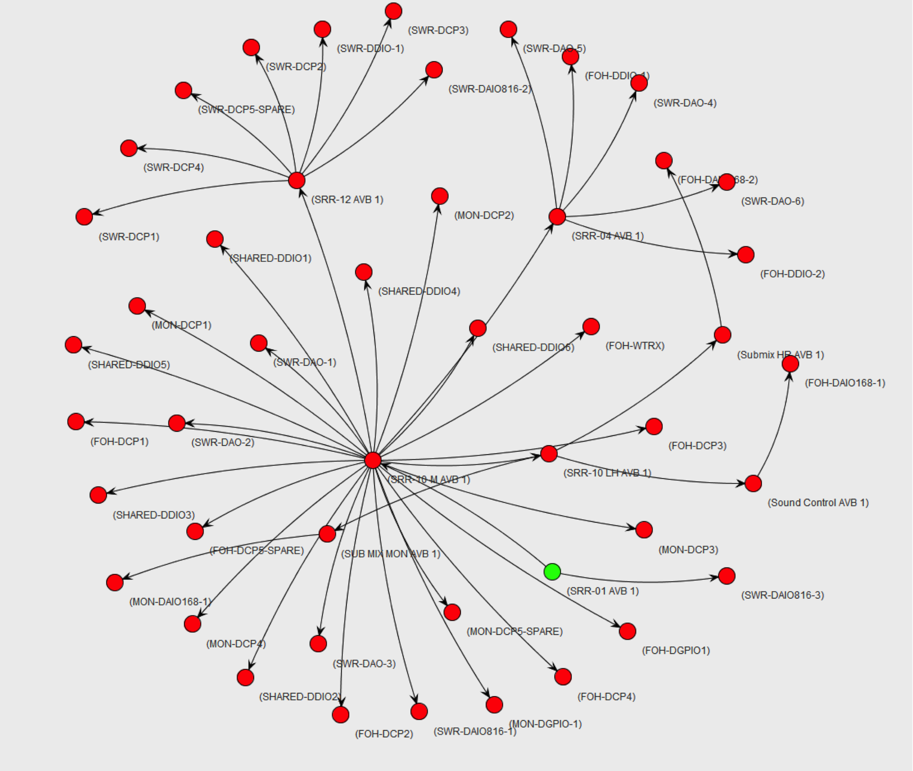
AVB Network graph
generated from
802.1AS path
as reported by
Each AVDECC
entity on the
network
Copyright 2014 by InfoComm International®

Slide 31
Second Question Period
Copyright 2014 by InfoComm International®
Notes:
Topics: tiny, small, medium scale networks

Slide 32
Large scale AVB Networks
Spectacular
Theme Park
Airport
Copyright 2014 by InfoComm International®

Slide 33
Large Scale AVB Networks (Theme park/Spectacular)
Multiple controllers with redundancy
Multiple network server rooms
Multiple performance and audience areas with some shared audio
Gigabit and 10 Gigabit links
up to 1000 talker devices
up to 2000 streams
up to 1000 listener devices
48 kHz, 8 ch * 2000 streams = 16000 channels
34 182 336 000 bps network bandwidth for media
Copyright 2014 by InfoComm International®

Slide 34
Deploying Large Scale AVB Networks
What issues exist on a large scale network
that do not exist at a smaller scale?
Copyright 2014 by InfoComm International®

Slide 35
Considerations for Large Scale AVB Networks
Multicast group limits
Switch backplane limits
Stream Reservation Protocol “attribute packing”
Copyright 2014 by InfoComm International®

Slide 36
Multicast group limits
AVB streams are multicast
Some enterprise switches have a limit of 1,000 multicast groups
Some have a limit of 4,000
Copyright 2014 by InfoComm International®

Slide 37
Switch backplane limits
Typically not a problem as “Enterprise” level switches handle wire-speed switching and “backplane bandwidth” and “backplane packets per second”
Copyright 2014 by InfoComm International®

Slide 38
SRP Packing
The Stream Reservation Protocol (SRP) is a distributed database that allows all the bridges and nodes to keep track of all of the stream reservations on the network
For AVB networks larger than 250 Talker devices the information about the streams must be “Packable”
Copyright 2014 by InfoComm International®

Slide 39
SRP Talker Attributes are packable when:
They have the same bandwidth
They have the same latency
The Stream IDs are consecutive
The Destination Addresses are consecutive
Copyright 2014 by InfoComm International®

Slide 40
Packing Attributes across Talkers
Group the talkers together
Use an AVDECC controller that allows you to set the Stream ID and Destination Address for each talker
Make the attributes packable by the uplinks
Copyright 2014 by InfoComm International®

Slide 41
Third Question Period
Copyright 2014 by InfoComm International®
Notes:
Topics: 10 gig, 40 gig, SRP Packing, Hop counts, multicast addressing

Slide 42
Deploying Large Scale AVB Networks
ACT 3
Copyright 2014 by InfoComm International®
Notes:
ACT 3 (01:00:00 - 01:30:00)

Slide 43
Deploying Large Scale AVB Networks
Managing AVB Networks
Copyright 2014 by InfoComm International®
Notes:
Managing Networks
- mapping available connections
- mapping available bandwidth in real time
- changing topologies: additions & deletions (planned and unplanned)

Slide 44
Deploying Large Scale AVB Networks
Putting things together...
Optimizing media traffic and “legacy Traffic” between nodes with IEEE 1722.1-2013 (AVDECC)
Copyright 2014 by InfoComm International®
Notes:
Putting things together into a coherent system
- Optimizing Media Traffic and "Legacy Traffic" between nodes
- Device Control: 1722.1 and friends

Slide 45
IEEE 1722.1-2013 (AVDECC)
Audio
Video
Discovery
Enumeration
Connection management
Control
Copyright 2014 by InfoComm International®

Slide 46
IEEE 1722.1-2013 (AVDECC)
Controller
Talker
Listener
Responder
Copyright 2014 by InfoComm International®

Slide 47
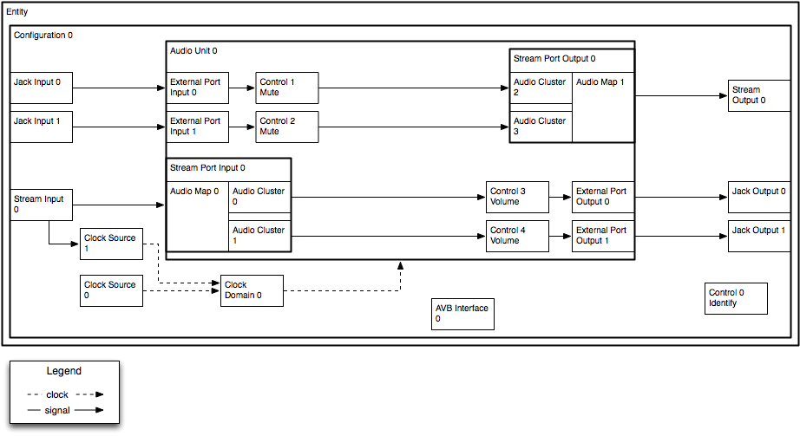
AVDECC Entity Model (AEM)
Copyright 2014 by InfoComm International®

Slide 48
AVDECC Discovery (ADP)
Advertising
Querying (Global/Specific)
Redundancy
Identification (Signal/Wink)
Copyright 2014 by InfoComm International®

Slide 49
AVDECC Connection Management (ACMP)
Connection of AVB streams with audio channel mapping
Persistent connections
Stream connection status and health
Configuration of redundant connections
Copyright 2014 by InfoComm International®

Slide 50
AVDECC Enumeration (AECP)
Describe the internal structure of the device from the stream entry/exit through to the "physical" entry/exit
Describe and control the mapping of media sources and sinks to channels within the stream sinks and sources
Describe and control the signal chains such as DSP, mute, volume, mixers, selectors, through the device
Provide user settable names for many objects within the device including stream, media sources and sinks
Copyright 2014 by InfoComm International®

Slide 51
AVDECC Enumeration (AECP)
Describes and controls the clocking model within the device to configure media clocking sources, sample rate converters
Describe the internal latency through the device from the defined timing reference plane to the "physical" world
Describe the AVB capabilities of the interfaces and provide the current AVB related information such as 802.1AS GMID, and MSRP domain, for each AVB interface
Copyright 2014 by InfoComm International®

Slide 52
IEEE 1722.1-2013 (AVDECC)
Provides diagnostic information such as AVB interface event counters and errors, stream packet event counters and errors, and clock domain lock status, as well as vendor specific counters when necessary.
Describe and control generic control points within the device such as location information, enables, video camera controls, and custom controls
Copyright 2014 by InfoComm International®

Slide 53
IEEE 1722.1-2013 (AVDECC)
Performs basic authentication of controllers
Perform key management for securing the network
Enable and disable transport and stream security
Copyright 2014 by InfoComm International®

Slide 54
AVDECC Control (AECP)
Distributes updates to multiple interested controllers
Exposes signal path, processing latency and control latency
Rich set of control meta-data available:
value data format and encoding
Min/Max/default/current values
SI units options:Time, Frequency, Distance, Temperature, Mass,Voltage, Current, Power, Energy, Resistance,Velocity, Level, etc, with scaling.
single values, multiple values, array values, and bode plots of filters and measurements
Copyright 2014 by InfoComm International®

Slide 55
Offline Provisioning
A device’s capabilities and control points are described by the set of descriptors that it publishes
These descriptors are put into a standard XML Schema form which allows manufacturers to publish the Entity Models for their products on their website
These XML files can then be loaded into an AVDECC Controller which can then be used to instantiate virtual AVDECC Entities based on them.
The user can then connect them and configure them before arriving at the venue.
Copyright 2014 by InfoComm International®

Slide 56
Remote Access
Allows access to AVB networks via TCP/IP for control and management
Uses the existing HTTP 1.1 protocol which enables it to work over the internet via existing network infrastructure including traversing multiple transparent or non-transparent HTTP proxies
Secured with existing SSL/TLS encryption tools
Authentication with existing HTTP Basic/Digest authentication
Copyright 2014 by InfoComm International®

Slide 57
Deploying Large Scale AVB Networks
Graceful failures and redundancy
Copyright 2014 by InfoComm International®
Notes:
Graceful failures and redundancy
- Design for the real world recognizes failures will occur
- Redundant devices and redundant network paths

Slide 58
Graceful Failures and Redundancy
Approach depends on the installation
Cost of failure versus cost of implementation
For some large systems we have set up talkers and listeners with separate but simultaneous ethernet ports, using two separate AVB networks
This allows any packet or cable or switch to fail without any impact to the show
Copyright 2014 by InfoComm International®

Slide 59
Graceful Failures and Redundancy
Listeners can be set to have a primary, secondary, and tertiary backup stream for content
The Listener can decide on its own to use the available stream automatically
Not all Listeners have this capability
This allows you to have redundant/failover talkers
Copyright 2014 by InfoComm International®

Slide 60
Deploying Large Scale AVB Networks
finale
Copyright 2014 by InfoComm International®
Notes:
Review
- What makes an AVB network "large scale"
- What are the maximum number of devices I can have on an AVB network?
- For a given latency, how many hops can I have on an AVB path?
- Physical Size (SRP radius)
- Media Clocks

Slide 61
Deploying Large Scale AVB Networks
everything is now on the network...
Copyright 2014 by InfoComm International®
Notes:
Recapitulation
The promise of the cloud of IO and what that means to production and operation.
-What does putting media (audio/video) on a network mean to me?
- why is it better than analog point-to-point
- why is it worth the extra complexity to implement and maintain

Slide 62
Open Source
General info:
https://avb.statusbar.com/
BW Calculator:
https://abc.statusbar.com/
XMOS :
https://github.com/xcore
Avnu:
https://github.com/Avnu/Open-AVB
Jeff Koftinoff:
https://github.com/jdkoftinoff/jdksavdecc-c
Audioscience:
https://github.com/audioscience/avdecc-lib
Notes:
Links for more information

Slide 63
Final Question Period
Copyright 2014 by InfoComm International®

