Slide 1
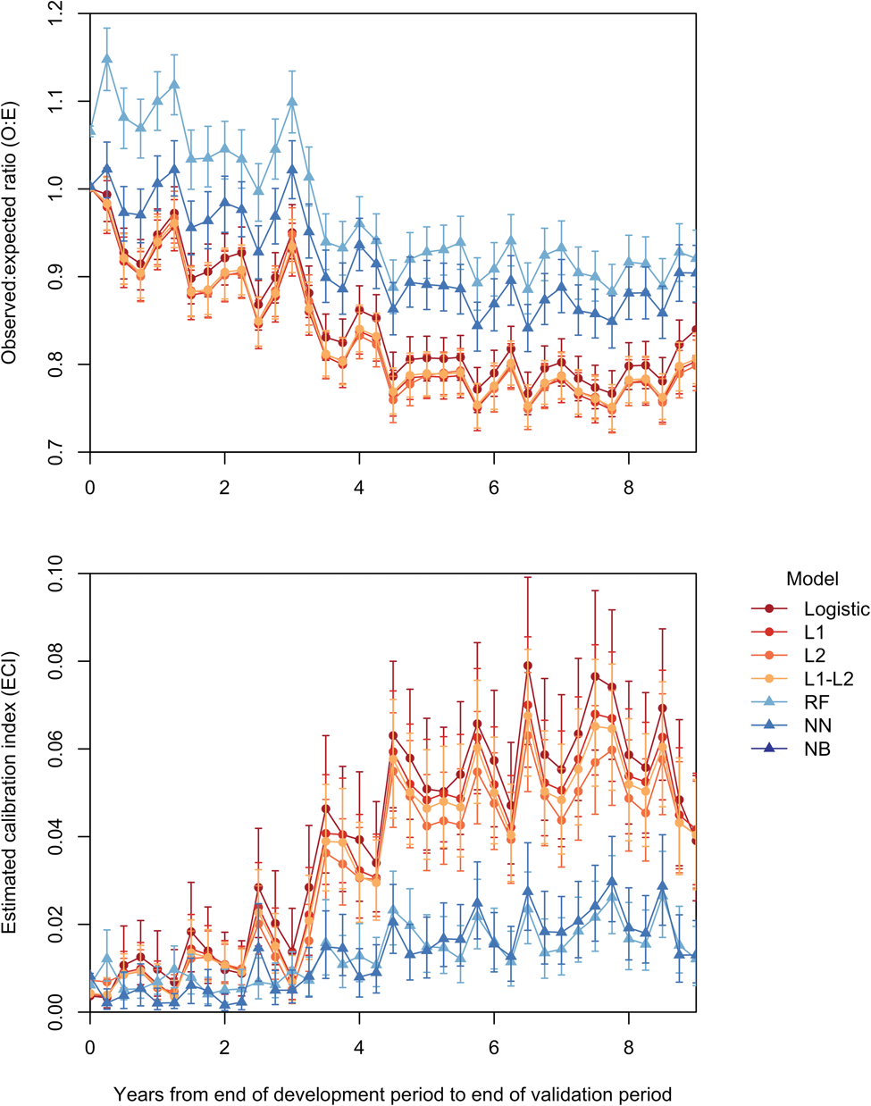

Figure 2. Calibration over time by modeling method. Regression models – logistic regression (LR), L-1 penalized ...
Notes:
Figure 2. Calibration over time by modeling method. Regression models – logistic regression (LR), L-1 penalized logistic regression (L1), L-2 penalized logistic regression (L2), and L-1/L-2 penalized logistic regression (L1-L2) – are displayed with circular markers and red-orange colors. Machine learning models – random forest (RF), neural network (NN), and naïve Bayes (NB) – are displayed with triangular markers and blue-purple colors. Due to the large discrepancy between NB performance and performance of the other models, the vertical axes are scaled such that NB values are excluded from the plots.
Unless provided in the caption above, the following copyright applies to the content of this slide: © The Author 2017. Published by Oxford University Press on behalf of the American Medical Informatics Association. All rights reserved. For Permissions, please email: journals.permissions@oup.com

