Slide 1
My Fitness
John Kouris
Build Week Presentation – March 9th

Slide 2

Developer
John Kouris

Slide 3
My Fitness
Track your workouts and overall fitness progress
Receive recommendations for recipes and fitness centers near you

Slide 4
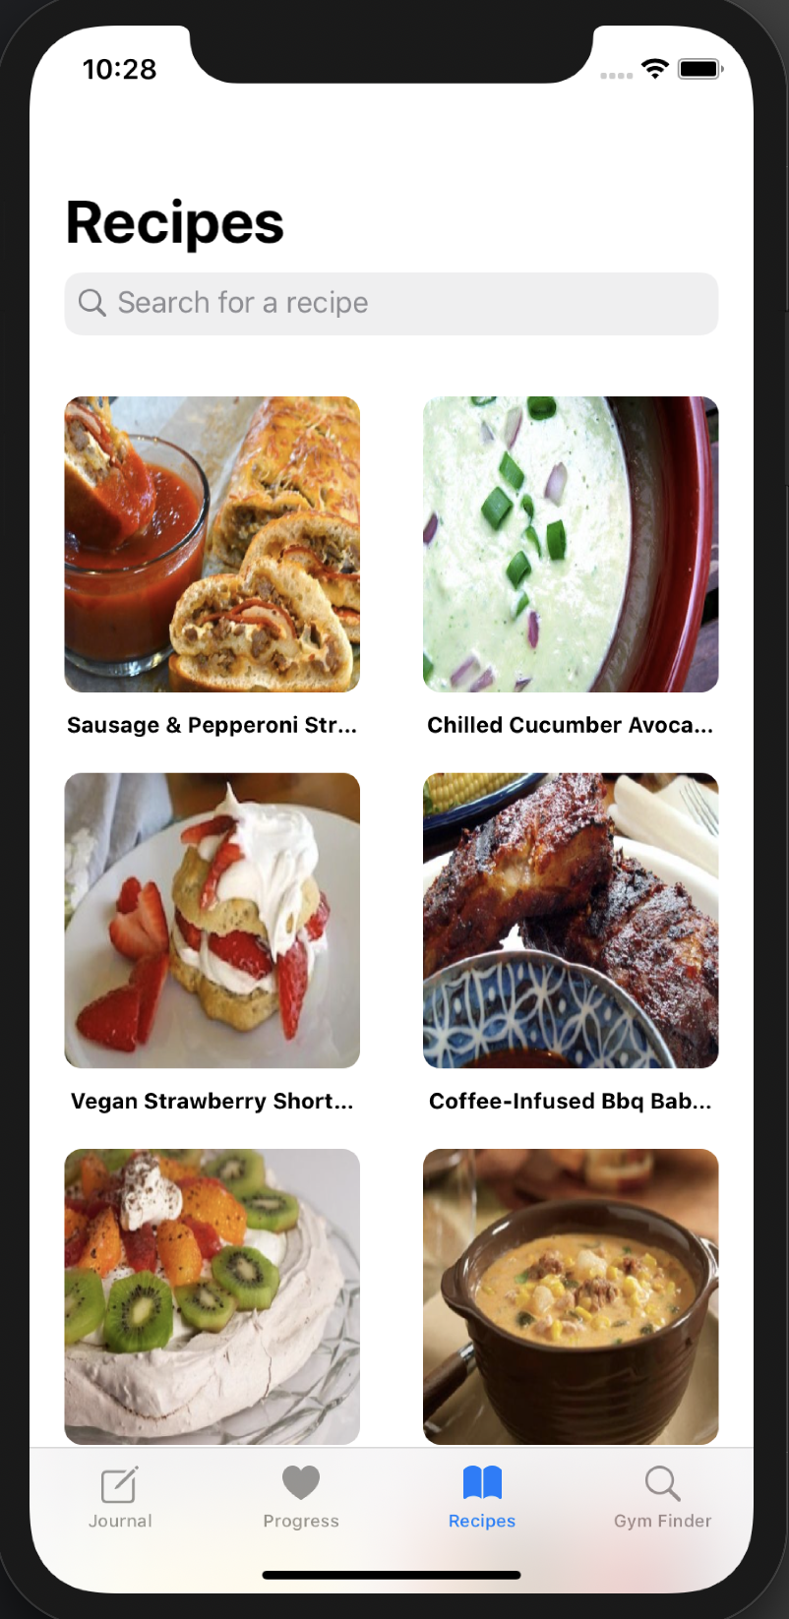
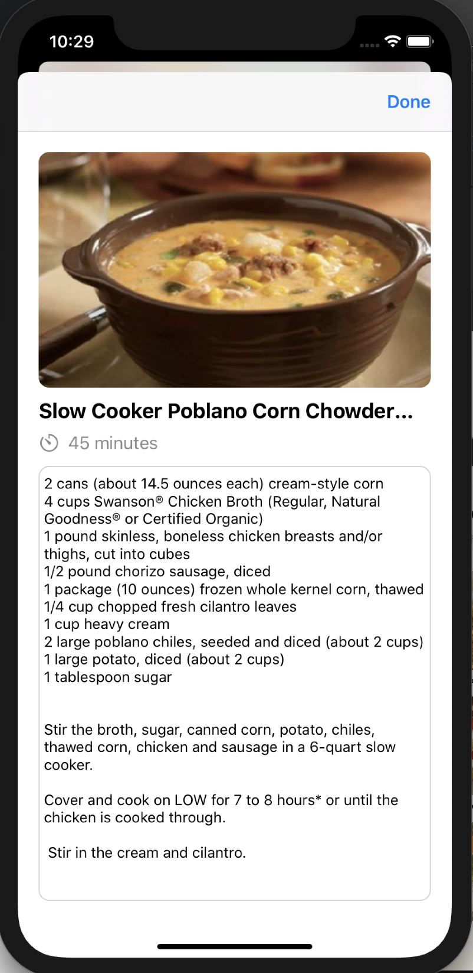
Favorite Feature
Rotating list of 20 recipes

Slide 5
Future Goals
Saving meals to a favorites list
Uploading own recipes
Provide more details for fitness centers
Save videos to workouts or individual exercises

