Slide 1

Inspirational Women
Maria Sierra Lizarazo
Jeongdae Kwak
Cesar Serrano
Yeonjae Riyoon

Slide 2
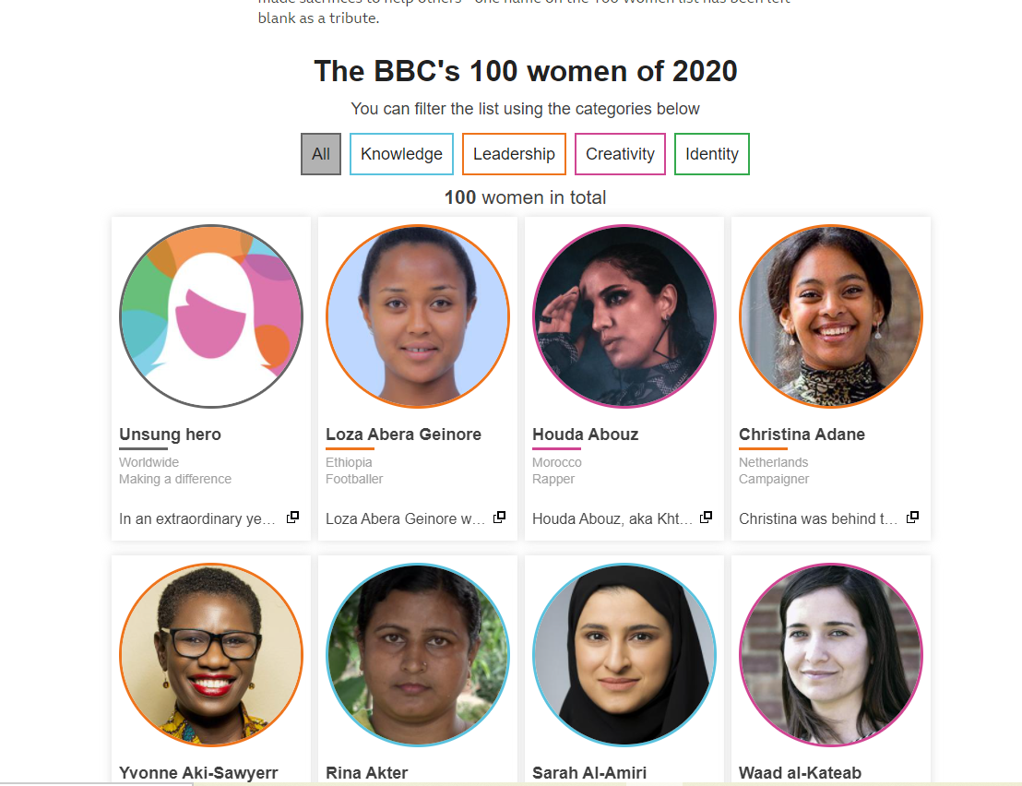
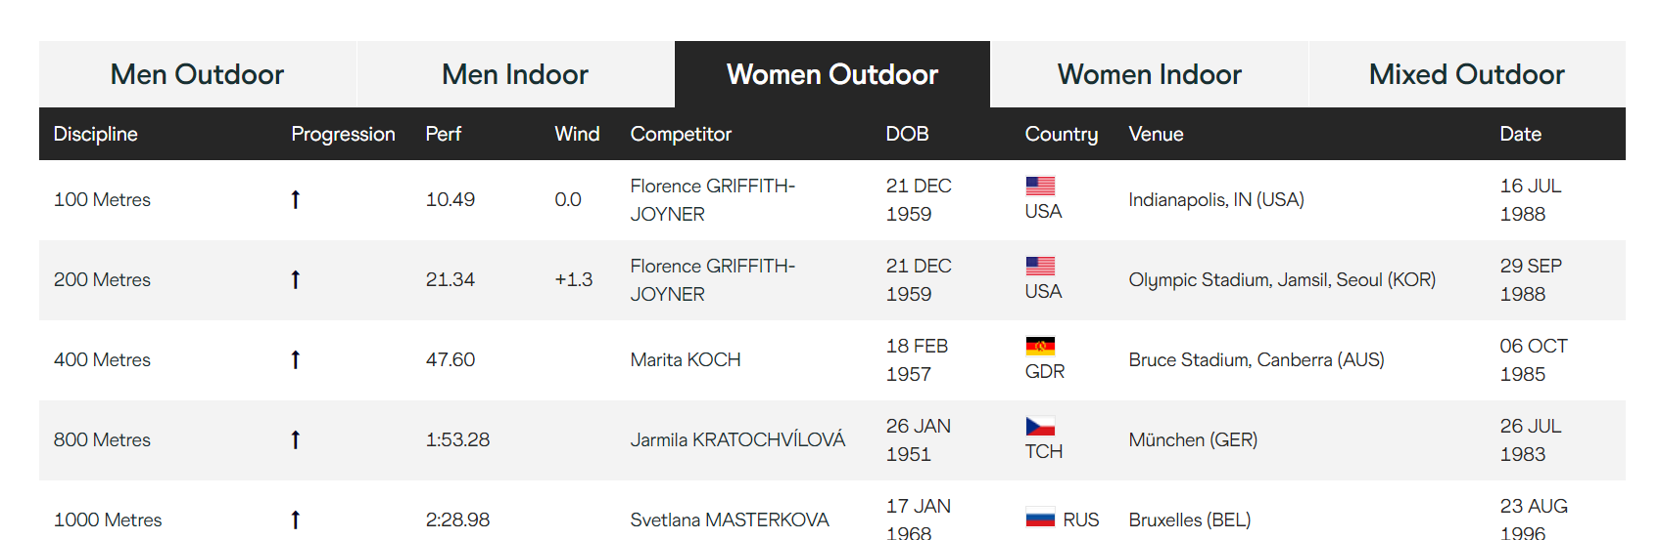
Our Data
BBC Data
World Athletics
https://www.bbc.com/news/world-55042935
https://www.worldathletics.org/records/by-category/world-records

Slide 3
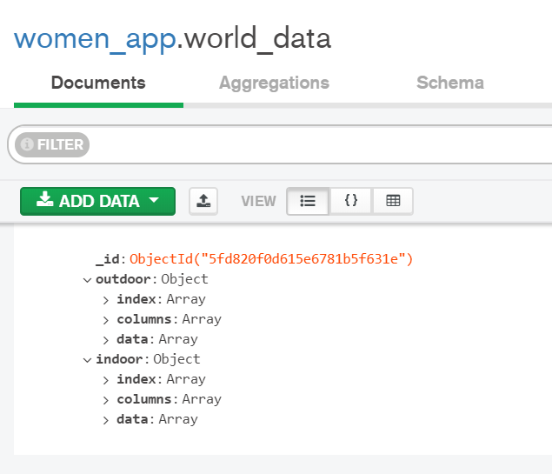

Getting the data!
BBC Data
World Athletics
Read the data from a CSV file
https://github.com/rfordatascience/tidytuesday
Website scrapping and MongoDB database creation

Slide 4
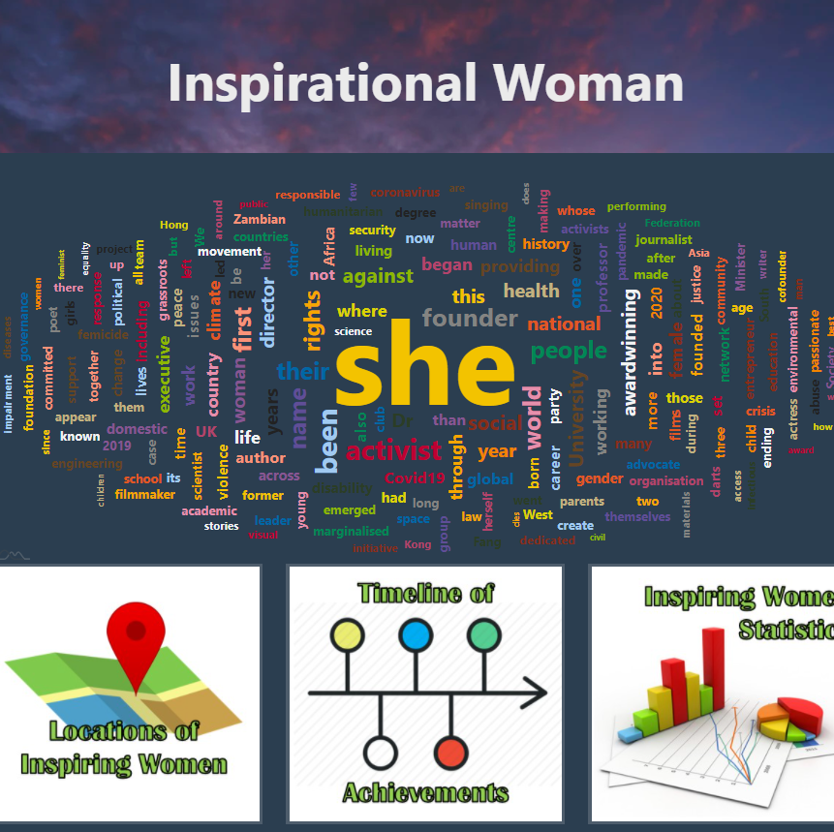
Tools Used
Python: web scraping and Flask app (pandas, json, beautiful soup, OTHERS)
MongoDB: non-relational database creation
General website: HTML, CSS, D3, JavaScript, bootstrap
Pie chart: c3.min.js, papaparse.min.js
Map: Leaflet
Word cloud: AM Chart – JavaScript library

Slide 5

L E T ‘S T A K E A L O O K!

