Slide 1
Which Type of Restaurant to open?
Applied Data Science Capstone
November 2018

Slide 2
Problem Description
There is a theoretical empty space which supports a restaurant in a New York City neighborhood.
The owner has decided to open a restaurant that will be profitable and enhance the neighborhood with something that is missing.
To start the process, the owner decides to assess which restaurants are underrepresented in the neighborhood and adjacent to the neighborhood

Slide 3
Data Requirements
Geo-location information about each borough and the neighborhoods in each borough.
Available from a pre-existing data set identified in an earlier lab
Data about different restaurants in different neighborhoods of each borough.
Available using data calls through the Foursquare API. Specific information required for each venue:
Precise latitude and longitude
Type of restaurant.

Slide 4
Methodology
Importing the neighborhood data for New York City into a dataframe that just included the borough, neighborhood and location.
Using the Foursquare API I retrieved restaurant venues located in each neighborhood in New York City. The retrieved venues were placed in a dataframe.
The code compiles data for all the neighborhoods in New York City since for just the cost of a slightly longer processing time, the code could be quickly adapted to a different neighborhood.
Fictional restaurant property located in the neighborhood of Concourse in the Bronx.
Yankees Stadium is located here. This means a large diverse group of people from all over the city also come into this area approximately 80 days a year. This choice allowed me to ignore strong ethnic ties of other neighborhoods (i.e. Chinatown or Little Italy).
Create a table of the most popular restaurant venues in Concourse and compared them to the most popular venues in New York City and identify where the biggest disparities are.

Slide 5
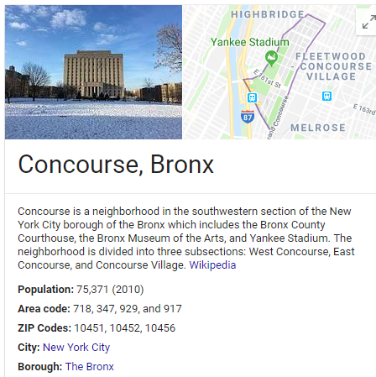
Concourse in the bronx

Slide 6
Results

Slide 7
Discussion/Conclusions
The biggest disparity was Sushi restaurant (38 spots lower) than in New York City.
A smarter analysis indicates that Japanese restaurant is also 34 spots lower, indicating a Japanese restaurant that also has a Sushi bar may be extremely successful.
Another good choice would be Dount/Bagel shop that has quality coffee.
Bagel shop was 37 spots lower than the city on whole, while café and donut shop were each 6 spots lower.
A third and final suggestion would be to open an American restaurant.
American restaurants were 34 spots less popular in Concourse than New York City. Combine this with Burger joints being 32 spots less popular, there appears to be great opportunity for an American restaurant that has an extensive burger menu.

