Slide 1
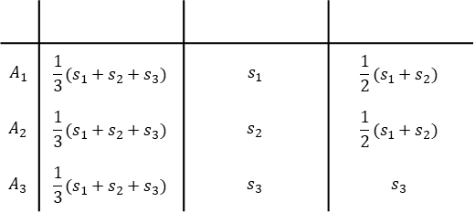
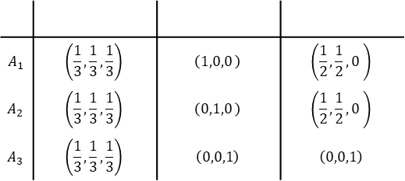
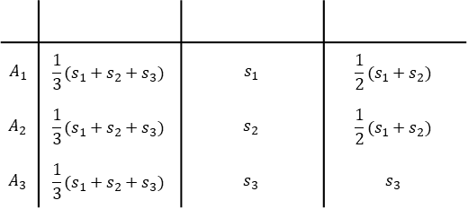
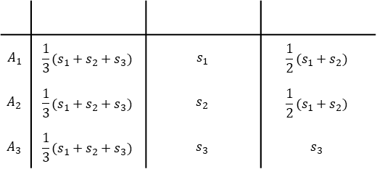
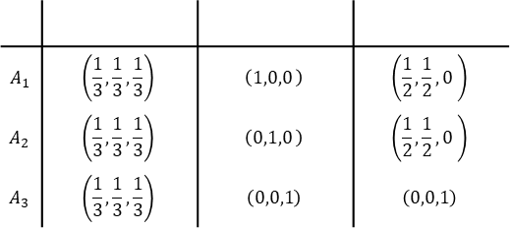
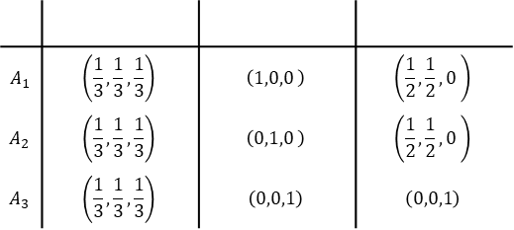
$$A_{1}$$ | $$\frac{1}{3}(s_{1}+s_{2}+s_{3})$$ | $$s_{1}$$ | $$\frac{1}{2}(s_{1}+s_{2})$$
$$A_{2}$$ | $$\frac{1}{3}(s_{1}+s_{2}+s_{3})$$ | $$s_{2}$$ | $$\frac{1}{2}(s_{1}+s_{2})$$
$$A_{3}$$ | $$\frac{1}{3}(s_{1}+s_{2}+s_{3})$$ | $$s_{3}$$ | $$s_{3}$$
$$A_{1}$$ | $$\frac{1}{3}(s_{1}+s_{2}+s_{3})$$ | $$s_{1}$$ | $$\frac{1}{2}(s_{1}+s_{2})$$
$$A_{2}$$ | $$\frac{1}{3}(s_{1}+s_{2}+s_{3})$$ | $$s_{2}$$ | $$\frac{1}{2}(s_{1}+s_{2})$$
$$A_{3}$$ | $$\frac{1}{3}(s_{1}+s_{2}+s_{3})$$ | $$s_{3}$$ | $$s_{3}$$
R
R
R
R
G
B
R
R
B
$$A_{1}$$ | $$\left(\frac{1}{3},\frac{1}{3},\frac{1}{3}\right)$$ | $$\left(1,0,0 \right)$$ | $$\left(\frac{1}{2},\frac{1}{2},0 \right)$$
$$A_{2}$$ | $$\left(\frac{1}{3},\frac{1}{3},\frac{1}{3}\right)$$ | $$\left(0,1,0 \right)$$ | $$\left(\frac{1}{2},\frac{1}{2},0 \right)$$
$$A_{3}$$ | $$\left(\frac{1}{3},\frac{1}{3},\frac{1}{3}\right)$$ | $$\left(0,0,1\right)$$ | $$\left(0,0,1\right)$$
$$A_{1}$$ | $$\left(\frac{1}{3},\frac{1}{3},\frac{1}{3}\right)$$ | $$\left(1,0,0 \right)$$ | $$\left(\frac{1}{2},\frac{1}{2},0 \right)$$
$$A_{2}$$ | $$\left(\frac{1}{3},\frac{1}{3},\frac{1}{3}\right)$$ | $$\left(0,1,0 \right)$$ | $$\left(\frac{1}{2},\frac{1}{2},0 \right)$$
$$A_{3}$$ | $$\left(\frac{1}{3},\frac{1}{3},\frac{1}{3}\right)$$ | $$\left(0,0,1\right)$$ | $$\left(0,0,1\right)$$
R
R
R
R
G
B
R
R
B
$$A_{1}$$ | $$\frac{1}{3}(s_{1}+s_{2}+s_{3})$$ | $$s_{1}$$ | $$\frac{1}{2}(s_{1}+s_{2})$$
$$A_{2}$$ | $$\frac{1}{3}(s_{1}+s_{2}+s_{3})$$ | $$s_{2}$$ | $$\frac{1}{2}(s_{1}+s_{2})$$
$$A_{3}$$ | $$\frac{1}{3}(s_{1}+s_{2}+s_{3})$$ | $$s_{3}$$ | $$s_{3}$$
$$A_{1}$$ | $$\left(\frac{1}{3},\frac{1}{3},\frac{1}{3}\right)$$ | $$\left(1,0,0 \right)$$ | $$\left(\frac{1}{2},\frac{1}{2},0 \right)$$
$$A_{2}$$ | $$\left(\frac{1}{3},\frac{1}{3},\frac{1}{3}\right)$$ | $$\left(0,1,0 \right)$$ | $$\left(\frac{1}{2},\frac{1}{2},0 \right)$$
$$A_{3}$$ | $$\left(\frac{1}{3},\frac{1}{3},\frac{1}{3}\right)$$ | $$\left(0,0,1\right)$$ | $$\left(0,0,1\right)$$
R
R
R
R
G
B
R
R
B
R
R
R
R
G
B
R
R
B

Slide 2














$$E= SelfAttn(X)$$
$$D=CrossAttn\left(X, Y\right)$$
Encoder states
Decoder states
$$E_{1} E_{2} E_{3} ⋯ E_{T}$$
Relation tensor
$$R_{ij}=⟨φ_{1}\left(x_{i}\right), φ_{2}(x_{j})⟩$$
$$D_{1} D_{2} D_{3} ⋯ D_{T_{y}}$$
cross-relation tensor
$$R_{ij}=⟨φ_{1}\left(x_{i}\right), φ_{2}(y_{j})⟩$$
$$x_{1} x_{2} x_{3} ⋯ x_{T}$$
$$x_{1} x_{2} x_{3} ⋯ x_{T_{x}}$$
$$y_{1} y_{2} y_{3} ⋯ y_{T_{y}}$$
Input sequence
Input sequence
Target Sequence
$$A= RelationalCrossAttn(X, S)$$
Relational Bottleneck
Abstractor states
Relation tensor
$$R_{ij}=⟨φ_{1}\left(x_{i}\right), φ_{2}(x_{j})⟩$$
$$A_{1} A_{2} A_{3} ⋯ A_{T}$$
$$x_{1} x_{2} x_{3} ⋯ x_{T}$$
$$s_{1} s_{2} s_{3} ⋯ s_{T}$$
Input sequence
Symbols

Slide 3











$$E= SelfAttn(X)$$
$$D=CrossAttn\left(X, Y\right)$$
Decoder states
Encoder states
Relation tensor
$$R_{ij}=⟨φ_{1}\left(x_{i}\right), φ_{2}(x_{j})⟩$$
$$D_{1} D_{2} D_{3} ⋯ D_{T_{y}}$$
$$E_{1} E_{2} E_{3} ⋯ E_{T}$$
cross-relation tensor
$$R_{ij}=⟨φ_{1}\left(x_{i}\right), φ_{2}(y_{j})⟩$$
$$x_{1} x_{2} x_{3} ⋯ x_{T}$$
$$x_{1} x_{2} x_{3} ⋯ x_{T_{x}}$$
$$y_{1} y_{2} y_{3} ⋯ y_{T_{y}}$$
Input sequence
Input sequence
Target Sequence
$$A= RelationalCrossAttn(X, S)$$
Relation tensor
$$R_{ij}=⟨φ_{1}\left(x_{i}\right), φ_{2}(x_{j})⟩$$
Relational Bottleneck
Abstract states
$$A_{1} A_{2} A_{3} ⋯ A_{T}$$
$$x_{1} x_{2} x_{3} ⋯ x_{T}$$
$$s_{1} s_{2} s_{3} ⋯ s_{T}$$
Input sequence
Symbols

Slide 4









Standard Transformer
Encoder states
Decoder states
$$E_{1} E_{2} E_{3} ⋯ E_{T}$$
$$D_{1} D_{2} D_{3} ⋯ D_{T}$$
$$x_{1} x_{2} x_{3} ⋯ x_{T}$$
$$y_{0} y_{1} y_{2} ⋯ y_{L−1}$$
Input sequence
Target
Encoder
Decoder
(Sensory-Connected) Abstractor
Encoder states
Abstract states
Decoder states
$$E_{1} E_{2} E_{3} ⋯ E_{T}$$
$$A_{1} A_{2} A_{3} ⋯ A_{T}$$
$$D_{1} D_{2} D_{3} ⋯ D_{T}$$
$$x_{1} x_{2} x_{3} ⋯ x_{T}$$
$$s_{1} s_{2} s_{3} ⋯ s_{T}$$
$$y_{0} y_{1} y_{2} ⋯ y_{L−1}$$
Input sequence
Symbols
Target
Encoder
Abstractor
Decoder

Slide 5


Standard Transformer
Encoder states
Decoder states
$$E_{1} E_{2} E_{3} ⋯ E_{T}$$
$$D_{1} D_{2} D_{3} ⋯ D_{T_{y}}$$
$$x_{1} x_{2} x_{3} ⋯ x_{T}$$
$$y_{1} y_{2} y_{3} ⋯ y_{T_{y}}$$
Input sequence
Target
Encoder
Decoder
(Sensory-Connected) Abstractor
Encoder states
Abstract states
Decoder states
$$E_{1} E_{2} E_{3} ⋯ E_{T}$$
$$A_{1} A_{2} A_{3} ⋯ A_{T}$$
$$D_{1} D_{2} D_{3} ⋯ D_{T}$$
$$x_{1} x_{2} x_{3} ⋯ x_{T}$$
$$s_{1} s_{2} s_{3} ⋯ s_{T}$$
$$y_{0} y_{1} y_{2} ⋯ y_{L−1}$$
Input sequence
Symbols
Target
Encoder
Abstractor
Decoder

Slide 6





Standard Transformer
Encoder states
Decoder states
$$E_{1} E_{2} E_{3} ⋯ E_{T}$$
$$D_{1} D_{2} D_{3} ⋯ D_{T}$$
$$x_{1} x_{2} x_{3} ⋯ x_{T}$$
$$y_{0} y_{1} y_{2} ⋯ y_{L−1}$$
Input sequence
Target
Encoder
Decoder
(Sensory-Connected) Abstractor
Encoder states
Relational Bottleneck
Abstract states
Decoder states
$$E_{1} E_{2} E_{3} ⋯ E_{T}$$
$$A_{1} A_{2} A_{3} ⋯ A_{T}$$
$$D_{1} D_{2} D_{3} ⋯ D_{T}$$
$$x_{1} x_{2} x_{3} ⋯ x_{T}$$
$$s_{1} s_{2} s_{3} ⋯ s_{T}$$
$$y_{0} y_{1} y_{2} ⋯ y_{L−1}$$
Input sequence
Symbols
Target
Encoder
Abstractor
Decoder

Slide 7
E
A
A
D
E
A
A
D
E
A
A
D
Input
Symbols
Symbols
Target
Encoder
Abstractor
Abstractor
Decoder
E
A
A
D
E
A
A
D
E
A
A
D
Input
Symbols
Symbols
Target
Encoder
Abstractor
Abstractor
Decoder

