Slide 1
Analyzing the Development Lifecycle of Vichan
What 16 years of Git history say about how an open-source project ages
Jonathan Lange, Tristan Lopez, Noah Cash, Ar-Raniry Ar-Rasyid
COSC 445 Final Project

Slide 2
Objective
• Vichan is an open-source PHP imageboard engine: Tinyboard in 2010, vichan fork in 2014, base of 8chan, end-of-life and archived in 2026
• Its whole life is public, from the first commit to the shutdown
• Q1: As it aged, did work shift from new features to bug and security fixes?
• Q2: How much work was forced from outside (security holes, new PHP versions) and how much was cleanup the team chose?
2

Slide 3
Data
• Source: github.com/vichan-devel/vichan, all 27 branches
• Collected by repository mining: bare git clone + git log, saved as CSV
• Nov 2010 to Jul 2026
• Each commit: author, time, message, files, and every changed code block (hunk)
Records | Count
Commits (all branches) | 9,646
File changes | 25,276
Hunks (changed code blocks) | 65,641
Unique changes after cleaning | 5,241
Hunks after cleaning | 46,290
Developers after merging aliases | 194
3

Slide 4
Approach
1 Extract
2 Clean
3 Classify
4 Check
5 Analyze
Clone repo, export commits, files, and hunks to CSV
Drop merges and branch copies, UTC times, merge developer aliases
Keyword and file rules, then an AI model for the 3,022 commits left over
Re-label a random sample of 200 by reading the actual code diff
Share of each category per year and per era
Categories: Feature, Bug Fix, Security Fix, Code Cleanup, Documentation
Extra flag for outside-driven work: security, or a message naming a PHP, browser, or library version
Tools: Git, Python, pandas, Matplotlib, Claude (AI labels saved to CSV so the pipeline re-runs offline)
4

Slide 5
Challenges
• Branch copies: 3,155 commits were rebased or cherry-picked duplicates on other branches. Without removing them, 2013 to 2015 counts almost twice
• Aliases: the Tinyboard creator used 10 name/email pairs, Fredrick Brennan used 10 (including “8chan”)
• Vague messages: about 5% are just “...”, “h”, or “Update post.php”
• Hunks were misleading: 66% are in translation or bundled library files, so we measured commits instead
5

Slide 6
How accurate are the labels?
Label source | Sampled | Correct
Keyword rules | 63 | 70%
File rule | 7 | 100%
AI model | 130 | 79%
All | 200 | 77%
• About 1 in 4 commits is in the wrong category, so only large differences count
• Security: every commit labeled Security Fix was one (5/5), but only half of real security fixes were caught
• So security numbers are a floor
6

Slide 7
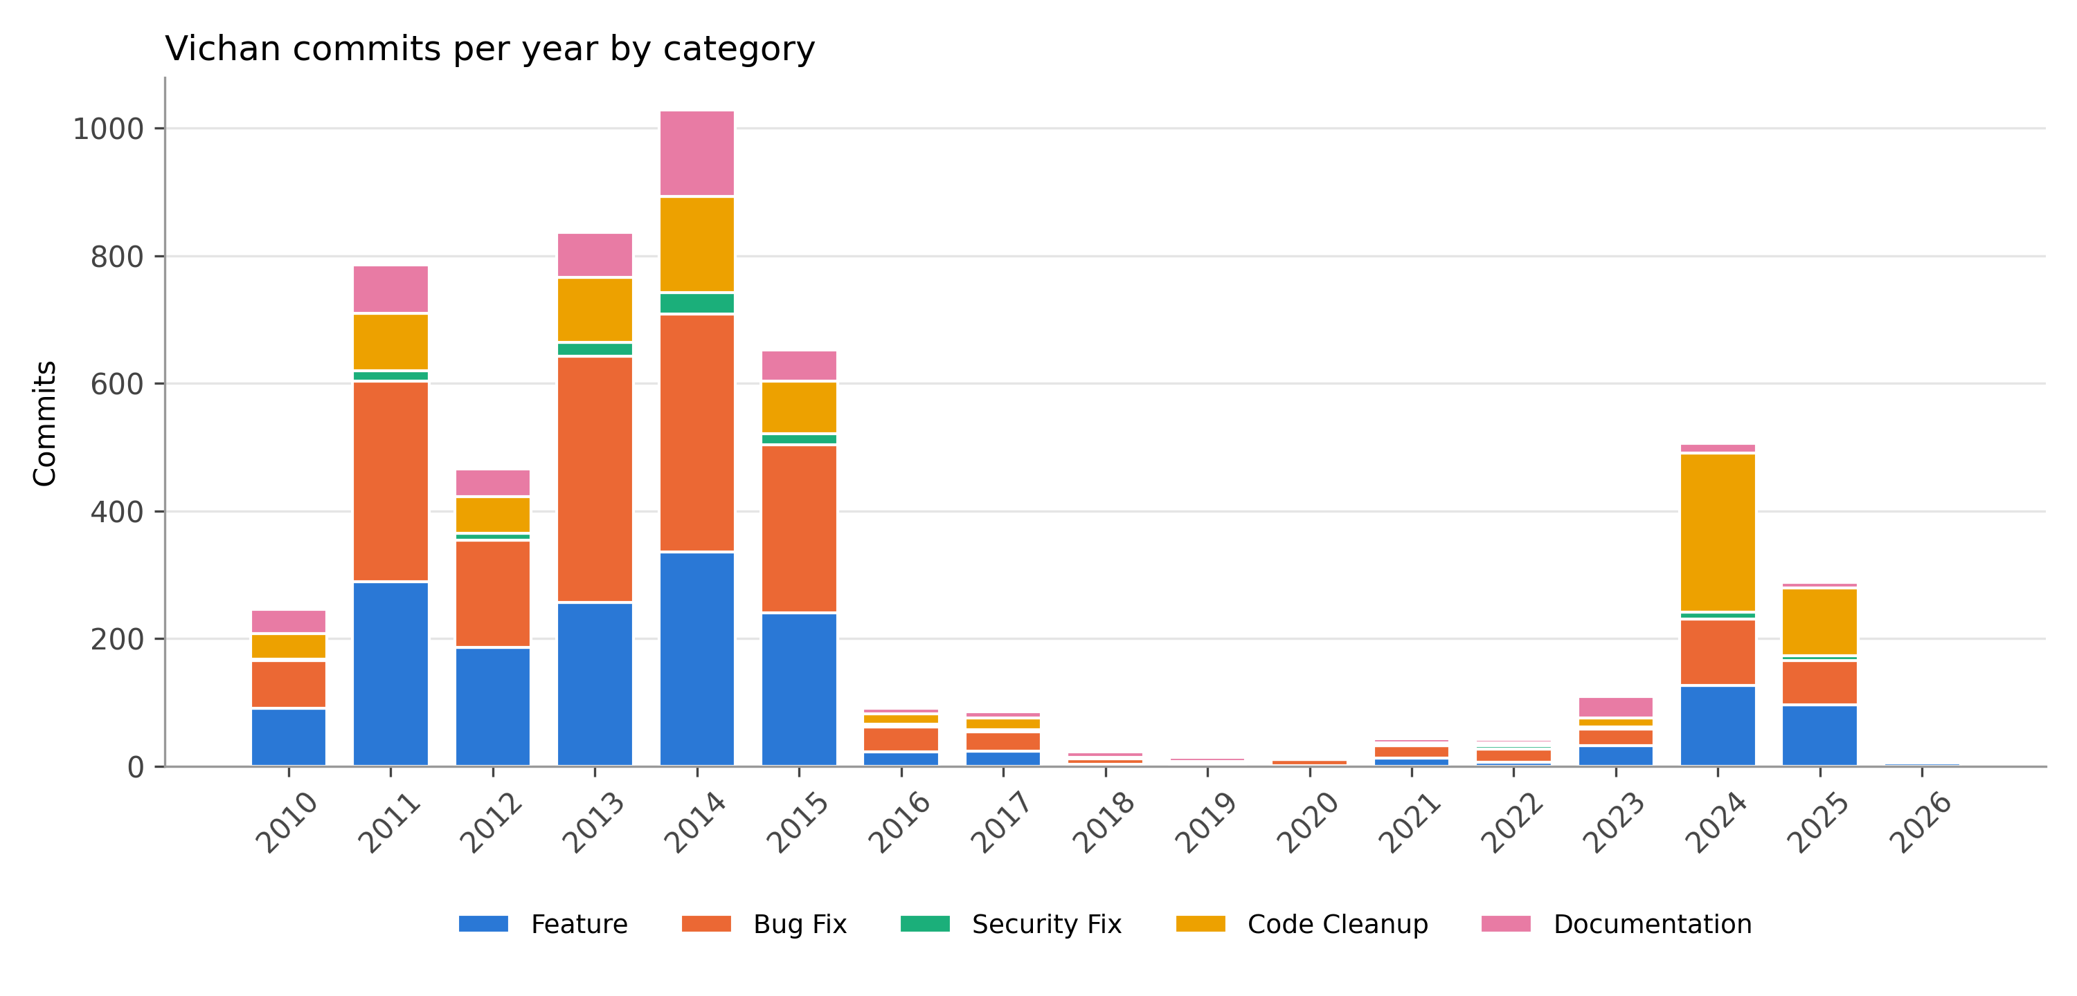
Results: the shape of the project
7

Slide 8
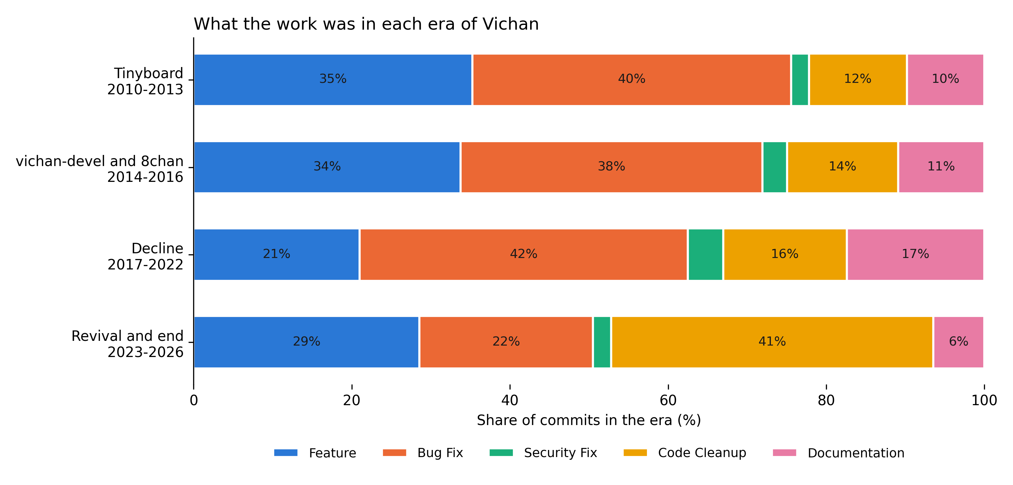
Q1: did the work shift toward fixes?
Decline: features fell from 34% to 21%; fixes and cleanup rose from 55% to 62%
Revival: not a slide into fixes. Cleanup jumped to 41% as new maintainers modernized the code
8

Slide 9
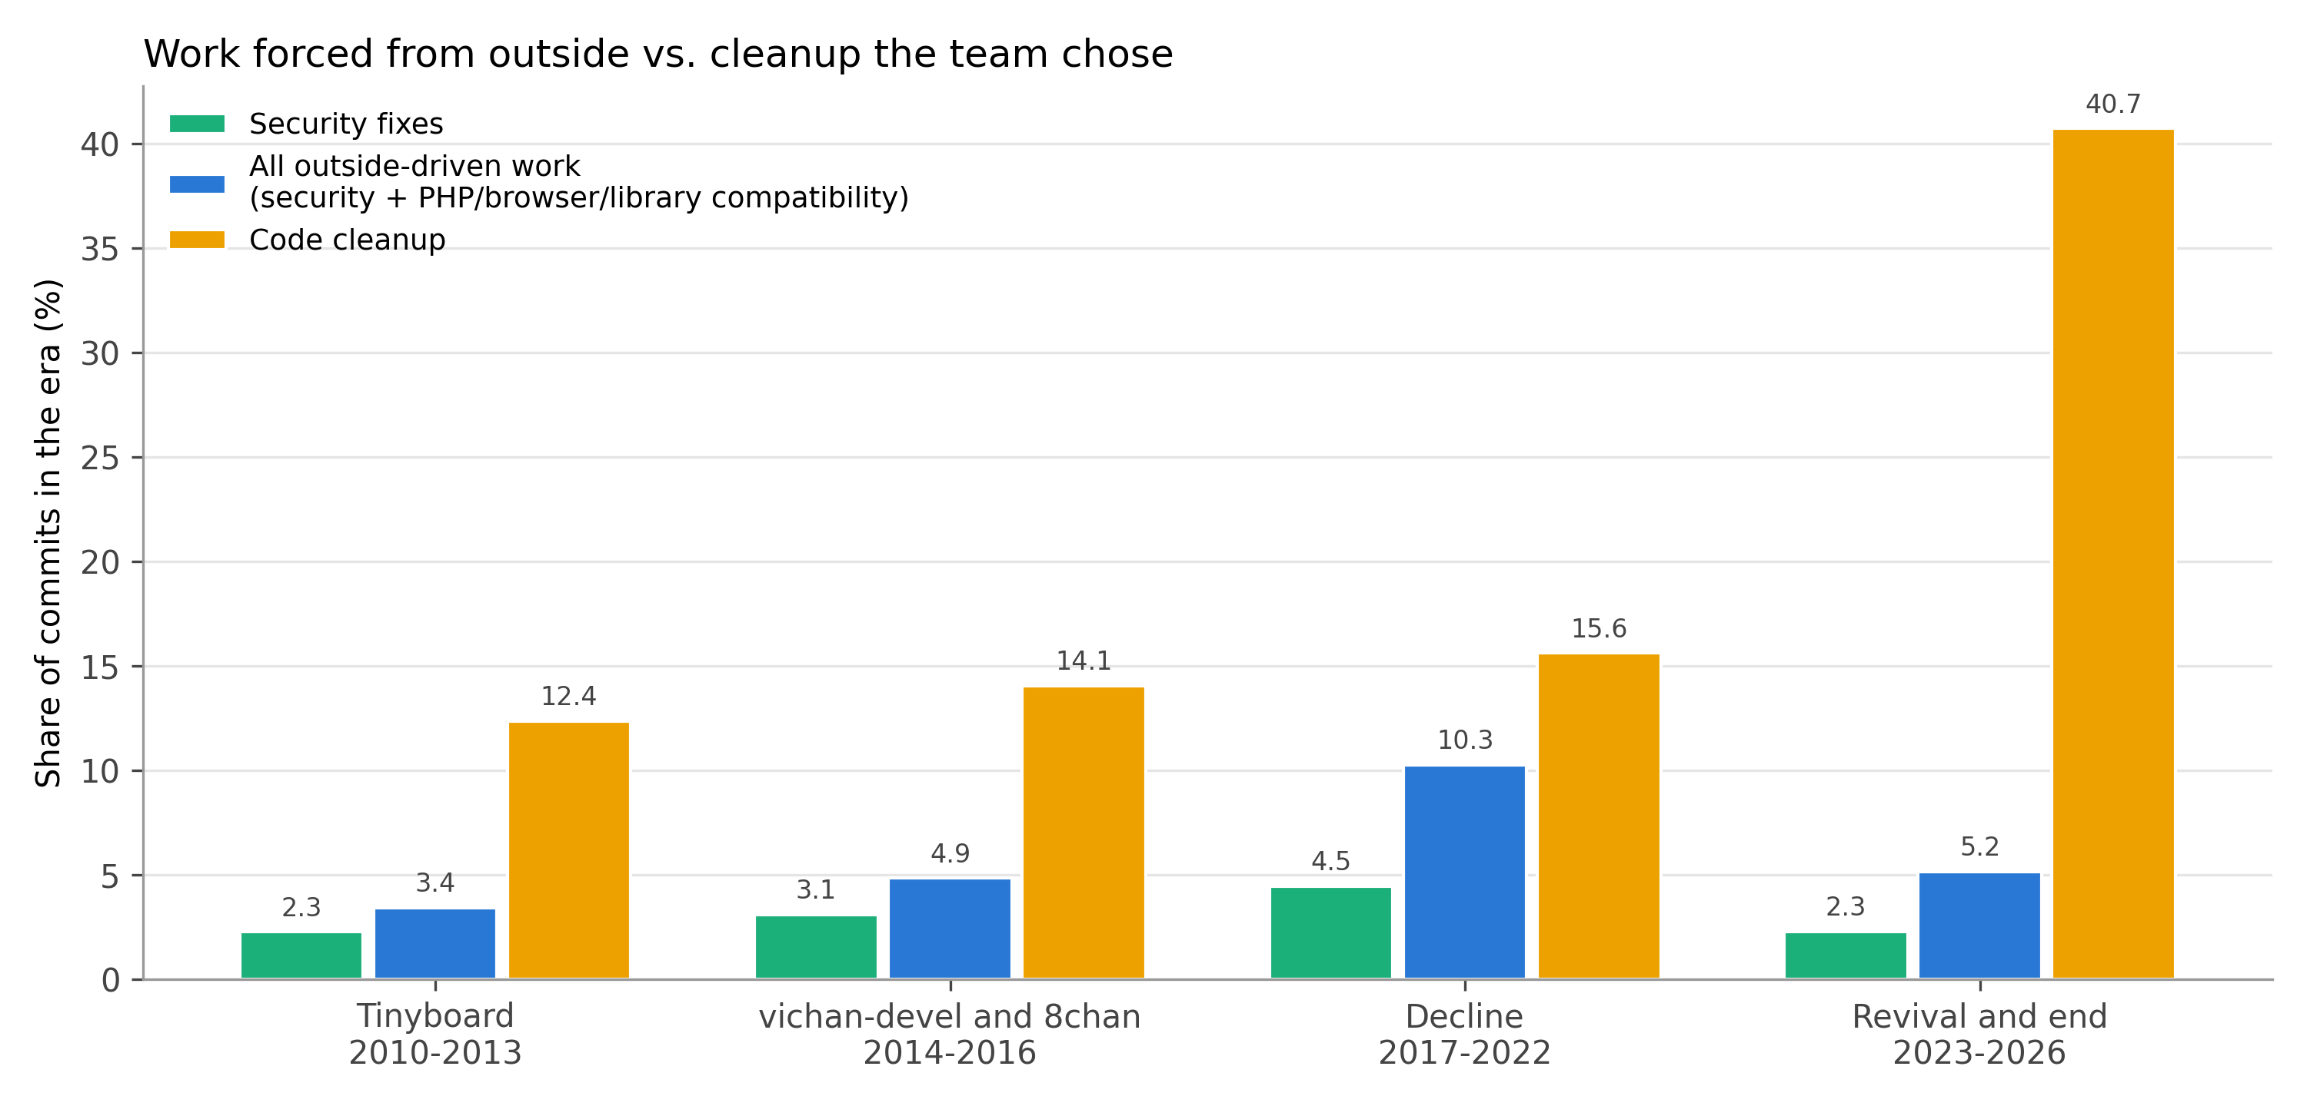
Q2: forced work or chosen work?
Outside-driven work peaked at 10% in the decline (PHP 7 and 8 fixes); security never passed 4.5%
Cleanup the team chose was larger in every era, and about 8x larger at the end
9

Slide 10
Conclusions and limitations
What we found
Limitations and next steps
• Shrinking years were mostly upkeep: fewer features, more fixes
• The end came after a planned rebuild, not a slow decay
• Most maintenance was chosen, not forced from outside
• 77% label accuracy; security undercounted
• A commit is not a unit of effort
• Next: give the model the diff, add GitHub issues and CVE data, compare other projects
10

