Slide 1



Theoretical Maximum Capacity as a Benchmark for Empty Vehicle Redistribution in Personal Rapid Transit
John D. Lees-Miller^{1,2}
Dr. John C. Hammersley²
Dr. R. Eddie Wilson¹
¹ University of Bristol
² Advanced Transport Systems Ltd.
89th Annual Meeting of the Transportation Research Board (2010)

Slide 2
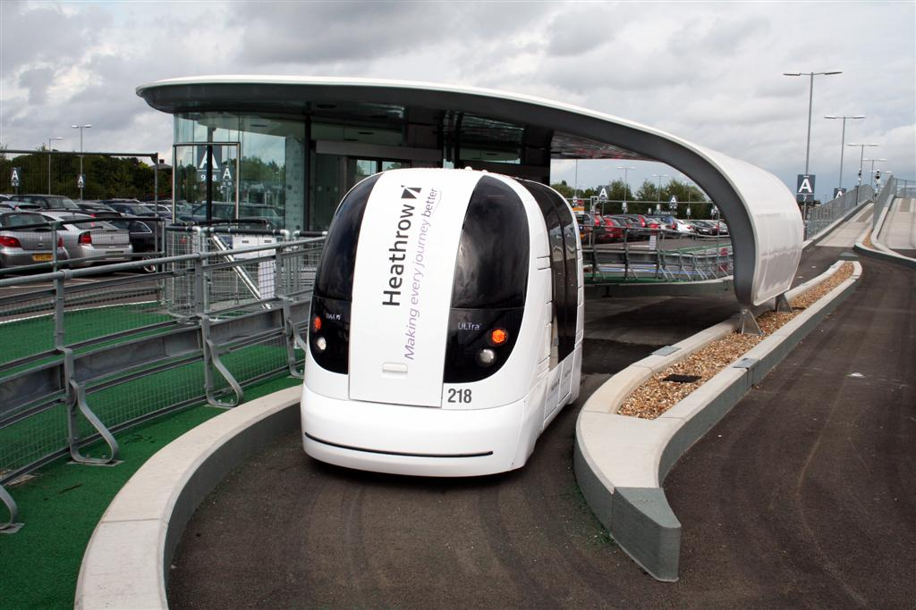
Personal Rapid Transit
Notes:
I think this is the first talk in the session, so it may be worth saying a few words about what PRT is.
It is basically a taxi system, but the taxis are driven by computers.
A passenger boards a taxi at a station, and the vehicle takes him to his destination station.

Slide 3
Empty Vehicle Redistribution (EVR)
Passenger flows between stations may not balance, so some vehicles must move empty.
An EVR algorithm must decide which vehicles to move, and when to move them, as the system operates (on-line).
Possible objectives:
  Minimize mean passenger waiting time
  Minimize (say) 90th percentile waiting time
  Minimize mean squared passenger waiting time
  Minimize empty vehicle running time

Slide 4
Modeling Assumptions
Ignore congestion on the line.
  Vehicles always take quickest paths.
Ignore congestion at stations.
  All vehicles are moving (either occupied or empty) when the system is busy.
Demand is stationary
  Poisson with constant mean rate.
No ride sharing. [L-M et al. 2009]
  One “passenger party” (passengers traveling together by choice) per vehicle.
[L-M, H, W 2010]
Notes:
Exit: Under these assumptions, the following well-known results can be derived…

Slide 5
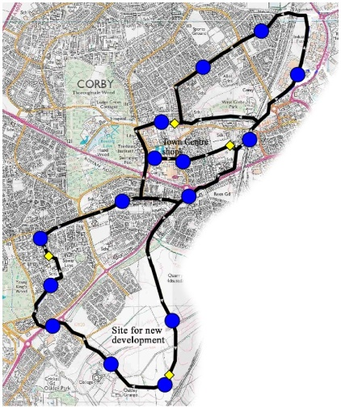
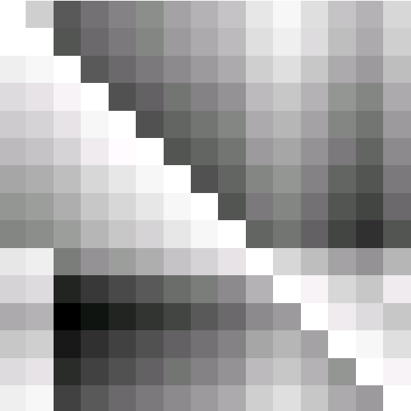
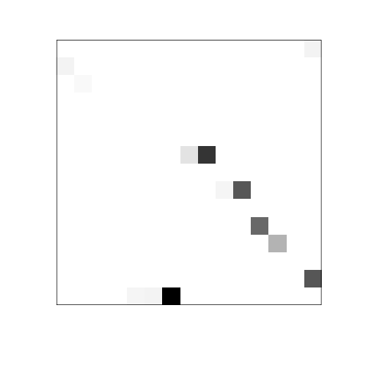
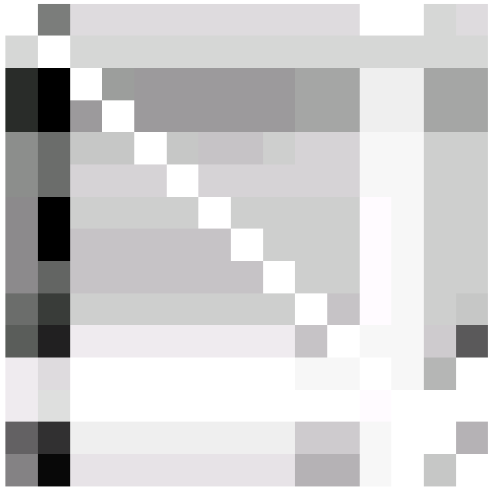
Fluid Limit Example: Corby Case Study
Destination
Minimize Fleet Size Required in Fluid Limit
Origin
Network
[Bly 2005]
Travel Times (T)
Destination
Destination
Patronage
Study
[Bly 2005]
Origin
Origin
Demand (D)
Empty Vehicle Flow (X)
Notes:
Mention that the demand matrix gives OCCUPIED VEHICLE flow under these assumptions.

Slide 6
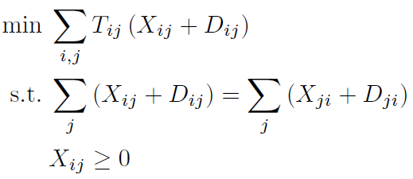
EVR Fluid Limit
T_{ij} : Travel time from station i to station j (known)
D_{ij} : Flow of occupied vehicles from i to j (known)
X_{ij} : Flow of empty vehicles from i to j (unknown)
total number of vehicles needed
flow out = flow in at stations
for all stations i
for all stations i, j
[see also Anderson 1978; Irving 1978]
Notes:
The Tij come from the network.
The Dij come from an OD matrix and the assumption that 1 party = 1 vehicle.
The Xij are the variables.

Slide 7

EVR Fluid Limit
T_{ij} : Travel time from station i to station j (known)
D_{ij} : Flow of occupied vehicles from i to j (known)
X_{ij} : Flow of empty vehicles from i to j (unknown)
concurrent empty vehicles
flow out = flow in at stations
for all stations i
for all stations i, j
[see also Anderson 1978; Irving 1978]
Notes:
This does not prescribe exactly which empty trips should be taken – it is not an EVR algorithm. But, it is useful for analyzing EVR algorithms.

Slide 8
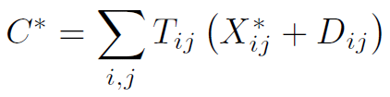
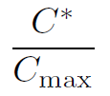
Demand Intensity
This also yields the minimum fleet size required for the given network and demand,
Suppose there are only C_{max} vehicles in the fleet, and define the intensity as
[L-M, H, W 2010]
Notes:
The term intensity is motivated by queueing theory.

Slide 9
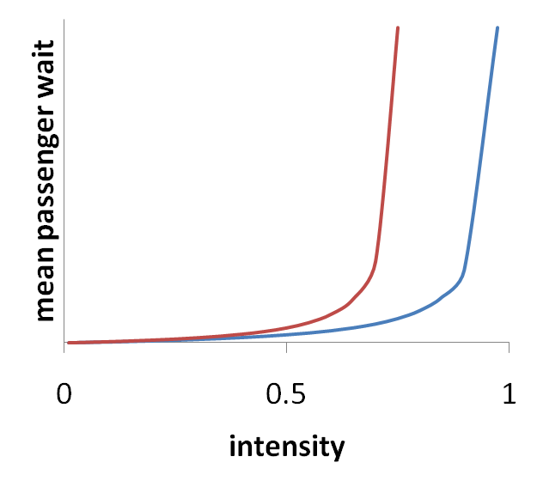
Demand Intensity
Fix the network (T) and fleet size (C_{max}).
Scale up demand, keeping proportions fixed.
Can assess throughput of EVR algorithms absolutely.
Algorithm 1
Algorithm 2
[L-M, H, W 2010]

Slide 10
Existing EVR Algorithm
For PRT:
  decision rules [Irving 1978; Andréasson 1994; Anderson 1998]
  plus repeated assignment problems [Andréasson 2003]
For taxis:
  dynamic programming [Bell, Wong 2005]
For full truckload motor carriers:
  repeated assignment problems [Powell 1996]
For other related problems:
  elevators (lifts) [Wesselowski, Cassandras to appear]
  Dynamic Pickup & Delivery [Berbeglia, Cordeau, Laporte 2009]

Slide 11
Bell and Wong Nearest Neighbours (1)
passenger
destination
vehicle
passenger
origin
[Bell, Wong 2005]

Slide 12
Bell and Wong Nearest Neighbours (2)
[Bell, Wong 2005]

Slide 13
Bell and Wong Nearest Neighbours (3)
[Bell, Wong 2005]

Slide 14
Bell and Wong Nearest Neighbours (4)
[Bell, Wong 2005]

Slide 15
Longest-Waiting Passenger First (1)
station
vehicle
[L-M, H, W 2010]
Notes:
Here vehicles just remember the next station they have to visit.

Slide 16
Longest-Waiting Passenger First (2)
longest-waiting passenger (he just arrived, but he’s the only passenger )
[L-M, H, W 2010]
Notes:
In light traffic (lots of idle vehicles), an arriving passenger gets the nearest idle vehicle.

Slide 17
Longest-Waiting Passenger First (3)
[L-M, H, W 2010]
Notes:
In light traffic (lots of idle vehicles), an arriving passenger gets the nearest idle vehicle.

Slide 18
Longest-Waiting Passenger First (4)
longest-waiting passenger
[L-M, H, W 2010]
Notes:
In light traffic (lots of idle vehicles), an arriving passenger gets the nearest idle vehicle.

Slide 19
Longest-Waiting Passenger First (5)
longest-waiting passenger
[L-M, H, W 2010]
Notes:
In light traffic (lots of idle vehicles), an arriving passenger gets the nearest idle vehicle.

Slide 20
Longest-Waiting Passenger First (6)
it would have been quicker to go to this station, but we chose the longest-waiting passenger instead
[L-M, H, W 2010]
Notes:
In light traffic (lots of idle vehicles), an arriving passenger gets the nearest idle vehicle.

Slide 21
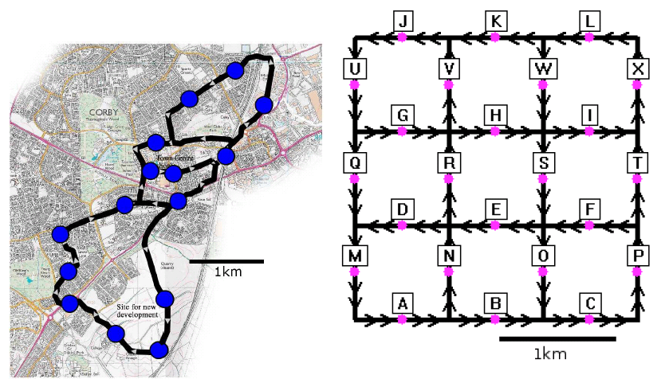
Case Study Networks
Corby Network (15 stations)
[Bly 2005]
‘Grid’ Network (24 stations)
[L-M, H, W 2010]

Slide 22
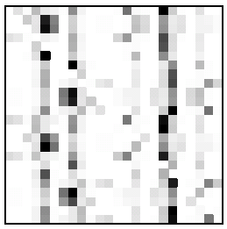
Case Study Demand Patterns
Corby Network (15 stations)
[Bly 2005]
‘Grid’ Network (24 stations)
[L-M, H, W 2010]

Slide 23
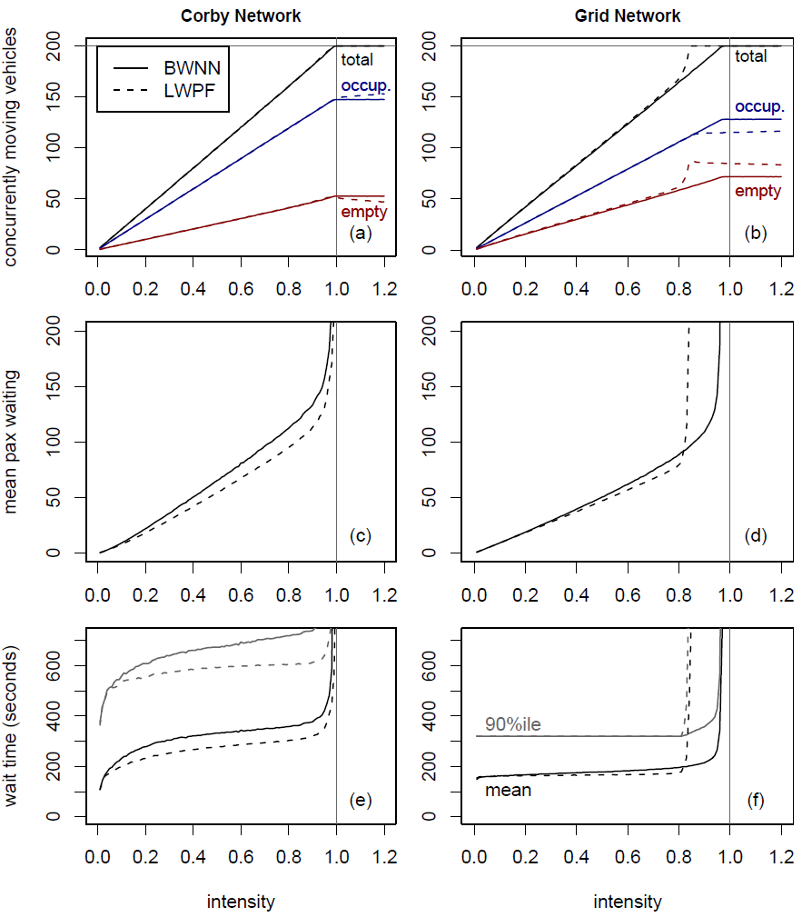
Saturation Intensities from Simulations
intensity
intensity
fleet size (C_{max}) = 200; error bars are below the resolution of the graphs
[L-M, H, W 2010]

Slide 24
Waiting Times from Simulations
Passenger waiting times are long, because neither heuristic moves vehicles in anticipation of demand.
Corby Network
Grid Network
demand
[L-M, H, W 2010]

Slide 25
Conclusions
Can use fluid limit analysis to benchmark EVR algorithms in terms of throughput.
Cannot yet assess absolute performance of EVR algorithms in terms of passenger waiting time, but the fluid limit analysis is useful for interpreting simulation results.
A simple nearest-neighbors strategy is quite strong, in terms of throughput, but it delivers fairly poor waiting times.

Slide 26
Acknowledgements
Prof. Martin V. Lowson (ATS Ltd.)
Prof. Frank P. Kelly (Cambridge)

Slide 27
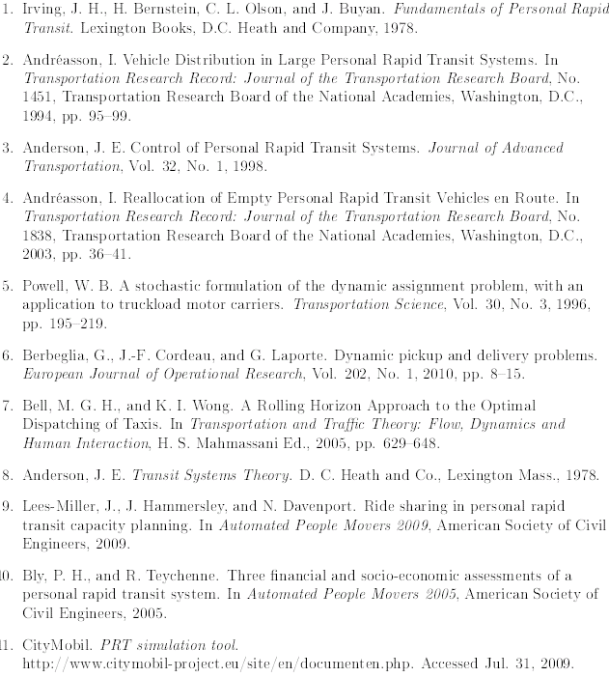
References
Lees-Miller, J. D., J. C. Hammersley and R. E. Wilson. Theoretical Maximum Capacity as a Benchmark for Empty Vehicle Redistribution in Personal Rapid Transit. To appear in the proceedings of the 89th Annual Meeting of the Transportation Research Board, 2010.
Advanced Transport Systems Ltd.
www.atsltd.co.uk

Slide 28
Thank You
Questions?

Slide 29
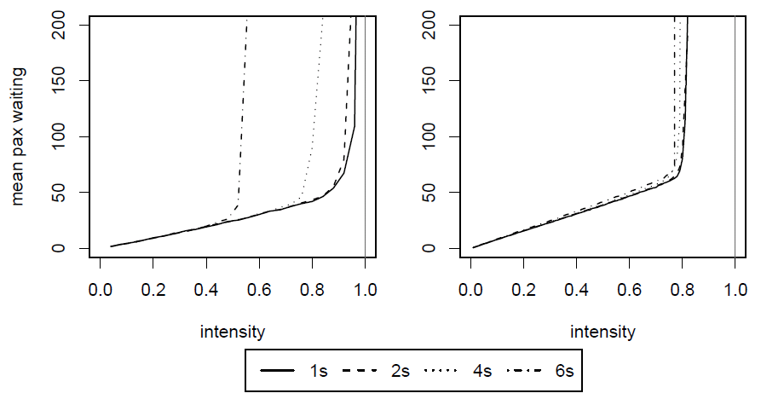
Effect of Line Capacity
Increasing the minimum vehicle separation (headway) decreases line capacity.
Corby Network
Grid Network
(The EVR used here is similar to the LWPF heuristic.)

