Slide 1
Memory Model Sensitive Analysis of Concurrent Data Types
Sebastian Burckhardt
Dissertation Defense
University of Pennsylvania
July 30, 2007
Notes:
I am S.B. , a PhD student u po, my adv

Slide 2
Thesis
Our CheckFence method / tool is a valuable aid for designing and implementing concurrent data types.

Slide 3
Talk Overview
I. Motivation: The Problem
II. The CheckFence Solution
III. Technical Description
IV. Experiments
V. Results
VI. Conclusion

Slide 4
General Problem
multi-threaded software
shared-memory multiprocessor
concurrent executions
bugs
Notes:
Architecture is pushing multicore hardware,
software ready for concurrency? not quite...

Slide 5
Specific Problem
multi-threaded software
with lock-free synchronization
shared-memory multiprocessor
with relaxed memory model
concurrent executions
do not guarantee order of memory accesses
bugs
Notes:
Architecture is pushing multicore hardware,
software ready for concurrency? not quite...

Slide 6
relaxed memory models
Motivation (Part 1)
... are common because they enable HW optimizations:
allow store buffers
allow store-load forwarding and coalescing of stores
allow early, speculative execution of loads
... are counterintuitive to programmers
processor may reorder stores and loads within a thread
stores may become visible to different processors at different times
Notes:
promise sounds quite nice.
take on the challenge!

Slide 7
Example: Relaxed Execution
Initially, A = Flag = 0
Not consistent with any interleaving.
2 possible causes:
processor 1 reorders stores
processor 2 reorders loads
Processor 1
Processor 2
store A, 1
store Flag, 1
load Flag, 1
load A, 0
thread 1
Notes:
explain weirdness

Slide 8
Memory Ordering Fences
A memory ordering fence is a machine instruction that enforces in-order execution of surrounding memory accesses.
(Also known as: memory barriers, sync instructions)
Implementations with lock-free synchronization need fences to function correctly on relaxed memory models.
For race-free lock-based implementations, no additional fences (beyond the implicit fences in lock/unlock) are required.
Notes:
explain weirdness

Slide 9
Example: Fences
Initially, A = Flag = 0
Load can no longer get stale value.
processor 1 may not reorder stores across fence
processor 2 may not reorder loads across fence
Processor 1
Processor 2
store A, 1
store-store fence
store Flag, 1
load Flag, 1
load-load fence
load A, 1
thread 1
Notes:
explain weirdness

Slide 10
concurrency libaries with lock-free synchronization
Motivation (Part 2)
... are simple, fast, and safe to use
concurrent versions of queues, sets, maps, etc.
more concurrency, less waiting
fewer deadlocks
... are notoriously hard to design and verify
tricky interleavings routinely escape reasoning and testing
exposed to relaxed memory models
Notes:
promise sounds quite nice.
take on the challenge!

Slide 11
Example: Nonblocking Queue
Processor 1
Processor 2
....
... enqueue(1)
... enqueue(2)
....
....
....
void enqueue(int val) {
...
}
int dequeue() {
...
}
....
...
...
a = dequeue()
b = dequeue()
The client program
on multiple processors
calls operations
may be large
The implementation
optimized: no locks.
small: 10s-100s loc
needs fences

Slide 12
Michael & Scott’s Nonblocking Queue [Principles of Distributed Computing (PODC) 1996]
boolean_t dequeue(queue_t *queue, value_t *pvalue)
{
node_t *head;
node_t *tail;
node_t *next;
while (true) {
head = queue->head;
tail = queue->tail;
next = head->next;
if (head == queue->head) {
if (head == tail) {
if (next == 0)
return false;
cas(&queue->tail, (uint32) tail, (uint32) next);
} else {
*pvalue = next->value;
if (cas(&queue->head, (uint32) head, (uint32) next))
break;
}
}
}
delete_node(head);
return true;
}
1
2
3
head
tail
Notes:
- linked list. concurrent access. ex (multiple prod, multiple cons)
- compare-and-swap instead of locks.

Slide 13
Correctness Condition
Data type implementations must appear sequentially consistent to the client program:
the observed argument and return values must be consistent with some interleaved, atomic execution of the operations.
∀ Observation ∃ Witness Interleaving
Observation
Witness Interleaving
enqueue(1)
enqueue(2)
dequeue() -> 1
dequeue() -> 2
enqueue(1)
dequeue() -> 2
enqueue(2)
dequeue() -> 1
Notes:
- operation-level sequential consistency
- an implementation is CORRECT if illusion is successful.

Slide 14
Each Interface Has a Consistency Model
Client Program
Sequentially Consistent
on Operation Level
enqueue, dequeue
Queue Implementation
Relaxed Memory Model
on Instruction Level
load, store, cas, ...
Hardware
Notes:
repeat “what I just described” : client sees simple sequential consistent atomic ops
bu impl may not!
MOTIVATE RELAXED MEMORY MODELS

Slide 15
Checking Sequential Consistency: Challenges
Automatic verification of programs is difficult
unbounded problem is undecideable
relaxed memory models allow many interleavings and reorderings, large number of executions
Need to handle C code with realistic detail
implementations use dynamic memory allocation, arrays, pointers, integers, packed words
Need to understand & formalize memory models
many different models exist; hardware architecture manuals often lack precision and completeness

Slide 16
Part II The CheckFence Solution

Slide 17
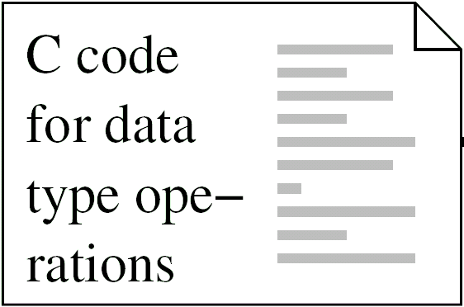
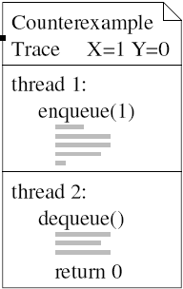
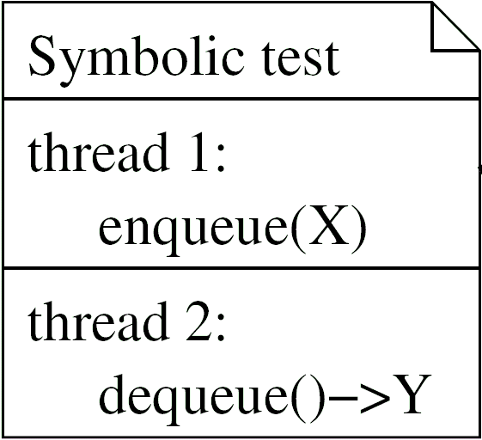
Bounded Model Checker
Pass: all executions of the test are observationally equivalent to a serial execution
Fail:
CheckFence
Inconclusive:
runs out of time or memory
Memory
Model Axioms
Notes:
black-box view 3 inputs (green) red output
code: e.g. nonbl queue code;
symb. test (shown simplest, two threads, one op each)

Slide 18
Workflow
Write test program
Analyze Fail
Fix Implem.
CheckFence
inconclusive
fail
pass
yes
Enough Tests?
no
done
Check the following memory models:
(1) Sequential Consistency (to find alg/impl bugs)
(2) Relaxed (to find missing fences)

Slide 19
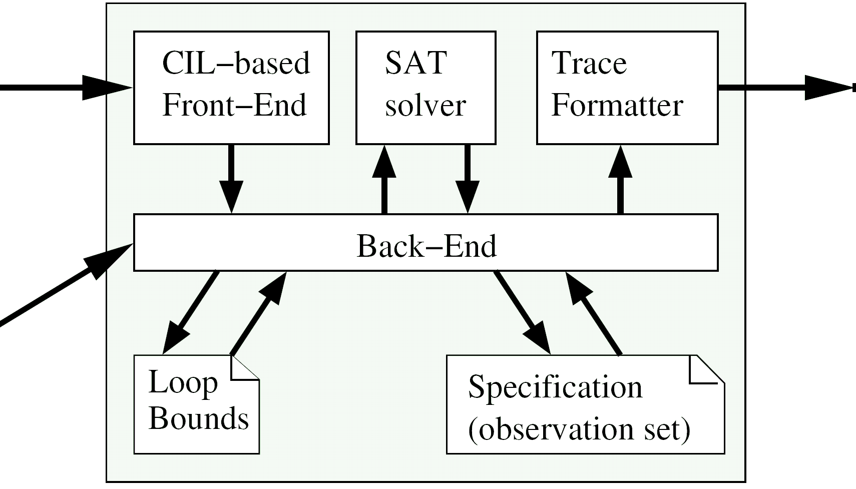
Tool Architecture
C code
Trace
Memory Model
Symbolic Test
Symbolic test is nondeterministic, has exponentially many executions
(due to symbolic inputs, dyn. memory allocation, interleaving/reordering of instructions).
CheckFence solves for “bad” executions.

Slide 20
Demo: CheckFence Tool

Slide 21
Part III Technical Description

Slide 22
Next: The Formula 
what is ?
how do we use  to check consistency?
how do we construct ?
how do we formalize executions?
how do we encode memory models?
how do we encode programs?

Slide 23
The Encoding
Bounded Test T
Encode
set of variables V_{T,I,Y} formula _{T,I,Y}
Implementation I
Memory Model Y
correspond
to
Executions of T, I on Y
Valuations  of V such that [[]] = true

Slide 24
Observations
Bounded Test T
processor 1: processor 2:
enqueue(X) Z=dequeue()
enqueue(Y)
Variables X,Y,Z represent argument and return values of the operations.
Define observation vector obs = (X,Y,Z)
Executions of T, I on Y
with observation (x,y,z) ∈ Val³
correspond
to
Valuations  of V such that [[]] = true
[[obs]] = (x,y,z)

Slide 25
Specification
Bounded Test T
processor 1: processor 2:
enqueue(X) Z=dequeue()
enqueue(Y)
Which observations are
sequentially consistent?
Definition: a specification for T is a set Spec ⊆ Val³
Definition: An implementation satisfies a specification if all of its observations are contained in Spec.
For this example, we would want specification to be Spec = { (x,y,z) | (z=empty) ∧ (z=y) ∧ (z=x) }

Slide 26
Consistency Check
Assume we have T, I, Y, , obs as before.
Assume we have a finite specification Spec = { o₁, ... o_{k} }.
the implementation I satisfies the specification Spec
if and only if
☞ ∧ (obs ≠ o₁) ∧ ... ∧ (obs ≠ o_{k})
is unsatisfiable.
Now we can decide satisfiability with a standard SAT solver (which proves unsatisfiability or gives a satisfying assignment)

Slide 27
Specification Mining
Idea: use serial executions of code as specification
an execution is called serial if it interleaves threads at the granularity of operations.
Define the mined specification Spec_{T,I} = { o | o is observation of a serial execution of T,I}
Variant 1 : mine the implementation under test (may produce incorrect spec if there is a sequential bug)
Variant 2 : mine a reference implementation (need not be concurrent, thus simple to write)

Slide 28
Specification Mining Algorithm
Idea: gather all serial observations by repeatedly solving for fresh observations, until no more are found.
S := {}
⬥ := _{T,I,Serial}
Is  satisfiable ?
o := ←obs→
S := S  {o}
⬥ :=   (obs  o)
yes, by 
no
Spec_{T,I} := S

Slide 29
Next: how to construct _{T,I,Y}
Formalization
how do we formalize executions?
how do we specify the memory model?
how do we encode programs?
how do we encode the memory model?
Encoding

Slide 30
Local Traces
When executed, a program produces a sequence of {load, store, fence} instructions called a local trace.
The same program may produce many different traces, depending on what values are loaded during execution.
,
, ...
,
, ...

Slide 31
Global Traces
a global trace consists of individual local traces for each processor and a partial function seed that maps loads to the stores that source their value.
- the seeding store must have matching address and data values.
- an unseeded load gets the initial memory value.

Slide 32
Memory Models
A memory model restricts what global traces are possible.
Example:
Sequential Consistency
requires that there exist a total temporal order < over all accesses in the trace such that
the order < extends the program order
the seed of each load is the latest preceding store to the same address

Slide 33
Example: Specification for Sequential Consistency
model sc
exists
relation memory_order(access,access)
forall
L : load
S,S' : store
X,Y,Z : access
require
<T1> memory_order(X,Y) & memory_order(Y,Z) => memory_order(X,Z)
<T2> ~memory_order(X,X)
<T3> memory_order(X,Y) | memory_order(Y,X) | X = Y
<M1> program_order(X,Y) => memory_order(X,Y)
<v1> seed(L,S) => memory_order(S,L)
<v2> seed(L,S) & aliased(L,S') & memory_order(S',L) & ~(S = S‘)
=> memory_order(S',S)
<v3> aliased(L,S) & memory_order(S,L) => has_seed(L)
end model

Slide 34
Example: Specification for Sequential Consistency
model sc
exists
relation memory_order(access,access)
forall
L : load
S,S' : store
X,Y,Z : access
require
<T1> memory_order(X,Y) & memory_order(Y,Z) => memory_order(X,Z)
<T2> ~memory_order(X,X)
<T3> memory_order(X,Y) | memory_order(Y,X) | X = Y
<M1> program_order(X,Y) => memory_order(X,Y)
<v1> seed(L,S) => memory_order(S,L)
<v2> seed(L,S) & aliased(L,S') & memory_order(S',L) & ~(S = S‘)
=> memory_order(S',S)
<v3> aliased(L,S) & memory_order(S,L) => has_seed(L)
end model
memory_order is a total order on
accesses

Slide 35
Example: Specification for Sequential Consistency
model sc
exists
relation memory_order(access,access)
forall
L : load
S,S' : store
X,Y,Z : access
require
<T1> memory_order(X,Y) & memory_order(Y,Z) => memory_order(X,Z)
<T2> ~memory_order(X,X)
<T3> memory_order(X,Y) | memory_order(Y,X) | X = Y
<M1> program_order(X,Y) => memory_order(X,Y)
<v1> seed(L,S) => memory_order(S,L)
<v2> seed(L,S) & aliased(L,S') & memory_order(S',L) & ~(S = S‘)
=> memory_order(S',S)
<v3> aliased(L,S) & memory_order(S,L) => has_seed(L)
end model
memory_order extends the
program order

Slide 36
Example: Specification for Sequential Consistency
model sc
exists
relation memory_order(access,access)
forall
L : load
S,S' : store
X,Y,Z : access
require
<T1> memory_order(X,Y) & memory_order(Y,Z) => memory_order(X,Z)
<T2> ~memory_order(X,X)
<T3> memory_order(X,Y) | memory_order(Y,X) | X = Y
<M1> program_order(X,Y) => memory_order(X,Y)
<v1> seed(L,S) => memory_order(S,L)
<v2> seed(L,S) & aliased(L,S') & memory_order(S',L) & ~(S = S‘)
=> memory_order(S',S)
<v3> aliased(L,S) & memory_order(S,L) => has_seed(L)
end model
the seed of each load is the latest preceding store to the same address

Slide 37
Encoding
To present encoding, we show how to collect the variables in V_{T,I,Y} and the constraints in _{T,I,Y}
We show only simple examples here (see dissertation for algorithm incl. correctness proof)
Step (1): unroll loops
Step (2): encode local traces
Step (3): encode memory model

Slide 38
(1) Unroll Loops
Unroll each loop a fixed number of times
Initially: unroll only 1 iteration per loop
After unrolling, CFG is DAG (only forward jumps remain)
if (i >= j) {
i = i - 1;
if (i >= j)
fail(“unrolling 1 iteration is not enough”)
}
while (i >= j)
i = i - 1;
Automatically increase bounds if tool finds failing execution
Use individual bounds for nested loop instances
Handle spin loops separately (do last iteration only)

Slide 39
(2) Encode Local Traces
Variables
For each memory access x, introduce boolean variable G_{x} (the guard) and bitvector vars A_{x} and D_{x} (address and data values)
Constraints
to express value flow through registers
to express arithmetic functions
to express connection between conditions and guard variables
reg = *x;
if (reg != 0)
reg = *reg;
*x = reg;
[G₁] load A₁, D₁
[G₂] load A₂, D₂
[G₃] store A₃, D₃
G₁ = G₃ = true
G₂ = (D₁ ≠ 0)
A₁ = A₃ = x
A₂ = D₁
D₃ = (G₂ ? D₂: D₁)

Slide 40
(3) Encode the Memory Model
For each pair of accesses x,y in the trace
Introduce bool vars S_{xy} to represent (seed(x) = y)
Add constraints to express properties of seed function S_{xy} ⇒ (G_{x} ∧ G_{y} ∧ (A_{x}=A_{y}) ∧ (D_{x}=D_{y})) .... etc
For each relation in memory model spec relation memory_order(access,access) introduce bool vars to represent elements M_{xy} represents memory_order(x,y)
For each axiom in memory model spec memory_order(X,Y) & memory_order(Y,Z) => memory_order(X,Z) add constraints for all instantiations, conditioned on guards (G_{x} ∧ G_{y} ∧ G_{z}) ⇒ (M_{xy} ∧ M_{yz} ⇒ M_{xz})

Slide 41
Part IV Experiments

Slide 42
Experiments: What are the Questions?
How well does the CheckFence method work
for finding SC bugs?
for finding memory model-related bugs?
How scalable is CheckFence?
How does the choice of memory model and encoding impact the tool performance?

Slide 43
Experiments: What Implementations?
Type | Description | loc | Source
Queue | Two-lock queue | 80 | M. Michael and L. Scott (PODC 1996)
Queue | Non-blocking queue | 98
Set | Lazy list-based set | 141 | Heller et al. (OPODIS 2005)
Set | Nonblocking list | 174 | T. Harris (DISC 2001)
Deque | “snark” algorithm | 159 | D. Detlefs et al. (DISC 2000)

Slide 44
Experiments: What Memory Models?
Memory models are platform dependent & ridden with details
We use a conservative abstract approximation “Relaxed” to capture common effects
Once code is correct for Relaxed, it is correct for stronger models
RMO
PSO
TSO
z6
SC
Alpha
IA-32
Relaxed
Notes:
So far unspecific. for a good reason: it’s not the same on all platforms.
program for Relaxed

Slide 45
Experiments: What Tests?

Slide 46
Part V Results

Slide 47
Bugs?
snark algorithm has 2 known bugs, we found them
lazy list-based set had an unknown bug (missing initialization; missed by formal correctness proof [CAV 2006] because of hand-translation of pseudocode)
Type
Description
regular
bugs (SC)
Queue
Two-lock queue
Queue
Non-blocking queue
Set
Lazy list-based set
1 unknown
Set
Nonblocking list
Deque
original “snark”
2 known
Deque
fixed “snark”

Slide 48
Fences?
Bugs?
snark algorithm has 2 known bugs, we found them
lazy list-based set had a unknown bug (missing initialization; missed by formal correctness proof [CAV 2006] because of hand-translation of pseudocode)
Many failures on relaxed memory model
inserted fences by hand to fix them
small testcases sufficient for this purpose
Type
Description
regular
bugs
(SC)
# Fences inserted (Relaxed)
Store Store
Load Load
Dependent Loads
Aliased Loads
Queue
Two-lock queue
1
1
Queue
Non-blocking queue
2
4
1
2
Set
Lazy list-based set
1 unknown
1
3
Set
Nonblocking list
1
2
3
Deque
original “snark”
2 known
Deque
fixed “snark”
4
2
4
6

Slide 49
How well did the method work?
Very efficient on small testcases (< 100 memory accesses) Example (nonblocking queue): T0 = i (e | d) T1 = i (e | e | d | d ) - find counterexamples within a few seconds - verify within a few minutes - enough to cover all 9 fences in nonblocking queue
Slows down with increasing number of memory accesses in test Example (snark deque): Dq = ( pop_l | pop_l | pop_r | pop_r | push_l | push_l | push_r | push_r ) - has 134 memory accesses (77 loads, 57 stores) - Dq finds second snark bug within ~1 hour
Does not scale past ~300 memory accesses

Slide 50
Tool Performance

Slide 51
Impact of Encoding
ms2 implementation

Slide 52
Related Work
Bounded Software Model Checking
Clarke, Kroening, Lerda (TACAS'04) Rabinovitz, Grumberg (CAV'05)
Correctness Conditions for Concurrent Data Types
Herlihy, Wing (TOPLAS'90) Alur, McMillan, Peled (LICS'96)
Operational Memory Models & Explicit Model Checking
Park, Dill (SPAA'95) Huynh, Roychoudhury (FM'06)
Axiomatic Memory Models & SAT solvers
Yang, Gopalakrishnan, Lindstrom, Slind (IPDPS'04)

Slide 53
Part VI Conclusion

Slide 54
Conclusion
Our CheckFence method / tool is a valuable aid for designing and implementing concurrent data types.

Slide 55
Contribution
First model checker for C code on relaxed memory models.
Handles ``reasonable’’ subset of C (conditionals, loops, pointers, arrays, structures, function calls, dynamic memory allocation)
No formal specifications or annotations required
Requires manually written test suite
Soundly verifies & falsifies individual tests, produces counterexamples
Lock-free implementations
Relaxed Memory Models
Software Verification

Slide 56
Future Work
Build CheckFence website and user community source code is available under BSD-style license at http://checkfence.sourceforge.net
Experiment with more memory models
hardware (PPC, Itanium), language (Java, C++ volatiles)
Improve solver component
enhance SAT solver support for total/partial orders
Develop reasoning techniques for relaxed memory models
Develop scalable methods for finding specific, common bugs
Apply tool to industrial library

Slide 57

END

Slide 58
Bounded Model Checker
Pass: all executions of the test are observationally equivalent to a serial execution
Fail:
CheckFence
Inconclusive:
runs out of time or memory
Memory
Model Axioms
Notes:
black-box view 3 inputs (green) red output
code: e.g. nonbl queue code;
symb. test (shown simplest, two threads, one op each)

Slide 59
Why bounded test programs?
1) Avoid undecidability by making everything finite:
State is unbounded (dynamic memory allocation) ... is bounded for individual test
Sequential consistency is undecidable ... is decidable for individual test
2) Gives us finite instruction sequence to work with
State space too large for interleaved system model .... can directly encode value flow between instructions
Memory model specified by axioms .... can directly encode ordering axioms on instructions

Slide 60
Axioms for Relaxed
A set of addresses V set of values
X set of memory accesses S  X subset of stores L  X subset of loads
a(x) memory address of x v(x) value loaded or stored by x
<_{p} is a partial order over X (program order)
<_{m} is a total order over X (memory order)
For a load l  L, define the following set of stores that are “visible to l”:
S(l) = { s  S | a(s) = a(l) and (s <_{m} l or s <_{p} l ) }
Executions for the model Relaxed are defined by the following axioms:
1. If x <_{p} y and a(x) = a(y) and y  S, then x <_{m} y
2. For l  L and s  S(l), always either v(l) = v(s) or there exists another store s’  S(l) such that s <_{m} s’

