Slide 1
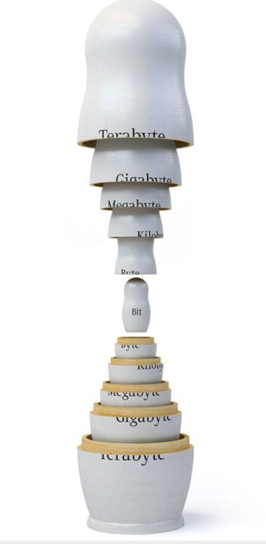

Introduction to XML, Part 1 Building a Website with HTML
Getting started:
1) Create a directory (folder) in a convenient place on your computer and call it XML-workshop.
2) Download the following files from the location on the board and save them to your XML-workshop folder.
pirates-instructions.pdf
template.html
style.css
info.txt
The CaseFiles directory and all of its contents
wellformed-sheet.pdf
3) Download and install the Atom text editor. Installation instructions can be found here: https://atom.io/docs/v0.194.0/getting-started-installing-atom
DLab April 19 & 26, 2016
Scott Paul McGinnis

Slide 2
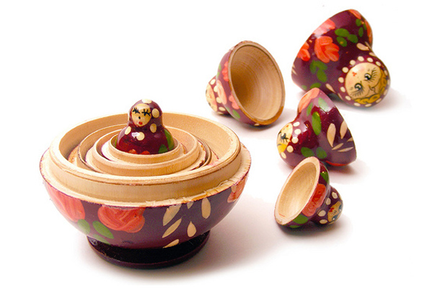
What is XML?
“eXtensible Markup Language”
A markup language
Like a language family
(extensibility)
Human readable and
fairly easy to create
XML
etc.
HTML*
KML
SVG
TEI
Some XML
Applications

Slide 3
Should I learn XML?
Advantages
Ubiquity
Relative Ease
Made for Text
Helpful with Web-scraping / APIs
Well-maintained by a large and active community
Unicode Compliant
Helpful XML Principles
Extensible
Human Readable*
Separation of Content and Display
But... XML doesn't do very much by itself…
Websites: HTML + CSS + Javascript/JQuery
Wordpress: HTML + CSS + PHP
XRX databases: XML + Restful APIs + xQuery
Web-scraping: HTML + scripting (e.g. Python)
APIs: XML + URL queries + scripting

Slide 4
Examples in Projects and Research
(switch to the other slides)

Slide 5
XML Basic Concepts: Elements and Content
The basic unit of XML is called an Element. Think of it like a container for your data or text that describes and categorizes it for the computer. When viewing a web page, for example, you will not see the elements. But you can access and manipulate the elements in all sorts of ways.
This is an Element. It has two components: the Start Tag and the End Tag.
Notice the use and order of the special characters:
< > /
<event>
<name>XML Workshop</name>
<date y=“2013” m=“03” d=“01” />
<description>A workshop about the basics of XML, designed for people without a programming background.</description>
</event>
All of this stuff is nested (i.e. contained) within the “event” element. Elements may contain other elements and they may contain content (e.g. the prose description of the workshop).

Slide 6
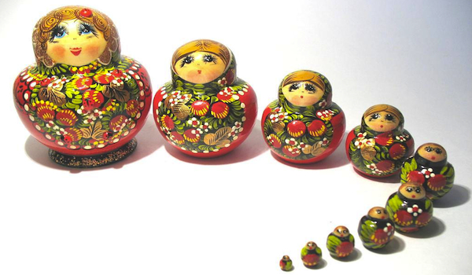
XML Basic Concepts: Attributes and Values
Attributes and their values classify specific instances of an element.
<event>
<name>XML Workshop</name>
<date ref=“03-01-2013”>2013 Mar. 1 </date>
<description>A workshop about the basics of XML, designed for people without a programming background.</description>
</event>
End Tag
Start Tag
This is an Attribute, which has been added to the date element.
Note the syntax and the special characters: = “ ”
Also note that the attribute attaches to the Start Tag of an Element, and not the End Tag.

Slide 7

More XML Basic Concepts
Well-formed-ness
A “well-formed” XML document obeys these main rules:
It has at least one XML element.
It has a single root element, which contains all elements and content and which is not contained by any other element.
All elements are properly closed, with a start tag and an end tag, or as a self-closing element.
All elements are properly nested. If it opens inside another element, it must close inside it too.
All elements and attributes obey the proper syntax (e.g. no missing quotation marks).
No element my have the same attribute more than once.
(other rules) [CASE sensitive]
Validation
- Validation rules are additional requirements made for a particular XML application.
- Document Type Declaration (DTD) or Schema

Slide 8
The XML Tree
<html>
<head>
<title>My Webpage</title>
</head>
<body>
<h1>Headline</h1>
<p>A paragraph<img
src=“http://image.com/picture.jpg”
alt=“a picture”/>with a picture in it.
</p>
<p>Another paragraph.</p>
</body>
</html>
The “Document Object Model” (DOM)
Nodes and leaves
Parents, Children, Siblings
(Document)
Root element: <html/>
Element:
<head/>
Element:
<body/>
Element:
<title/>
Element:
<h1/>
Element:
<p/>
Element:
<p/>
Text:
My webpage
Text:
Headline
Text:
A paragraph
Element:
<img/>
Text:
with a picture in it.
Text:
Another paragraph.
Attribute:
src=“http:…”
Atribute:
alt=“a picture”

Slide 9
The XML Tree: Exercise
Working with your neighbors, draw a tree that represents the following made-up XML:
<book isbn=“12345”>
<toc></toc>
<chapter n=“1”>
<title></title>
</chapter>
<chapter n=“2”>
<title></title>
</chapter>
<chapter n=“3”>
<title></title>
<section></section>
<section></section>
</chapter>
<bibl></bibl>
<index></index>
</book>

Slide 10

XML Basics: HTML
HTML is a close sibling to XML applications, which is used for web design. It has special rules in addition to the basics of XML, for example, it must have the root element <html>, which contains all other Elements. And it must have both a <head> and a <body> element, one or the other of which contain all other elements except the root.
<html>
<head>
</head>
<body>
<div>
<h1>XML Workshop
<br/>2012 Dec. 18</h1>
<p>A workshop about the basics of XML, designed for people without a programming background.</p>
</div>
</body>
</html>
The <head> Element. This contains information about the page, but will not (usually) be displayed on the page itself.
The Root Element <html>
The <body> element. It contains what people see on the page.

