Slide 1
Artificial Intelligence Lecture12 – Evaluation

Slide 2
Agenda
Evaluation of LLMs

Slide 3
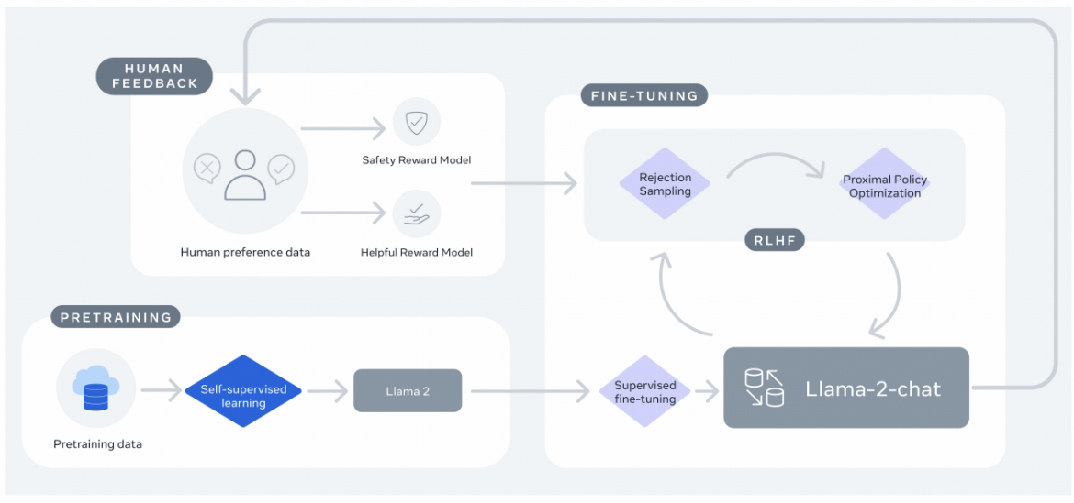
Overview of LLMs Training

Slide 4
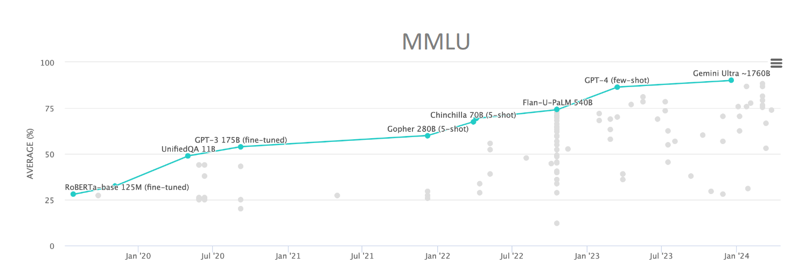
Benchmarks and evalua:ons drive progress
MMLU (Massive Multitask Language Understanding)

Slide 5
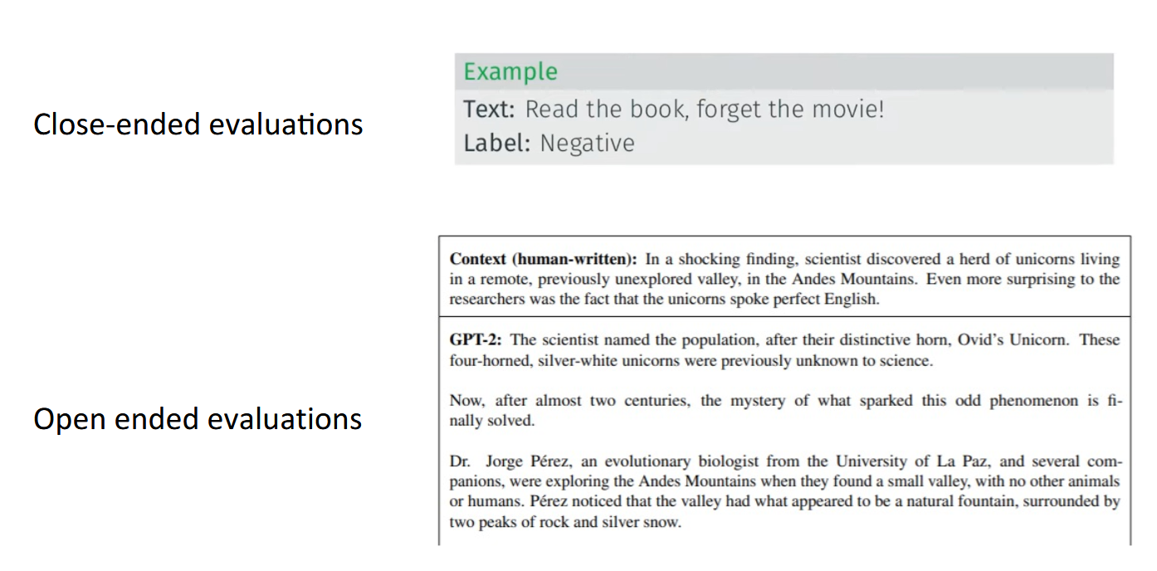
Two major types of evaluations

Slide 6
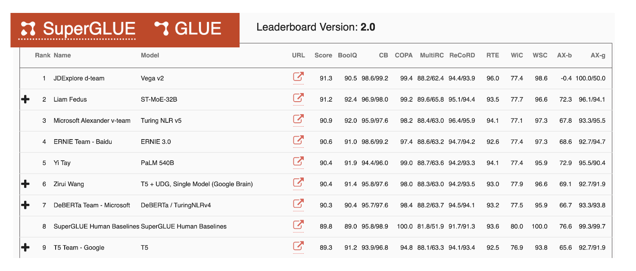
Close-ended mul:-task benchmark - superGLUE
https://super.gluebenchmark.com/
Attempt to measure “general language capabilites”

Slide 7
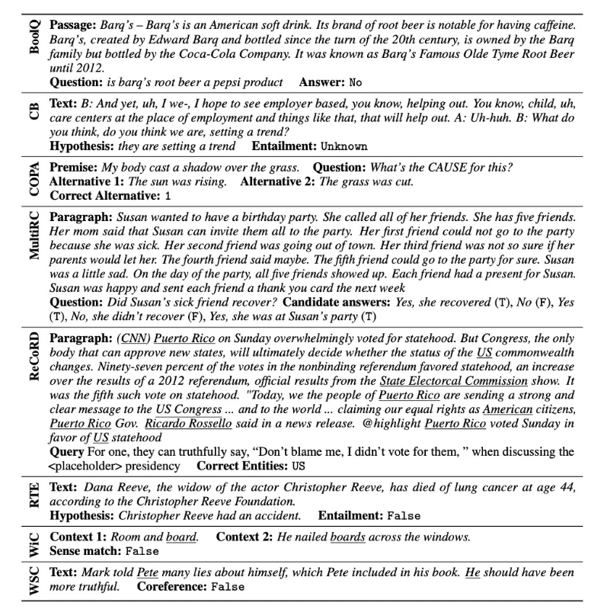
Close-ended mul:-task benchmark - superGLUE
Cover a number of different tasks
• BoolQ, Mul;RC (reading texts)
• CB, RTE (Entailment)
• COPA (cause and effect)
• ReCoRD (QA+reasoning)
• WiC (meaning of words)
• WSC (coreference)

Slide 8
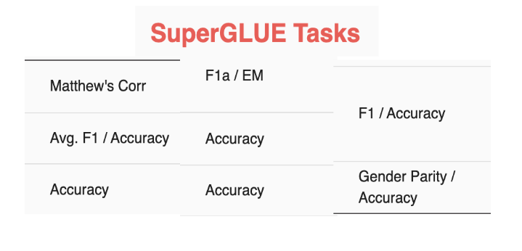
Close-ended: challenges
Choosing your metrics: accuracy / precision / recall / f1-score / ROC
https://github.com/cgpotts/cs224u/blob/main/evaluation_metrics.ipynb
Aggregating across metrics or tasks
• Where do the labels come from?
• Are there spurious correlations?

Slide 9
Open-ended tasks
Long generations with too many possible correct answers to enumerate
• => can’t use standard ML metrics
• There are now better and worse answers (not just right and wrong)
• Example:
• Summarization: CNN-DM / Gigaword
• Translation: WMT
• Instruction-following: Chatbot Arena / AlpacaEval / MT-Bench

Slide 10
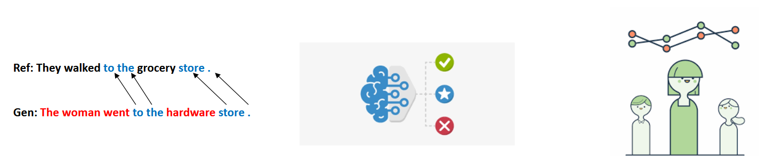
Types of evalua:on methods for text generation
Content Overlap Metrics
Model-based Metrics
Human Evaluations

Slide 11
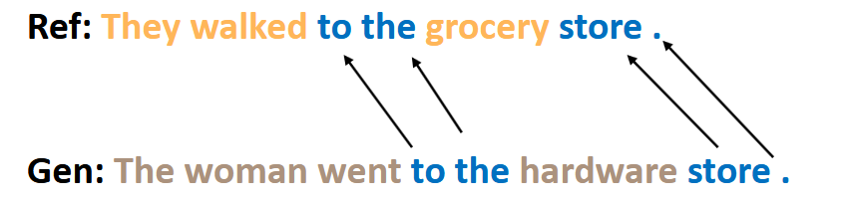
Content Overlap Metrics
• Compute a score that indicates the lexical similarity between generated and gold-
standard (human-written) text
• Fast and efficient
• N-gram overlap metrics (e.g., BLEU, ROUGE, METEOR, CIDEr, etc.)
• Not ideal but often still reported for translation and summarization

Slide 12
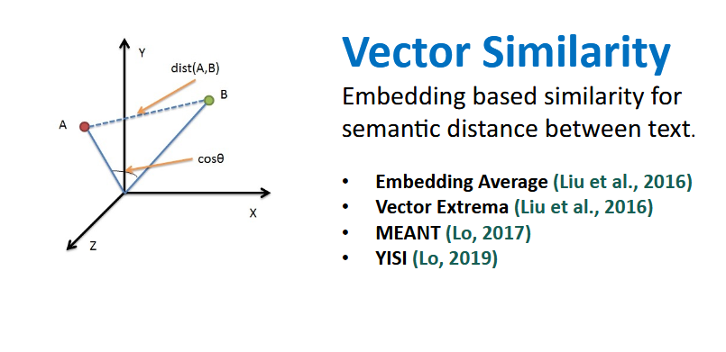
Model-based metrics to capture more semanantics
Use learned representations of words and sentences to compute semantic similarity between generated and reference texts
The embeddings are pretrained, distance metrics used to measure the similarity can be fixed

Slide 13
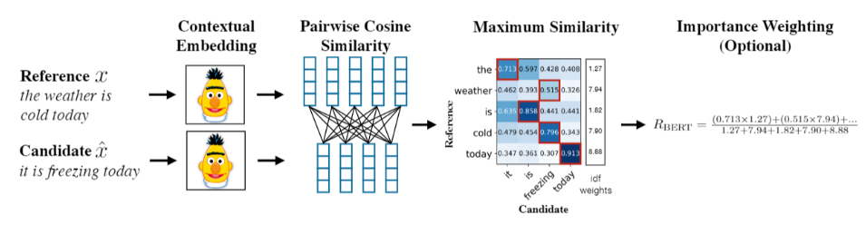
BERTSCORE
Uses pre-trained contextual embeddings from BERT and matches words in candidate and reference sentences by cosine similarity.
(Zhang et.al. 2020)

Slide 14
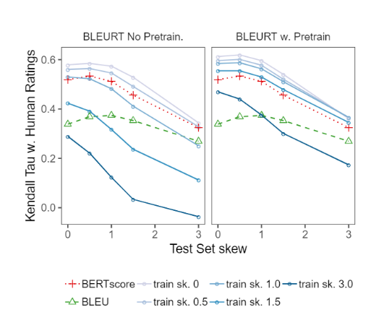
Model-based metrics: Beyond word matching
BLEURT:
A regression model based on BERT returns a score that indicates to what extent the candidate text is gramatical and conveys the meaning of the reference text.
(Sellam et.al. 2020)

Slide 15
Reference free evals
Reference-based evaluation:
• Compare human written reference to model outputs
• Used to be ‘standard’ evalua;on for most NLP tasks
• Examples: BLEU, ROUGE, BertScore etc.
Reference free evaluaEon
• Have a model give a score
• No human reference
• Was nonstandard – now becoming popular with GPT4
• Examples: AlpacaEval, MT-Bench

Slide 16

Human Evaluations
Automatic metrics fall short of matching human decisions
• Human evaluation is most important form of evaluation for text generation.
• Gold standard in developing new automatic metrics
• New automated metrics must correlate well with human evaluations!

Slide 17
Human Evaluations
- Ask humans to evaluate the quality of generated text
- Overall or along some specific dimension:
• fluency
• coherence / consistency
• factuality and correctness
• commonsense
• style / formality
• gramma;cality
• redundancy
Note: Don’t compare human
evaluation scores across
differently conducted studies
Even if they claim to evaluate
the same dimensions!

Slide 18
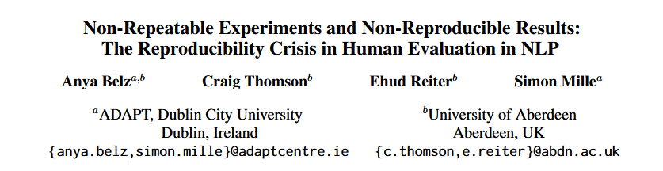
Human Evaluations: Issues
Human judgments are regarded as the gold standard, but it also has issues:
• Slow
• Expensive
• Inter-annotator disagreement (esp. if subjective)
• Intra-annotator disagreement across time
• Not reproducible
• Precision not recall
• Biases/shortcuts if incentives not aligned (max $/hour)
“just 5% of human evaluations are repeatable in the sense that (i) there are no prohibitive barriers to repeat on, and (ii) sufficient information about experimental design is publicly available for rerunning them. Our estimate goes up to about 20% when author help is sought.”

Slide 19
Human Evaluations: Issues
Challenges with human evaluation
• How to describe the task?
• How to show the task to the humans?
• What metric do you use?
• Selecting the annotators
• Monitoring the annotators: time, accuracy, …

Slide 20
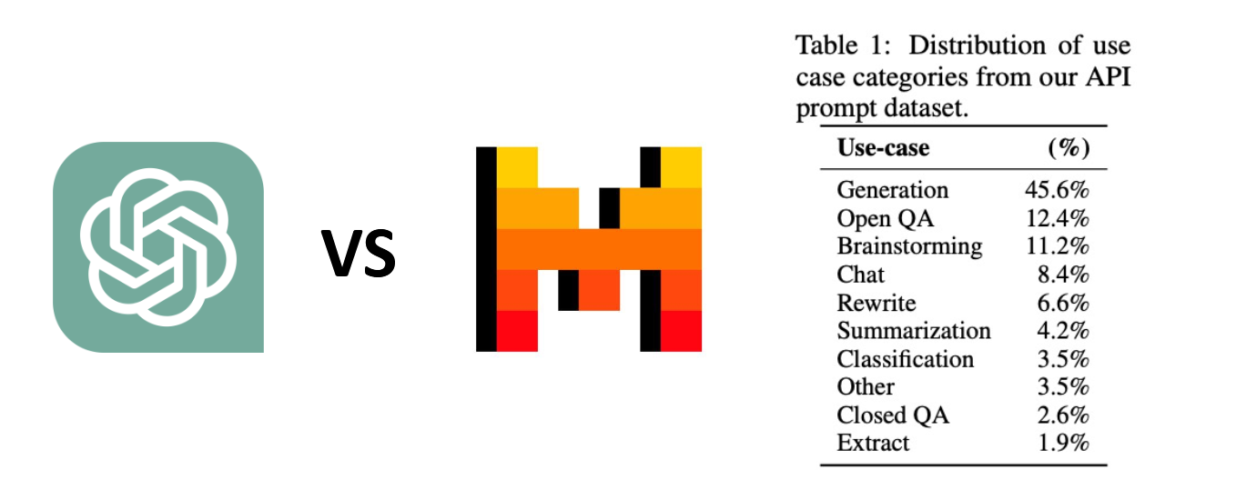
Reference-free eval: Chatbots
How do we evaluate something like ChatGPT?
• So many different use cases it’s hard to evaluate
• The responses are also long-form text, which is even harder to evaluate.

Slide 21
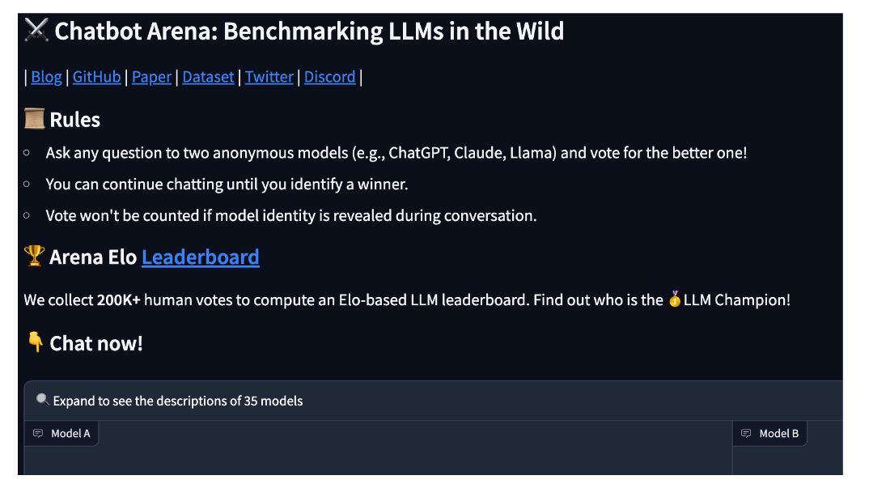
Side-by-side ratings
Have people play with two models side by side, give a thumbs up vs down rating.

Slide 22
What is missing with Side-by-side ratings
Current gold standard for evaluation of chat LLM
• External validity
• Typing random questions into a head-to-head website may not be representative
• Cost
• Human annotation takes large, community effort
• New models take a long time to benchmark
• Only notable models get benchmarked

Slide 23
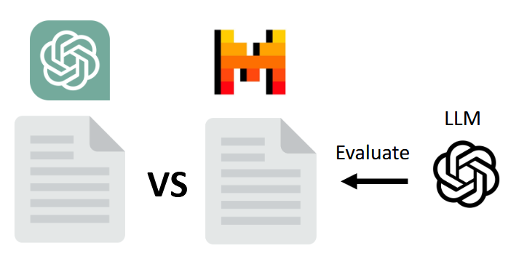
Lowering the cost – use a LM evaluator
Use a LM as a reference free evaluator
• Surprisingly high correla;ons with human
• Common versions: AlpacaEval, MT-bench

Slide 24
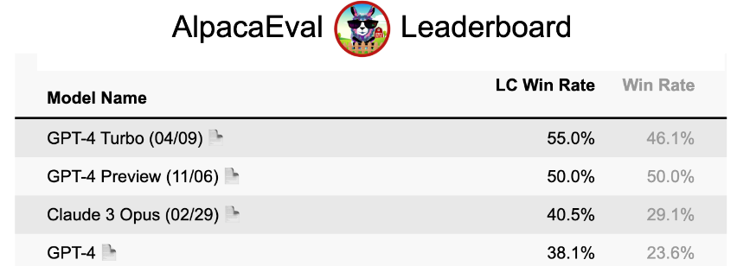
AlpacaEval
AlpacaEval
• Internal benchmark for developing Alpaca
• 98% correlation with Chatbot Arena
• < 3 min and < $10
• 1. For each instruction: generate an output by baseline and model to eval
• 2. Ask GPT-4 the probability that the model’s output is better
• 3. (AlpacaEval LC) Reweight win-probability based on length of outputs
• 4. Average win-probability => win rate

Slide 25
TakeAways
Closed ended tasks
• Think about what you evaluate (diversity, difficulty)
Open ended tasks
• Content overlap metrics (useful for low-diversity settings)
• Chatbot evals – very difficult! Open problem to select the right examples / eval
Challenges
• Consistency (hard to know if we’re evalua&ng the right thing)
• Contamina&on (can we trust the numbers?)
• Biases
In many cases, the best judge of output quality is YOU!
• Look at your model generations. Don’t just rely on numbers!

Slide 26
Readings
https://arxiv.org/html/2412.05579v1
https://www.datacamp.com/blog/llm-evaluation
https://arxiv.org/abs/2404.18796
https://huggingface.co/papers/2404.18796

