Slide 1
Pangenome Graphs
Justin Mau

Slide 2

Pangenome Graphs - About
Single-Reference can lead to bias
Rare alleles in reference genome may be overestimated in population
Need for a more holistic view of multiple genomes
Pangenome Graph – graph representing multiple genomes
Easier to map reads
Observe a population’s genomes as a whole
View all variations, structural variants, etc
Useful for tracking pathogens (Yang et al., 2023)
Pathogens mutate quickly, lots of variation
Variations not well detected with single-reference

Slide 3
Variation Graph
Visualizes differences in sequences
Convergent subsequences = common alleles among population
Branches in graph = mutations and variations in population
Fewer branches, less variation in genomes
Allows for jumps between distant nodes
Makes it helpful for mapping reads

Slide 4
Variation Graph – Implementation
Iterate through each position i in the strings
Get set of unique characters at each position
[['A'], ['C'], ['G', 'C'], ['G'], ['T'], ['T'], ['A'], ['A’], ['G', '-'], ['G', '-’],
['G', '-'], ['C', '-'], ['G'], ['A'], ['T'], ['C'], ['G'], ['A', 'C', 'G', 'T’]]
Compress those characters
Consecutive singletons combine into one string
[['AC'], ['G', 'C'], ['GTTAA'], ['G', '-'], ['G', '-'], ['G', '-'], ['C', '-'], ['GATCG'], ['A', 'C', 'G', 'T']]

Slide 5
Variation Graph – Implementation
Each label becomes a node
‘ – ‘ character is ignored (indicates a jump)
Labels within the same set are given the same “layer”
Ex. [“A, CG”] [“TGA”]
Adding edges
Uses sliding window, keeps track of substring_A and substring_B
Creates edge between A and B
If substring_B == ‘ – ‘, keeps A the same and stretches the window
This way an edge can form between non-adjacent nodes (jump)
Ex. [“A”] [“TG”, “-”] [“G”]
A
TGA
CG
G
TG
A

Slide 6
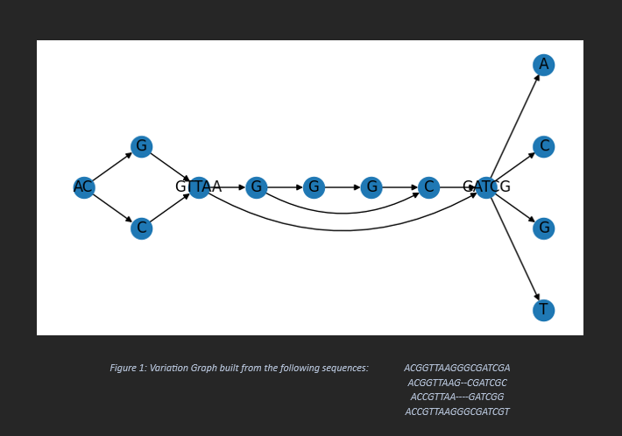

Slide 7
K-Block Graph
Splits sequences into k-size blocks
Ex. K = 6
GAGCTA | ACCGTA | GTGGAA | CCAT
GCGCTC | ACCGTA | GTGGAA | CCAT
GAGCAA | ACCGTA | GTGGAT | CCAT
GAGCTA | ACCGTA | GTGGAT | CCAT
GCGCTC | ACCGTA | GTGGAT | CCAT
Setting k can help reduce runtime
Also helpful if you know what general size of subsequence you’re looking for

Slide 8
K-Block Graph – Implementation
Fairly simple
Split sequences into k-sized blocks
For each block, take unique labels
These become the nodes
All labels in same block are assigned same “layer”
Goes through each sequence, adding edges between blocks
If edge already exists, moves on

Slide 9
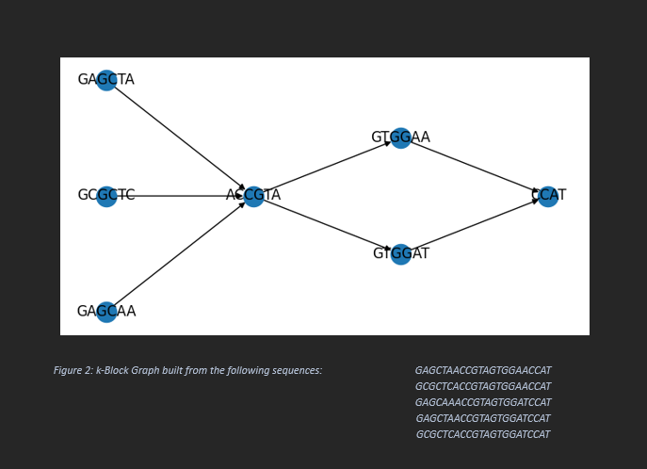

Slide 10
Sequences – Ex. 2
AGGCTGATGACCCTTGAAGTAGTTGACCATGATGACGATGCAAATGTTGAGTAGAAGTTGAGAAGAGGCCGT
AGCTTCGATCGATCGATCGGTTAGGCAAGCATATCCCATTGCAAATGTTGAGTAGAGTTGAGAAGAGGCCGT
AGGCTCGATCGATTTGAAGTCGGTTAGGCAAGCATATCCCATTGCAATTGAGTAGAGTTGAGAAGAGGCCGT
AGGCTGATGACCCTTGAAGTAGTTGACCATGAGTACTTTAGCTATCGTTAGTAGAAGTTGAGAAGAGGCCGT
ATGCTAGGCTAGCGACGACGTAATCGATCGTTAGCATTACTTAGGCATCGGAAGAAGATTCGAAGAGGCCGA
AGGTATGATATTGGATGGCTCTCACCGACTTGCATTGCTAGCAGCCTAGCTTTAGCATCGCGAAGAGGCCAG
ATGTGATGAGCTATCGACTGACTGATTCGATTGCATGCTAGCAGCCTAGCTTTAGAGCCATGGACGGGCCAG
ATGTGATGACGTATCGAAGTAGTATGAAGCGTTAGCGATCGGTACGGGGACTTAGACCCATGGATCTAATCG

Slide 11
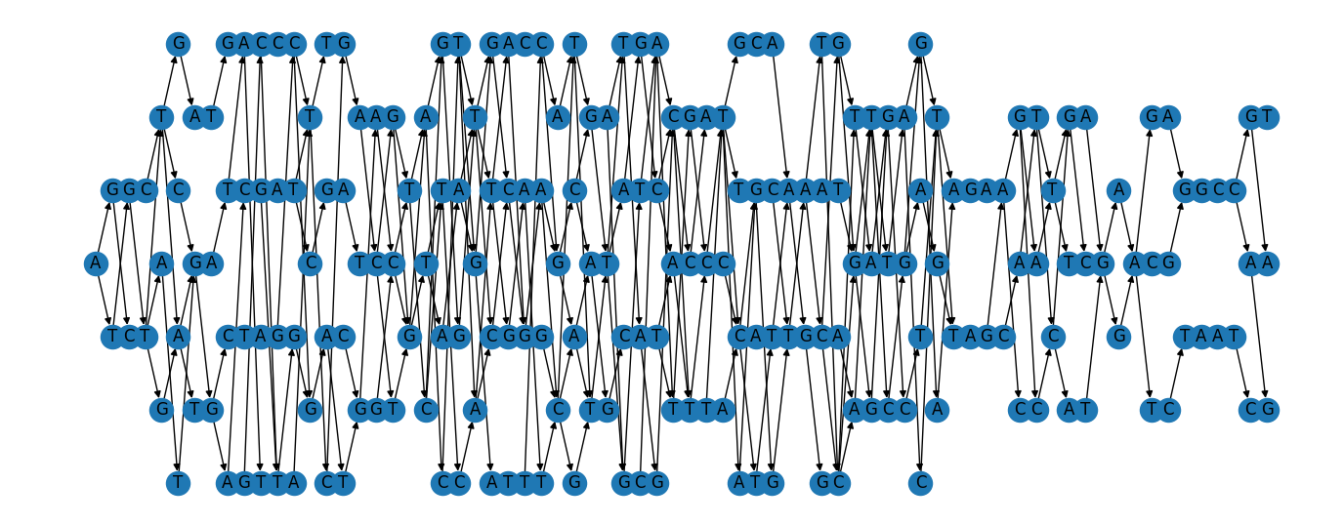
Variation Graph – Ex. 2

Slide 12
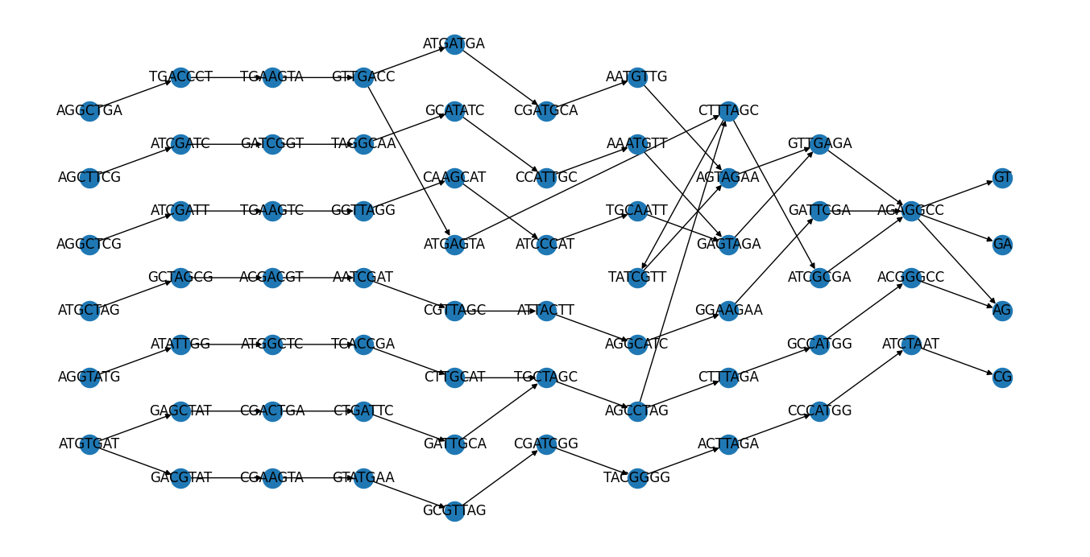
K-Block Graph – Ex. 2

Slide 13
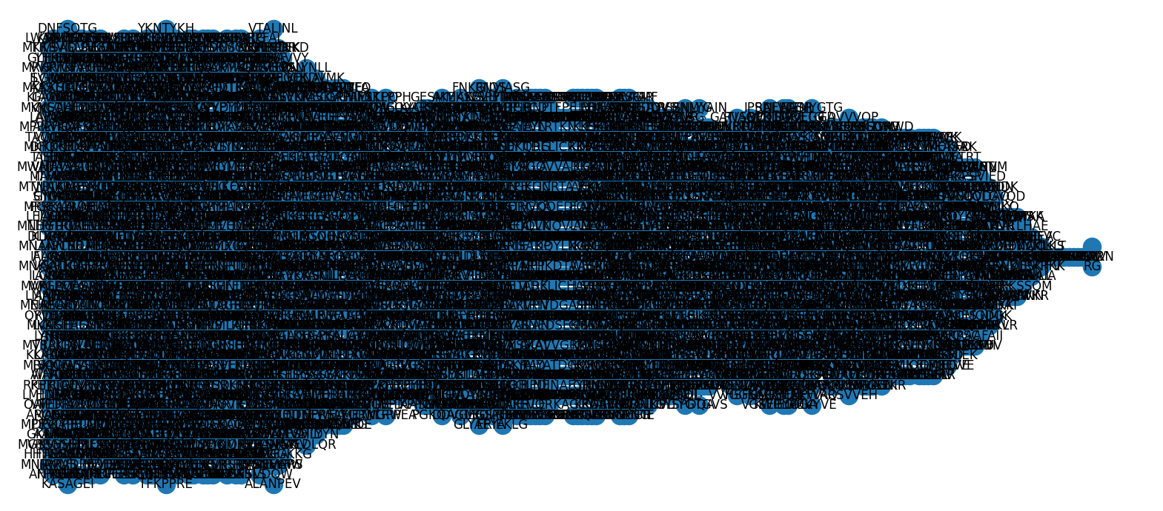
Ex. 3
Run on ~ 30 fairly large virus protein sequences

Slide 14
Pangenome Graphs - Options
Minigraph (Li et al., 2020)
Only calls SVs (structural variants)
SVs helpful for pathogen evolution
Cactus (Armstrong et al., 2020)
Creates multiple alignments using a guide phylogenetic tree
Accurate, but doesn’t scale well
Cactus Pangenome Pipeline – doesn’t need guide tree, adds alignments to minigraph (Hickey et al. 2023)
PPanGGOLiN (Gautreau et al., 2020)
Nodes -> gene families
Edges -> genomic neighborhoods
Effective for finding persistent genone/shell genome
Pandora (Colquhoun et al., 2021)
Uses individual MSAs of coding sequences for graphs
Finds more SNPs (single-nucleotide polymorphisms) than single-reference based

Slide 15
Sources
Yang Z, Guarracino A, Biggs PJ, Black MA, Ismail N, Wold JR, Merriman TR, Prins P, Garrison E, de Ligt J. Pangenome graphs in infectious disease: a comprehensive genetic variation analysis of Neisseria meningitidis leveraging Oxford Nanopore long reads. Front Genet. 2023 Aug 10;14:1225248. doi: 10.3389/fgene.2023.1225248. PMID: 37636268; PMCID: PMC10448961.
Li H, Feng X, Chu C. The design and construction of reference pangenome graphs with minigraph. Genome Biol. 2020 Oct 16;21(1):265. doi: 10.1186/s13059-020-02168-z. PMID: 33066802; PMCID: PMC7568353.
Armstrong J, Hickey G, Diekhans M, Fiddes IT, Novak AM, Deran A, Fang Q, Xie D, Feng S, Stiller J, Genereux D, Johnson J, Marinescu VD, Alföldi J, Harris RS, Lindblad-Toh K, Haussler D, Karlsson E, Jarvis ED, Zhang G, Paten B. Progressive Cactus is a multiple-genome aligner for the thousand-genome era. Nature. 2020 Nov;587(7833):246-251. doi: 10.1038/s41586-020-2871-y. Epub 2020 Nov 11. PMID: 33177663; PMCID: PMC7673649.
Gautreau G, Bazin A, Gachet M, Planel R, Burlot L, Dubois M, Perrin A, Médigue C, Calteau A, Cruveiller S, Matias C, Ambroise C, Rocha EPC, Vallenet D. PPanGGOLiN: Depicting microbial diversity via a partitioned pangenome graph. PLoS Comput Biol. 2020 Mar 19;16(3):e1007732. doi: 10.1371/journal.pcbi.1007732. Erratum in: PLoS Comput Biol. 2021 Dec 10;17(12):e1009687. PMID: 32191703; PMCID: PMC7108747.
Colquhoun RM, Hall MB, Lima L, Roberts LW, Malone KM, Hunt M, Letcher B, Hawkey J, George S, Pankhurst L, Iqbal Z. Pandora: nucleotide-resolution bacterial pan-genomics with reference graphs. Genome Biol. 2021 Sep 14;22(1):267. doi: 10.1186/s13059-021-02473-1. PMID: 34521456; PMCID: PMC8442373.

