Slide 1
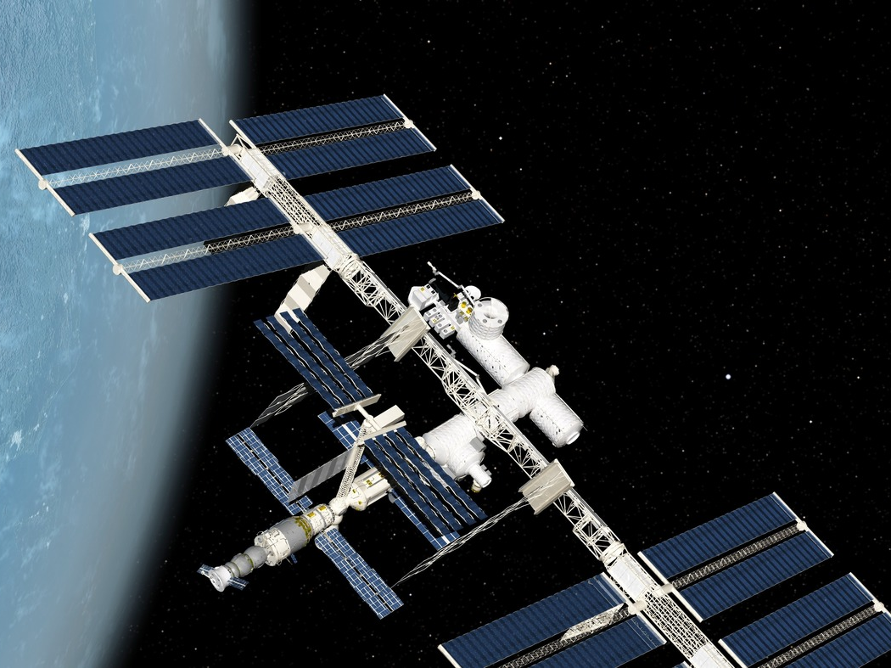
Worldwide Satellite Analysis
Justin Merryman
Raven Washington
Tamara Washington
December
2020

Slide 2
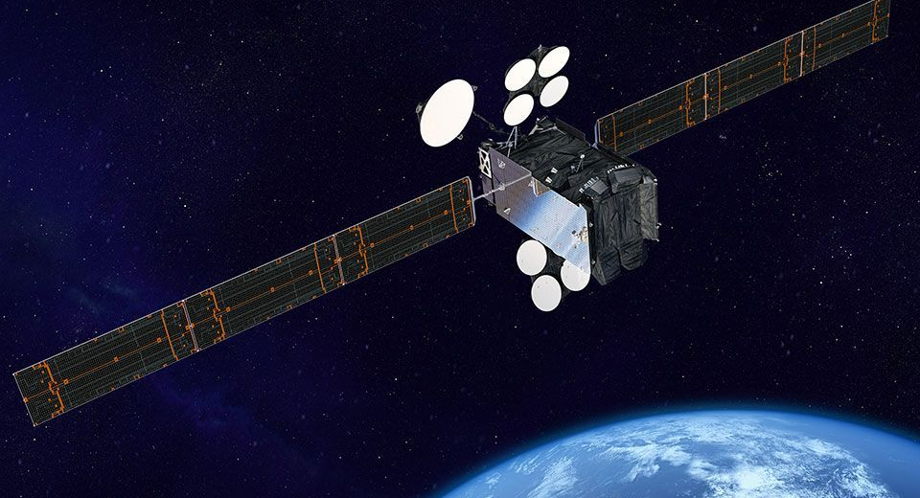
UCS Satellite Database
Assembled by experts at the Union of Concerned Scientists (UCS), the Satellite Database is a listing of the almost 3,000 operational satellites currently in orbit around Earth.
The intent in producing the database is to create a research tool for specialists and non-specialists alike by collecting open-source information on operational satellites and presenting it in a format that can be easily manipulated for research and analysis.

Slide 3
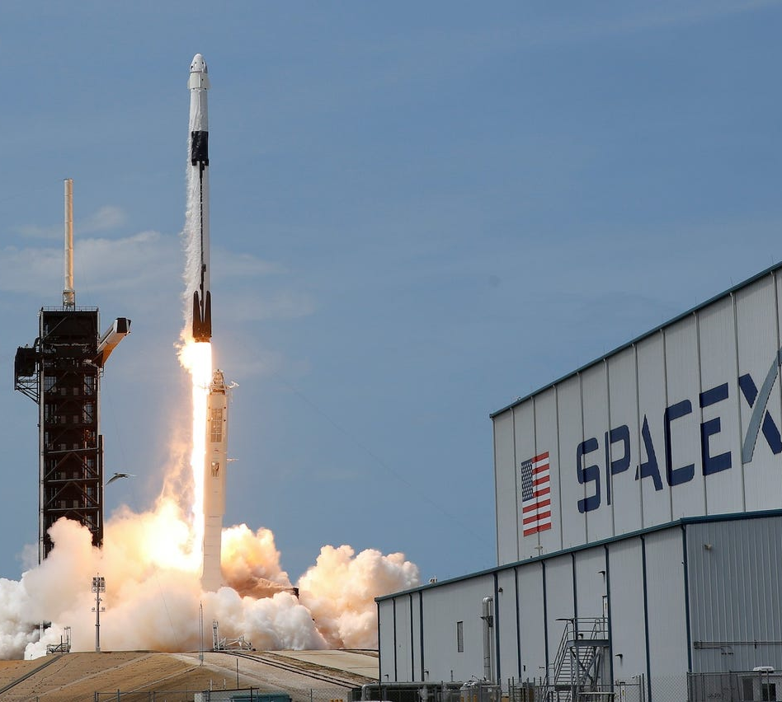
Research Questions
Using the info provided we will answer the following questions:
How many satellites do the top 10 countries have in orbit?
How many satellites are used for military purposes versus commercial purposes?
At what altitudes do most satellites orbit?
What activities are most satellites involved with?
Launch locations and number of launches at each site.
Visualize the number of satellites launched since inception.
Which contractors are involved in satellite launches?

Slide 4
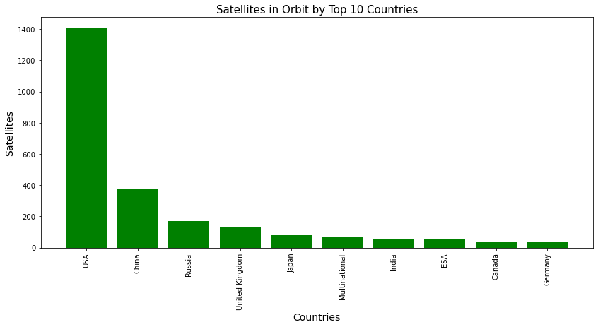
Satellites in orbit
How many satellites does a given country have in orbit?

Slide 5
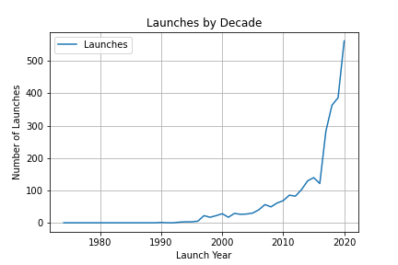
Launches by Year
How many satellites are launch per year?

Slide 6
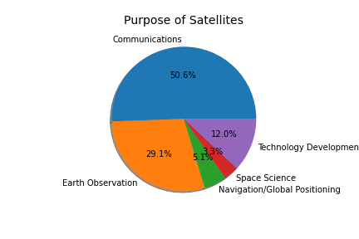
Purpose of Satellites
What activities are most satellites involved in?

Slide 7
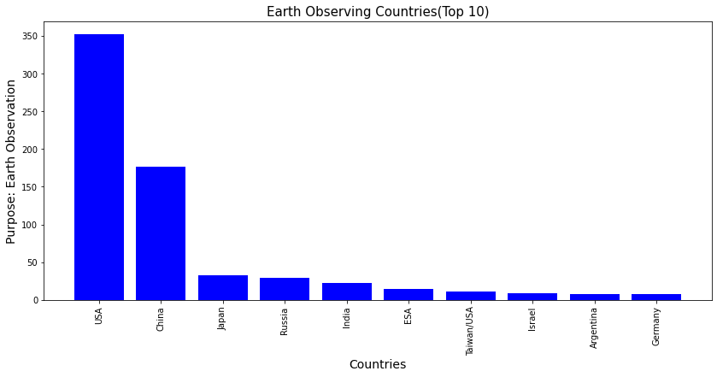
Earth Observing Countries
Which country has the most earth observing satellites?

Slide 8
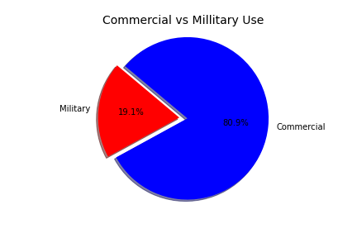
User Types
Compare the military vs commercial use of satellites.

Slide 9
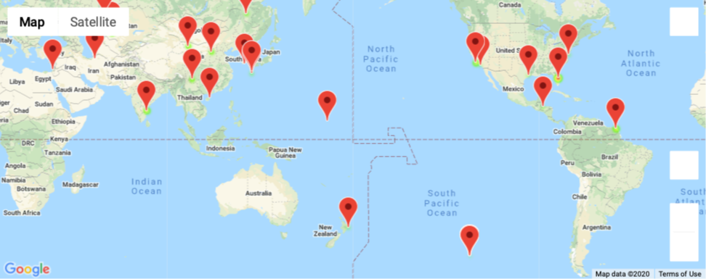
Launch Locations

Slide 10
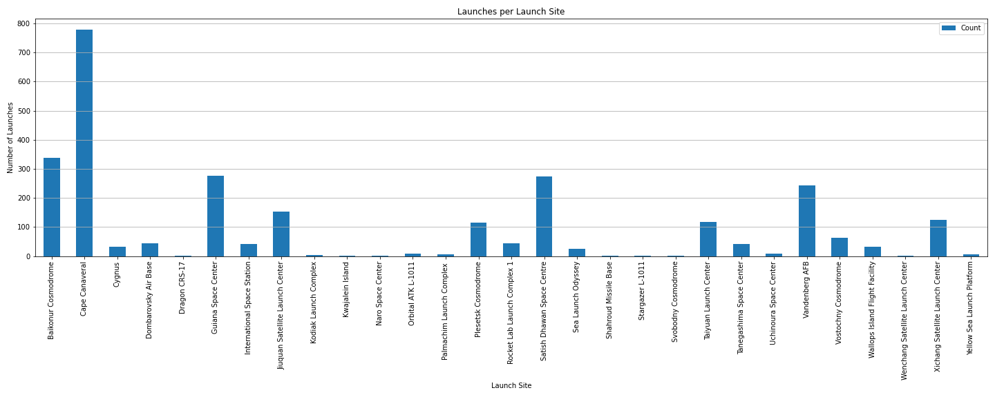
Launches per Launch Site

Slide 11
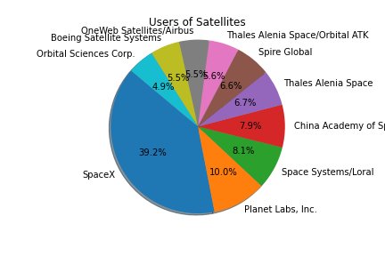
Contractors
Which contractor has launched the most satellites?

Slide 12
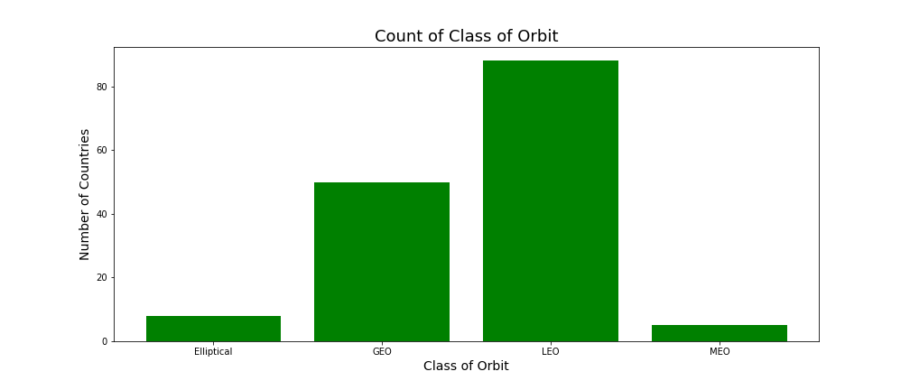
Altitudes of Satellites
At what altitudes are the satellites orbiting?

Slide 13
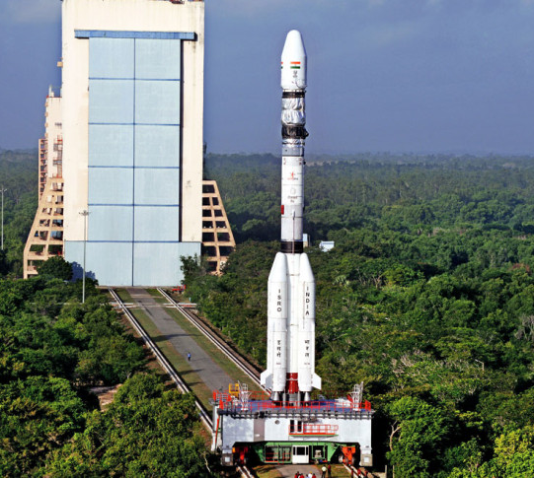
Observations
Based on the data we complied we’ve arrived at these conclusions:
Cape Canaveral has launched the most satellites of any launch site in the world; and has launched almost twice as many satellites as any other launch site.
The amount of satellites launched per year has increased almost exponentially since 1980, with greatest increase beginning in 2015.
The top contractor for launching satellites is SpaceX, making up 39.2% of all satellites launched by the top 10 contractors.
Communications and earth observation account for nearly 80% of all satellite use.
Low Earth Orbit altitude is by far where most satellites orbit. There is likely correlation between the altitude and purpose.

Slide 14

THANK YOU!
Questions?

