Slide 1
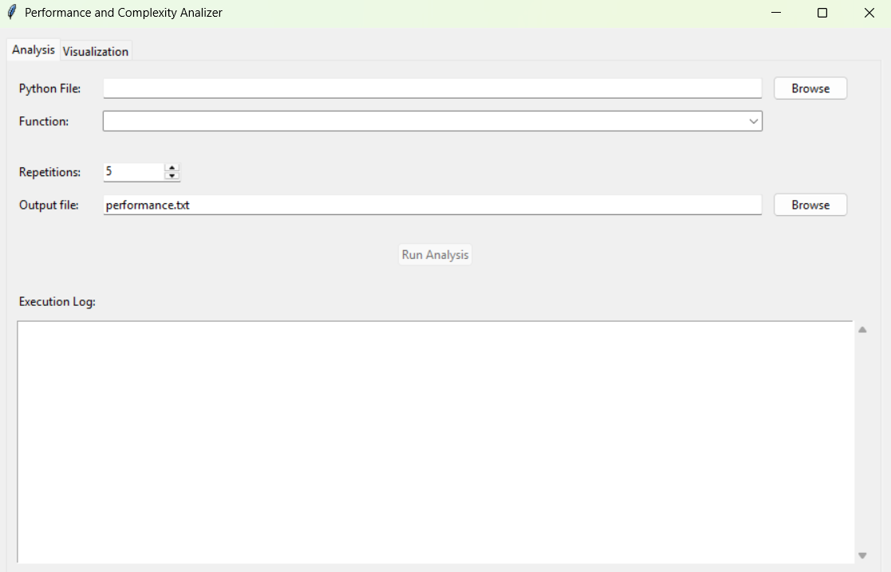





$$1$$
$$2$$
$$3$$
$$4$$
$$5$$

Slide 2
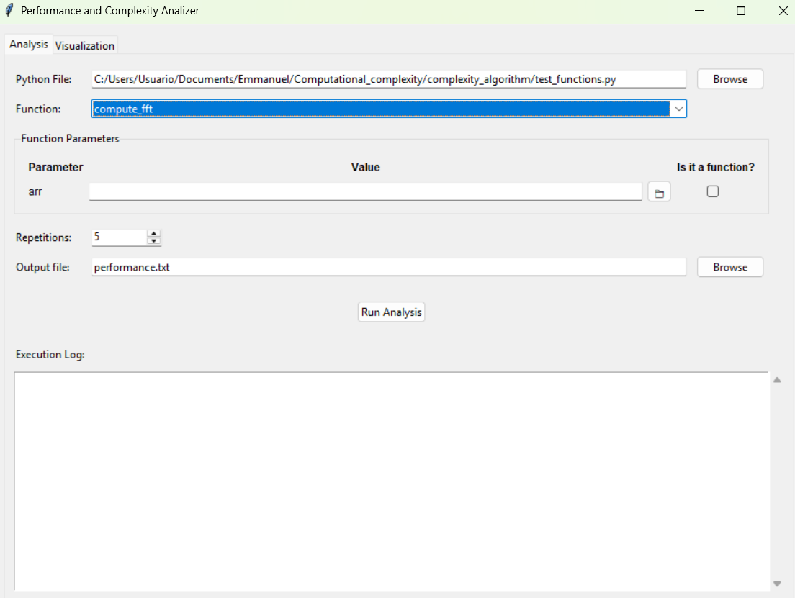

Slide 3




Slide 5


