Slide 1
StratModLib: correct geology for everyone¹
Julio Daniel Silva,
Clarissa Coda Marques, Felipe Moura, Mario Costa Sousa
University of Calgary – March 10th, 2017
¹: everyone who knows how to program and link code to this library.

Slide 2
Summary
Getting new versions of this document (p.3)
Rationale (p.4-5)
Installation (p.6-12)
Using the library (p.13-23)
Issues and caveats (p.24)
Appendix (p.25-52)
The Appendix is a brief introduction to the geologic rules adapted from my 5th sponsors meeting presentation at the Imperial College (Nov 2017).

Slide 3
Getting new versions of this document
This presentation will be superseded by proper documentation in the future!
For the time being, and since we don’t have a proper channel to share binary files as of yet, updates to this document (and perhaps other helpful binaries) will be available in the StratModLib repository as Git LFS objects.
Download Git LFS (https://git-lfs.github.com), and then execute in terminal:
$ git lfs install
to install the appropriate git hooks. New versions of this document will be automatically downloaded in subsequent git-pulls or -clones. For details see:
https://www.atlassian.com/git/tutorials/git-lfs

Slide 4
Rationale
StratModLib stands for the stratigraphy modeller library.
It is LGPL3 to make its use in RRM simpler;
It was built to encapsulate the library that currently performs all modelling in RRM, the PlanInLib;
It was designed to be as simple to use as possible, at the cost of offering just the minimal modelling primitives that are required to implement RRM’s stratigraphic geologic rules;
It is an opaque class that can be easily compiled as a shared library.

Slide 5
Rationale
This library implements part of the modularization of the Rules Processor as defined in Clarissa’s new architecture for RRM.
MainWindow
Diagram represents January 2017 release.
Arrangement
Sketching View
3D View
SketchLib
Scene
Controller
Rules Processor
Drawables Geol. Models
Geological Model
PlanInlib
View
Drawable Objects
Controller
Model
Tools

Slide 6
Installation
The library is available at the repository:
git@bitbucket.org:jdms/stratmod.git
It depends on the PlanInLib (git@bitbucket.org:jdms/planinlib.git), which is included into StratModLib as a git submodule.
Cmake should be used to compile the library.

Slide 7
Dependencies
The StratModLib supports Clang (v3.7+; macOS, Linux), G++ (v5.4+, Linux), and MSVS (2013 update 5+, Windows 7 or newer). It uses:
C++11 semantics and data structures (required);
OpenMP for parallelization (useful but not required);
Cmake for building configuration/introspection (v3.3+, required);
Git to manage resources (required);
PlanInLib (depends on Eigen3 http://eigen.tuxfamily.org/, required);
Catch (https://github.com/philsquared/Catch, only for testing).

Slide 8
Installing deps (Ubuntu 16.04, macOS 10.11+)
Ubuntu 16.04:
$ sudo apt-get install build-essentials git cmake eigen3
macOS (using homebrew https://brew.sh; llvm is required for OpenMP):
$ brew install llvm cmake git eigen3
A system wide Eigen3 installation is not strictly required. If Eigen3 is not available at compile time cmake/git will checkout Eigen3’s newest version.
Catch is downloaded by cmake if option ”BUILD_TESTING” is set as true.

Slide 9
Installing deps (Windows 7+)
Install cmake (required):
https://cmake.org/download/
and install Git for Windows (required):
https://git-scm.com/download/win
Native Windows binaries will require either MS Visual Studio (MSVS) or the Intel Compiler (the latter is not officially supported, but should work).
If Eigen3 is not installed as a standalone library it will be automatically downloaded by cmake inside PlanInLib’s dir (simplest option in Windows).

Slide 10
Compilation steps
Clone the StratModLib:
$ git clone git@bitbucket.org:jdms/stratmod.git stratmod
Create an out of source build directory:
$ cd stratmod; mkdir build; cd build
Configure and compile (e.g., in a MS Visual Studio cmd prompt):
$ cmake .. –G ”NMake Makefiles”; nmake

Slide 11
Compiling and running the example
The StratModLib’s Cmake config will automatically manage all other dependencies;
It compiles without warnings in Clang 3.8 (macOS, homebrew llvm installation), GCC/G++ 5.4 (Ubuntu 16.04), and Visual Studio 2013 Update 5 (Windows 7);
The default is to have the StratModLib compiled as a shared library together with a small command line utility (”run_me[.exe]”);
The utility ”run_me[.exe]” creates an example model using as input files:
testing_model/surface_channel.txt
testing_model/surface_inside_channel.txt
testing_model/surface_top.txt”
This example model can be visualized in Matlab using the script ”testing_model/view_model.m”.

Slide 12
Building options
The following building options are available in the StratModsLib’s CMakeLists.txt file:
BUILD_SHARED_LIBRARY: toggles whether a shared library or a static library will be built;
BUILD_USING_OPENMP: uses OpenMP to parallelize computations;
BUILD_DOCS: uses Doxygen to create documentation (”make doc” in the build dir);
BUILD_TESTS: includes Catch for unit-testing, logging and debugging;
BUILD_EXAMPLE: builds the ”run_me[.exe]” example from ”main.cpp”.

Slide 13
Using the library
In the following slides we will use the StratModLib to create a simple channel model from three point data input surfaces.
We advise using the RRM binary to prototype how the geologic rules are used to build models before using this lib – this process may be counterintuitive in the beginning.

Slide 14
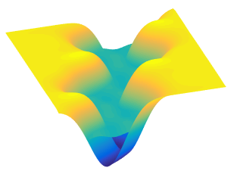
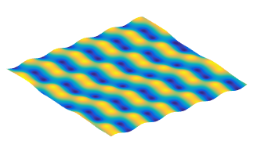
A simple channel model built in 3 steps
A base layer (step 1) is eroded (Remove Below) by a channel (step 2), later eroded (Remove Above) by a new top layer (step 3).
Step 1
Step 2
Step 3

Slide 15
Loading surfaces from files
We will follow the ”main.cpp” example, it first loads input surfaces:
bool status = true;
/************************************************/
/* Load surface data from files. */
/************************************************/
std::vector<double> top_surface, channel, interior_surface;
status &= load_surface("surface_top.txt", top_surface);
status &= load_surface("surface_channel.txt", channel);
status &= load_surface("surface_inside_channel.txt", interior_surface);

Slide 16
Loading surfaces from files
The helper functions:
bool load_surface( std::string filename, std::vector<double> &point_data );
bool write_surface( std::string filename, std::vector<double> &point_data,
size_t numX, size_t numY );
are not important, they just facilitate reading/writing data to/from Matlab.

Slide 17
Loading surfaces from files
The files are loaded into vectors:
surface_top.txt –> std::vector<double> top_surface,
surface_channel.txt –> std::vector<double> channel,
surface_inside_channel.txt –> std::vector<double> interior_surface;
which contain a list of the {x, y, z} coordinates of the points that encompasses the input surfaces.
The points need not be given in any specific order when they are copied to the vectors that will be used as input to the StratModLib.

Slide 18
Loading surfaces from files
The class StratigraphyModeller is responsible for everything.
StratigraphyModeller modeller;
The discretization in which the model will be sampled can only be changed while the modeller is empty:
modeller.tryChangeDiscretization(128, 128);
otherwise modeller.tryChangeDiscretization(…) returns false.

Slide 19
Bounding box and coordinate system
We select the default coordinate system ( x = depth, y = width, z = height):
modeller.useDefaultCoordinateSystem();
And a unit cube as the bounding box for the model:
modeller.setOrigin(0., 0., 0.);
modeller.setLenght(1., 1., 1.);

Slide 20
Creating the model (step 1)
We begin the creation of the model by inserting what should be the surface inside the channel.
We (arbitrarily) attribute to this surface the number 0.
status &= modeller.createSurface(0, interior_surface);

Slide 21
Creating the model (step 2)
Since we just want what is inside the channel, we choose to put the modeller in the removeBellow() state. This way, once we add the channel surface it will correctly trim the ”interior_surface”.
modeller.removeBelow();
We now create the channel,
status &= modeller.createSurface(1, channel);
and arbitrarily declare it to be surface number 1.

Slide 22
Creating the model (step 3)
The last surface we need to add to obtain the desired model is the channel's top, which is here named ”top_surface”.
To make the modeller trim everything above the ”top_surface” we set the modeller into state removeAbove().
modeller.removeAbove();
We finally create the channel's top, which makes the modeller apply the geologic rule. We choose to number the ”top_surface” as surface number 2.
status &= modeller.createSurface(2, top_surface);

Slide 23
Getting output data
To get surface data from the modeller use the surface number you've chosen when the surface was inserted.
Here, the processed vertex lists will be saved in the same vectors that were used for the input data, for simplicity.
status &= modeller.getVertexList(0, interior_surface);
status &= modeller.getVertexList(1, channel);
status &= modeller.getVertexList(2, top_surface);
The vectors ”interior_surface”, ”channel”, and ”top_surface” now contain the processed list of {x, y, z} coordinates for the surfaces points.
In this example this data is later written to files, for visualization in Matlab. Of course, different applications can use the processed data as is.

Slide 24
Issues and caveats
The issue tracker can be found at https://bitbucket.org/jdms/stratmod/issues.
Most code in this library was extensively tested to RRM’s 2017 January release. However, this library will be under intense development for 2017 Summer’s release – expect its API to stabilize during this development cycle.
Stable code will be available in the master branch. This means no known major bugs (only minor bugs), and the code will compile on all supported platforms.
Development code will be available in the devel branch. This code will compile on Clang (macOS) and G++ (Linux), but MSVS is not guaranteed to compile the devel’s branch HEAD. Transient major bugs may exist.
RRM has no proper memory model, parallelization is done with OpenMP which is less than desirable (but works). So far, MSVS binaries are 3x slower than Clang’s.

Slide 25
Appendix (presented 5th Sponsors meeting)
The Geologic Rules:
Remove above (RA);
Remove above intersection (RAI);
Remove below (RB);
Remove below intersection (RBI);
Create above (CA);
Create below (CB).

Slide 26
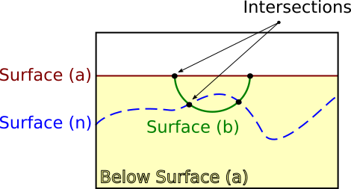
What’s the core problem?
The core problem is relative positioning. Surfaces can:
Intersect;
Lie above/below;
What above/below means at any of a surface’s points is its height.

Slide 27
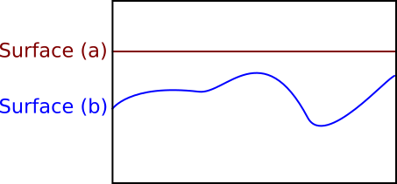
Classic SBIM approach: Sketch Below
Let us begin with Surface (a), and Surface (b) as depicted below:

Slide 28
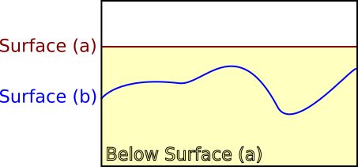
Classic SBIM approach: Sketch Below
We select to Sketch Below Surface (a), i.e., we will only consider as valid (segments of) sketches in the yellow region.

Slide 29
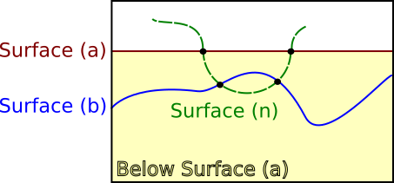
Classic SBIM approach: Sketch Below
Now we draw Surface (n). First of all, the sketch is only valid if below Surface (a).

Slide 30
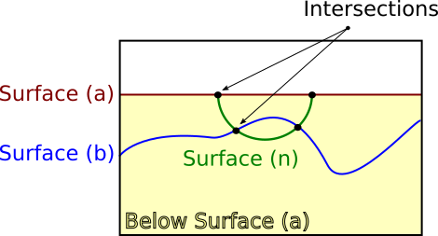
Classic SBIM approach: Sketch Below
Yielding the following figure. However, Surface (n) still intersects Surface (b), which is not valid.

Slide 31
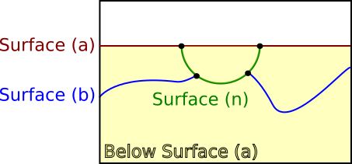
Classic SBIM approach: Sketch Below
If we further Remove Above Surface (n) we get this:
But what should happen if we try to Remove Below Surface (n)?

Slide 32
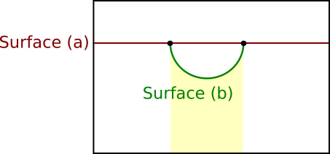
Problem with classic SBIM approach
Sketches are the basic objects both for input and geometric modelling;
Sketches have no notion of relative position:
What does below Surface (b) mean?

Slide 33
Enabling technology: SBIM + RKHS
Sketch based modelling (SBIM) meets Reproduction Kernel Hilbert Spaces (RKHS);
RKHS is a single name to represent various well known tools: RBFs, HRBFs, Kriging, Co-Kriging, natural splines, etc.
Here we use smoothed approximation with Radial Basis Functions;
It allows representing sketches through smooth functions:
``Reproduces” points that were sketched (What you sketch is what you get);
Fill’s up regions where data is missing with a smooth interpolated function;
Tolerant to errors in the input.

Slide 34
SBIM excels at handling input
Natural abstraction in the prototyping phase of modelling;
Fast and mature algorithms to process input data to different geometric representations;
Extensive literature on solving problems related to uncertainty: honours the user intent;

Slide 35
RKHS excels at handling geometry
Have ``infinite resolution”, can be re-sampled as much as one pleases;
Create models with regular geometry, regardless of the input;
Compute based representation: implementation can deduce any step of the history of the modelling process.
Able to exploit parallelism on modern computer architectures.

Slide 36
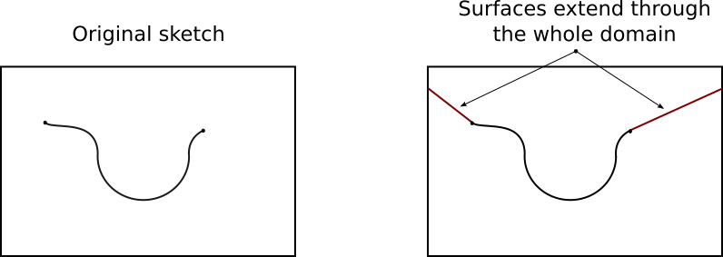
From sketches to smoothed RBFs (RKHS)
Now input sketches are always converted into entire surfaces (graphs of functions):
This solves the problem of determining what is above/below.
But still, how does the Geologic Rules operate on these surfaces?

Slide 37
Operations on surfaces
The new Geologic Rules’ model use entire surfaces (graphs of functions) as input.
Therefore the result of applying a Geologic Rule must be an entire surface.

Slide 38
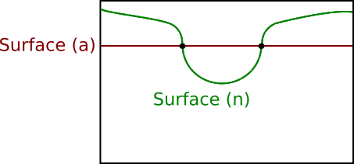
Case study: Remove Above
We have Surface (n), and afterwards we’ve drawn Surface (a).
We want to remove from Surface (n) what is above Surface (a).

Slide 39
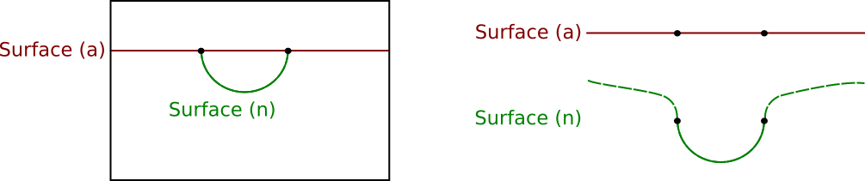
Operations on surfaces (Remove Above)
The previous approach, directly processing the input curve:
The pieces of the channel that were marked as ``removed’’ would have been trimmed out.

Slide 40
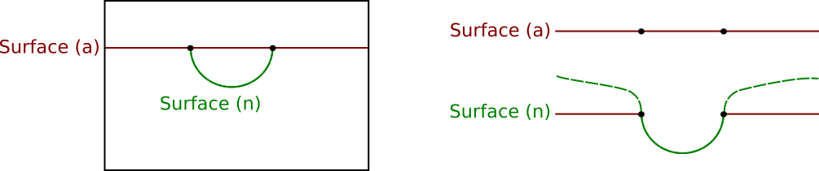
Operations on surfaces (Remove Above)
The new approach (sketch to functions) does not trim any surface:
Instead, it sets the ``removed’’ parts to inherit the geometry of the surface that modified it.

Slide 41
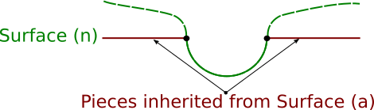
Operations on surfaces (Remove Above)
Now the modified surfaces always know who modified them, and how they were modified.
If needed, the modified surface can report back only its unmodified pieces, yielding the same output as of directly processing the input curve (previous approach).

Slide 42
Building blocks for Geologic Rules
The building blocks to implement all Geologic Rules are:
Remove Above (RA);
Remove Below (RB);
The intersection based Geologic Rules (RAI, RBI) differ from the aforementioned from an intersection check.
We now show how this framework extends to Create Above/Below.

Slide 43
Create Above/Below
The big difference is that:
RA and RB modify surfaces that were drawn (past);
CA and CB modify surfaces that will be drawn (future);
When a surface is selected and a Create Above is issued, all new surfaces are Removed Below the selected surface.
When a surface is selected and a Create Below is issued, all new surfaces are Removed Above the selected surface.
This process stops when a stop Create Above/Below method is called.

Slide 44
Case Study: Create Below
Revisiting our example (one last time!):

Slide 45
Case Study: Create Below
Again, we select to Create Below Surface (a), i.e., we will only consider as valid (segments of) sketches in the yellow region.

Slide 46
Case Study: Create Below
Now we draw Surface (n). Again, the sketch is only valid if below Surface (a).

Slide 47
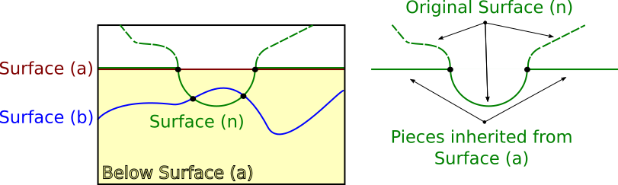
Example: Create Below
Now, however, Surface (n) is entire and the result of a Remove Above Surface (a).

Slide 48
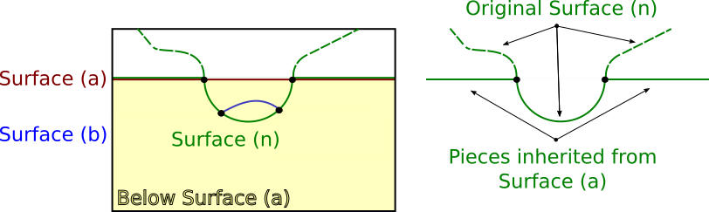
Case Study: Create Below
If we further Remove Below Surface (n) we get this:
The ambiguity is gone!

Slide 49
Lazy evaluation
Delays evaluation of an expression until its value is needed;
Allows more straightforward, bug free implementations;
Avoids need of keeping track of details in complex operations;
Allows modelling in any resolution;
Allows the implementation to recover any previous state of the model with a simple re-evaluation.

Slide 50
Unlimited Undo/Redo
Only possible because of lazy evaluation:
The result of applying Geologic Rules is storing a list of tags;
Tags represent who modified the surface, and how it was modified;
To Undo (any operation), simply remove the last surface – the implementation will update the model correctly.

Slide 51
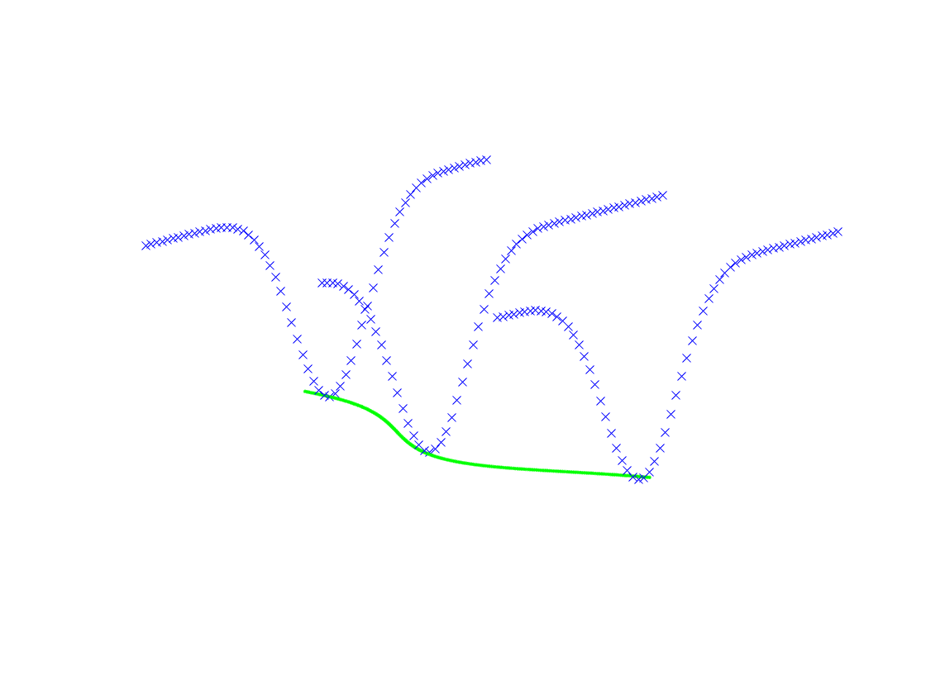
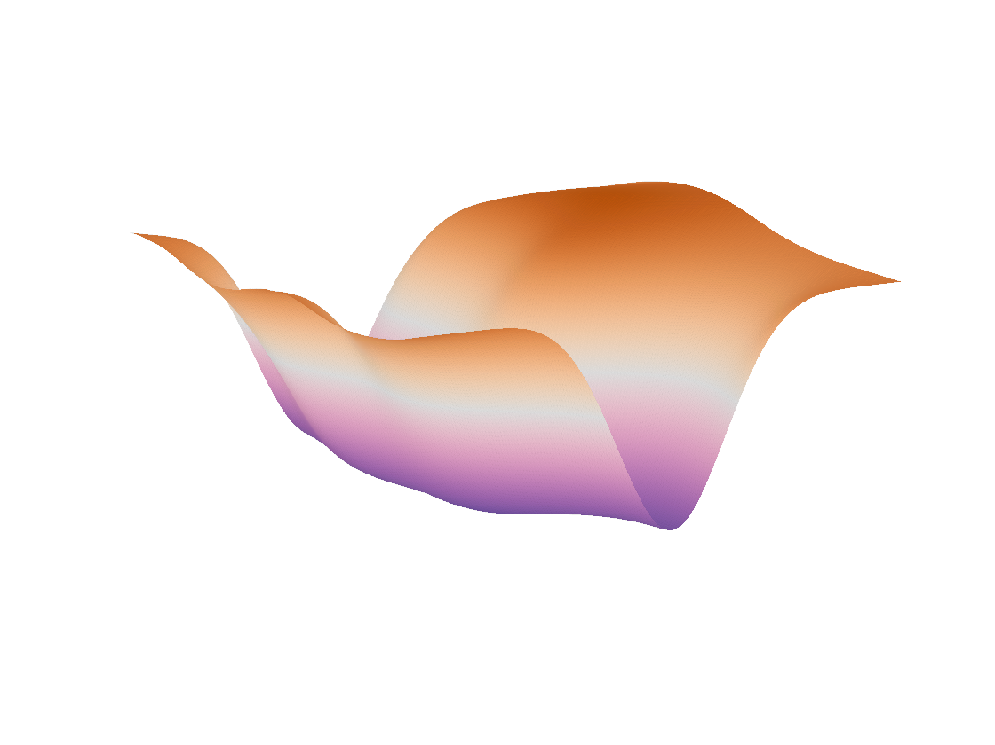
General Framework
Previously, input sketch was interpolated to yield a smooth function;
Actually, smooth functions can be created from multi-plane, multi-view input sketches:
This allows the same implementation to work for general (non-extruded) 3D surfaces.

Slide 52
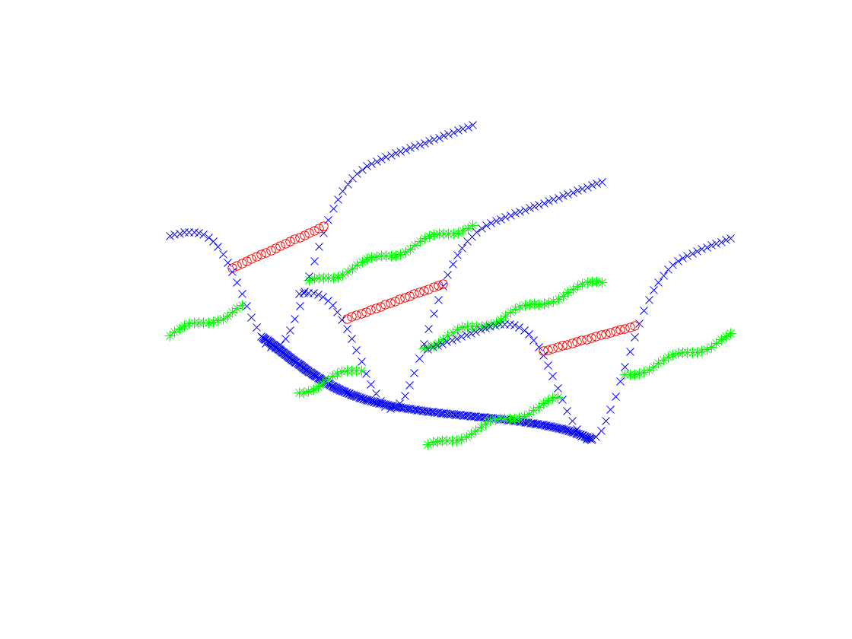
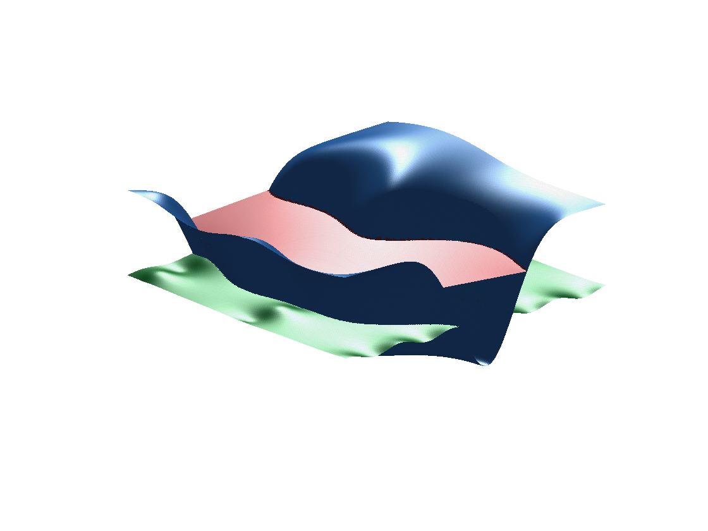
General Framework
Not available (yet) in the prototype’s graphical user interface…
But Geologic Rules for general surfaces is already available through the PlanInLib and the StratModLib.

